Slide 1
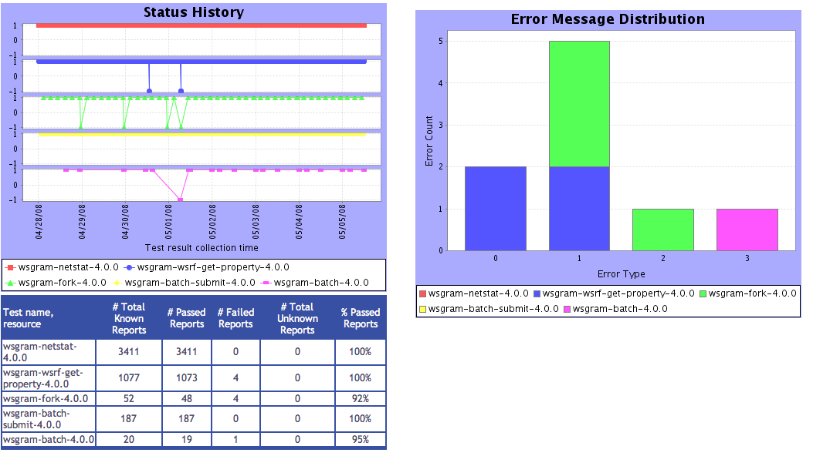
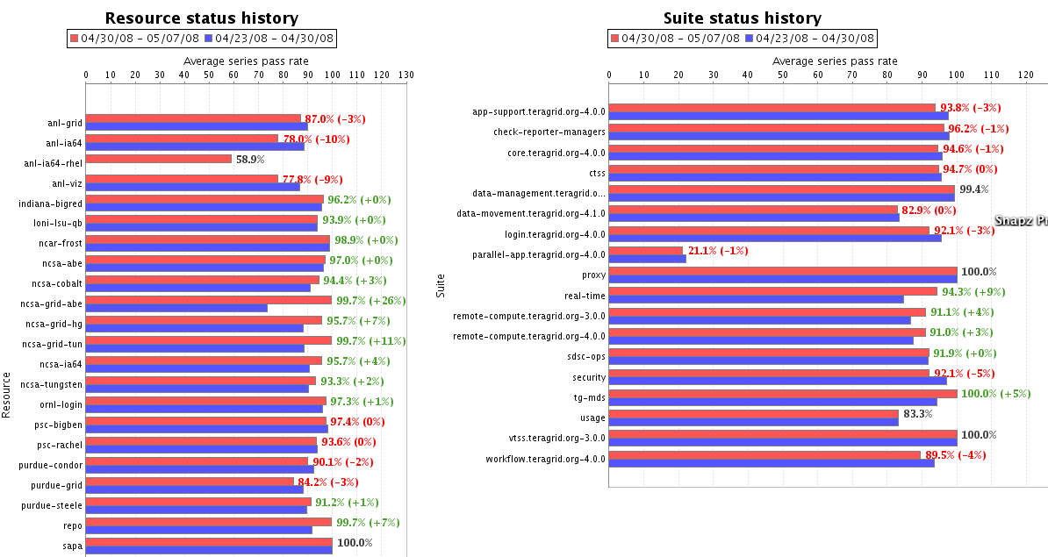
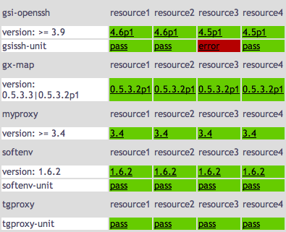
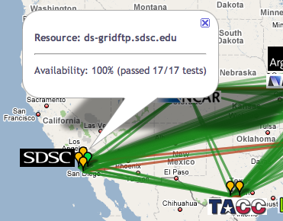

Inca: Verification & Validation
Running on TeraGrid since 2003
Verifies IIS published information through automated, user-level testing
Total of ~2200 tests running on 18 login nodes, 2 grid nodes, and 3 servers
Email notifications for critical services
Status views from detailed test information to summary and historical reports
Data published as XML - translated to HTML using XSLT or graphed using JFreeChart
REST interfaces to view status information in XML or HTML
info.teragrid.org
XSL
XML
CTSS kit
registrations
http://inca.teragrid.org/

