Slide 1
Inca Control Infrastructure
Shava Smallen
ssmallen@sdsc.edu
Inca Workshop August 26, 2010

Slide 2
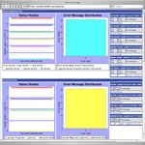
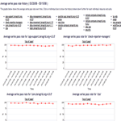
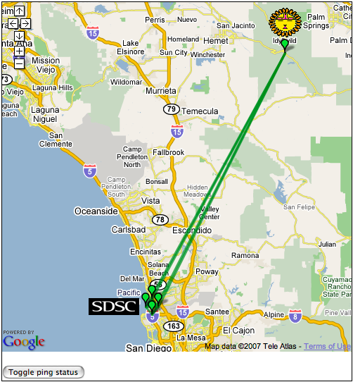
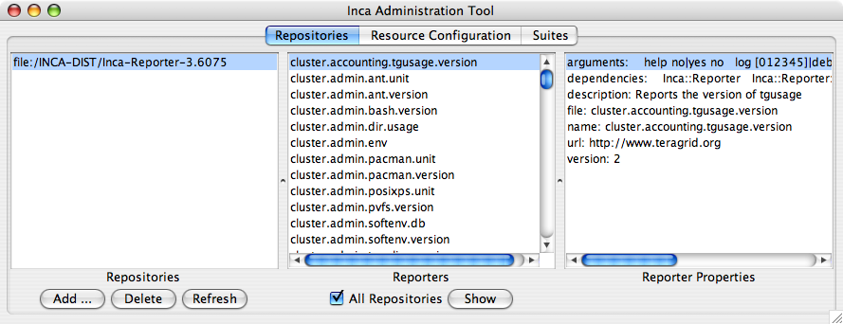

Reporter
Repository
Data Consumers
Incat
R
C
C
Agent
Depot
Control Infrastructure
S
Minimal impact on monitored resources
Flexible reporter scheduling and configuration options
Easy installation and maintenance
Proxy credential available to reporters for user-level execution
S
r
R
r
S
R
Reporter
Manager
Reporter
Manager
…
Grid Resource
Grid Resource

Slide 3
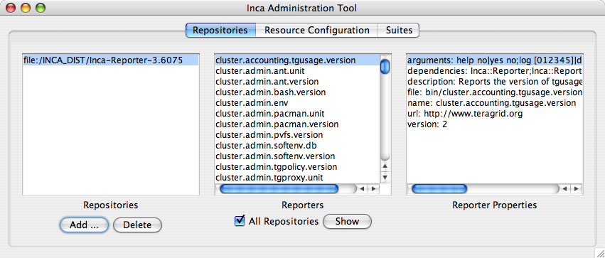
Agent provides centralized configuration and management
Implements the configuration specified by Inca administrator
Stages and launches a reporter manager on each resource
Sends package and configuration updates
Manages proxy information
Administration via GUI interface (incat)
Screenshot of Inca GUI tool, incat, showing the reporters that are available from a local repository

Slide 4
A configuration is a description of an Inca deployment
Which resources do you want to monitor?
What do you want to monitor?
How do you want to monitor?

Slide 5
Step 1a: Defining your resources
A resource can be a cluster, supercomputer, or server
TeraGrid
TACC
CentOS
SDSC
A resource group is two or more related resources
Shared characteristic
(e.g., CentOS)
Site
VO
tacc-spur
tacc-ranger
sdsc-dash
…
Resource Group
Resource Group
Resource
Resource

Slide 6
Step 1b: Describing your resources
Macros - Attributes (or variables) that describe your resource
Can be defined in a resource or in a resource group
Can be inherited -- most specific value wins
Can have multiple values
TeraGrid
projectId = TG-STA060008N
scheduler = PBS
TACC Ranger
NCSA Abe Cluster
gramContact = ranger.tacc.utexas.edu
queue = default
scheduler = SGE
gramContact = grid-abe.ncsa.edu
queue = standby
Notes:
XXXXX

Slide 7
Step 1c: Automating access to resource
Reporter manager
Uses Java Runtime exec
Agent
Local
Grid Resource
Local
Remote
Ssh
Globus
Manual
Reporter manager
Reporter manager
Reporter manager
…
…
Grid Resource
Grid Resource
Grid Resource
Uses Java CoG
Uses SSHTool’s Java SSH API
Installs in $HOME/incaReporterManager by default

Slide 8
A configuration is a description of an Inca deployment
Which resources do you want to monitor?
What do you want to monitor?
How do you want to monitor?

Slide 9
Step 2: Selecting or creating reporters
Use local repository
Copy of the standard Inca reporter repository installed by default
Use file:// or http:// (recommended)
Use Inca project reporter repository + local repository
Receive updates

Slide 10
A configuration is a description of an Inca deployment
Which resources do you want to monitor?
What do you want to monitor?
How do you want to monitor?

Slide 11
What is a report series?
A set of reports collected at different points in time by executing a reporter with a set of arguments in a context on a particular resource.

Slide 12
Step 3a: Find reporter to execute
E.g., can you submit a batch job via Globus WS-GRAM to Grid resources
Select reporter: grid.middleware.globus.unit.wsgram.jobsubmit
% grid.middleware.globus.unit.wsgram.jobsubmit \
-host="tg-condor.purdue.teragrid.org:8443" \
-log="5" \
-maxMem="2048" \
-nodes="1" \
-project="TG-STA060008N" \
-queue="standby" \
-scheduler="Condor"

Slide 13
Step 3b: Decide where to run reporter
TeraGrid
Select a single resource name or resource group
E.g.,
sdsc-dash
SDSC
TeraGrid
CentOS
TACC
CentOS
SDSC
tacc-spur
tacc-ranger
sdsc-dash
…
Resource Group
Resource

Slide 14
Step 3c: Configure reporter arguments
% grid.middleware.globus.unit.wsgram.jobsubmit \
-host=”@gramContact@" \
-log="5" \
-maxMem="2048" \
-nodes="1" \
-project=”@projectId@" \
-queue=”@queue@" \
-scheduler=”@scheduler@"
Resource group macro
Resource macros
TeraGrid
projectId = TG-STA060008N
scheduler = PBS
TACC Ranger
NCSA Abe Cluster
gramContact = ranger.tacc.utexas.edu
queue = default
scheduler = SGE
gramContact = grid-abe.ncsa.edu
queue = standby

Slide 15
Agent “expands” macro values in series
TeraGrid
TACC Ranger
grid.middleware.globus.unit.wsgram.jobsubmit \
-host=”ranger.tacc.utexas.edu:8443" \
-log="5" \
-maxMem="2048" \
-nodes="1" \
-project=”TG-STA060008N" \
-queue=”@queue@" \
-scheduler=”@scheduler@"
grid.middleware.globus.unit.wsgram.jobsubmit \
-host=”@gramContact@" \
-log="5" \
-maxMem="2048" \
-nodes="1" \
-project=”@projectId@" \
-queue=”@queue@" \
-scheduler=”@scheduler@"
SDSC Dash
grid.middleware.globus.unit.wsgram.jobsubmit \
-host=”dash.sdsc.edu:8443" \
-log="5" \
-maxMem="2048" \
-nodes="1" \
-project=”TG-STA060008N" \
-queue=”standby” \
-scheduler=”PBS”

Slide 16
Agent “expands” multi-valued macro values in series
TACC Ranger
TACC Ranger
grid.performance.ping \
-host=dash.sdsc.edu
grid.performance.ping \
-host=@hosts@
TACC Ranger
grid.performance.ping \
-host=tg-login.uc.edu
Reporter will be executed once for each value in macro.
hosts = dash.sdsc.edu, tg-login.uc.edu, tg-login.psc.edu
TACC Ranger
grid.performance.ping \
-host=tg-login.psc.edu

Slide 17
Agent “expands” multiple multi-valued macro values in series
Multiple multi-valued macros ⇒ cross product
E.g.,
@gridftpServers@ = dash.sdsc.edu, tg.ncsa.edu
@dirs@ = /gpfs/inca, /users/inca, /scr/inca
data.transfer.unit -host=@gridftpServers@ -dir=@dirs@
Will expand to:
data.transfer.unit -host=dash.sdsc.edu -dir=/gpfs/inca
data.transfer.unit -host=dash.sdsc.edu -dir=/users/inca
data.transfer.unit -host=dash.sdsc.edu -dir=/scr/inca
data.transfer.unit -host=tg.ncsa.edu -dir=/gpfs/inca
data.transfer.unit -host=tg.ncsa.edu -dir=/users/inca
data.transfer.unit -host=tg.ncsa.edu -dir=/scr/inca

Slide 18
New expansion feature available in v2.6
@TeraGrid->gridftpServers@ = dash.sdsc.edu, tg.ncsa.edu
@TeraGrid->dirs@ = /gpfs/inca, /users/inca, /scr/inca
@RESOURCE/GROUP->macro@
By default RESOURCE/GROUP assumed to be resource the series is being executed on

Slide 19
Step 3d: Specify an execution context
Optional execution string can be used to set the context the reporter runs under
E.g., run reporter under fresh shell: /bin/sh -l -c ‘net.benchmark.wget –args’
E.g., softenv/modules configuration soft add +atlas; cluster.math.atlas.version –args
E.g., batch configuration
$INSTALL_DIR/bin/cluster.batch.wrapper
-scheduler="pbsxt" -nodes=":8:8" -walllimit=420
-exec=’performance.hpcc …’

Slide 20
Step 3e: Choose a scheduling frequency
Expressed in extended cron syntax
minute hour dayOfMonth month dayOfWeek
minute = The minute of the hour the reporter will be executed (range: 0-59)
hour = The hour of the day the reporter will be executed (range: 0-23)
dayOfMonth = The day of the month the reporter will be executed (range: 0-23)
month = The month the reporter will be executed (range: 1-12)
dayOfWeek = The day of the week the reporter will be executed (range: 0-6)
"?" in the field tells Inca to pick a random time within the specified range -- spreads out load
? * * * * = run anytime every hour
?-59/10 * * * * = run anytime every 10 minutes

Slide 21
Step 3f: Specify a unique nickname
Descriptive name that describes the test
Can contain macros -- important for multi-valued macros
E.g., atlas_version
E.g., gridftp_test_to_@site@

Slide 22
Step 3g: Limit resource usage of reporter (optional)
Wall clock time
E.g., no more than 10 seconds
Cpu seconds
E.g., no more than 2 cpu seconds
Memory
E.g., no more than 20 MB
Reporter will be killed and an error report will be sent indicating the resource usage exceeded

Slide 23
What is a suite?
A set of report series that share a common theme. E.g.,
data management
job management
file transfer
LiDAR workflow

Slide 24
Inside the agent
Reporter
Repository
Incat
R
C
Refresh
repository
Expand series
S
C
S
Depot
Download reporters
Distribute
S
S
S
S
S
S
Repository
cache
Suites
RM
r
RM
controller
r
S
S
Configuration contains:
Repository URLs
Resources
Suites
R
R
Reporter
Manager
Reporter
Manager
…
Grid Resource
Grid Resource

Slide 25
Agent supports proxy credentials
Case 1:
Case 2:
Agent
MyProxy
Server
Agent
MyProxy
Server
P
Java CoG
Proxy retrieved to launch Reporter Manager using Globus access method
Myproxy
info
P
Reporter
Manager
Proxy retrieved to provide credential for reporters
Reporter
Manager

Slide 26
Agent supports “run now” execution for debugging
Each series can be scheduled for immediate execution
Invoked from Incat (inca admins)
Invoked from command-line (system admins)
Run a series before its next scheduled execution time to update a series result

Slide 27
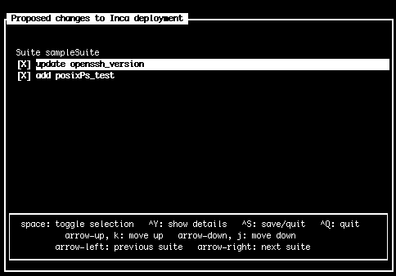
Agent supports approval mode
Provide control to resource administrators (while providing consistent testing)
Changes queued at agent and notification sent to resource administrator
Resource administrator approves changes via “inca approveChanges” GUI
Screenshot of Inca approveChanges GUI tool

Slide 28
Agent monitors reporter managers
Pings reporter managers every 10 minutes
Attempts to restart every hour
If multiple hosts specified for a resource, will try each host
sdsc-ia64
tg-login1
tg-login2
tg-login3

Slide 29
Reporter Manager
Minimal functionality to limit load on resource
Receives from reporter agent that started it:
Reporters and libraries
Reporter configuration and schedules
Executes reporters periodically (cron) or now and forwards reports to the depot
Profiles reporter system usage and enforces timeouts
Reporter
Manager
Grid Resource

Slide 30
Summary
Inca control infrastructure provides centralized configuration and management
Provides flexible reporter scheduling and configuration options
Eases installation and maintenance via macros, access methods, and automatic package updates
Limits impact on monitored resources
Proxy credential available to reporters for user-level execution

Slide 31
Agenda -- Day 1
9:00 - 10:00 | Inca overview
10:00 - 11:00 | Working with Inca Reporters
11:15 - 12:00 | Hands-on: Reporter API and Repository
1:00 - 2:00 | Inca Control Infrastructure
2:00 - 3:00 | Administering Inca with incat
3:15 - 4:00 | Hands-on: Inca deployment

