Slide 1
Working with Inca Reporters
Jim Hayes
jhayes@sdsc.edu
Inca Workshop
September 4-5, 2008

Slide 2
Outline
Reporter Definition
Using the Reporter Libraries
Reporters in an Inca Deployment
Meta-Reporters

Slide 3

Reporters Collect Monitoring Data
A Reporter is an executable program that measures some aspect of the system or installed software
Requirements:
  Support four specific command-line options
  Write XML (Inca Reporter schema) to stdout
Can be used outside of Inca
Notes:
Any language will do; library support for Perl/Python

Slide 4
Reporters Support Four Options
--help[=yes|no]
If yes, reporter prints help, then exits
--version[=yes|no]
If yes, reporter prints version, then exits
--log=0|1|2|3|4|error|warn|system|info|debug
Selects log messages to include in output
--verbose=0|1|2
Output plain text or Inca Report XML
Notes:
Note single dash
Yes/no value optional--missing means yes
Semantics: -help=yes, -version=yes prints info only; -verbose=0 success/failure, logs; -verbose=1 XML; -verbose=2 extended XML; -log=0|1|2|3|4 cumulative messages; -log=error, etc. specific messages

Slide 5
Reporters Output Inca Report XML
<?xml version='1.0'?>
<rep:report xmlns:rep='http://inca.sdsc.edu/dataModel/report_2.1'>
<gmt>2008-02-07T18:31:08Z</gmt>
<hostname>cuzco.sdsc.edu</hostname>
<name>cluster.compiler.any.unit</name>
<version>2</version>
<workingDir>/home/jhayes/inca/install</workingDir>
<reporterPath>bin/cluster.compiler.any.unit</reporterPath>
<args><arg><name>compiler</name><value>gcc</value></arg> … </args>
<body>
<unitTest>
<ID>gcc</ID>
</unitTest>
</body>
<exitStatus><completed>true</completed></exitStatus>
</rep:report>
ISO8601 format
Optional <log> tag
Well-formed XML; otherwise unrestricted
<errorMessage> tag on failure
Optional <help> tag
Notes:
<help> used by automated tools (e.g., incpack)

Slide 6
<log> Tag Documents Reporter Execution
<log>
<system>
<gmt>2008-08-25T21:21:08Z</gmt>
<message>(gcc src471.c -o src471 &amp;&amp; ./src471)</message>
</system>
<system>
<gmt>2008-08-25T21:21:08Z</gmt>
<message>/bin/rm -f src471*</message>
</system>
</log>
Notes:
System log vs. info logs

Slide 7
<help> Tag Describes Reporter
<help>
<ID>help</ID>
<name>cluster.compiler.any.unit</name>
<version>2</version>
<description>Tests that a specified compiler compiles hello world</description>
<url>http://biokdd.informatics.indiana.edu/…</url>
<argDescription>
<ID>verbose</ID>
<accepted>[012]</accepted>
<description>verbosity level (0|1|2)</description>
<default>1</default>
</argDescription>
. . .
<dependency><ID>Inca::Reporter</ID></dependency>
<dependency><ID>Inca::Reporter::SimpleUnit</ID></dependency>
</help>

Slide 8
Outline
Reporter Definition
Using the Reporter Libraries
Reporters in an Inca Deployment
Meta-Reporters

Slide 9
Libraries Ease Reporter Development
Perl and Python APIs for performing common reporter tasks
Documentation
http://inca.sdsc.edu/releases/latest/repdocs/perl.html
http://inca.sdsc.edu/releases/latest/repdocs/python.html
Reporter Purpose | Perl Library | Python Library
General report | Inca::Reporter | inca.Reporter
Software version testing | Inca::Reporter::Version | inca.VersionReporter
Software unit testing | Inca::Reporter::SimpleUnit | inca.SimpleUnitReporter
Globus unit testing | Inca::Reporter::GlobusUnit | inca.GlobusUnitReporter
System performance testing | Inca::Reporter::Performance | inca.PerformanceReporter

Slide 10
Reporter Library Implements Base Methods
Perl: Inca::Reporter
Python: inca.Reporter
Base class for all reporters
Handles command-line parsing
Provides interface for log message generation
Automates generation of Report header information--hostname, time, reporter name, etc.
Supports construction of XML for body
Direct use by reporters that gather miscellaneous information--user environment, system CPU, etc.

Slide 11
An Example Base Reporter Body
<body>
<env>
<ID>env</ID>
<var>
<ID>HOME</ID>
<value>/Users/jhayes</value>
</var>
<var>
<ID>JAVA_HOME</ID>
<value>/Library/Java/Home</value>
</var>
<var>
<ID>PERL5LIB</ID>
<value>/sw/lib/perl5:/sw/lib/perl5/darwin</value>
</var>
</env>
</body>
ID/Value pairs

Slide 12
Perl Base Reporter Code
use Inca::Reporter;
my $reporter = new Inca::Reporter
(version => 3, description => 'Reports all environment settings');
$reporter->processArgv(@ARGV);
my @varXmls;
foreach my $line(split(/\n/, $reporter->loggedCommand('sh -c set'))) {
my ($var, $value) = $line =~ /(\w+)=(.*)/;
push(@varXmls,
$reporter->xmlElement('var', 0, $reporter->xmlElement('ID', 0, $var),
$reporter->xmlElement('value', 1, $value)));
}
$reporter->setBody(
$reporter->xmlElement('env', 0, $reporter->xmlElement('ID', 0, 'env'), @varXmls));
$reporter->setResult(1);
$reporter->print();

Slide 13
Python Base Reporter Code
import re; import sys; from inca.Reporter import Reporter
reporter = Reporter(version=3, description='Reports all environment settings')
reporter.processArgv(sys.argv[1:])
varXmls = []
for line in reporter.loggedCommandOutput('sh -c set').split('\n'):
parsed = re.match('(\w+)=(.*)', line)
varXmls.append(
reporter.xmlElement('var', 0, reporter.xmlElement('ID', 0, parsed.group(1)),
reporter.xmlElement('value', 1, parsed.group(2))))
reporter.setBody(
reporter.xmlElement('env', 0, reporter.xmlElement('ID', 0, 'env'), *varXmls))
reporter.setResult(1)
reporter.printReport()

Slide 14
Version Reporter Library Assists Software Version Testing
Perl: Inca::Reporter::Version
Python: inca.VersionReporter
Defines common <body> schema for version reporters
Supports subpackage versions
Automates common ways of determining version:
gcc --dumpversion
grep '#define PVFS_RELEASE_NR': $PVFS_HOME/include/pvfs_config.h
gpt_query | grep '^condor.*version:'

Slide 15
A Typical Version Reporter Body
<body>
<package>
<ID>openssh</ID>
<version>3.6.1p1</version>
</package>
</body>
Notes:
Note ID/Value pair

Slide 16
Perl Version Reporter Code
use Inca::Reporter::Version;
my $reporter =
new Inca::Reporter::Version(package_name => 'openssh');
$reporter->addArg('ssh', 'ssh command', 'ssh');
$reporter->processArgv(@ARGV);
my $ssh = $reporter->argValue('ssh');
$reporter->setVersionByExecutable
("$ssh -V", 'OpenSSH_([\w\.]+)|GSI ([\w\.\-]+)');
$reporter->print();

Slide 17
Python Version Reporter Code
import sys; from inca.VersionReporter import VersionReporter
reporter = VersionReporter(package_name='openssh')
reporter.addArg('ssh', 'ssh command', 'ssh')
reporter.processArgv(sys.argv[1:])
ssh = reporter.argValue('ssh')
reporter.setVersionByExecutable(
ssh + ' -V', 'OpenSSH_([\w\.]+)|GSI ([\w\.\-]+)')
reporter.printReport()

Slide 18
SimpleUnit Library Supports Unit Testing
Perl: Inca::Reporter::SimpleUnit
Python: inca.SimpleUnitReporter
Defines common <body> schema for unit test reporters
Tests software packages and system facilities
Reporter author determines definition of success
Provides methods for recording success or failure of unit test

Slide 19
A Typical SimpleUnit Reporter Body
<body>
<unitTest>
<ID>posixps</ID>
</unitTest>
</body>

Slide 20
Perl SimpleUnit Reporter Code
use Inca::Reporter::SimpleUnit;
my $reporter = new Inca::Reporter::SimpleUnit(unit_name => 'posixps');
$reporter->processArgv(@ARGV);
my $output = $reporter->loggedCommand('ps -Af');
if($? == 0) {
$reporter->unitSuccess();
} else {
$reporter->unitFailure(output);
}
$reporter->print();

Slide 21
Python SimpleUnit Reporter Code
import sys; from inca.SimpleUnitReporter import SimpleUnitReporter
reporter = SimpleUnitReporter(unit_name='posixps')
reporter.processArgv(sys.argv[1:])
(status, output) = reporter.loggedCommandStatusOutput('ps -Af')
if status == 0:
reporter.unitSuccess()
else:
reporter.unitFailure(output)
reporter.printReport()

Slide 22
GlobusUnit Library Runs Globus Tests
Perl: Inca::Reporter::GlobusUnit
Python: inca.GlobusUnitReporter
Extends SimpleUnit
Supports reporters that test Globus components
Provides methods for execution via Globus--submitJob and submitCSource

Slide 23
Performance Reporter Library Supports Metrics Tests
Perl: Inca::Reporter::Performance
Python: inca.PerformanceReporter
Defines common <body> schema for system/software performance metric reporters
Allows recording of a collection of benchmarks, each a set of parameters (name/value) and statistics (name/value/units)

Slide 24
A Typical Performance Reporter Body
<body>
<performance>
<ID>ping</ID>
<benchmark>
<ID>ping</ID>
<parameters><parameter>
<ID>host</ID>
<value>cuzco.sdsc.edu</value>
</parameter></parameters>
<statistics><statistic>
<ID>round_trip</ID>
<value>11.3</value>
<units>ms</units>
</statistic></statistics>
</benchmark>
</performance>
</body>

Slide 25
Perl Performance Reporter Code
use Inca::Reporter::Performance;
my $reporter = new Inca::Reporter::Performance(measurement_name => 'ping');
$reporter->addArg('host', 'target host');
$reporter->processArgv(@ARGV);
my $host = $reporter->argValue('host');
if(!open(INPUT, "ping $host|")) {
$reporter->setResult(0, 'ping not available');
} else {
my $line = <INPUT>; $line = <INPUT>;
if($line =~ /time *= *([\d.]+) *(\S*)/) {
my $benchmark = $reporter->addNewBenchmark('ping');
$benchmark->setParameter('host', $host);
$benchmark->setStatistic('round_trip', $1, $2);
$reporter->setCompleted(1);
}
}
$reporter->print();

Slide 26
Python Performance Reporter Code
import os; import popen2; import re; import sys
from inca.PerformanceReporter import PerformanceReporter
reporter = PerformanceReporter(measurement_name='ping')
reporter.addArg('host', 'target host')
reporter.processArgv(sys.argv[1:])
host = reporter.argValue('host')
try:
child = popen2.Popen3('ping ' + host)
line = child.fromchild.readline(); line = child.fromchild.readline()
parsed = re.search('time *= *([\d.]+) *(\S*)', line)
benchmark = reporter.addNewBenchmark('ping')
benchmark.setParameter('host', host)
benchmark.setStatistic('round_trip', parsed.group(1), parsed.group(2))
os.kill(child.pid, 9); child.wait()
reporter.setCompleted(1)
except IOError:
reporter.setResult(0, 'ping not available')
reporter.printReport()

Slide 27
Outline
Reporter Definition
Using the Reporter Libraries
Reporters in an Inca Deployment
Meta-Reporters

Slide 28
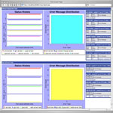
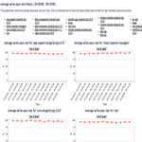
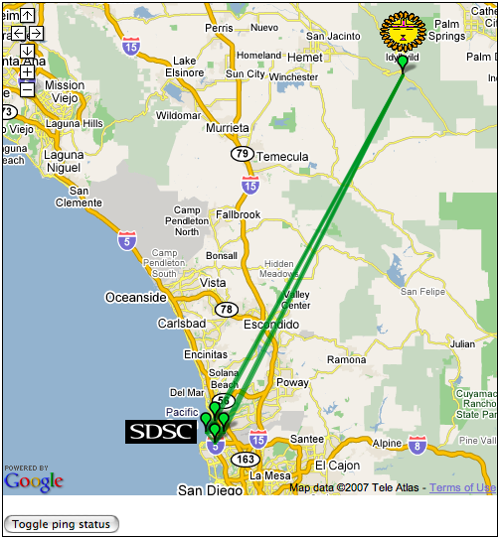
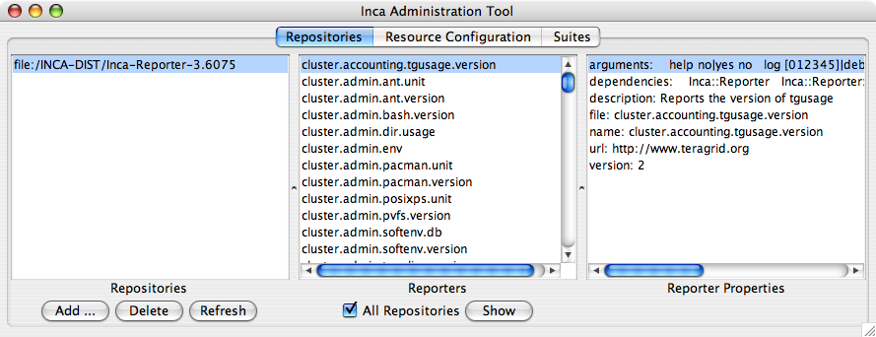
Agent and Managers Work With Reporters
Reporter
Repository
Data Consumers
R
Incat
C
Agent
Depot
S
Agent forwards reporters from Repositories to Reporter Managers
Managers run Reporters as per administrator’s schedule and send output and meta-data to Depot
S
r
S
R
r
R
Reporter
Manager
Reporter
Manager
…
Grid Resource
Grid Resource
Notes:
Meta-data: resource usage, stderr

Slide 29
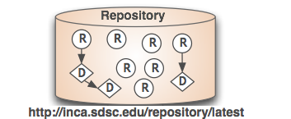
Reporter Repositories Publish Reporters
Collection of files made available via a URL
Inca knows how to handle Reporters, Perl/Python modules, .tar.gz packages
Inca standard repository (http://inca.sdsc.edu/repository/latest) contains Reporter libraries and 177 reporters: 91 version, 73 unit, 13 general
Packages.gz catalog of repository contents allows automated retrieval

Slide 30
Packages.gz Lists Reporter Attributes
arguments:
help no|yes no
host .*
log [012345]|debug|error|info|system|warn 0
verbose [012] 1
version no|yes no
dependencies:
Inca::Reporter
Inca::Reporter::Performance
Inca::Reporter::Performance::Benchmark
description: Reports the ping time to a given host
file: bin/grid.benchmark.performance.ping
name: grid.benchmark.performance.ping
url: http://inca.ucsd.edu
version: 2
arguments:
help no|yes no
log [012345]|debug|error|info|system|warn 0
verbose [012] 1
version no|yes no
dependencies:
Inca::Reporter
Inca::Reporter::Version
description: Reports the version of tgresid
file: bin/cluster.admin.tgresid.version
name: cluster.admin.tgresid.version
version: 3
arguments:
help no|yes no
log [012345]|debug|error|info|system|warn 0
verbose [012] 1
version no|yes no
dependencies:
Inca::Reporter
description: Reports top non-root CPU % process
file: bin/cluster.admin.topcpu
name: cluster.admin.topcpu
url: http://inca.sdsc.edu
version: 3
arguments:
dir .*
help no|yes no
log [012345]|debug|error|info|system|warn 0
verbose [012] 1
version no|yes no
dependencies:
Inca::Reporter
Inca::Reporter::Version
description: Reports the version of xcat
file: bin/cluster.admin.xcat.version
name: cluster.admin.xcat.version
url: http://www.suse.org
version: 2`

Slide 31
Reporters Can Require Other Packages
Reporter library addDependency method notes that a Reporter needs another package to run
Required package must be in Reporter Repository
Agent forwards package to Manager, which builds it via, e.g., configure/make
Dependency on GridProxy pseudo-package indicates a Reporter requires a credential to run
Examples:
$reporter->addDependency('Date::Manip');
$reporter->addDependency('sampleGridJob');
$reporter->addDependency('Inca::Reporter::GridProxy');
Notes:
Requirements w/requirements also work

Slide 32
incpack Tool Edits Packages.gz
incpack [-I path …] [-X] path [[-X] path …]
Creates or appends to Packages.gz by running reporters and reading .attrib files
-I -- include library for running reporters
-X -- exclude path (e.g., test directory) from catalog

Slide 33
Outline
Reporter Definition
Using the Reporter Libraries
Reporters in an Inca Deployment
Meta-Reporters

Slide 34
Special Reporter Submits to Batch Queues
cluster.batch.wrapper reports queue wait time or output of a specified reporter
Supports cobalt, dql, loadleveler, lsf, pub, sge
Batch-specific arguments --account, --nodes, --queue, etc.
Example:
cluster.batch.wrapper \
--scheduler=pbs --account=alf63 \
--exec='cluster.compiler.gcc.version'

Slide 35
Summary Reporters Analyze Series
New class of reporters to analyze series history and combine series
Get series data from Inca Consumer or Web Service
First instance: summary.successpct.performance reports success % of one or more series

Slide 36
Sample Summary Reporter Body
<body>
<performance xmlns:rep='http://inca.sdsc.edu/dataModel/report_2.1'>
<ID>successpct</ID>
<benchmark>
<ID>successpct</ID>
<parameters>
<parameter><ID>filter</ID><value>all2all:gsissh_to_.*</value></parameter>
…
</parameters>
<statistics>
<statistic><ID>all2all:gsissh_to_bg-login1.sdsc.teragrid.org-fail</ID><value>1</value></statistic>
<statistic><ID>all2all:gsissh_to_bg-login1.sdsc.teragrid.org-pct</ID><value>94</value></statistic>
<statistic><ID>all2all:gsissh_to_bg-login1.sdsc.teragrid.org-success</ID><value>18</value></statistic>
…
</statistics>
</benchmark>
</performance>
</body>

