Slide 1

http://inca.sdsc.edu
Status Report & Future Plans
Shava Smallen
ssmallen@sdsc.edu
February 13, 2008

Slide 2
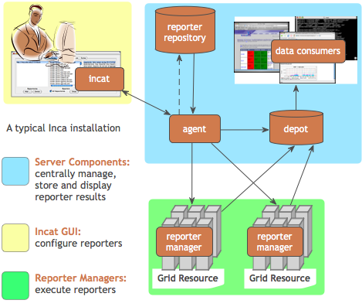
Inca is a Grid monitoring system
Provides periodic, automated, user-level testing of the software and services
Aids debugging by providing detailed test information
Eases the writing, deploying, and sharing of new tests or benchmarks
Centrally manages monitoring configuration
Easily updates and maintains monitoring deployment
Stores and archives a wide variety of monitoring results
Notes:
Set context of what Inca is
1. Key features of Inca (might need to cut a few)
2. Basic architecture (brief)

Slide 3








Inca is used on production Grids
Originally developed for TeraGrid and running there since 2003
First release, Inca 1, in late 2003
Current release is Inca 2.3
Users in U.S., Europe, and Australia
Awarded funding from SDCI program to support core development
Notes:
Inca originated from TeraGrid
We generalized the software and now other Grids are using it too

Slide 4
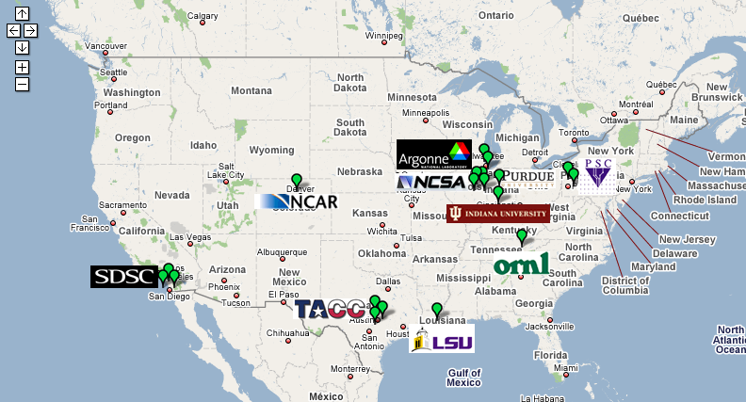
Inca is key to TeraGrid operations
Testing for CTSS
Cross-site tests
CA certificate and CRL checking
GRAM usage
Resource registration in MDS
Bi-weekly operations meetings
Gateway debugging (LEAD)
http://inca.teragrid.org/
“… inca errors are a very close subset of what we see and as they are being worked upon stability is improving…”
-- Surresh Marru (LEAD developer)
Notes:
Inca has and continues to play an important role in TeraGrid

Slide 5
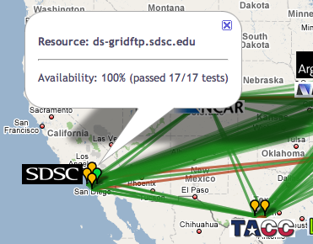
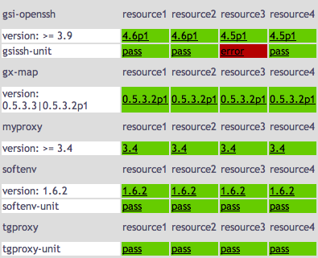
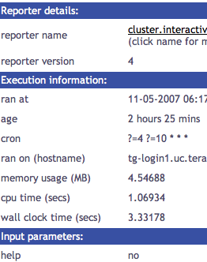
Inca in CY2007
Core development
6 Inca2 releases
Paper in HPDC 2007 Workshop on Grid Monitoring
133 downloads of Inca 2 from Feb - Sept 2007
TeraGrid
Added 3 new machines & 15 new tests; modified 50 tests
2505 tests collected at varying frequencies
Improved security
New data views: Google map view, historical graphs
Cumulative test status
by resource
Test status
by package and resource
Test details
Notes:
We did stuff
Production release of Inca 2 software. Other releases provided bug fixes, improvements in performance and usability, and new features such as graphing capabilities that display the reliability of tested services. version 2.0 (02/02), version 2.01 (3/23), version 2.02 (05/31), version 2.03 (06/15), version 2.1 (07/31), version 2.2 (10/31)
Deployed to Indiana’s bigred machine (May) and NCAR’s frost and NCSA’s abe machines (July).

Slide 6
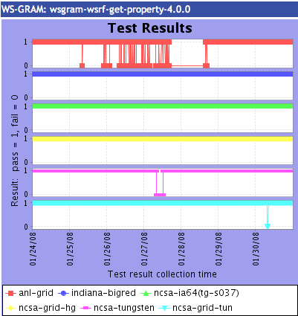
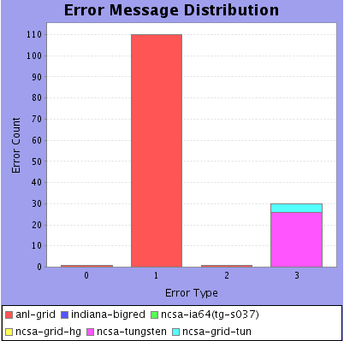
Inca in CY2008
SDCI award milestones
Continue development of historical data/graphs report capabilities to identify failure trends and services reliability problems.
Tune test frequency based on previous pass/fail history.
Custom views for Science Gateway users and other working groups.
Integrate Inca data into the proposed TG measurement infrastructure.
Integrate Inca data into TeraGrid information services
Notes:
We will do more stuff. (not including SDCI work)
SDCI award = 1 FTE (development)
SDSC TeraGrid RP = .5 FTE
(development + deployment)
TeraGrid GIG = 1 FTE (deployment)

