Slide 1
Inca Data Display
(data consumers)
Shava Smallen
Inca Workshop
September 5, 2008

Slide 2
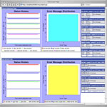
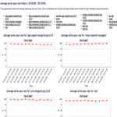
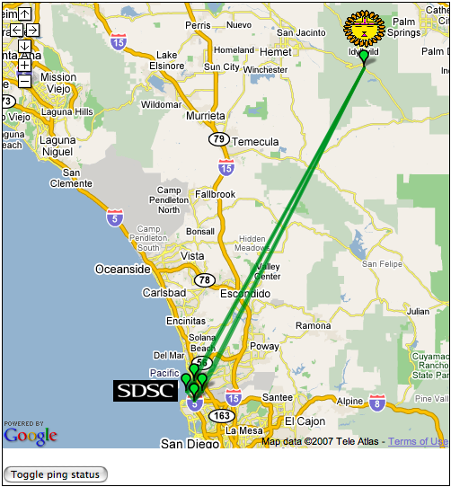
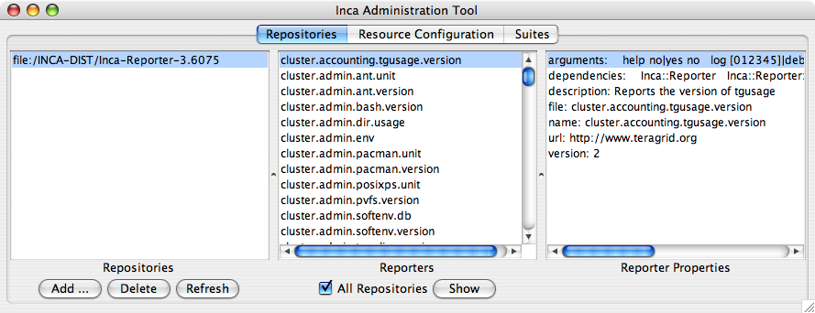
Reporter
Repository
Data Consumers
Incat
R
C
Agent
Depot
Data Consumers
S
Technically -- anything that queries and digests data from the depot
Inca distribution includes a container and webapp to provide Web view of Inca deployment
Designed for grid operators, system administrators, and users
S
r
R
r
S
R
Reporter
Manager
Reporter
Manager
…
Grid Resource
Grid Resource

Slide 3
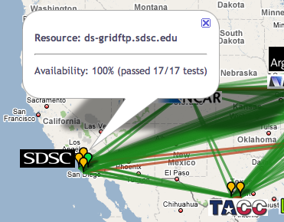
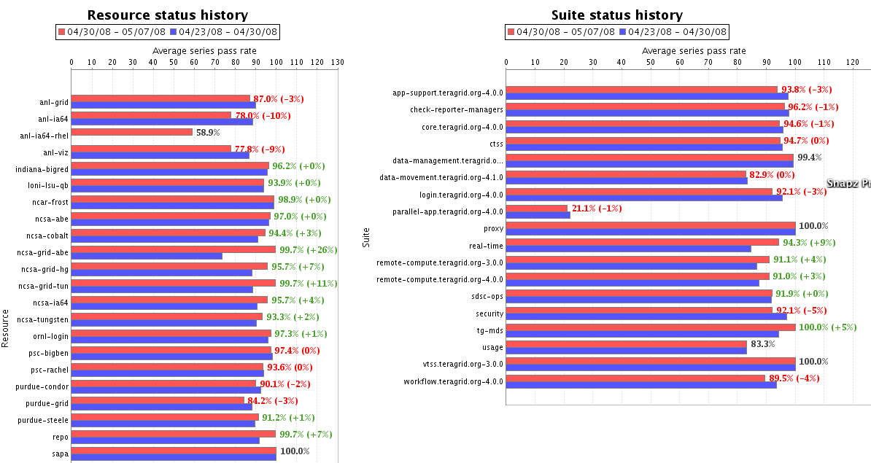
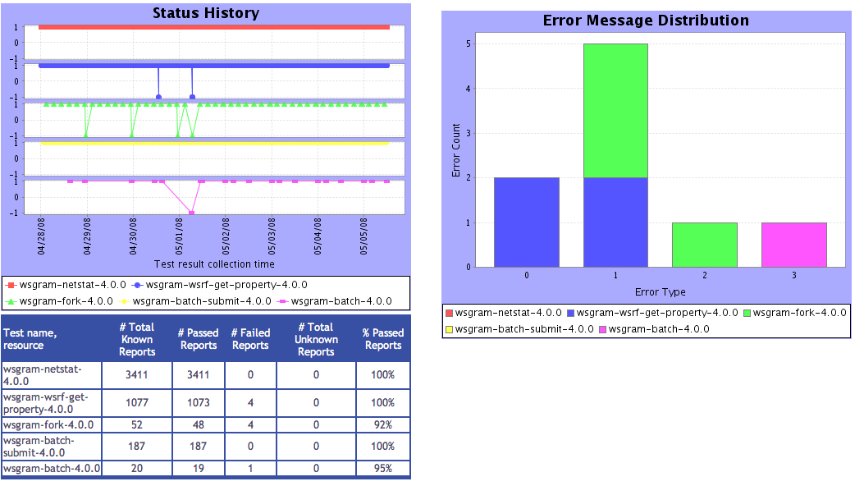



Consumer displays data
Current and historical views
Web application packaged with Jetty
JSP 2.0 pages/tags to query data and format using XSLT
CeWolf/JFreeChart to graph data
Consumer
HTML
Graphs
charts
JSP
XML
JSP
JSP
XSL
query results (XML)
query
Depot

Slide 4
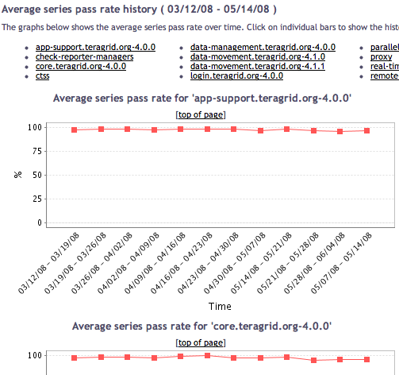
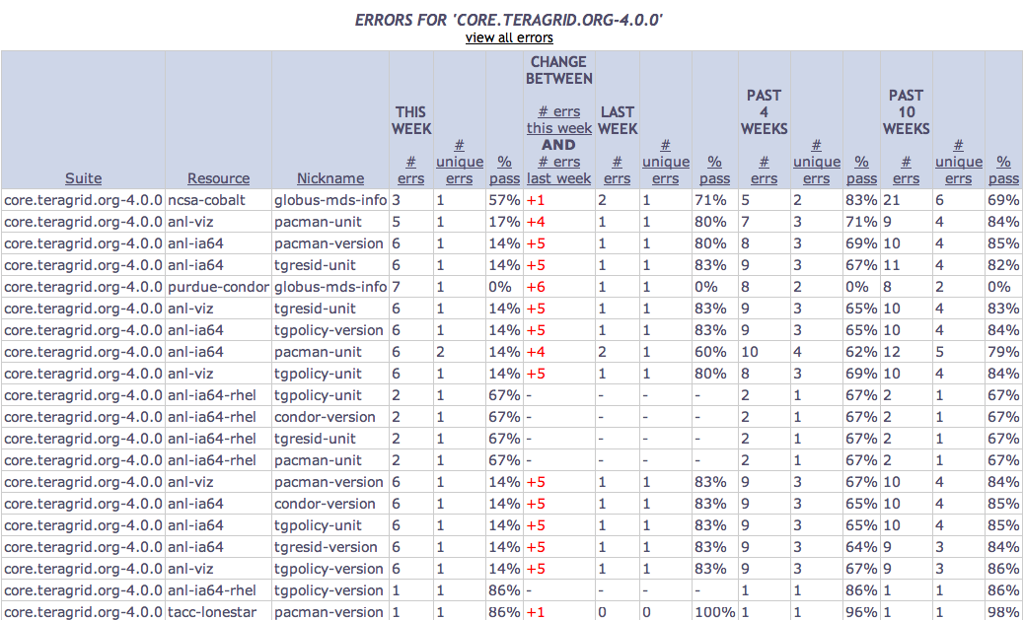
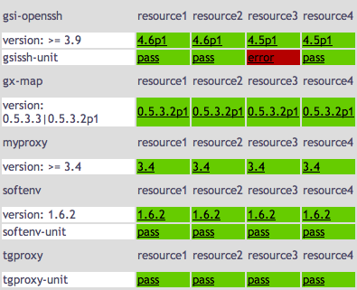
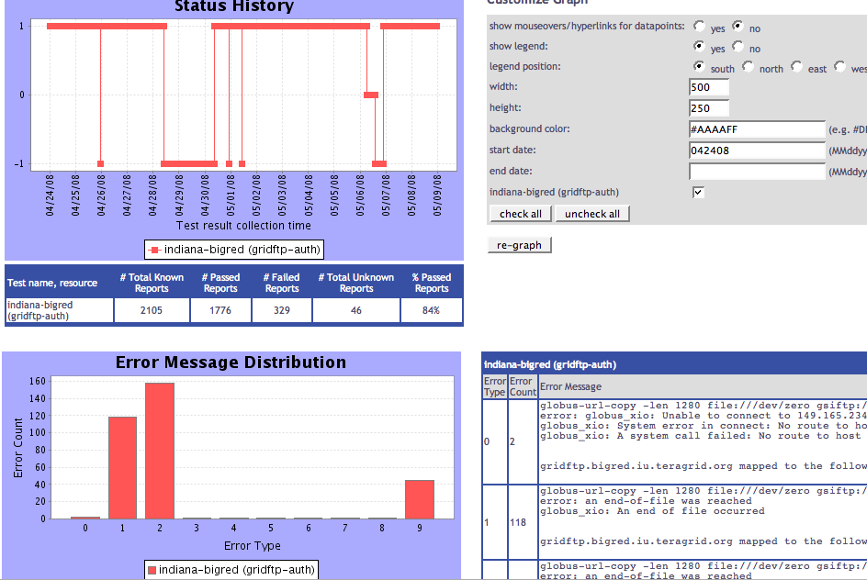
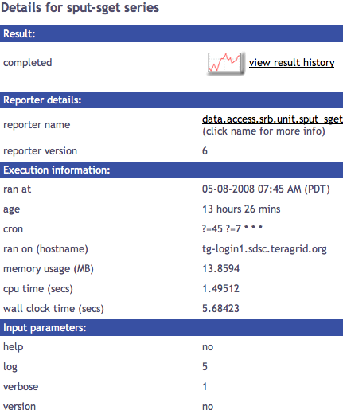
Series
Summary
Weekly status report
Cumulative series status by resource
Suite & resource histories
Inca’s status pages provide multiple levels of details
Error history summary
Series status by package and resource
Related series histories
Individual series history
Individual report details
Series
Details
Historical
Current status

Slide 5
Series
Summary
Weekly status report
Cumulative series status by resource
Suite & resource histories
Inca’s status pages provide multiple levels of details
Error history summary
Series status by package and resource
Related series histories
Individual series history
Individual report details
Series
Details
Historical
Current status

Slide 6
View cumulative series status by resource
Register for a Google Map API key
http://code.google.com/apis/maps/signup.html
Specify size of map, center of map, zoom level
Define sites -- logo and resources
Optionally change icons or colors
Consumer
HTML
google.xml
status.jsp
google.xsl
query results (XML)
query
Depot

Slide 7
Google map view configured via XML
<google>
  <key>ABQIAAAA_4IHDoSvxQqISMa1RKFLQBSAw7Yim1cIRTlscO</key>
  <width>800</width>
  <height>500</height>
  <center>
    <latitude>37</latitude>
    <longitude>982</longitude>
  </center>
  <magnificationLevel>4</magnificationLevel>
  <sites> <site>
  <name>SDSC</name>
  <latitude>32.8724</latitude>
  <longitude>-117.23769900</longitude>
  <logo>…
  <resources>
    <resource>ia64</resource>…
  </resources>
  </site>
  …
Size of map
Center of map -- default is middle of US
Site name and location
List of resources

Slide 8
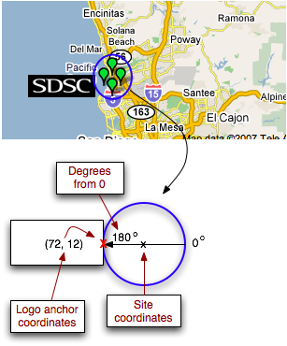
Specify a logo for a site
<logo>
  <url>http://inca.sdsc.edu/www/images/sdsc_black.gif</url>
  <width>72</width>
  <height>24</height>
  <angle>180</angle>
  <logoAnchorX>72</logoAnchorX>
  <logoAnchorY>12</logoAnchorY>
</logo>

Slide 9
Series
Summary
Weekly status report
Cumulative series status by resource
Average suite & resource series pass rate history
Inca’s status pages provide multiple levels of details
Error history summary
Series status by package and resource
Related series histories
Individual report details
Series
Details
Individual series history
Historical
Current status

Slide 10
View series status by package and resource
Specify list of suite(s) and resource(s) in URL
http://host:8080/inca/jsp/status.jsp ?
  suiteNames=s1,s2
  resourceIds=r
  or
http://host:8080/inca/jsp/status.jsp ?
  suiteNames=s1,s2
  resourceIds=r1,r2
Consumer
HTML
status.jsp
default.xsl
query results (XML)
query
Depot

Slide 11
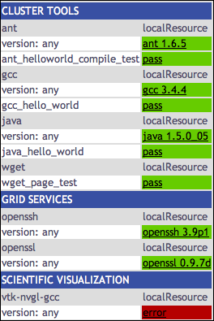
View report status by package and resource (categories)
Specify list of suite(s), resource(s), xml(s) in URL
http://host:8080/inca/jsp/status.jsp ?
  xsl=swStack.xsl
  suiteNames=s1[,s2, …]
  resourceIds=r1[,r2, …]
  xml=x1[,x2, …]
Consumer
HTML
swStack.xml
status.jsp
swStack.xsl
query results (XML)
query
Depot

Slide 12
Software categories listed in XML file
<stack>
<id>Software and Services</id>
<category>
<id>Cluster Tools</id>
<package>
<id>gcc</id>
<version>any</version>
<tests>
<version><id>gcc_version</id></version>
<unitalias>
<id>gcc_hello_world</id>
</unitalias>
</tests>
</package>
…

Slide 13
Series
Summary
Weekly status report
Cumulative series status by resource
Suite & resource histories
Inca’s status pages provide multiple levels of details
Error history summary
Series status by package and resource
Related series histories
Individual series history
Individual report details
Series
Details
Historical
Current status

Slide 14
View individual report details
Linked from other views
Specify series config id, instance id, and resource id
http://host:8080/inca/jsp/status.jsp ?
  configId=1234 &
  instanceId=456 &
  resourceId=r
Consumer
HTML
instance.jsp
instance.xsl
query results (XML)
query
Depot

Slide 15
Series
Summary
Weekly status report
Cumulative series status by resource
Suite & resource histories
Inca’s status pages provide multiple levels of details
Error history summary
Series status by package and resource
Related series histories
Individual series history
Individual report details
Series
Details
Historical
Current status

Slide 16
View individual series history
Linked from individual report details page
Requires series nickname, resource, and title
Two weeks of history by default
Options:
  Mouseovers and links
  Legend ( and position)
  Width, Height
  Background color
Consumer
HTML
Graphs
charts
graph.jsp
query results (XML)
query
Depot

Slide 17
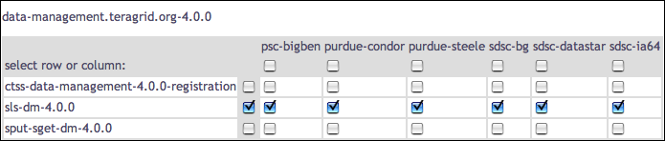
Choose selected series histories
Is an error related to the resource or the software?
What is the reliability of a service (viewing multiple tests)?

Slide 18
Series
Summary
Weekly status report
Cumulative series status by resource
Suite & resource histories
Inca’s status pages provide multiple levels of details
Error history summary
Series status by package and resource
Related series histories
Individual series history
Individual report details
Series
Details
Historical
Current status

Slide 19
View related series histories
Requires multiple series nickname, resource, and title
Two weeks of history by default
Options:
  Mouseovers and links
  Legend ( and position)
  Width, Height
  Background color
Consumer
HTML
Graphs
charts
graph.jsp
query results (XML)
query
Depot

Slide 20
View related series histories as report
Requires multiple series nickname, resource, and titles desccribed in XML file
Two weeks of history by default
Options:
  Mouseovers and links
  Legend ( and position)
  Width, Height
  Background color
Consumer
HTML
Graphs
charts
report.jsp
status
Report.xml
query results (XML)
query
Depot

Slide 21
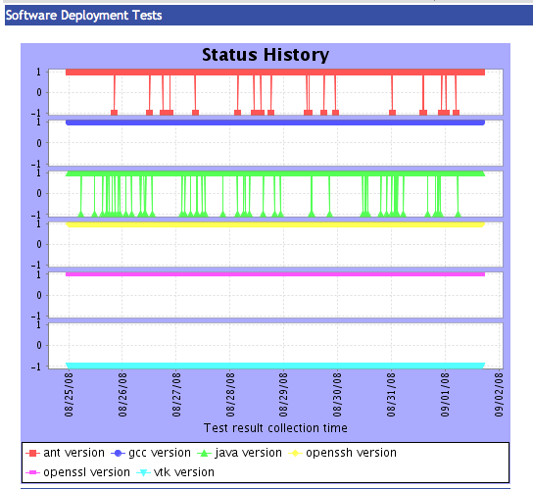
Graphs and series described in XML file
<sr:statusReport>
<graph>
<!-- Format is: nickname, resource, label -->
<series>ant_version,localResource,ant version</series>
<series>gcc_version,localResource,gcc version</series>
<series>java_version,localResource,java version</series>
<series>openssh_version,localResource,openssh version</series>
<series>openssl_version,localResource,openssl version</series>
<series>vtk-nvgl_version,localResource,vtk version</series>
<title>Software Deployment Tests</title>
</graph>
…
<width>350</width>
<height>350</height>
</sr:statusReport>

Slide 22
Series
Summary
Weekly status report
Cumulative series status by resource
Suite & resource histories
Inca’s status pages provide multiple levels of details
Error history summary
Series status by package and resource
Related series histories
Individual series history
Individual report details
Series
Details
Historical
Current status

Slide 23
View error history summary
( “diff” )
Designed for daily/weekly review
Uses cached historical query
Four weeks of history by default
Sortable by column
Consumer
HTML
Graphs
charts
status.jsp
week
Summary.xml
query results (XML)
query
Depot

Slide 24
Configure length of history
<summaries>
<summary>
<title>this week</title>
<beginIndex>1</beginIndex>
<endIndex>1</endIndex>
</summary> <summary>
<title>last week</title>
<beginIndex>2</beginIndex>
<endIndex>2</endIndex>
</summary> <summary>
<title>past 4 weeks</title>
<beginIndex>4</beginIndex>
<endIndex>1</endIndex>
</summary>
</summaries>
Most recent
1
2
3
4
5
6
…
Past 4 weeks
This week
Last week
Least recent

Slide 25
Series
Summary
Weekly status report
Cumulative series status by resource
Suite & resource histories
Inca’s status pages provide multiple levels of details
Error history summary
Series status by package and resource
Related series histories
Individual series history
Individual report details
Series
Details
Historical
Current status

Slide 26
View average suite and resource histories
Designed for daily/weekly review
Uses cached historical query
Four weeks of history by default
Click to view further details
Consumer
HTML
Graphs
charts
summary
History.jsp
week
Summary.xml
query results (XML)
query
Depot

Slide 27
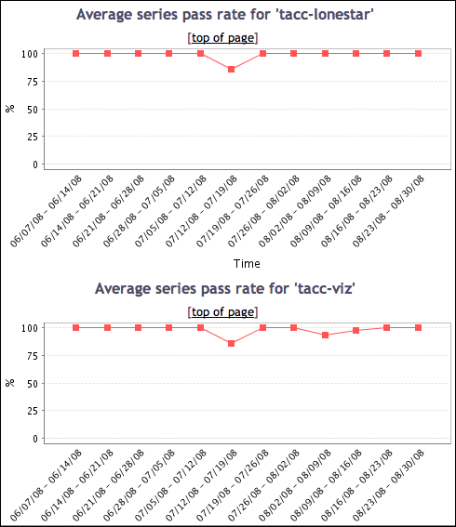
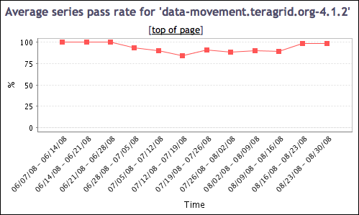
View suite or resource history details
Suite status for each resource
Status of suite on all resources

Slide 28
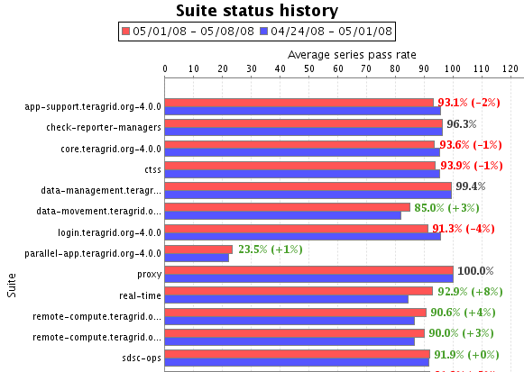
Series
Summary
Weekly status report
Cumulative series status by resource
Suite & resource histories
Inca’s status pages provide multiple levels of details
Error history summary
Series status by package and resource
Related series histories
Individual series history
Individual report details
Series
Details
Historical
Current status

Slide 29
View weekly suite and resource status
Designed for daily/weekly review
Uses cached historical query
Four weeks of history by default
Click to view further details -- error summary
Consumer
HTML
Graphs
charts
series
Averages.xsl
summary.jsp
period
Averages.xsl
query results (XML)
query
Depot

Slide 30
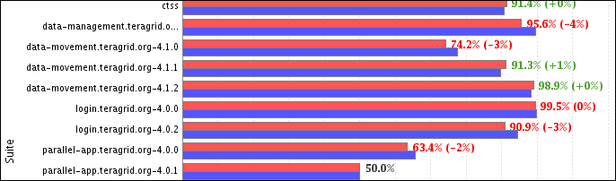
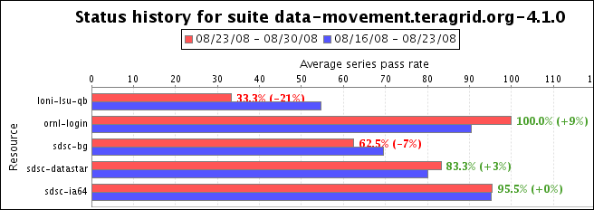
View suite and resource details
Suite status for each resource

Slide 31
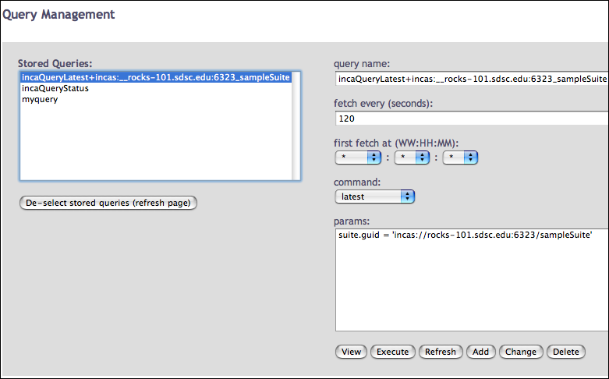
Caching provides quick page load times
Periodically load and store large queries
Requires authentication
Latest suite instances cached by default -- frequency from reload property
Query management page allows view, execute, refresh, and modification action on queries
Query management page

Slide 32
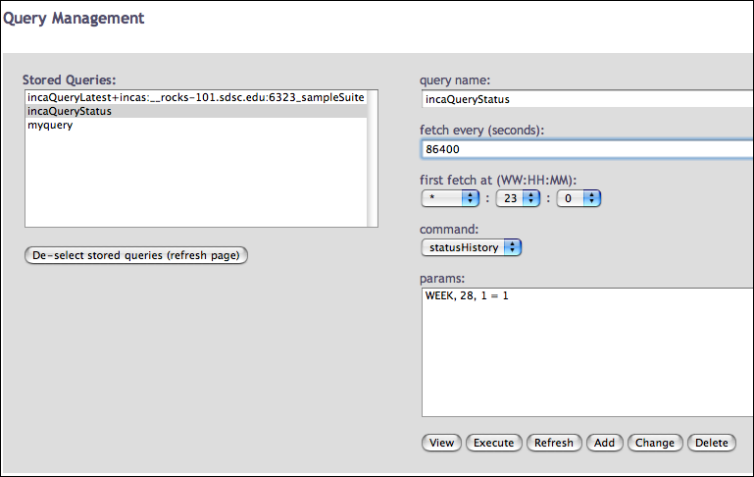
Daily history query analyzes errors
PERIOD , DAYS, CONDITION
where
PERIOD = DAY, WEEK, MONTH, QUARTER
Four weeks of history loaded every day -- time of day from reloadAt property
TeraGrid - 10 weeks of history
  WEEK, 70, 1 = 1
Query management page

Slide 33
Daily history query output
<quer:object>
<row><series>
<guid>incas://rocks-101.sdsc.edu:6323/sampleSuite</guid>
<nickname>gcc_hello_world</nickname>
<resource>localResource</resource>
<period>
<begin>1217830004174</begin>
<end>1218434804173</end>
<success>1008</success>
<failure>
<message>gcc: Command not found</message>
<count>2</count>
</failure>
</period> <period>
<begin>1218434804174</begin>
…
suite
series
period 1
num successes
failure

Slide 34
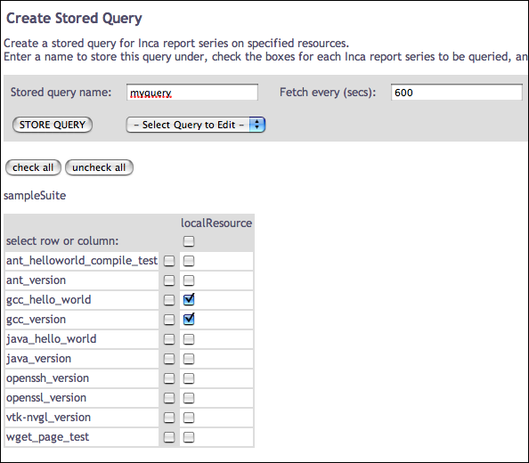
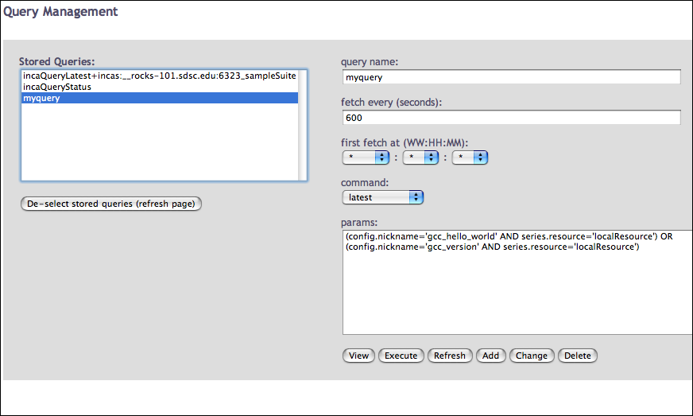
Create a custom query
View subset of series in a suite
View series in multiple suites
Requires authentication and suiteNames

Slide 35
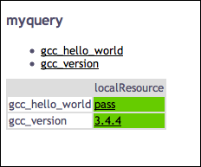
Use custom query name in views
Use queryNames in place of suiteNames
http://host:8080/inca/jsp/status.jsp ?
  queryNames=myquery
  resourceIds=defaultGrid

Slide 36
Password authentication can be customized
Ports: HTTP on 8080, HTTPS on 8443
Password protection on query.jsp and status-auth.jsp
(change in $INCA_DIST/webapps/inca/WEB-INF/web.xml)
Password set in $INCA_DIST/etc/realm.properties
username: password

Slide 37
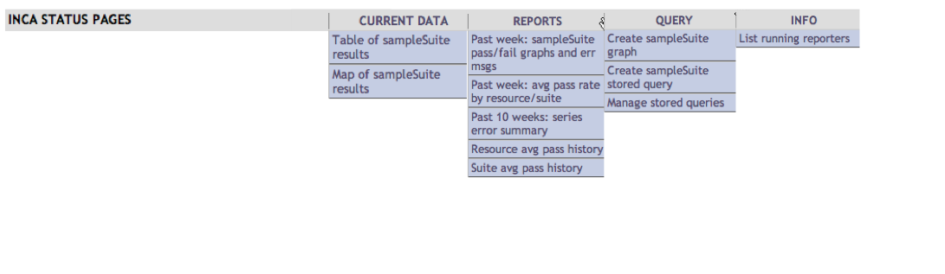
Customize the header
Add logo or background color here
Header can be customized by editing unordered list in header.xsl -- change for your suites
Add logo at top or background color by adding row to table

Slide 38
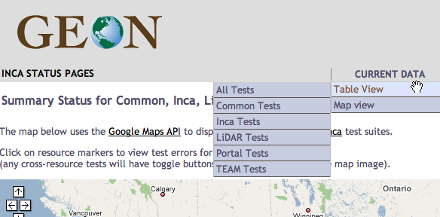
…
<table width="100%" class="subheader">
<tr> <td> <a href="http://www.geongrid.org">
<img src="http://www.geongrid.org/images/logo_lofi.gif"/>
</a></td>
</tr> <tr>
…
<ul>
<li><h2>Current Data</h2>
<ul>
<li>
<a href="{concat($jsp, 'status.jsp?', $all)}">Table View </a>
<ul>
<li><a href="{concat($jsp, 'status.jsp?', $all)}">All Tests</a></li>
<li>
<a href="{concat($jsp,'status.jsp?suiteNames=Common&amp;resourceIds=ROCKS')}">
Common Tests
</a></li>
…
Add GEON logo to top of page

Slide 39
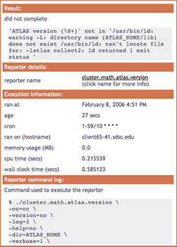
Changing colors in CSS
Edit CSS (Cascading Style Sheet) to change colors and fonts
E.g. change .header background-color
$INCA_INSTALL/etc/inca.css
.header {
background-color: #D07651;

Slide 40
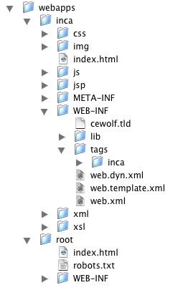
Finding files
Inca webapp runs inside Jetty 6 container
Config colors
Config authentication
Config files for views

Slide 41
Summary
Inca includes a data consumer -- an embedded Jetty web container that includes a webapp
Webapp is made of JSP pages and tags, XSL templates, and XML files that query data from the depot and display it in status pages
Inca’s status pages provide multiple levels of details from historical to current data and summary and detail views
Caching of queries is done automatically to provide quicker load times of pages and can be customized
Status pages’ content and look can be customized
Security can be customized

