Slide 1
Inside the Inca Depot
Jim Hayes
jhayes@sdsc.edu
Inca Workshop
September 4-5, 2008

Slide 2
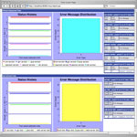
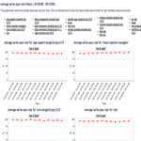
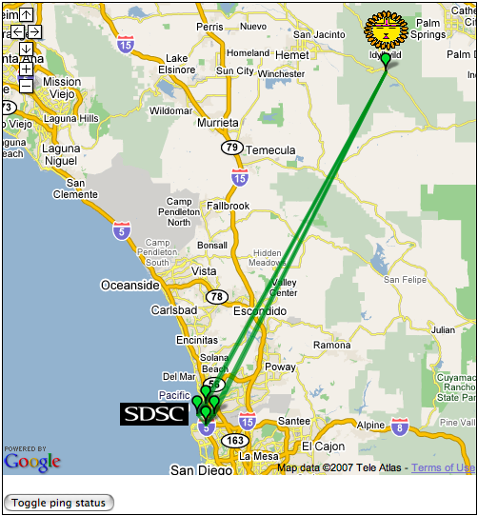
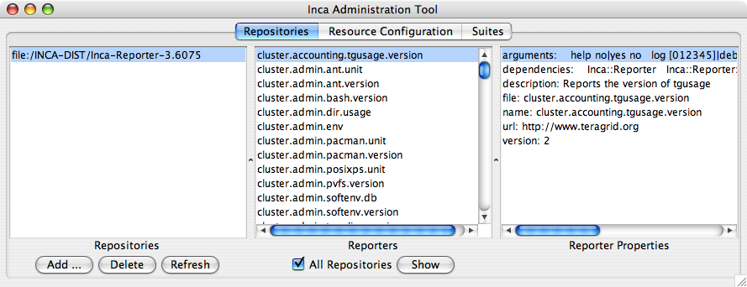
Depot
Reporter
Repository
Data Consumers
R
Incat
C
Agent
Depot
S
Inca report storage goals:
Flexible data content
Efficient storage/retrieval
Flexible access to data
Data security
S
r
S
R
r
R
Reporter
Manager
Reporter
Manager
…
Grid Resource
Grid Resource
Notes:
Focus on storage--leaves decision-making to Agent, data interpretation to consumers
Data security via Inca system security model

Slide 3
Report Body Provides Flexible Data Content
<body>
<env>
<ID>env</ID>
<var>
<ID>HOME</ID>
<value>/Users/jhayes</value>
</var>
<var>
<ID>JAVA_HOME</ID>
<value>/Library/Java/Home</value>
</var>
<var>
<ID>PERL5LIB</ID>
<value>/sw/lib/perl5:/sw/lib/perl5/darwin</value>
</var>
</env>
</body>
<body>
<package>
<ID>openssh</ID>
<version>3.6.1p1</version>
</package>
</body>
Notes:
Flexible data content
Efficient storage/retrieval
Flexible access to data

Slide 4
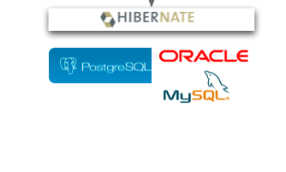
Hibernate Supports Efficient Data Access
Hibernate library provides an abstraction layer to DB applications
Supports PostgreSQL, MySQL, Oracle, HSQLDB, others
Provides HQL object-oriented SQL dialect
Depot
Notes:
Flexible data content
Efficient storage/retrieval
Flexible access to data
DB2, Microsoft SQL Server 2000, Sybase, TimesTen, HypersonicSQL, SAP DB, InterSystems Cache' 2007.1

Slide 5
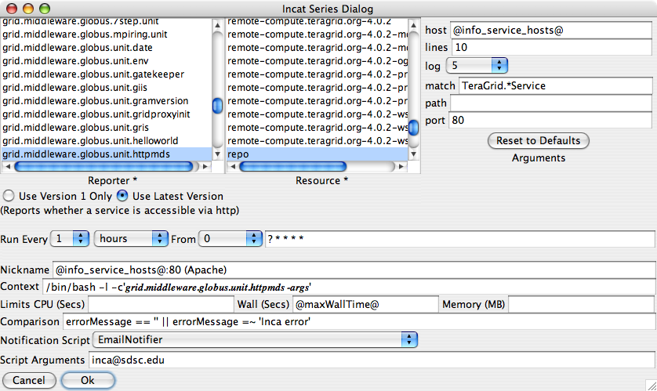
incat Series Edit Dialog
Notes:
Flexible data content
Efficient storage/retrieval
Flexible access to data

Slide 6
Depot Schema Reduces Redundancy
Reports often identical; Depot merges them
Instance contains info that varies--timestamps, resource usage
Series defines reporter execution; SeriesConfig manipulates execution and output
SeriesConfig/Series may be many-to-one, but typically one-to-one
SeriesConfig
schedule limits
comparison
Series
reporter
arguments
context
resource
Report
body
stderr
Instance
collected
cpuUsage
wallClockTime
Reporter output
Execution control
Runtime stats
Execution spec
Notes:
Flexible data content
Efficient storage/retrieval
Flexible access to data

Slide 7
Depot Provides Flexible Access to Data
Depot retains history of reporter output
Protocol supports direct DB access via HQL queries
Convenience queries provide easy access to common combinations of data
  Single instance
  Latest instance of a set of series
  Instances collected during a specified time period
  Success/failure history of a set of series
Special queries report DB schema, suite list
Notes:
Flexible data content
Efficient storage/retrieval
Flexible access to data

Slide 8
Depot Customization
Switch underlying database engine
Add/modify notifier scripts
Add report filters
Notes:
Also, optimizing underlying DB

Slide 9
Hibernate Supports Multiple DB Engines
PostgreSQL, MySQL, Oracle, HSQLDB, others
Differ in optimizations, tools
Configured via $INCA_DIST/etc/hibernate.properties
hibernate.dialect=org.hibernate.dialect.HSQLDialect
hibernate.connection.driver_class=org.hsqldb.jdbcDriver
hibernate.connection.url=jdbc:hsqldb:test
hibernate.connection.username=sa
hibernate.connection.password=
# Settings for a local PostgreSQL database.
#hibernate.dialect=org.hibernate.dialect.PostgreSQLDialect
#hibernate.query.substitutions=yes 'Y', no 'N'
#hibernate.connection.driver_class=org.postgresql.Driver
#hibernate.connection.url=jdbc:postgresql:test
#hibernate.connection.username=test
#hibernate.connection.password=

Slide 10

Notifiers Report Comparison Success/Failure
<body>
<package>
<ID>openssh</ID>
<version>3.6.1p1</version>
</package>
</body>
ID/Value pair
Notifier scripts found in installation $INCA_DIST/sbin/
EmailNotifier, LogNotifier provided; custom notifiers supported
Invoked on new/changed failure, new success

Slide 11
LogNotifier
use Cwd qw(abs_path getcwd);
my $name = $ENV{incanickname} || $ENV{incareporter};
my $log =
"Test '$ENV{incacomparison}' on output of series $name on " .
"$ENV{incaresource} now produces '$ENV{incacomparisonResult}'";
my @timeBits = localtime;
my $timestamp =
sprintf('%02d:%02d:%02d ', $timeBits[2], $timeBits[1], $timeBits[0]);
my $path = abs_path($ARGV[0]);
open(LOG, ">>$path") || die "Unable to open log $path";
print LOG "$timestamp" if defined($timestamp);
print LOG "$log\n";
close(LOG);

Slide 12
Report Filters Tweak Reporter Output
Java class in Depot CLASSPATH extends edu.sdsc.inca.depot.util.ReportFilter
Invoked by Depot before incoming report is examined or stored
set/get methods for context, report, resource, stderr, sysusage
Registered by setting inca.depot.reportFilter property in $INCA_DIST/etc/common/inca.properties
Cooperates with Consumer for more accurate display
Use with caution
Notes:
Examples, DownTimeFilter, AllToAllFilter

Slide 13
Agenda -- Day 2
9:00 - 9:30 | Inside the Inca Depot
9:30 - 10:00 | Inca APIs
10:00 - 11:00 | Data display (data consumers)
11:15 - 12:00 | Hands-on: Data display (data consumers)
1:00 - 3:00 | Hands-on: Inca deployment (part 2)
3:15 - 4:00 | Wrap up

