Slide 1



Assessing CI Software
SRB
  > 5,000 SDSC curators
  > 1 PB stored
  > 100 million files managed
  Distributed to 102 sites in 2005
Rocks
  > 170 TFLOPS enabled
  > 1,100 users on active
  support list
  > 2,000 clusters
  installed (est.)
Inca
  6 grids
  27 sites
  39 resources
Notes:
Num sites where Inca deployed:
7 TeraGrid
4 UK NGS
5 UK White Rose Grid
11 DEISA
Num Resources where Inca deployed:
19 TeraGrid
4 UK NGS
5 UK White Rose Grid
11 DEISA

Slide 2
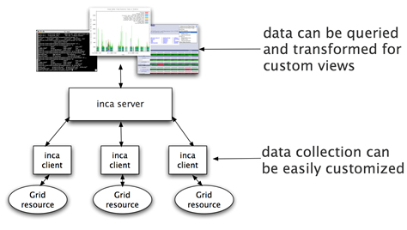





: Grid Monitoring Framework
Automated user-level functionality and performance testing of Grid resources
  Schedules execution of information gathering scripts (reporters)
  Collects, archives, and publishes data
Releases
  Version 1 being phased out
  Version 2 - improved security, installation and maintenance, and storage capabilities
    Pre-release (Feb ‘06)
    Beta (Nov ‘06)
    Production (planned Jan ‘07)
Inca user workshop @ SDSC (Feb 23 & 24, ‘06)
Production use by:
Notes:
Inca: 1 FTE (Kate) from GIG, 0.5 FTE from RP (.5 Shava), 1 FTE from Core (.5 Shava, .5 Jim Hayes)
Inca targets 3 different types of users/consumers of the Inca results: Grid/VO mgmt, system administrators, and end users
Our view is that responsibility of the testing should occur at the Grid/VO level. Based on the goals of the Grid, they decide what should be tested and then collect the results - the goal being to detect problems before the users do
While the Grid/VO will decide what to test, system administrators from each of the participating sites will need to be notified of failures and be able to understand how the test was conducted so they can debug their system.
While ideally, we hope that the failures will be caught before users notice them, in practice this is hard to achieve. Therefore, the results of our testing should be made available to users so if they’re having a problem, they can check the results to see if it might be system or user related.
Key Inca features:
Runs under regular user account to enable user-level testing
Reporter output (XML) expresses more than test pass/fail for example different types of performance information
Capture context of reporter execution (script, what machine it ran on, time it ran, inputs, selected environment variables, etc.) so sysadmins can debug the problem detected by Inca
Centralized administration makes it easy to make changes to an existing deployment (e.g., deploy a new test, change a parameter of a test) which is important because effective testing is an iterative refinement process & resources change over time; uses SSL authentication to make that secure
Reports fully archived to understand the how the Grid behaves over time - for example to understand how a service fails over time and if it fails with the same type of error
Inca activities over this past year have focused on the implementation of a new version of the framework, Inca 2, which has substantial improvements over Inca 1 with respect to security, installation and maintenance, and storage capabilities.
February 5, 2006 - pre-release of Inca 2 released
In order to solicit new Inca 2 users and to improve the transition to Inca 2 for current users, the Inca team held a workshop on February 23 & 24, 2006 at SDSC. The workshop was attended by 15 people from the following organizations: ANL (MDS4), DEISA, GEON, NCSA, NGS, PSC, PRAGMA, SDSC, TACC, TeraGrid, White Rose Grid, and Univ. of Southampton. The Inca team presented six talks over the two-day workshop detailing the components of the Inca 2 architecture and included four hands-on sessions for attendees to try out the new features of Inca 2 for themselves. Slides and video are posted on the Inca website.
October 31, 2006 - beta of Inca 2 released
Currently working with new users from Australia APAC Grid, UK ECMWF (Weather), Germany (2)
Production release expected at end of year

