Slide 1
Hands-on: Inca deployment
(part 1)

Slide 2
Steps
Deploying default Inca installation
  Using inca script
  Using incat
  Reading log files
Creating suite
  Adding reporters
  Using macros
Adding resources

Slide 3
Logistics
Login id and password for desktops on handout
MyProxy password sent in email

Slide 4
inca.properties
Configuration file for all Inca components
Property names use the following convention:
inca.<component name>.<option name>
E.g., start the inca agent on port 6323
inca.agent.port=6323
Options can also be specified on the command-line
./bin/inca start agent --port=6323

Slide 5
Common component properties
Security related properties
  auth=[true|false]
  cert=<path>
  key=<path>
  password=<path>
  trusted=<path>
Server related properties
  port=<number>
  numthreads=<number>

Slide 6
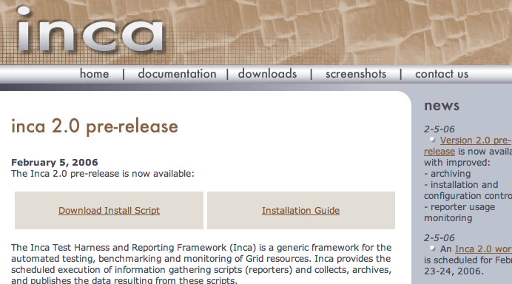
Step 1: Deploy default Inca installation
Follow instructions in Section 2.3 of Inca Installation Guide
http://inca.sdsc.edu/docs/install.html#INSTALL-BIN
Also linked off pre-release page:
http://inca.sdsc.edu/prerelease.html

Slide 7
Step 1 Explained
Agent, Depot, and Consumer servers started
Wait 20 seconds to make sure all servers are up
Sends suite ‘TestSuiteLocal’ to agent to start up a set of 8 reporters on the localhost
Agent receives suite and builds a reporter manager on the localhost in ~/inca2install (takes 1-5 minutes to build)
  View progress of build ~/inca2install/build.log
1-59/10 * * * * | cluster.math.atlas.version
2-59/10 * * * * | cluster.compiler.gcc.version
3-59/10 * * * * | cluster.security.openssl.version
4-59/10 * * * * | cluster.interactive_access.openssh.version
5-59/10 * * * * | cluster.interactive_access.openssh.unit
6-59/10 * * * * | viz.lib.vtk-nvgl.version
7-59/10 * * * * | viz.lib.chromium.version
8-59/10 * * * * | cluster.compiler.any.unit

Slide 8
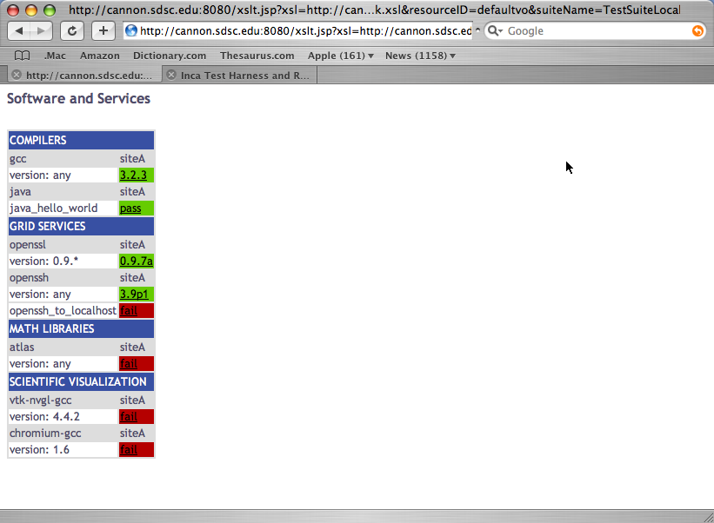
Step 1 Explained (cont.)
When reporter manager finishes building, it registers itself with the agent. Agent sends reporters, libraries, and schedule to reporter manager.
Reporter manager will execute reporters based on schedule. Should see at least one box filled within 3 minutes.

Slide 9
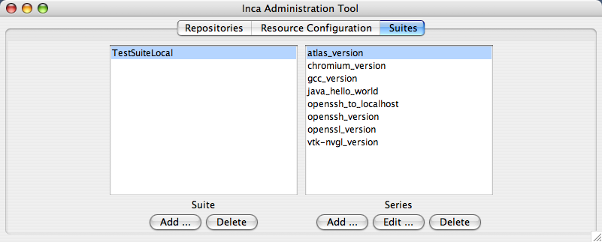
Step 2: Add a reporter to TestSuiteLocal
Start incat and click on Suites tab
Click on Add button

Slide 10
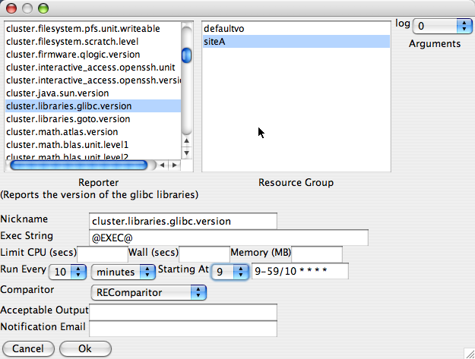
Step 2: Add a reporter to TestSuiteLocal (cont.)
Choose glibc version reporter
Choose siteA
Choose an execution time. This shows every 10 minutes starting at minute 9. If you want to see the result show up sooner, check the current time and pick a schedule within a few minutes later.

Slide 11
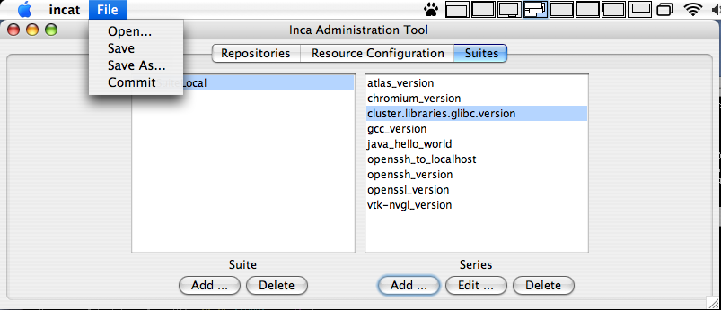
Step 2: Add a reporter to TestSuiteLocal (cont.)
Choose Commit

Slide 12
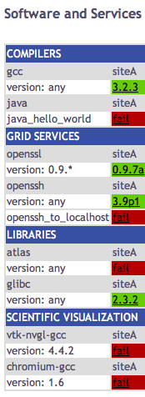
Step 2: Add a reporter to TestSuiteLocal (cont.)
Verify result by updating your swStack.xml located in <installdir>/etc/common with
http://inca.sdsc.edu/workshop/swStack.xml
Reload web page and wait for result

Slide 13
Step 3: Modify default configuration
Before adding remote resources, edit inca.properties and provide the fqdn of the machine using the following steps:
Stop the Inca server components
<installdir>/bin/inca stop all
Choose the Quit option in Incat
Edit inca.properties in <installdir>/etc/common and replace all instances of localhost with the fqdn of the machine you are using.
Start the Inca server components
<installdir>/bin/inca start all
Start Incat
<installdir>/bin/inca start incat

Slide 14
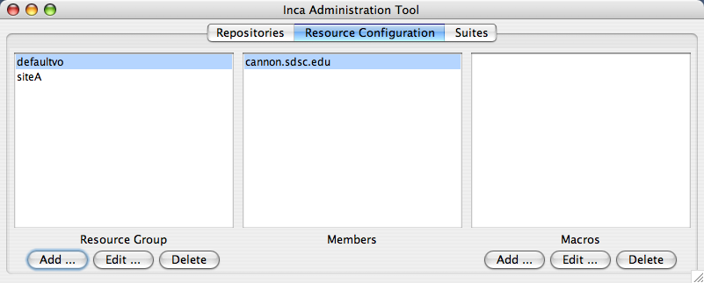
Step 4: Add new resource
Click Add under Resource Configuration

Slide 15
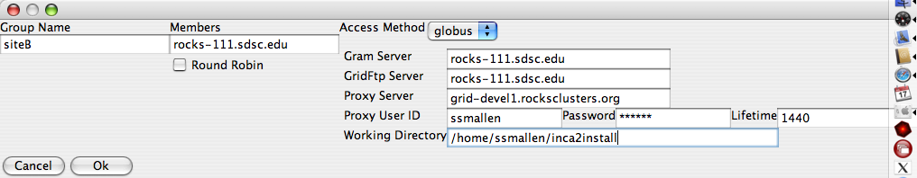
Step 4: Add a new resource (cont.)
Add one of the following resources using Globus as the invocation method as siteB:
  rocks-111.sdsc.edu
  rocks-112.sdsc.edu
  rocks-113.sdsc.edu
  rocks-104.sdsc.edu

Slide 16
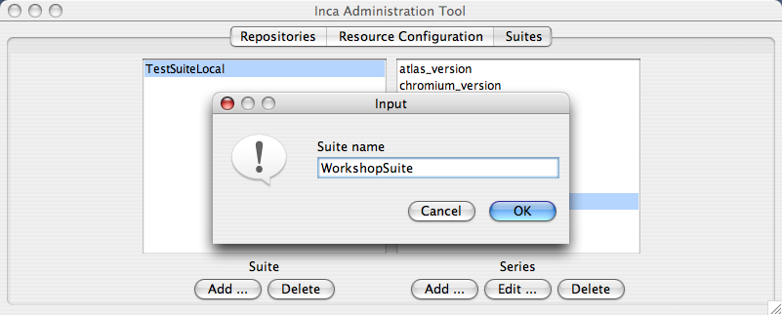
Step 5: Create a new suite
Click the Add button and type in a new name for your suite

Slide 17
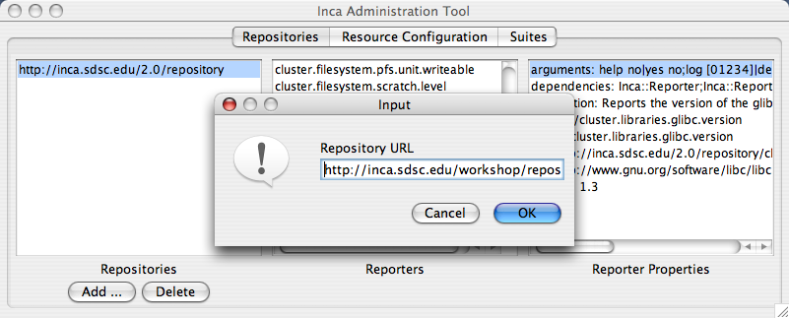
Step 6: Add a new repository
Click the Add button under Repositories and type in http://inca.sdsc.edu/workshop/repository

Slide 18
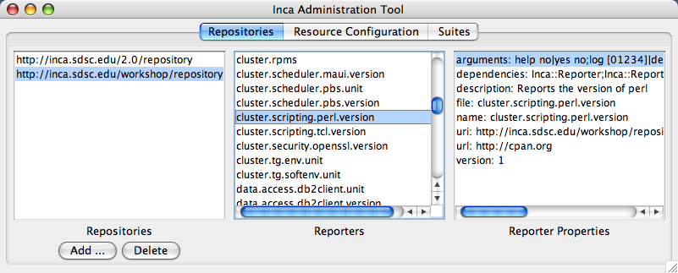
Step 6: Add a new repository (cont.)
You should see a “Retrieving info from Agent” message.
Once complete, scroll down to see the new reporter: cluster.scripting.perl.version

Slide 19
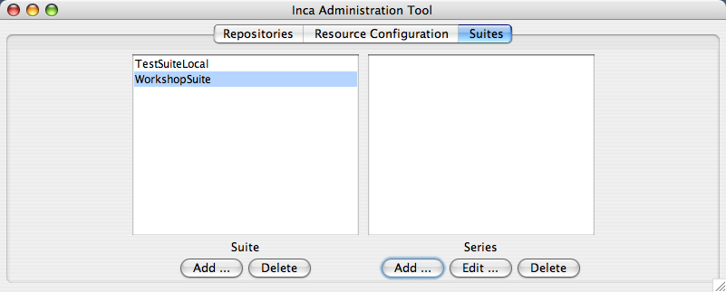
Step 7: Add perl version reporter to suite
Click on Suites tab
Click on Add button

Slide 20
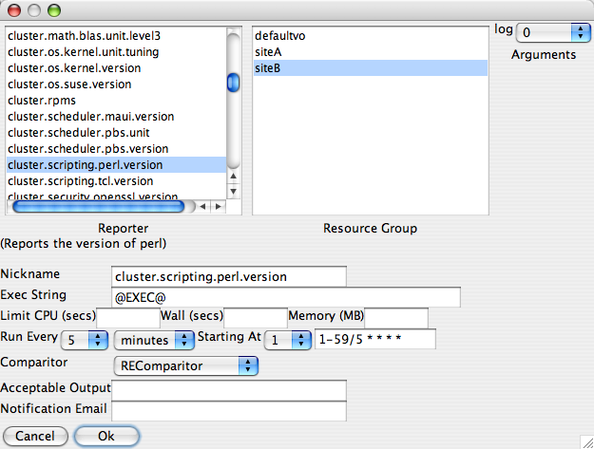
Step 7: Add perl version reporter to suite (cont.)
Choose perl version reporter
Choose siteB.
Choose an execution time. This shows every 5 minutes starting at minute 1.
Click Ok.

Slide 21
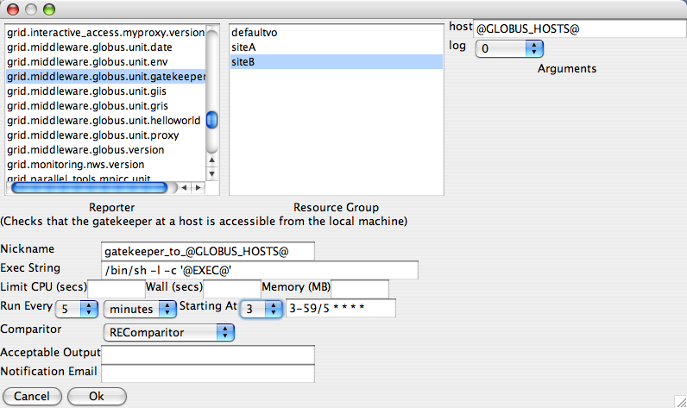
Step 8: Add globus gatekeeper test to suite
Choose globus gatekeeper test reporter
Choose siteB
Choose @GLOBUS_HOSTS@ as the hostname
Choose gatekeeper_to_@GLOBUS_HOSTS@ as the Series Name.
Choose /bin/sh -l -c '@EXEC@’ as the Exec string
Choose an execution time. This shows every 5 minutes starting at minute 3.
Click Ok.

Slide 22
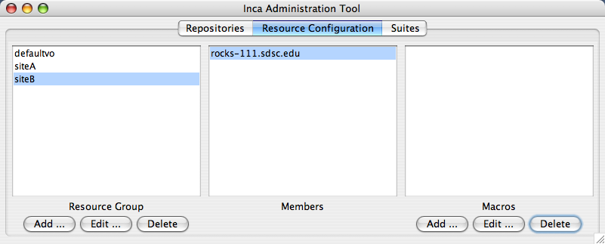
Step 9: Define macro
Click on Resource Configuration tab, highlight siteB and click the Add button under Macros.

Slide 23

Step 9: Define macro (cont.)
Define the macro GLOBUS_HOSTS with values
rocks-111.sdsc.edu rocks-112.sdsc.edu
Click Ok button.

Slide 24
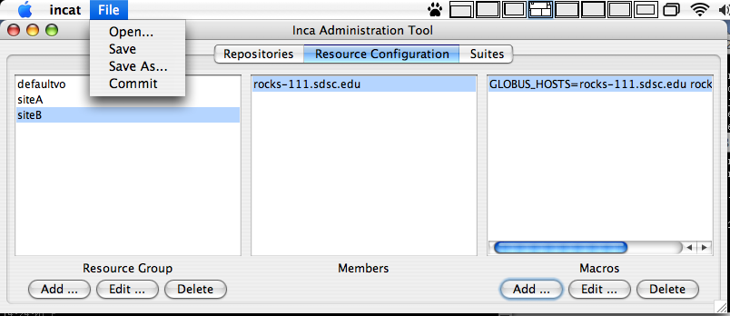
Step 10: Commit changes
Choose Commit

Slide 25
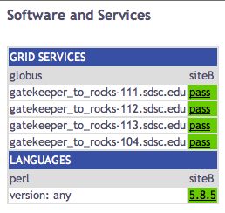
Step 11: View result
Copy swStack2.xml from
http://inca.sdsc.edu/workshop/swStack2.xml
into <installdir>/etc
Open page:
http://host.sdsc.edu:8080/xslt.jsp?xsl=http://host.sdsc.edu:8080/swStack.xsl&resourceID=siteB&suiteName=WorkshopSuite&xmlFile=swStack2.xml

