Slide 1

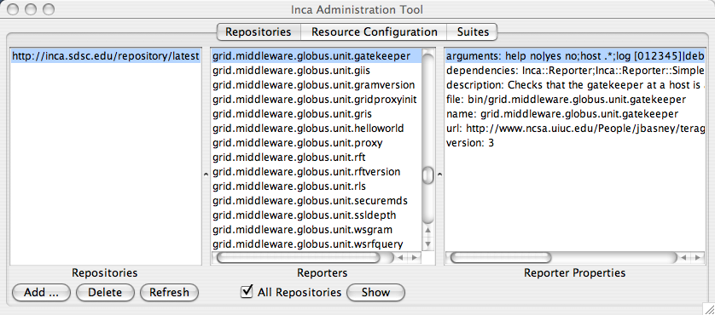
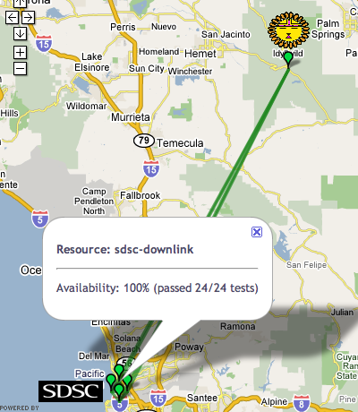
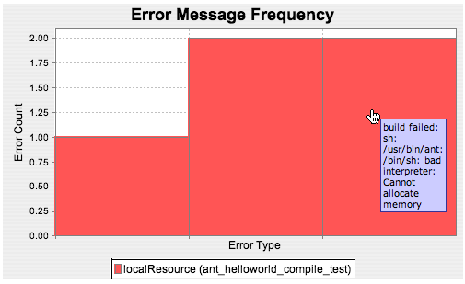
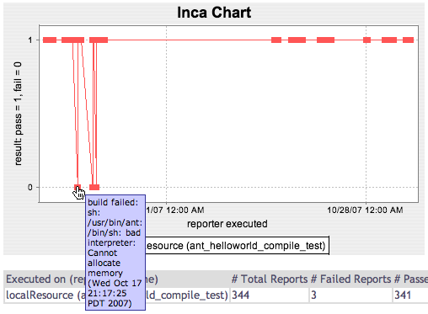
User-level Grid monitoring and performance measurement
Easy to customize, deploy, and maintain
Displays current resource summary status and test details
Provides test history and statistics
Version 2.2 now available.
For more information, visit http://inca.sdsc.edu.

Slide 2
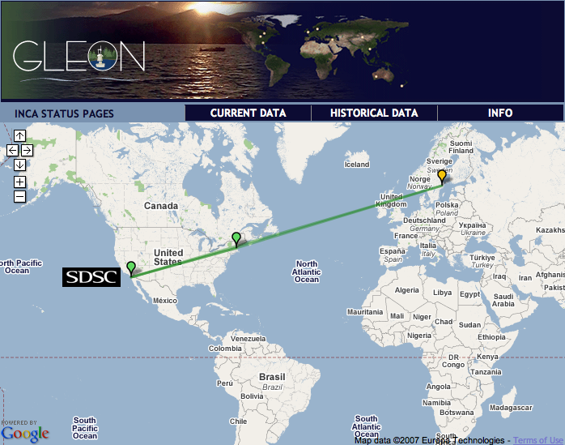
Inca GLEON deployment
Monitoring Data Turbine deployment since Oct. 24
Inca server located at SDSC
Inca clients deployed for Lake Sunapee and Lake Erken
Checks network connectivity (ping), DataTurbine, and some common software packages (java version, etc.)
http://inca-gleon.sdsc.edu
Notes:
Currently we have deployed Inca to Lake Sunapee in New Hampshire and Lake Erken in Sweden and will grow it out as the Data Turbine deployments increase, Taiwan next month, and Florida in Feb.
We check network connectivity (all-to-all ping tests), ping test for DataTurbine, and some bit of software reporting (e.g., version of java and data turbine). 9 tests running per Inca client either every 10 minutes or 24 hours. Tests like ping and data turbine ping run every 10 minutes. Collecting version information and compiler tests is every 24 hour.
Map shows cumulative test status by resource. Each marker represents a resource and if you click on it, you get the name of the resource and the pecentage of tests that it passed. If there are any tests that have failed, they are also listed and you can click on the links to the details page.

Slide 3
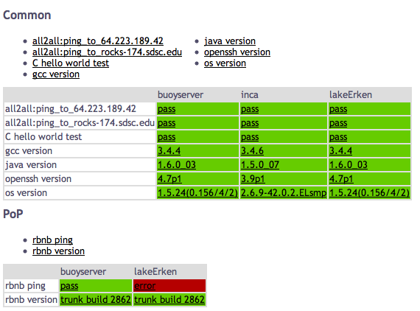
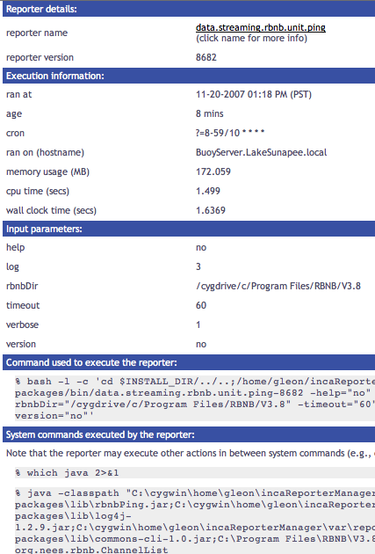
Other data views provide more detail
Test status by package and resources
Individual test details
Notes:
Here’s an example of the current data views we have:
This is the same data shown in the map but from the software stack view. Each row represents a package in a software stack and the columns are the resources. For each package, we report the version of software and the status of the unit test for that package. For each box, you can also click on it, to get the details page
The goal of the details page is to give a sys admin enough information to understand how the result was collected so as to assist in the debugging of a detected failure. You can see the script that run, with what arguments, on what host, etc.

Slide 4
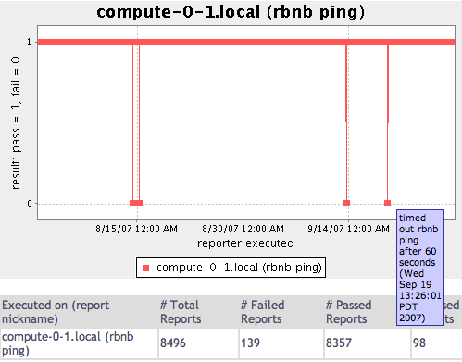
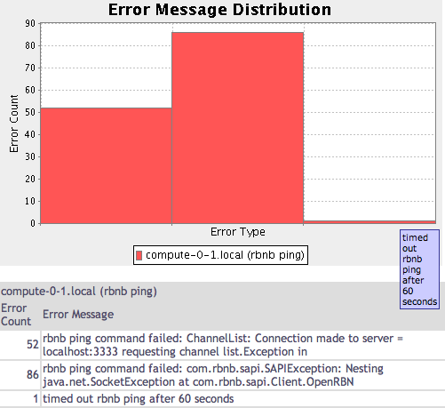
Historical Data Views
Status history of an rbnb ping test
Distribution of errors types _x0003_
Notes:
This view shows historical results of a particular reporter series which is a new feature of our most recent release on the first of the month.
The figure on the left shows the result history of a ping reporter over a 2 month period. The y-axis has 2 values, a zero to represent a failure, and 1 to represent a successful ping. The x-axis is the time. The graph is interactive so that when you mouse over, you can see the execution time and if there is an error, you can see the error message too. The table on the bottom there shows the numbers for the graph.
Since we provide full reporter archiving and as such we are archiving the failure messages. The graph on the right shows the distribution of the errors of the failed 139 reports. On the y-axis, there is the number of occurences of a error and the x-axis is the error type. There are 3 types of errors each represented by a bar and the table shows the counts below. This graph is also interactive so when you scroll over the bar, you see the error message.

Slide 5
Requirements for installing Inca
SSH access
For Unix machines:
  Perl 5.8.x or greater
  OpenSSL-0.9.6[jkl] or OpenSSL-0.9.7b or greater
  GNU tar (i.e., no limit on filename length)
For Windows XP machines:
  Cygwin with the following modules:
    ssh server
    Perl
    Make
    Gcc
    openssl & openssl-dev
    vim (not required for but generally useful)
Inca server
ssh
Inca client
DataTurbine node
Notes:
Inca server will install client using SSH
For unix machines, the requirements are pretty basic
For windows xp, the big difference is that cygwin will need to be installed

Slide 6


More information
Website:
http://inca.sdsc.edu
Email:
Shava Smallen
ssmallen@sdsc.edu
Funded by:

