Slide 1
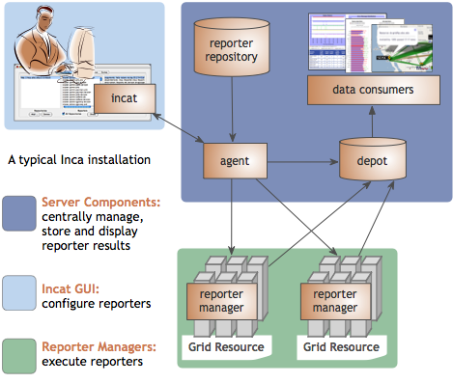
Inca provides user-level grid monitoring
Enables consistent user-level testing across resources
Easy to configure and maintain
Easy to collect data from resource
Archived results support troubleshooting
Large variety of tests
Comprehensive views of data
Notes:
Benefits Grid administrators/operators who want to verify that requirements are being met by their resource providers and want to understand failure trends; helps system administrators by notifying when failures are detected on their system and provides detailed information to help troubleshoot failures; helps end users by (hopefully) detecting failures before they do
Key differences between Inca and other monitoring systems is that it
Tests from a regular user account on all resources so can reflect user experience better than testing done from sys admin account which has privileges and custom shell initialization
In order to ensure test results collected across all sites are consistent, we centrally manage the test configuration and push it out to all resources automatically – this allows us to catch a lot of misconfiguration errors that are a result of sites misunderstanding the requirements -- other monitoring tools like OSG’s RSV aggregate each site’s self-managed test results which can lead to inconsistencies in the results – Inca can be used in coordination with these other tools
The centralized management approach also allows us to push out changes quickly (i.,e. to fix a test) and not have to log into each machine individually
New tests can easily be inserted to Inca by writing “reporters”, executables that output results in XML. Inca’s XML schema allows more than just pass/fail information – we also report versions, usage data, and performance information (i.e., any piece of XML limited to 4000 chars) – example of performance information is running IPM instrumented applications and reporting the results
Inca provides full archiving of results which allows longer term trend analysis – what’s failing the most over time and is it the same errors or different errors – aids in troubleshooting complex issues - other views show are we doing better or worse than last week
Inca has a repository of over 150 different reporters (primarily tests of Grid tools like Globus, SRB, MPICH-G, etc.) and some performance measurements)
Inca’s web pages provides a lot of different views that show high-level summary information to specific details on how a test result was collected
Inca has users in the U.S., Europe, and Australia -- TeraGrid, NGS, ARCS (Australia), DEISA, GEON, TEAM, and ZIH (Dresden)

Slide 2
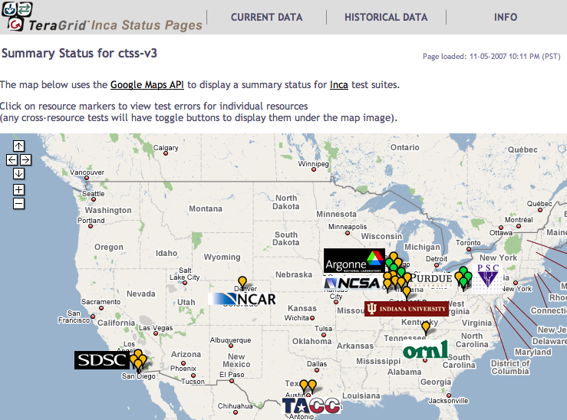
Inca TeraGrid deployment
Running since 2003
Total of ~2400 tests running on 20 login nodes, 3 grid nodes, and 3 servers
Coordinated software and services
Resource registration in information services
Cross-site tests
CA certificate and CRL checking
TeraGrid GIG services
Screenshot of Inca status pages for TeraGrid
http://inca.teragrid.org/
Notes:
Inca was developed originally for TeraGrid and we’ve been running on there since 2003
Inca mainly tests the various CTSS4 kits but also has a number of tests that run across sites to pick up site-to-site specific configuration errors (i.e., host.deny) – Inca configures testing based on what sites register into IIS (i.e., is what they register into IIS available on their systems)
Also does some tests for the security group
Tests GIG services such as IIS, the User Portal, CVS

Slide 3

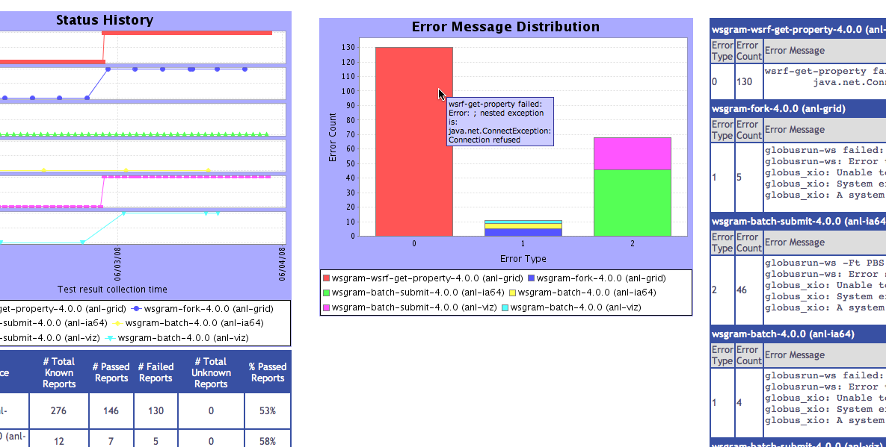
Inca monitoring benefits end users
“Inca reported errors mirror failures we’ve observed and as they are addressed we’ve noticed an improvement in TeraGrid’s stability.”
-- Suresh Marru (LEAD developer)
Tests resources and services used by LEAD. E.g.
  Pings service every 3 mins
  Verifies batch job submission every hour
Automatically notifies admins of failures
Show week of history in custom status pages
Notes:
All of the monitoring we do on TeraGrid is to improve the overall user experience. LEAD is a good example. They were encountering many problems with Globus on TeraGrid resources. They were using Globus at a larger scale than others and were also using cutting edge version of services deployed by sites (not even registered into IIS). Inca worked with the science gateway team and globus developers to develop a custom Inca web page view that showed tests that mirrored LEAD’s usage of TG services and produced reports for weekly telecons where problems were debugged until stability improved for LEAD.

Slide 4
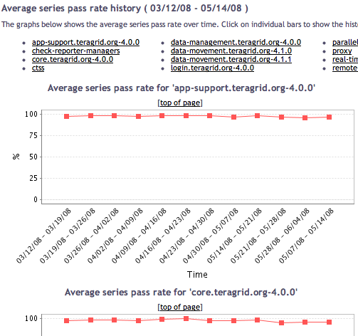
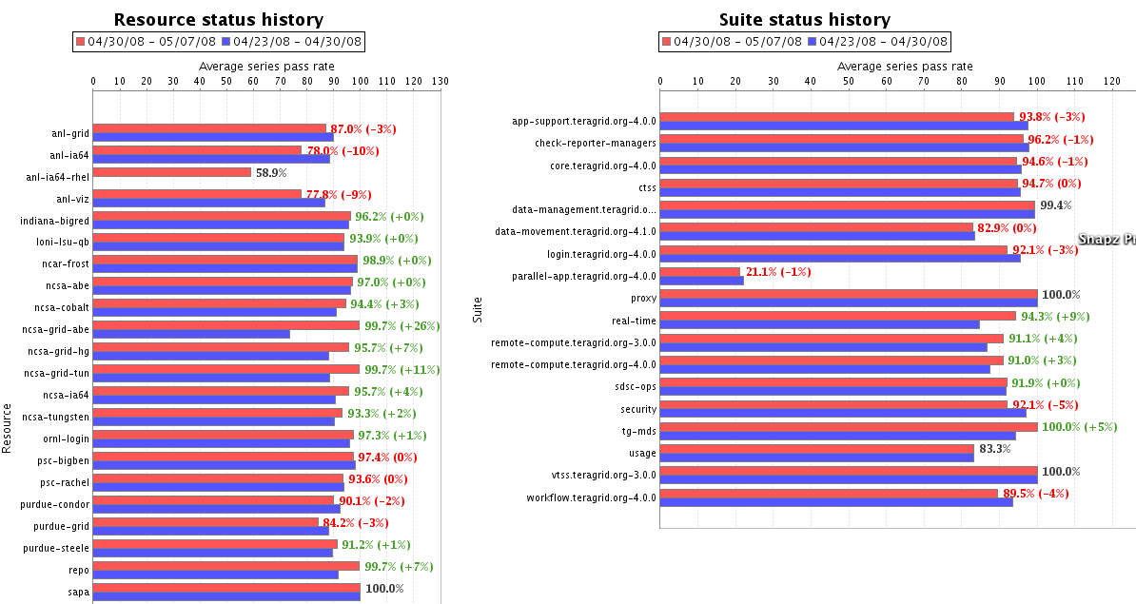
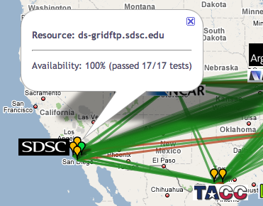
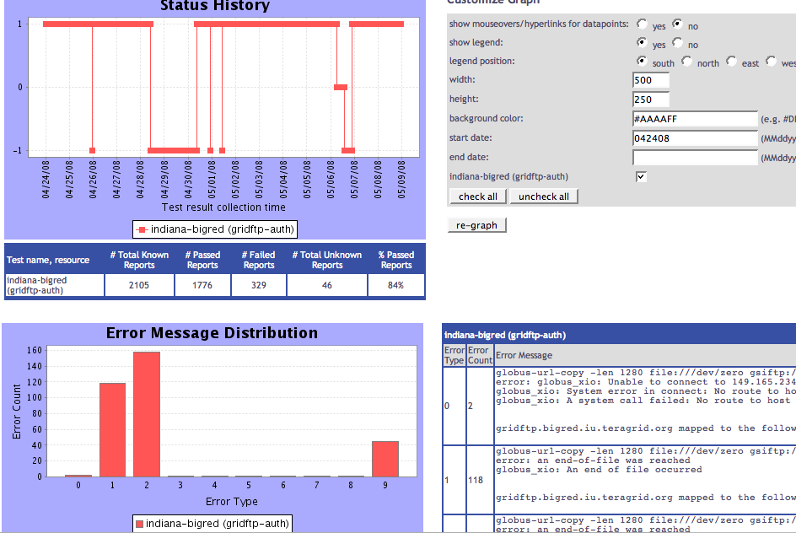
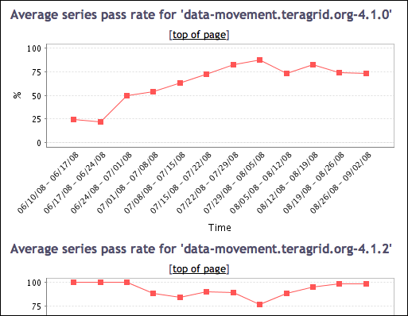
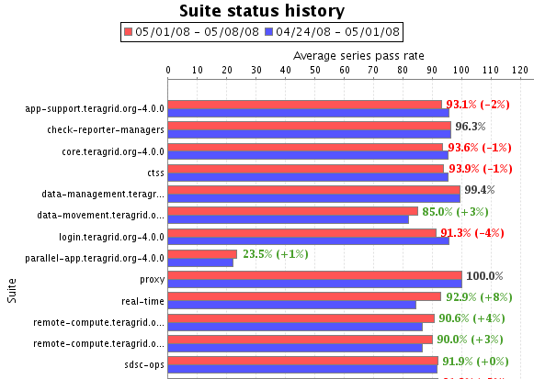
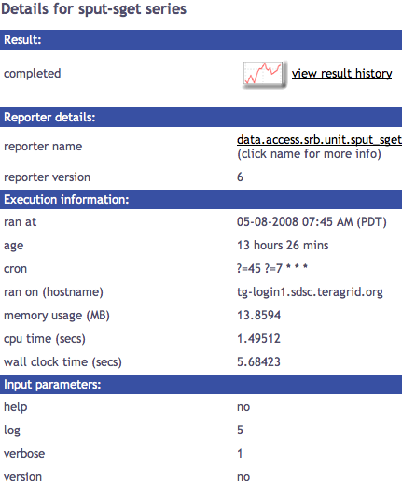
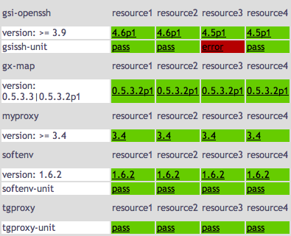
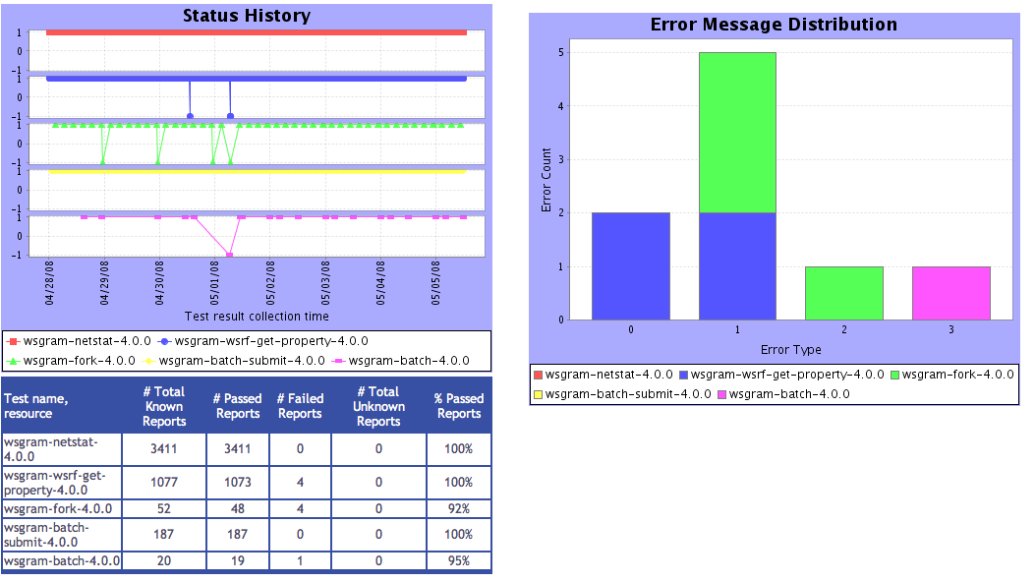
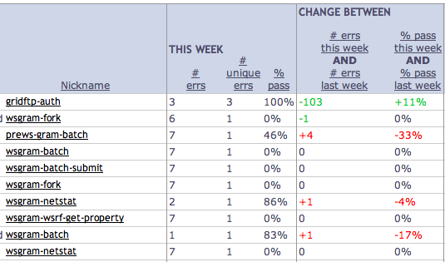
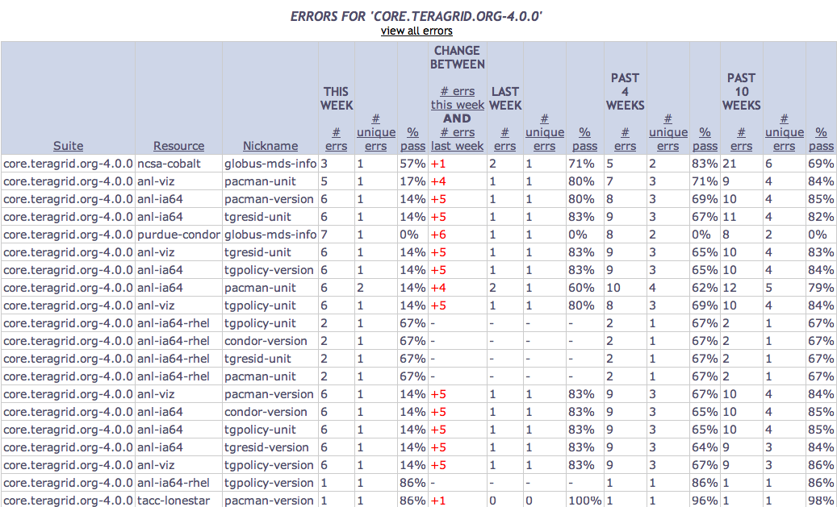
Tests
Summary
Weekly status report
Cumulative test status by resource
Resource status history
Inca’s status pages provide multiple levels of details
Error history summary
Test status by package and resource
Related test histories
Individual test result details
Test
Details
Individual test history
Historical
Current status
Notes:
* If have room, here are our different web status page views

