Slide 1
test harness and reporting framework
(new version’s affects on current work)
Cathie Olschanowsky
San Diego Supercomputer Center

Slide 2
Inca User Scenarios
Functionality Testing
Software Version Checking
Continuous Measurements

Slide 3
Outline
Inca User Scenarios
Grasp Specifics
Grasp Deployments
Available Software

Slide 4
Inca Reporters
Script or executable that outputs XML conforming to Inca specification
Context of execution is required - important for repeatability
  What commands were run?
  What machine?
  What inputs?
Communicate more than pass/fail
  Body XML can be reporter specific - flexibility
  E.g., package version info (software stack availability)
  E.g., SRB throughput (unusual drop in SRB performance)
Users can run it independently of framework
What time?
What result?

Slide 5
Reporter Execution Framework
How often should reporters run
  Boot-time, every hour, every day?
Modes of execution:
  One shot mode:
    boot-time, after a maintenance cycle, user checking their specific setup
  Continuous mode: cron scheduling
Data can be queried from a web service and displayed in a web page

Slide 6
Outline
Introduction
Inca architecture
Case study: V&V on TeraGrid
Current and Future Work
Feedback

Slide 7
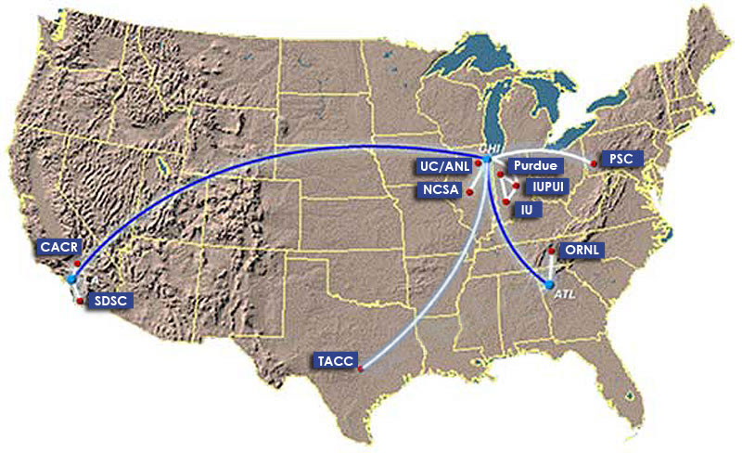
TeraGrid
TeraGrid - an “enabling cyberinfrastructure” for scientific research
  ANL, Caltech, Indiana Univ., NCSA, ORNL, PSC, Purdue Univ., SDSC, TACC
  40+ TF, 1+ PB, 40Gb/s net
Common TeraGrid Software & Services
  Common user environment across heterogeneous resources
  TeraGrid VO service agreement

Slide 8

Validation & Verification
Common software stack:
  20 core packages: Globus, SRB, Condor-G, MPICH-G2, OpenSSH, SoftEnv, etc.
  9 viz package/builds: Chromium, ImageMagick, Mesa, VTK, NetPBM, etc.
  21 IA-64/Intel/Linux packages: glibc, GPFS, PVFS, OpenPBS, intel compilers, etc.
50 version reporters: compatible versions of SW
123 tests/resource: package functionality
  Services: Globus GRAM, GridFTP, MDS, SRB, DB2, MyProxy, OpenSSH
  Cross-site: Globus GRAM, GridFTP, OpenSSH
Notes:
34 unit reporters run 123 unit tests per resource

Slide 9
Validation & Verification (cont.)
Common user environment
  $TG_CLUSTER_SCRATCH, $TG_APPS_PREFIX, etc.
  SoftEnv configuration - manipulate user environment
Verify environment vars defined in default environment
Verify Softenv keys defined consistently across sites

Slide 10
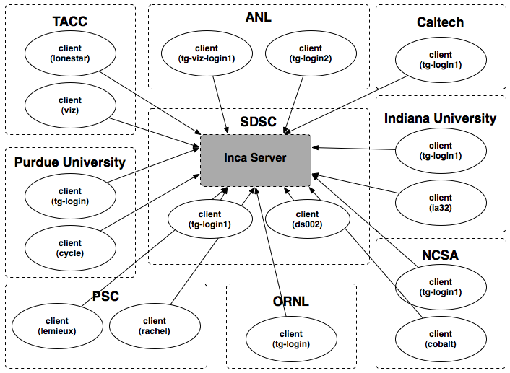
Inca deployment on TeraGrid
9 sites/16 resources
Run under user account inca

Slide 11
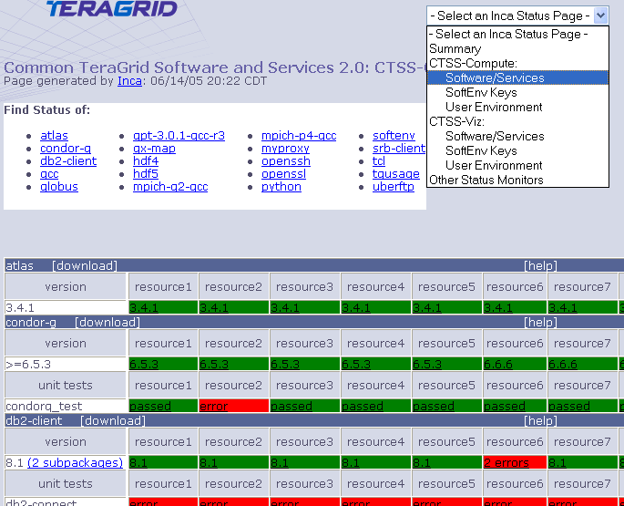
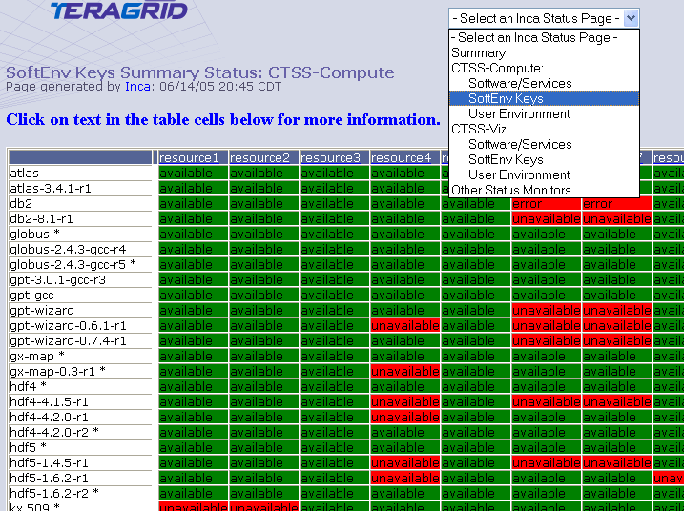
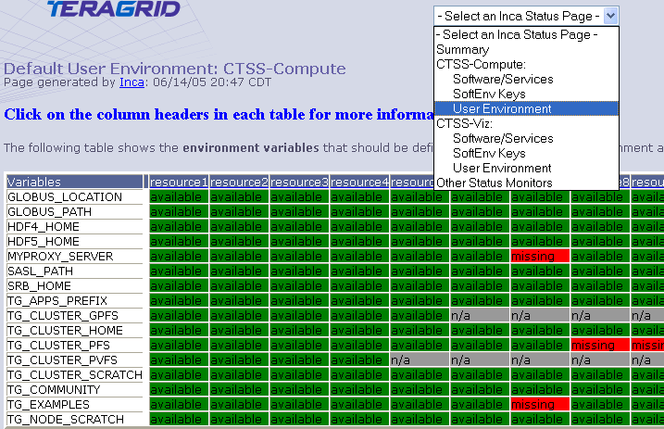
Detailed Status Views
Resources
SW
packages

Slide 12
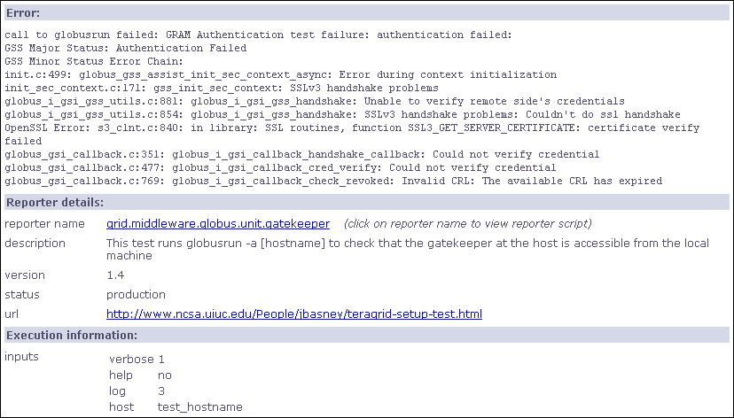
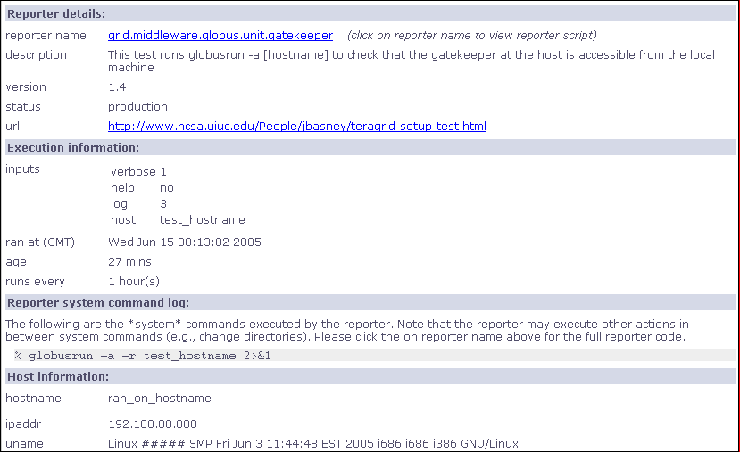
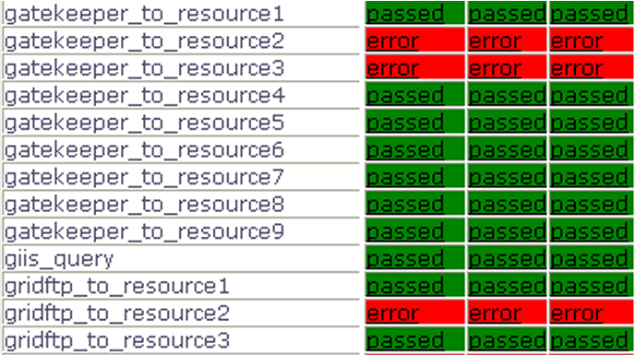
Drill-down capability

Slide 13
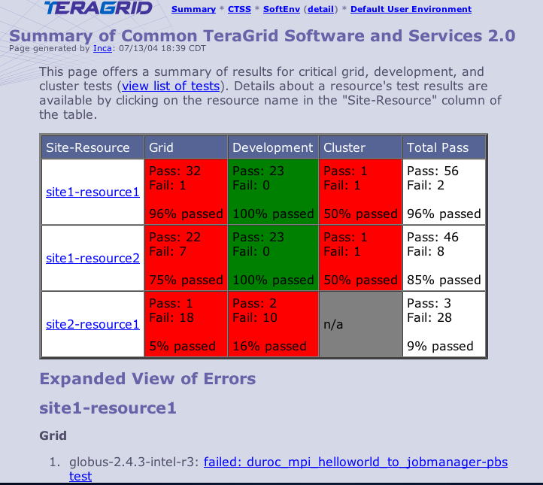
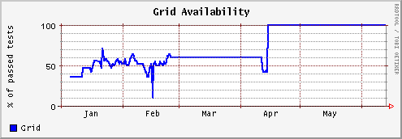
Summary Status
All tests passed: 100%
One or more tests failed: < 100%
Tests not applicable to machine or have not yet been ported
Key
History of percentage of tests passed in “Grid” category for a 6 month period

Slide 14
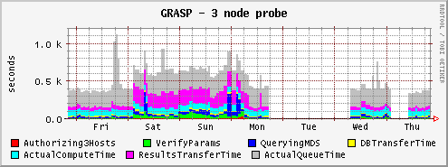
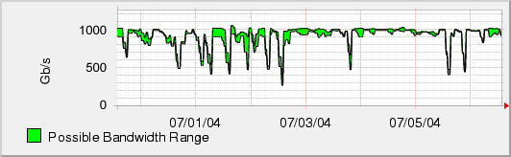
Measuring TeraGrid Performance
GRASP (Grid Assessment Probes)
  test and measure performance of basic grid functions
Pathload [Dovrolis et al]
  measures dynamic available bandwidth
  uses efficient and lightweight probes
1000
500
0

Slide 15
Lessons learned
Initially focused on system administrative view
Moving towards user-centric view
  File transfer functionality and performance
  File system availability
  Job submission
  SRB performance
  Interconnect bandwidth
  Applications: NAMD, AWM

Slide 16
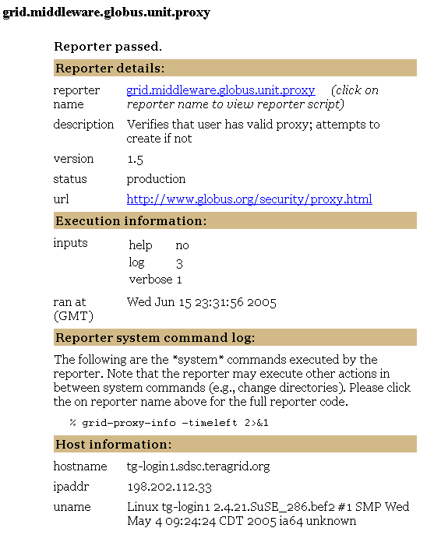
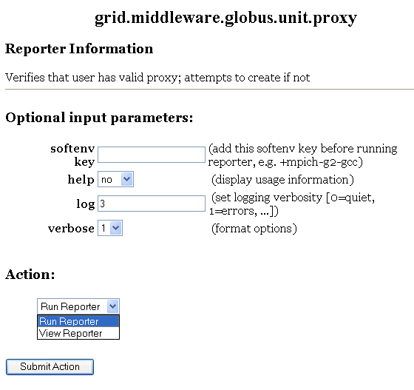
Integration with Knowledge Base
Narrow down trouble area
Are you having problem(s) with:
Data
Job Management
Security
…
YES: Are you having trouble transferring a file?
YES: Are you seeing poor performance?
…
Narrow down set of reporters
Check to see if you have valid proxy
…
Reporters they can run

Slide 17
Outline
Introduction
Inca architecture
Case study: V&V on TeraGrid
Current and Future Work
Feedback

Slide 18





Inca Today
Software available at:
http://inca.sdsc.edu
Current version: 0.10.3
Also available in NMI R7
Users:

Slide 19
Inca 2.0
Initial version of Inca focused on basic functionality
New features:
  Improved storage & archiving capabilities
  Scalability - control and data storage
  Usability - improved installation and configuration control
  Performance - self-monitoring
  Security - SSL, proxy delegation
  Condor integration
Release in 3-6 months

Slide 20
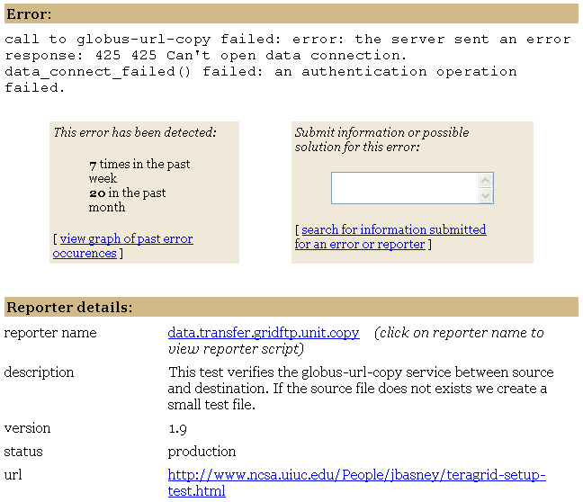
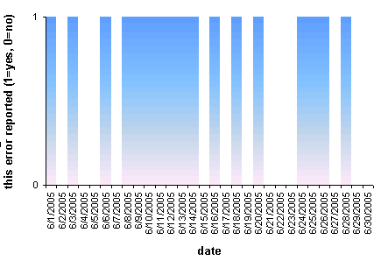
View Error History
Submit information
or suggestions
Search for information on error/reporter

Slide 21
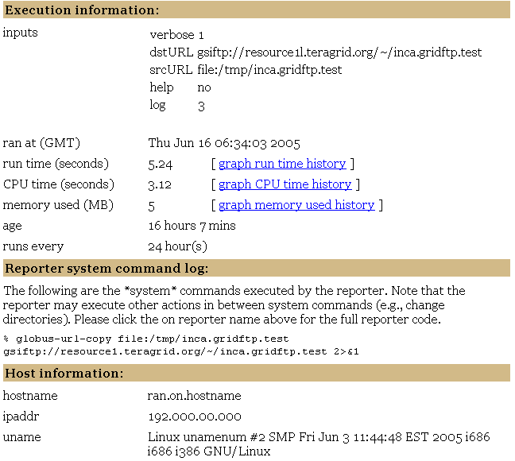
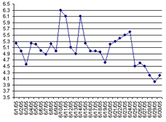
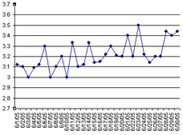
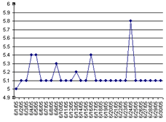
View Resource Usage

Slide 22
Summary
Inca is a framework that provides automated testing, benchmarking, and monitoring
  Grid-level execution to detect problems and report to system administrators
  Users can view status pages and compare to problems they see
  Users can run reporters as themselves to debug account/environment problems
Currently in-use for TeraGrid V&V, GEON, and others

Slide 23
Outline
Introduction
Inca architecture
Case study: V&V on TeraGrid
Current and Future Work
Feedback

Slide 24
Feedback
How are you monitoring your Grid infrastructure?
What do you need to test?
What diagnostic/debugging tools are available to users?
Displaying test results to users? In what format? How much detail?
Notes:
How tightly managed is the software?
Resource usage vs. update frequency?

Slide 25
More Information
http://inca.sdsc.edu
Current Inca version: 0.10.3
New version in 3-6 months
Email:
ssmallen@sdsc.edu

