Slide 1
test harness and reporting framework
(Grasp)
Cathie Olschanowsky
San Diego Supercomputer Center

Slide 2
Inca User Scenarios
Functionality Testing
Software Version Checking
Grid Measurements

Slide 3
Measure a Grid
Common User Scenario on Teragrid
Run large job at SDSC, store data using SRB.
Run large job at NCSA, move data from SRB to local scratch and store results in SRB
Run larger job using both SDSC and PSC systems together, move data from SRB to local scratch storing results in SRB
Move small output set from SRB to ANL cluster, do visualization experiments, render small sample, store results in SRB
Move large output data set from SRB to remote-access storage cache at SDSC, render using ANL hardware, store results in SRB

Slide 4
Outline
Inca User Scenarios
Grasp Specifics
Grasp Deployments
Available Software

Slide 5
Grasp Specifics:
Available Configurations
Circle
Gather

Slide 6
Grasp Specifics:
Functions Exercised
GSI Authentication
GridFTP
Job Submission
User Environment/Compilation

Slide 7
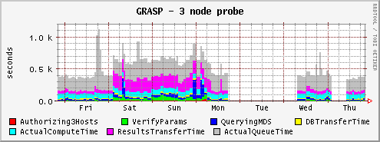
Grasp Specifics:
Storage and Results
Previously stored in RRDTool
Currently stored in relational database
1000
500
0

Slide 8
Grasp Deployments:
Current
Using alpha version of Inca
Teragrid
Geon

Slide 9
Grasp Deployments:
Teragrid
3 circles
  SDSC,ANL,Caltech,NCSA
  PSC,IU,ORNL,Purdue,Tacc
  Above concatenated
2 Gathers
  ANL,Caltech,IU to NCSA to SDSC
  PSC,ORNL,Purdue to Tacc to IU

Slide 10
Grasp Deployments:
Geon
In Progress
Globus 3 (Web Services)
Sharing Depot with Teragrid

Slide 11
Software Availability
Grasp available with Inca 2.0
Pre-release available for friendly users soon

