Slide 1
Administering Inca with incat
Jim Hayes
jhayes@sdsc.edu
Inca 2.0 Workshop
February 23, 2006

Slide 2
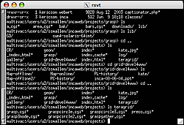
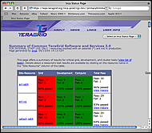
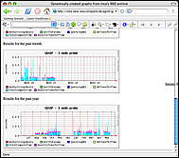
Architecture overview
Reporter
Repository
incat
Tool
Data Consumers
Suite
R
Reporter
Agent
Depot
Depot
S
S
S
R
R
R
Reporter
Manager
Reporter
Manager
Reporter
Manager
…
Resource N
Resource 1
Resource 2

Slide 3
Outline
Launching incat
Adding repositories
Adding resources
Managing suites and report series

Slide 4
Launching incat
“inca start incat” to start
Can work with a local file (--file path), a Reporter Agent (--agent host:port), or both
Retrieves existing configuration from Reporter Agent and/or loads specified file

Slide 5
incat Display
Tabs for repository, resource, and suite
File Open/Save/Save As menu
File/Commit sends to Reporter Agent

Slide 6
Outline
Launching incat
Adding repositories
Adding resources
Managing suites and report series

Slide 7
Repositories Tab
Repository list, reporter summary, reporter properties
Reporter information retrieved from Reporter Agent
Repository URLs relative to Reporter Agent

Slide 8
Outline
Launching incat
Adding repositories
Adding resources
Managing suites and report series

Slide 9
Resource Configuration Tab
Resource group name, associated macros, member hosts
Groups of groups supported
Macro for most specific group applies

Slide 10
Resource Panel (cont.)

Slide 11
Using Ssh Resources
Member specification allows choice (|) and character sets ([])
Round Robin resources considered equivalent--one Reporter Manager
Passwordless ssh key, for now

Slide 12
Using Globus Resources
Accessed by Reporter Agent via Globus CoG Java classes
Reporter Manager staging via GridFtp
Proxy used by Reporter Agent to launch Reporter Manager and potentially by Reporters

Slide 13
Using the Local Resource
Allows running reporters on the same machine as the Reporter Agent
Used by default installation

Slide 14
Grouping Resources
Directory, proxy info, etc. like macros--most specific value is used for each host

Slide 15
Outline
Launching incat
Adding repositories
Adding resources
Managing suites and report series

Slide 16
Suites Tab
Single/multiple series choice up to administrator
Report series named after reporter or given “nickname”

Slide 17
Report Series Editor
Select reporter, resource group, and command-line argument values
Argument list determined by reporter
Reporter description appears below reporter

Slide 18
Report Series Editor (cont.)
Nickname useful in later report display
Exec String allows specialized execution
Reporter killed and error report stored if limits exceeded
Run frequency uses cron syntax
Comparitor takes action on unacceptable output

Slide 19
Using Macros in Report Series
@macro@ expanded for each host
Multi-valued macros expand to multiple report series

