Slide 1
Welcome to the
Inca 2.0 Workshop
Sponsored by the San Diego Supercomputer Center
Presenters:
Shava Smallen ssmallen@sdsc.edu
Jim Hayes jhayes@sdsc.edu
Kate Ericson kericson@sdsc.edu
Cathie Olschanowsky cmills@sdsc.edu
Notes:
Introduce self
Welcome to workshop
Introduce team

Slide 2













Thank you for attending
Notes:
TODO: pragma

Slide 3
Workshop Goals
Understand Inca goals and objectives
Learn new features of v2
Deploy or upgrade to an Inca v2 installation
Give feedback to Inca project team

Slide 4
Agenda -- Day 1
9:00 - 10:00 | Inca 2.0 overview
10:00 - 11:00 | Working with Inca Reporters
11:15 - 12:00 | Hands-on: Reporter API and Repository
1:00 - 2:00 | Inca Control Infrastructure
2:00 - 3:00 | Administering Inca with incat
3:15 - 4:00 | Hands-on: Inca deployment (part 1)

Slide 5
Agenda -- Day 2
9:00 - 10:00 | Inside the Inca Depot
10:00 - 11:00 | Data display (data consumers)
11:15 - 12:00 | Hands-on: Data display (data consumers)
1:00 - 3:00 | Hands-on: Inca deployment (part 2)
3:15 - 4:00 | Wrap up

Slide 6



Inca Information
Announcements:
inca-users@sdsc.edu
Bugs/Feature Requests:
http://inca.sdsc.edu/bugs
Email:
inca@sdsc.edu
Website:
http://inca.sdsc.edu
Supported by:

Slide 7
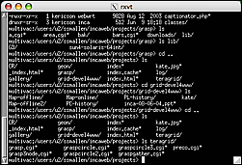
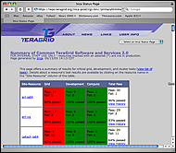
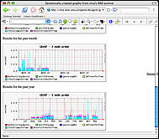
Inca 2 Architecture
5. GUIs can display collected data by querying Depot
Reporter
Repository
Incat
Create a “suite”
Data Consumers
suite
R
Reporter
Agent
Submit suite to Reporter Agent
Depot
Depot
3. Reporter Agent invokes Reporter Managers and distributes suite and reporters
S
S
S
R
R
R
4. Reporter Managers send data to Depot
Reporter
Manager
Reporter
Manager
Reporter
Manager
…
Resource N
Resource 1
Resource 2
Notes:
The Admin Tool is a user interface (java GUI) used by the Inca admin to administer all parts of an Inca deployment; it connects to the Reporter Agent
The Reporter Agent is a server which is the access point to an Inca deployment and is responsible for managing the control flow of an Inca installation
The Reporter Repository is responsible for storing Reporters (scripts that gather data from resources); reporters are packaged as RPMs; can be shared among multiple Inca deployments
The Reporter Manager is responsible for managing the schedule and execution of Reporters on a single resource; receives instructions from one and only one reporter agent.
The Depot is a server that is responsible for storing the data produced by reporters.
The Suite describes where to run the reporters, frequency of execution, and optionally expected values (I.e., instructions for how to collect data)

Slide 8
Inca 2 Components
Data Collection
R
A Reporter is an executable program that tests or measures some aspect of the system or installed software.
Reporter
Repository
A Reporter Repository contains a collection of reporters and is available via an URL.
Suite
A Suite specifies a set of reporters to execute on selected resources, their configuration, and frequency of execution.
Notes:
Use this slide to introduce the vocabulary we use to describe our architecture. The next slide will go into more of how these pieces fit together.
Need to tie our non-unique and unique features to the architecture

Slide 9
Inca 2 Components (cont.)
Administration and control
Reporter
Manager
A Reporter Manager is responsible for managing the schedule and execution of reporters on a single resource
Reporter
Agent
A Reporter Agent is a server that implements the configuration specified by the Inca Administrator.
Incat
Incat is a GUI used by the Inca administrator to control and configure the Inca deployment on a set of resources.
Notes:
Use this slide to introduce the vocabulary we use to describe our architecture. The next slide will go into more of how these pieces fit together.
Need to tie our non-unique and unique features to the architecture

Slide 10
Inca 2 Components (cont.)
Data Storage and Display
Depot
A Depot is a server that is responsible for storing the data produced by reporters.
A Data Consumer is typically a web page client that queries a Depot for data and displays it in a user-friendly format.
Data Consumer
Notes:
Use this slide to introduce the vocabulary we use to describe our architecture. The next slide will go into more of how these pieces fit together.
Need to tie our non-unique and unique features to the architecture

Slide 11
v1/v2 Inca Components
Components | Version 1 | Version2
Data Consumers | X | X
Depot | X | X
Reporter | X | X
Controller | X
Reporter Manager |  | X
Collector | X
Incat |  | X
Reporter Agent |  | X
Reporter Repository |  | X

Slide 12
Inca 2.0 Overview
Shava Smallen
ssmallen@sdsc.edu
Inca 2.0 Workshop
February 23, 2006

Slide 13
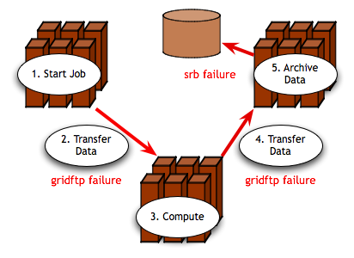
Grid Reliability
Grid computing: The ability to dynamically link resources together as an ensemble to support the execution of large-scale, resource-intensive, and distributed applications
“You know you have [a distributed system] when the crash of a computer you've never heard of stops you from getting any work done.” -- Leslie Lamport
Simple Grid application
Notes:
Main points
Motivation of our work is the issue of reliability in today’s production Grids
Running a Grid application implies the use of multiple resources and the software and services deployed on them
An increase in the number of dependencies result in an increase in the probability of failures
For example, the figure shows a simple Grid application where a user logged into a resource starts an application which transfer data to a resource to run a computation, and then transfers the results to a third resource for data archiving. The red arrows show where a failure in data transfer can occur.
Other sources of failures :
Software - faullty installation, misconfiguration, environment problem, bugs, not scalable
Hardware - power failures, overheating, cable unplugged
Networking problems
TODO: just have gridftp failure -- add X too

Slide 14
Is the Grid up?
Can user X run application[s] Y on Grid[s] Z? Access dataset[s] N?
  Can I login?
  Are Grid services the application[s] use available? Compatible versions?
  Are dataset[s] N accessible to user X? Credentials?
  …
Notes:
Now when we look at what this means for the user, the Grid is up if they can run their particular application on their set of resources, access their dataset, and get “good” performance.
This may seem straightforward but there are actually a lot of things that need to be working underneath the hood in order to make that happen. For example, …
And as you consider the requirements of a community of users and multiple communities of users, those set of requirements can grow quite large.

Slide 15
Testing a Grid
Iteratively define a set of concrete requirements
Write tests to verify requirements
Periodically run tests and collect data
Publish data
Automate Steps 3 and 4
Notes:
One way to veriify the user’s requirements are being met is through periodic, automated testing (as you do with software) so that you can have some confidence that when a user logs in, they can get work done
The way you go about this is to define a set of concrete requirements (I.e., machine-readable). These can then be be tested automatically and periodically (important in these dynamic Grid environments).
Some places where you can get requirements from are user documentation, talking to users, proposals, etc.
Note, this is not a simple matter of sitting down once and defining a complete set of requirements
This will be an iterative process as requirements are refined and because the Grid environment will change over time as packages are upgraded, etc.

Slide 16

What type of testing?
Deployment testing
  Automated, continuous checking of Grid services, software, and environment
  Installed? Configured correctly? Running? Accessible to users? Acceptable performance?
  E.g., gatekeeper ping or scaled down application
Junit,
PyUnit, Tinderbox
Software Package
(unit, integrated)
Software Stack
(interoperability)
NMI
Software
Deployment
Notes:
When we refer to testing, we’re talking about testing at the deployment level
This is different than the type of testing you do at the software package level where you’re looking at detailed testing of the software features and checking that it works on all architectures using something like junit, tinderbox, etc.
This is also different than the type of testing that occurs at the software stack level where you’re looking at package version interoperability (e.g., NMI)
We are checking whether packages are installed, running, and configured correctly.
This tests can be something as simple as pinging a Globus gatekeeper service to a more complicated test such as a scaled down version of an application

Slide 17
Who are the consumers?
Grid/VO management
  Responsible for designing & maintaining requirements
  Verify requirements are fulfilled by resource providers
System administrators
  Notified of problems
  Enough information to understand context of problem
End users
  View results and compare to problems they are having
  Debug user account/environment issues
  Advanced users: feedback to Grid/VO
Notes:
There are different consumers of the testing results: Grid/VO, system administrators, and end users
Our view is that responsibility of the testing should occur at the Grid/VO level. Based on the goals of the Grid, they decide what should be tested and then collect the results - the goal being to detect problems before the users do
While the Grid/VO will decide what to test, system administrators from each of the participating sites will need to be notified of failures and be able to understand how the test was conducted so they can debug their system. This implies that the need to trust the results.
While ideally, we hope that the failures will be caught before users notice them, in practice this is hard to achieve. Therefore, the results of our testing should be made available to users so if they’re having a problem, they can check the results to see if it might be system related.
They should also be able to use the tests to debug user account/environment issues specific to their account (e.g., removing an environment variable accidentally prevents a package from working)
For more advanced users, they could even feedback useful tests to the Grid/VO level.

Slide 18
Inca
Inca is a framework for the automated testing, benchmarking and monitoring of Grid resources
Inca provides:
  Scheduled execution of information gathering scripts (reporters)
  Data management
    collection
    archiving
    publishing
Notes:
To this end, we’ve developed Inca as a …
It provides …
We started almost Inca 3 years ago in the context of the TeraGrid project to do V&V of the software stack and environment. When we started, there were not any projects out there that fulfilled TeraGrid’s requirements.

Slide 19








Related Grid monitoring tools
MDS
Hawkeye
Inca’s primary objective: user-level Grid functionality testing and performance measurement
Notes:
Over the past couple years, several monitoring tools have been developed that are at a high-level similar to Inca wrt to data collection, data storage, and data dissemination
We feel the main difference between Inca and these tools is that ….
Because some of these tools support aggregation like MonALISA and MDS, Inca could be used to feed information into these systems.
Backup
Archiving of the data
some systems use a relational DB like Big Brother (Sybase), GridICE (postgres), MonALISA (MySQL, PostgreSQL, Microsoft SQL Server)
Ganglia uses RRDTool and Nagios uses logs
Tools like MonALISA and GridICE do a lot wrt accounting/job monitoring -- not something we’ve addressed but we could
Inca could complement MonALISA, GridICE, MDS since they are aggregate data.
There’s also the NCSA TestGrid and GITS -- not frameworks
We’re working with GITS’ David Baker to incorporate tests into Inca

Slide 20
Unique features of Inca
Debugging
  Runs under a regular user account
  Flexibly expresses results
  Captures reporter execution context
  Securely re-runs reporters
  Archives full reports
  Reporters can be run outside framework
Notes:
Here’s what sets us apart as unique -- based on our experience with real Grid deployment on TG. Places noted as v2 will be available to the public early 2006.
Run under regular user account enables user-level testing
Express more than test pass/fail for example different types of performance information
Capture context of reporter execution (script, what machine it ran on, time it ran, inputs, selected environment variables, etc.)
Easy to *securely* re-trigger a test (sys admin fixes a problem -- update the result)
Reports fully archived to understand the how the Grid behaves over time - for example to understand how a service fails over time and if it fails with the same type of error
Reporters can be run outside of the framework by a sysadmin debugging a problem or a user…eventually integrated into a knowledge base

Slide 21
Unique features of Inca (cont.)
Compares results to a specification
Easily and securely configured
  Data collection
  Installation
Profiles and logs reporter resource use
Notes:
Because analyzing information from resources for display can sometimes be resource-intensive, Inca provides support for comparing results to a specification and storing it (for example, a software stack specification). Comparisons are done each time a new result is collected so the cost is amortized over time rather than doing each time a web page is displayed.
The method to specify the data collection is very expressive to make it easy to configure Inca. Also easy to make changes to an existing deployment (important because resources change over time); uses SSL authentication to make that secure
There’s such a thing as testing too often -- tradeoff of between freshness of data and impact on resource

Slide 22
Outline
Inca in use
Architecture overview
Software Status

Slide 23
Inca today
Version 1
  aka 0.10.3
  available from website and NMI distribution
Version 2 pre-release
  Available as of 02/06
  Production version available in 1-3 months
Both versions of Inca are currently being used in production environments
Notes:
What we have today
First public release in April 2004
Used by handful of projects
Second major release on Inca January 2006 - number of substantial improvements based on our experience with deploying version 1

Slide 24
Inca in use
Software stack
validation and verification (v1)
Network bandwidth
measurements (v1)
Grid benchmarking
Notes:
3 examples of Inca used in production environments today

Slide 25
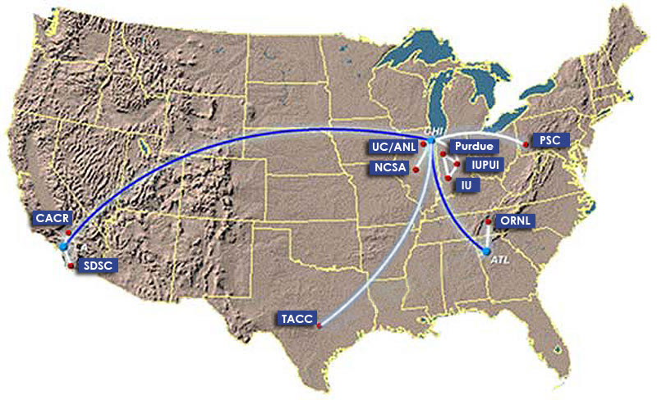
1) Inca in use: TeraGrid software stack V&V
TeraGrid - an “enabling cyberinfrastructure” for scientific research
  ANL, Indiana Univ., NCSA, ORNL, PSC, Purdue Univ., SDSC, TACC
  40+ TF, 1+ PB, 40Gb/s net
Common TeraGrid Software & Services
  Common user environment across heterogeneous resources
  TeraGrid VO service agreement
Notes:
TeraGrid first grid to use inca to verify its software stack requirements
8 sites, 17 resources

Slide 26

1) Inca in use: TeraGrid software stack V&V
Common software stack:
  20 core packages: Globus, SRB, Condor-G, MPICH-G2, OpenSSH, SoftEnv, etc.
  9 viz package/builds: Chromium, ImageMagick, Mesa, VTK, NetPBM, etc.
  21 IA-64/Intel/Linux packages: glibc, GPFS, PVFS, OpenPBS, intel compilers, etc.
50 version reporters: compatible versions of SW
123 tests/resource: package functionality
  Services: Globus GRAM, GridFTP, MDS, SRB, DB2, MyProxy, OpenSSH
  Cross-site: Globus GRAM, GridFTP, OpenSSH
Notes:
34 unit reporters run 123 unit tests per resource

Slide 27
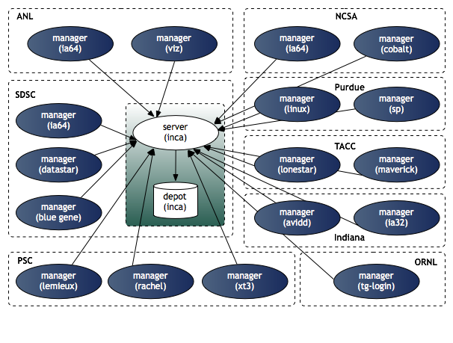
1) Inca in use: TeraGrid deployment
8 sites/17 resources
Run under user account inca

Slide 28
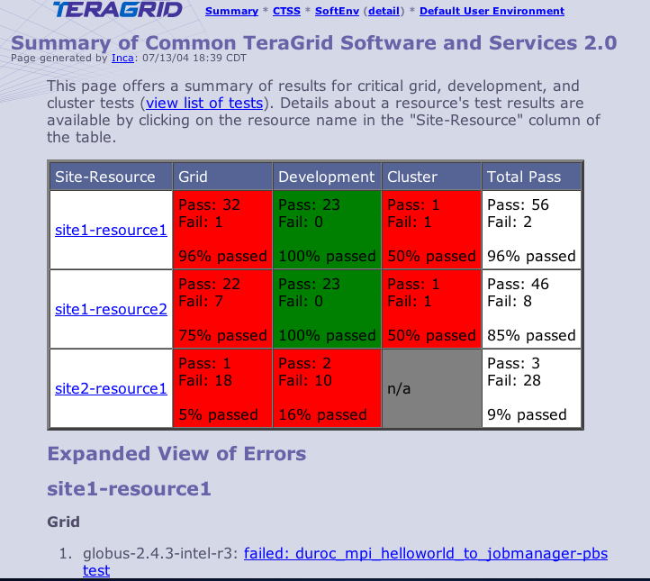
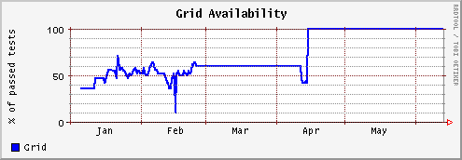
1) Inca in use: Summary status page
All tests passed: 100%
One or more tests failed: < 100%
Tests not applicable to machine or have not yet been ported
Key
History of percentage of tests passed in “Grid” category for a 6 month period
Notes:
Graph shows that it took about 3 months to get the Grid functionality working and then it was fairly stable.

Slide 29
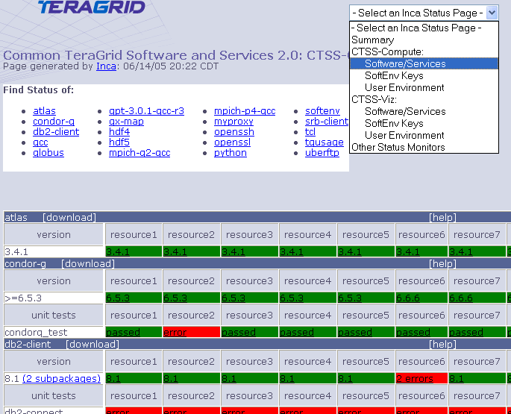
1) Inca in use: Detailed Status View
Resources
SW
packages

Slide 30
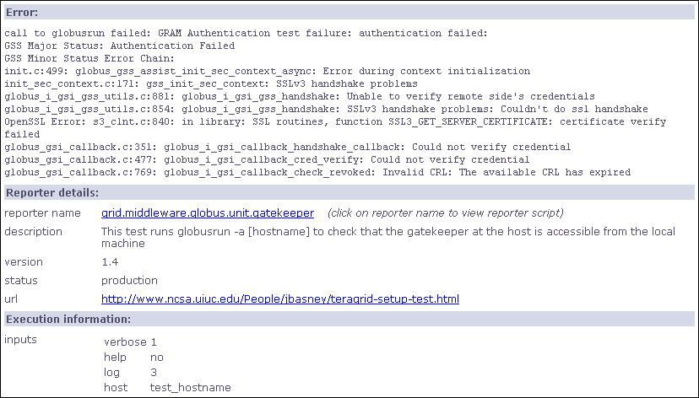
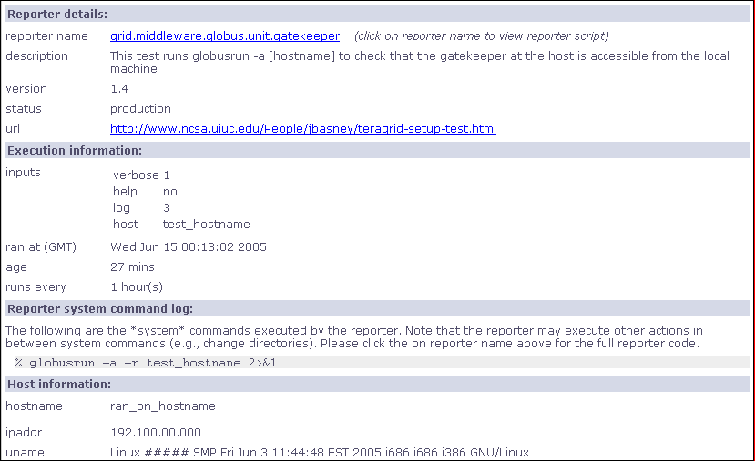
1) Inca in use: Detailed view

Slide 31
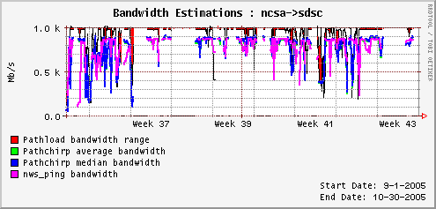
2) Inca in use: Comparison of end-to-end bandwidth measurement tools
Joint work with Margaret Murray (TACC) and Martin Swany (UDel)
Deployed to TeraGrid, GEON
Poster presented at Grid 2005
Compare bandwidth measurement tools:
  Pathload [Dovrolis]
  Pathchirp [Ribeiro]
  NWS ping [Wolski]
Notes:
Compare bandwidth measurements from 3 different bandwidth measurement tools in production Grid environments
Tools measure end-to-end bandwidth using different algorithms and are designed to be non-intruisive
Wrapped tools and deployed them using Inca on TeraGrid and GEON - collected full-mesh of measurements
Figure shows measurements take from NCSA to SDSC over a 2 month period. In this case, Pathchirp (blue and green but green not visible) and NWS (magenta) show close correlation and pathload (red) showing higher bandwidth
Poster describing TeraGrid results presented at Grid 2005 on Monday.
If asked:
NWS send probe data over TCP connection and measures time - on TeraGrid, we use 512 MB
Pathchirp and Pathload send smaller multi-packet probes and measure one-way delay

Slide 32
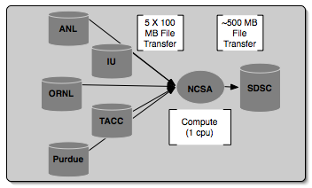
3) Inca in use: Grid benchmarks
GrASP: Grid Assessment Probes
  C. Olschanowsky, O. Khalili, J. He, H. Casanova, A. Snavely. Acquiring and Using Benchmark Data from Computational Grids, submitted for publication
  Set of probes designed to emulate Grid applications
  Deployed to GEON and TeraGrid
Gather probe on TeraGrid
Notes:
Collect Grid benchmark measurements using GrASP (Grid Assessment Probes) developed by Henri Casanova and Allan Snavely’s groups
Requested queue time is 1 hour, actual compute is less than a minute

Slide 33
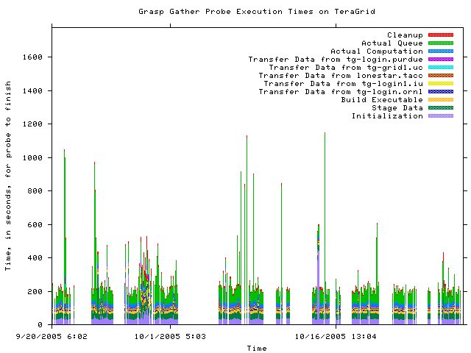
3) Inca in use: Measuring Grid middleware performance
Notes:
This is about 2 months of results from the gather probe running on TG
Y axis is execution time in seconds and x axis the time at which the measurement was taken
Colors indicate stage in execution of the probe
See how the performance varies over time - queue time most variable
white areas indicate probe did not complete due to an error - with version 2, we archive the error messages and can see what types of error messages are occurring

Slide 34
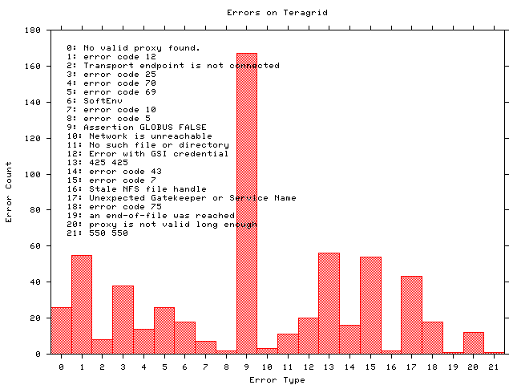
3) Inca in use: Monitoring Grid middleware reliability
Notes:
Histogram shows what types of errors are occuring the most often - error messages are truncated
The highest number of occurrrences in 9 which is the result of a documented Globus 2.0 bug when the GRAM server is under high load
A full report of errors on TG found by the grasp gather probe. This is a new capability in Inca 2.0 -- Inca 1 was unable to archive error messages.

Slide 35
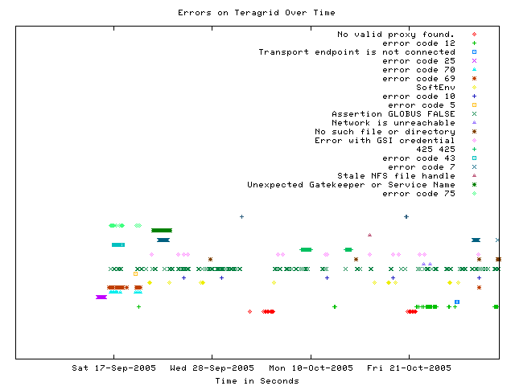
3) Inca in use: Error tracking over time
Notes:
This graph shows when a certain type of error occurs over time
Most errors only occur for a few days before being fixed - for example, the dark green * “Unexpected Gatekeeper of service name” is a configuration error
Dark green xxx’s represent the Globus 2.0 bug over time - a transient error occurs continuously

Slide 36
Outline
Inca in use
Architecture overview
Software Status

Slide 37
Architecture overview
5. GUIs can display collected data by querying Depot
Reporter
Repository
Incat
Create a “suite”
Data Consumers
Suite
R
Reporter
Agent
Submit suite to Reporter Agent
Depot
Depot
3. Reporter Agent invokes Reporter Managers and distributes suite and reporters
S
S
S
R
R
R
4. Reporter Managers send data to Depot
Reporter
Manager
Reporter
Manager
Reporter
Manager
…
Resource N
Resource 1
Resource 2
Notes:
The Admin Tool is a user interface (java GUI) used by the Inca admin to administer all parts of an Inca deployment; it connects to the Reporter Agent
The Reporter Agent is a server which is the access point to an Inca deployment and is responsible for managing the control flow of an Inca installation
The Reporter Repository is responsible for storing Reporters (scripts that gather data from resources); reporters are packaged as RPMs; can be shared among multiple Inca deployments
The Reporter Manager is responsible for managing the schedule and execution of Reporters on a single resource; receives instructions from one and only one reporter agent.
The Depot is a server that is responsible for storing the data produced by reporters.
The Suite describes where to run the reporters, frequency of execution, and optionally expected values (I.e., instructions for how to collect data)

Slide 38
Architecture overview:
Scalable design
VO B
Incat
Reporter
Repository
VO A
Incat
Reporter
Repository
Forward suite
Reporter
Agent
Reporter
Agent
Depot
Depot
Forward results
Reporter
Manager
Reporter
Manager
Reporter
Manager
Reporter
Manager
Reporter
Manager
Resource 4
Resource 5
Resource 1
Resource 2
Resource 3
Notes:
Inca designed to be scalable in wrt to data collection and storage (e.g., depots can be arranged hierarchically)
For example, suppose VO B has access to resources on VOA. Rather than VO B running duplicate reporters on VO A resources, VO B can request data from VO A (securely) and then VO A will send the results to VO B.

Slide 39
Outline
Inca in use
Architecture overview
Software Status

Slide 40
New features of v2
Full report archiving
Flexible querying interface
Improved installation and configuration control
  GUI tool for centralized administration
  Proxy management via MyProxy
  Reporter sharing via repositories
  Binary distribution
Profile reporter system usage
Inca components communicate using SSL

Slide 41
Software Status
2.0 Pre-release
  Available as of February 6, 2006
  More integration/stability testing
  Not recommended for production deployments
  Binary distribution
2.0 Production release in 1-3 months
  Source and binary distributions
http://inca.sdsc.edu/prerelease.html

