Slide 1
SDSC: Providing Critical TG Components Systems
Systems
  Author and maintainer of the Validation and Verification environment – Inca
    Inca 2 installed across the TG
  April 1, 06 TG production
    DataStar – IBM Power4
    BlueGene Data – IBM BlueGene/L
  November 15, 06 TG production
    BlueGene Data – two additional racks

Slide 2
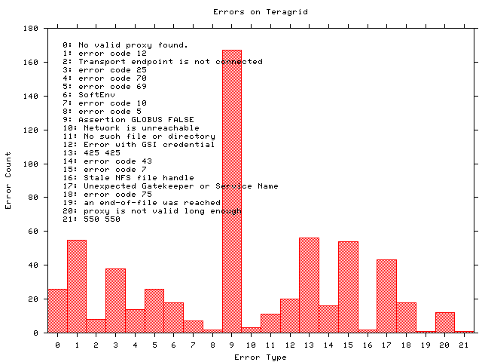
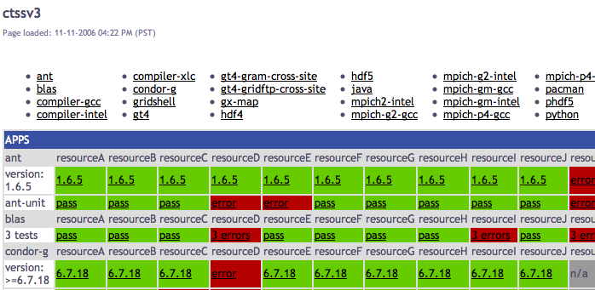
Monitoring a Consistent User Environment
TeraGrid Validation & Verification
Inca provides user-level Grid monitoring with periodic, automated testing of software and services.
Inca on TeraGrid:
deployed to 20 resources as of February 2007
ctssv3 monitoring
security tests
grid usage reporting
Other Grids using Inca:
CINECA, DEISA, GEON, UK Grids, NGS, White Rose Grid, APAC, Austrian Grid

