Slide 1
State of Health Monitoring using Inca
Shava Smallen

Slide 2

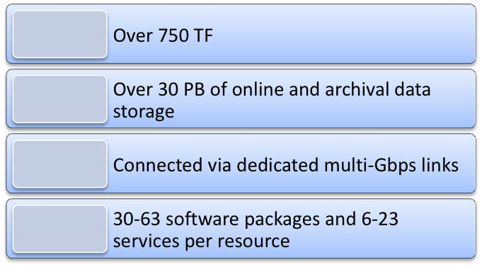
Reliability via state of health monitoring
Handles large-scale, distributed, heterogeneous systems
Automates periodic execution of tests
Notifies of failures in a timely manner
Serves a broad range of users
Easy to manage

Slide 3
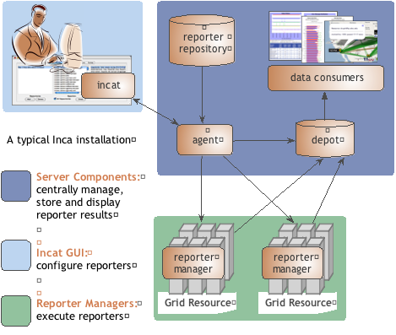
Inca provides state of health monitoring
Stores and archives a wide variety of monitoring results
Captures context of monitoring result as it is collected
Eases the writing, deploying, and sharing of new tests or benchmarks
Flexible and comprehensive web status pages
Secure

Slide 4
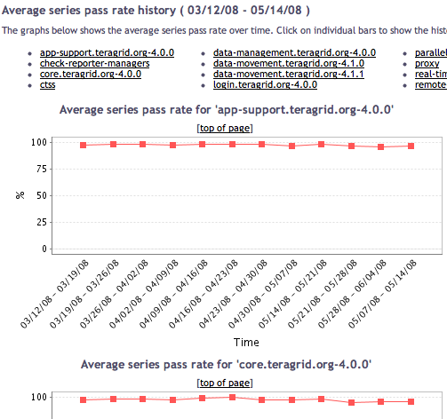
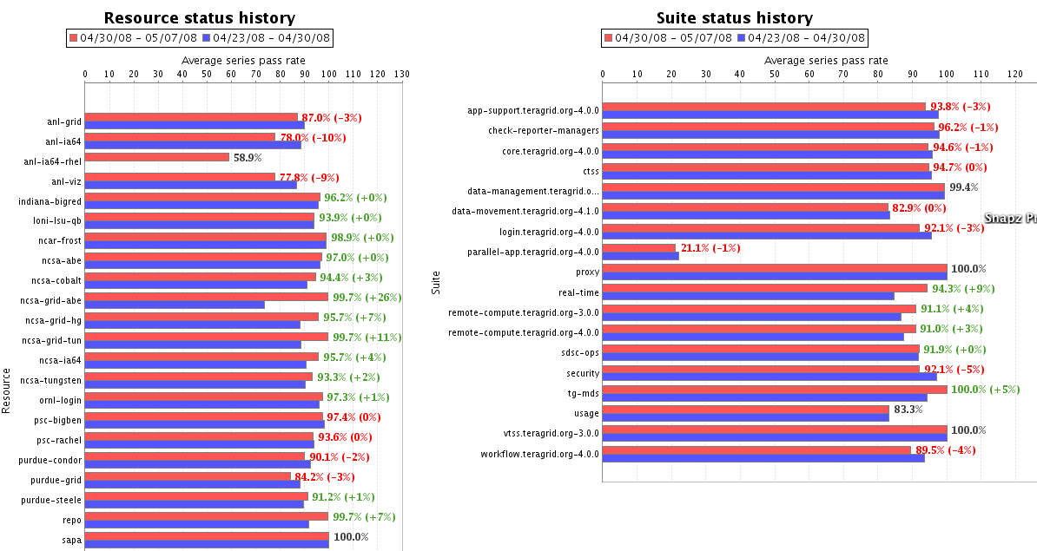
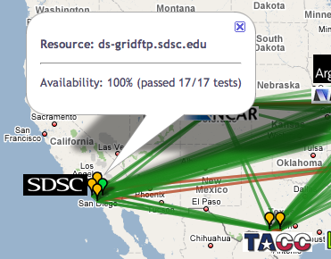
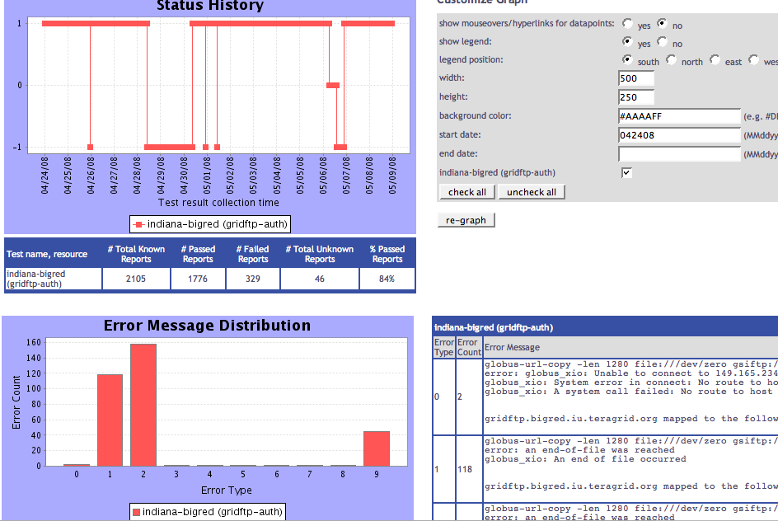
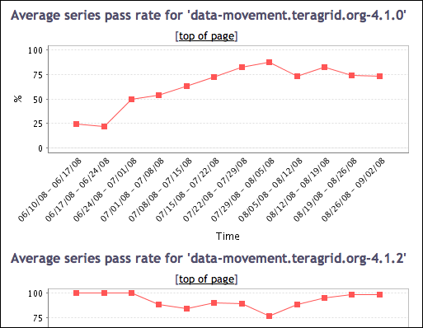
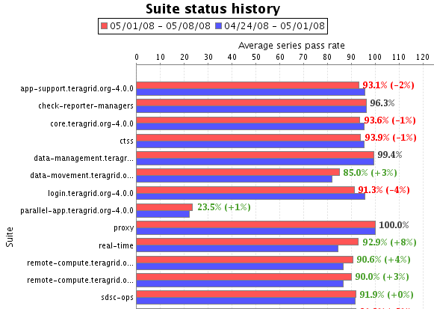
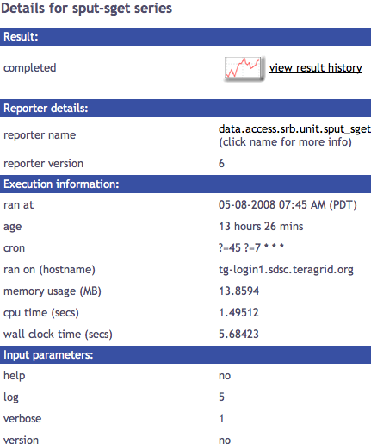
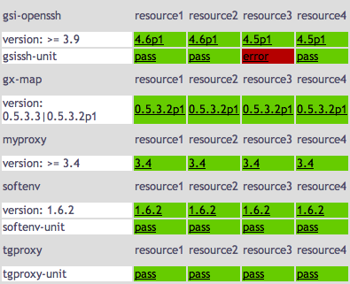
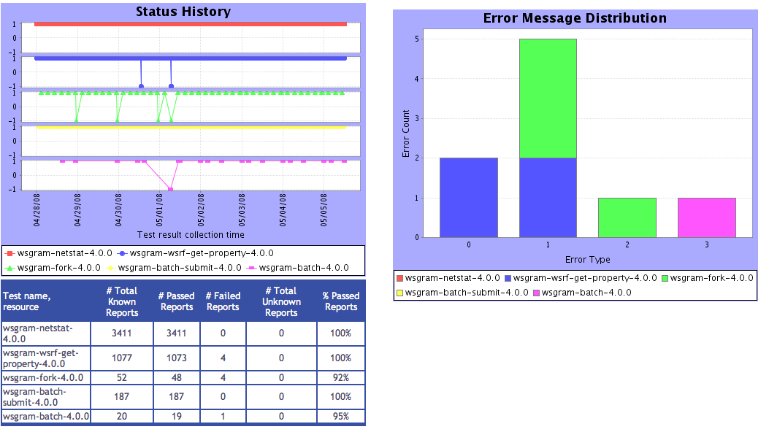
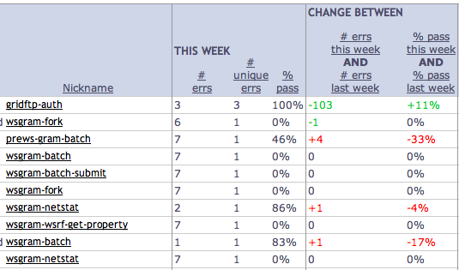
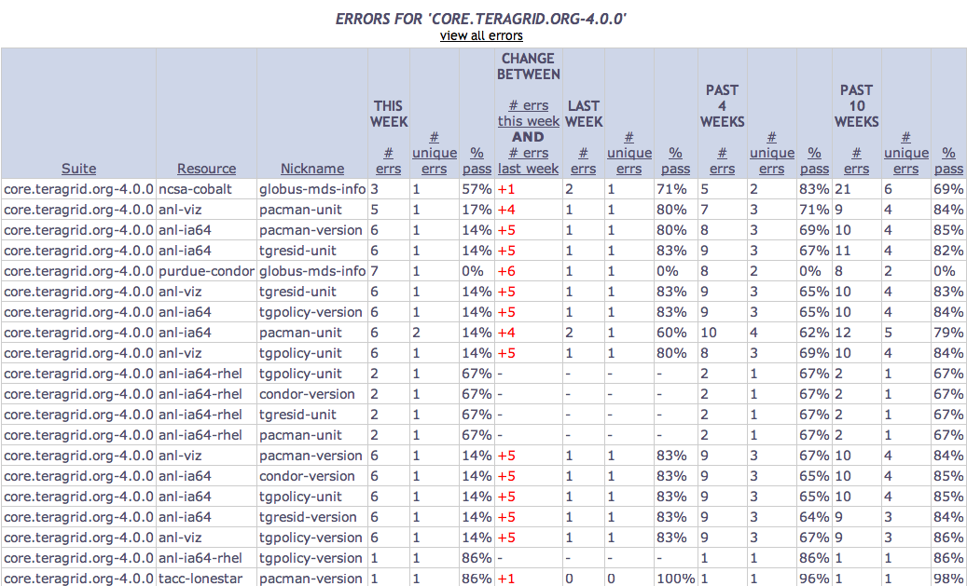
Tests
Summary
Weekly status report
Cumulative test status by resource
Resource status history
Inca’s status pages provide multiple levels of details
Error history summary
Test status by package and resource
Related test histories
Individual test result details
Test
Details
Individual test history
Historical
Current status

Slide 5
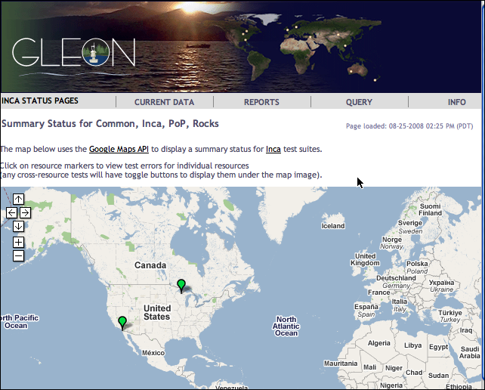

Inca GLEON deployment
Sensors in lake: dissolved oxygen level, temperature, velocity (some), etc.
Monitoring Data Turbine deployment since Oct 2007
Total of 26 tests running on data server at SDSC and windows box in Northern Temperate Lakes in Wisconsin
http://inca-gleon.sdsc.edu

Slide 6
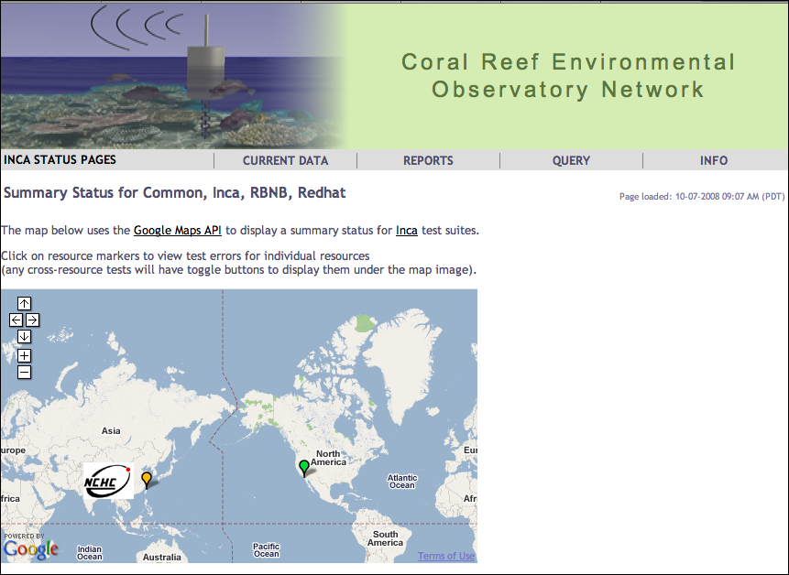
Inca CREON deployment
Coral reef observatory
Setup in January 2008
Total of 22 tests running on a machine at SDSC and a machine at NCHC in Taiwan.
http://inca-creon.sdsc.edu

Slide 7
Monitoring Open Source Data Turbine
Currently:
How to participate:
Reports installed version of Open Source DataTurbine
Performs a “ping” of the service (liveliness)
Tests connectivity to machines via SSH
Collects information about the base system (OS version, Java version, Gcc version, etc)
Install Cygwin [Windows] and include ssh server, perl, make, gcc, openssl & openssl-dev modules
Start SSH server
Add SSH key to authorized_keys file
Feedback wanted. What failures do you see the most often?

Slide 8







Inca software status and deployments
Current software version: 2.4
(available from Inca website)
http://inca.sdsc.edu

