Slide 1
Inca User-level Grid Monitoring
Shava Smallen
ssmallen@sdsc.edu
NBCR Summer Institute
August 7, 2009
Notes:
You’ve heard about Grid, Clouds, Web services, Science Gateways, etc – what’s the problem – cutting / bleeding edge software lends to failures – amplified as the number of components you add increases
TeraGrid
Sites have their own monitoring, need grid-level monitoring …
What is Inca –
Use cases – TG, GEON

Slide 2



Distributed System: “You know you have one when the crash of a computer you've never heard of stops you from, getting any work done.”
-Leslie Lamport

Slide 3

Goal: reliable grid software and services for users
Over 750 TF
Over 30 PB of online and archival data storage
Connected via dedicated multi-Gbps links
30-63 software packages and 6-23 services per resource
11 TeraGrid sites, 21 resources
Notes:
So, the problem we are addressing with Inca is the issue of reliability in Grids. Grids today are composed of hundreds to thousands services which adds more capabilities but also adds more complexity which leads to an increased probabillity that something will fail. We were originally developed within the TeraGrid is a project funded by NSF and is a collaboration of several supercomputer centers across the US. One of its TeraGrid’s activities in order to support and encourage the execution of Grid applications is to provide a coordinated software environment known as CTSS. CTSS contains packages such as Globus, Storage Resource Broker, MyProxy, and GSI-SSH and environment setup using a tool called SoftEnv. The goal of this was so developers and users could focus their effort of porting their Grid applications to machine architecture differences rather than the middleware. When CTSS was first deployed, there were many inconsistencies between sites due to misunderstandings of the specifications or misconfigurations of the software itself. These inconsistencies along with software failures in general is something we wanted to monitor in order to provide a stable environment to users.

Slide 4

Who benefits from grid monitoring?
Grid managers
Verify requirements are fulfilled by resource providers
Identify failure trends
System administrators
Email notification
Debugging support
End users
Higher availability
Debug user account/environment issues
System
administrators

Slide 5






Related Grid monitoring tools
Inca’s primary objective: user-level Grid monitoring
Notes:
There weren’t any Grid monitoring systems when we started Inca but today here is a sampling of the most common onethat have either been developed or adapted to do Grid monitoring. One key difference is Inca’s ability to collect a wide variety of monitoring data from functionality to performance data. But the main difference between Inca and these other tools is our the method of monitoring. A lot of these tools focus on aggregating each site’s system-level monitoring data such such as queue information while we focus on emulating a user’s experience.

Slide 6



User-level grid monitoring
Runs from a standard user account
Executes using a standard GSI credential
Uses tests that are developed and configured based on user documentation
Automates periodic execution of tests
Verifies user-accessible Grid access points
Centrally manages monitoring configuration
Easily updates and maintains monitoring deployment
Notes:
The approach we’ve developed over the years to address this is an active monitoring approach that we call user-level monitoring and the idea is that to attempt to emulate a user of the Grid and test the various services and software. The goal being to detect Grid infrastructure problems before the user’s notice them. In order to provide user-level monitoring a system would need to…
First testing should be done from a standard user account that’s no different than what a new user of a Grid receives. Early on, we found that testing was done from sys admin accounts which oftentimes have special privileges and have custom shell initialization file. So when users logged on to the system, things would not work for them due to permission problems, environment variables, etc.
Second, because many Grid services require a valid GSI credential, testing needed be run with a standard GSI credential that was mapped on resources to our standard user account
Third we really try to develop the tests that are meaningful and as such are based on the commands written in the user documentation because that is what user’s will using. Likewise, all our tests are configured using data from the user documentation. In practice, this is sometimes difficult to achieve because management asks you to test before user documentation is available. But these should be closely coordinated activities. This provides some checks and balances for cases when sysadmins change something but forget to notify user documentation. This helps to ensure that user documentation is correct. And so what we have now in TeraGrid isthat information gets published to an information service and both Inca and user documentation pull data from that same source. It’s does yet contain everything but we are working towards that
Next, as you know, it is important to execute tests periodically because the Grid is so dynamic. And as such, archiving those results will help us understand the Grid behavior over time.
In TeraGrid, a user can log in from any of the sites so has been important for us to run locally on each resource and verify that CTSS is available, there and working, etc.
Fourth, is that rather than allowing each sites to configure tests for their resources, the configuration of tests is done centrally and the goal of that is to ensure that resources are being tested consistently across TeraGrid. So, for example sometimes if a site has installed an incompatible version of software, this type of monitoring will detect that. And this is the same model as a user executing a Grid application…they will have a configuration file for their application.
Fifth, due to the dynamic nature of the Grid, it is important for a system to be able to adapt to changes when new versions of software are installed and updated. Another difficulty we’ve encountered is writing tests perfectly the first time around. And the reason for that is the same as writing a Grid application, you have to worry about bugs, porting issues and ensuring that the test is testing the right thing…sometimes we discover bugs in the user documentation

Slide 7
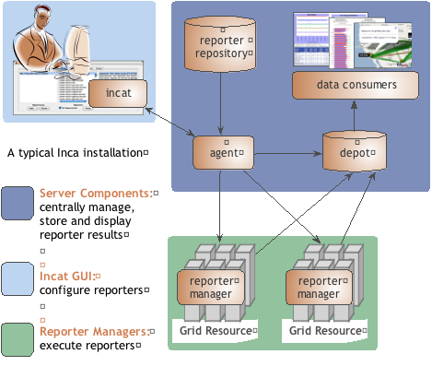
Inca provides user-level grid monitoring
Stores and archives a wide variety of monitoring results
Captures context of monitoring result as it is collected
Eases the writing, deploying, and sharing of new tests or benchmarks
Flexible and comprehensive web status pages
Secure
Notes:
We designed Inca to implement this user-level Grid monitoring and In addition to the features presented in the previous slide, Inca…
Collects more than pass/fail data such as error messages, version information, and performance information.
Inca also captures the context of a monitoring result as it executes such as the script name, version, arguments, etc so that when Inca reports an error, there is enough information for a system admin to understand how the result was collected for so they can either debug the problem or inform us that the test is testing the wrong thing. It also reports the system usage so that the impact of the testing can be understood so that you can reduce the frequency of a test if it’s taking too much resources. Mention in future work automatically tune frequency based on impact and past history
Inca also provides mechanisms to make it easy to write a new test or benchmark and propagate it out the monitored resources. More later.
Finally, because we are testing Grid services, a valid GSI credential is needed to authenticate to services. Inca provides facilities to securely download a short-term proxy for a particular test or benchmark and then cleans it off the system so as to a proxy is only on the machine for the time that it’s needed. Finally, all components communicate using SSL.
The figure here shows the architecture of a typical Inca deployment. The components inside the gray box indicate the core components of Inca. So, the way it works is that an administrator for Inca would have a set of monitoring data they want to collect from resources. The admin would use a GUI client called Incat to generate a configuration (stored in XML) for that monitoring data that contains the names of the tests they want to run, their parameters, execution frequency, and resources. That configuration is then sent to the agent component which downloads the tests from a repository and stages and launches a client called the reporter manager on each monitored resource. As each RM runs a test at its scheduled time, the data is stored in a component called the depot where it can be queried and displayed by a data consumer in a web page for example.
Talk a bit more about each component using from the bottom-up.

Slide 8

Reporters collect monitoring data
Executable programs that measure some aspect of the system or installed software
Supports a set of command-line options and writes XML to stdout
Schema supports multiple types of data
Extensive library support for perl and python scripts (most reporters < 30 lines of code)
Independent of other Inca components

Slide 9
A simple reporter
<?xml version='1.0'?>
<rep:report xmlns:rep='http://inca.sdsc.edu/dataModel/report_2.1'>
<gmt>2009-08-06T21:33:52Z</gmt>
<hostname>Shavas-Mac-2.local</hostname>
<name>posix</name>
<version>0</version>
<workingDir>/Users/ssmallen/inca-trunk/devel/reporters</workingDir>
<reporterPath>posix</reporterPath>
<args>
<arg>
<name>help</name>
<value>no</value>
</arg><arg>
<name>log</name>
<value>0</value>
</arg><arg>
<name>verbose</name>
<value>1</value>
</arg><arg>
<name>version</name>
<value>no</value>
</arg></args>
<body>
<unitTest>
<ID>posixps</ID>
</unitTest>
</body>
<exitStatus>
<completed>true</completed>
</exitStatus>
</rep:report>
use Inca::Reporter::SimpleUnit;
my $reporter = new Inca::Reporter::SimpleUnit
(unit_name => 'posixps');
$reporter->processArgv(@ARGV);
my $output = $reporter->loggedCommand ('ps -Af');
if($? == 0) {
$reporter->unitSuccess();
} else {
$reporter->unitFailure(output);
}
$reporter->print();
header
body
outputs
footer

Slide 10
Libraries Support Common Reporter Tasks
Documentation
http://inca.sdsc.edu/releases/latest/repdocs/perl.html
http://inca.sdsc.edu/releases/latest/repdocs/python.html
Reporter Purpose | Perl Library | Python Library
General report | Inca::Reporter | inca.Reporter
Software version testing | Inca::Reporter::Version | inca.VersionReporter
Software unit testing | Inca::Reporter::SimpleUnit | inca.SimpleUnitReporter
Globus unit testing | Inca::Reporter::GlobusUnit | inca.GlobusUnitReporter
System performance testing | Inca::Reporter::Performance | inca.PerformanceReporter

Slide 11
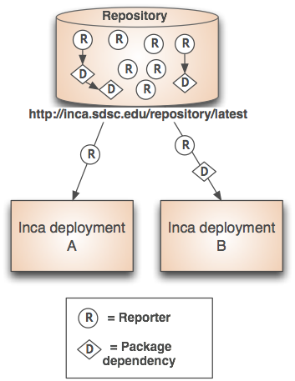
Repositories support sharing
Collection of reporters available via a URL
Supports package dependencies
Packages versioned to allow for automatic updates
Inca project repository contains 150+ reporters
Version, unit test, performance benchmark reporters
Grid middleware and tools, compilers, math libraries, data tools, and viz tool

Slide 12
Reporter Manager executes reporters
Minimal functionality to limit load on resource
Receives from reporter agent that started it:
Reporters and libraries
Reporter configuration and schedules
Executes reporters periodically (cron) or now and forwards reports to the depot
Profiles reporter system usage and enforces timeouts
Reporter
Manager
Grid Resource

Slide 13
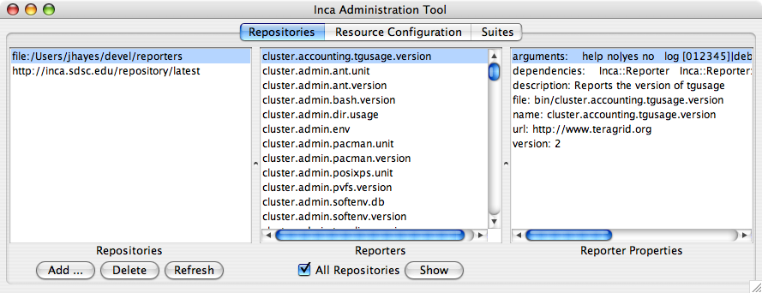
Agent provides centralized configuration and management
Implements the configuration specified by Inca administrator
Stages and launches a reporter manager on each resource
Sends package and configuration updates
Manages proxy information
Administration via GUI interface (incat)
Screenshot of Inca GUI tool, incat, showing the reporters that are available from a local repository

Slide 14
Agent supports multiple resource access methods
Reporter manager
Uses Java Runtime exec
Agent
Local
Local
Grid Resource
Remote
Ssh
Globus
Reporter manager
Reporter manager
…
Uses Java CoG - (supports Globus pre-WS servers)
Uses SSHTool’s Java SSH API
Grid Resource
Grid Resource
Installs in $HOME/incaReporterManager by default

Slide 15
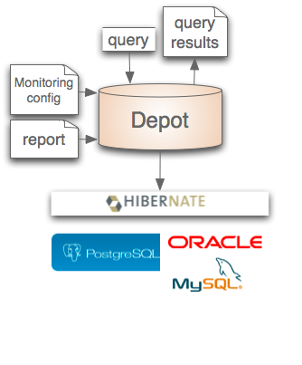

Depot stores and publishes data
Stores configuration information and monitoring results
Provides full archiving of reports
Uses relational database backend via Hibernate
Supports HQL and predefined queries
Supports plug-in customization (e.g., email notifications, downtimes)
Web services - Query data from depot and return as XML

Slide 16
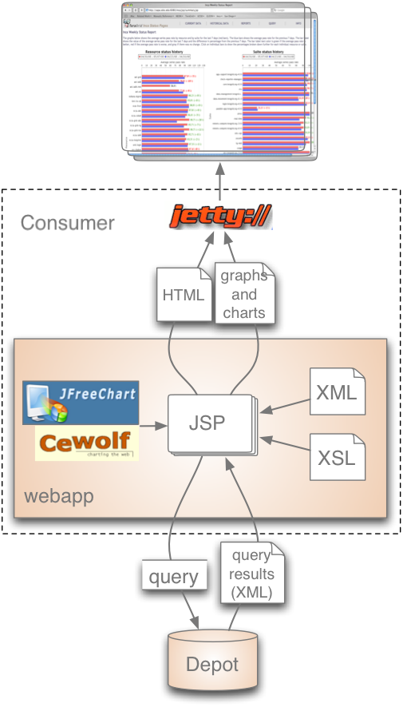
Consumer displays data
Current and historical views
Web application packaged with Jetty
JSP 2.0 pages/tags to query data and format using XSLT
CeWolf/JFreeChart to graph data

Slide 17
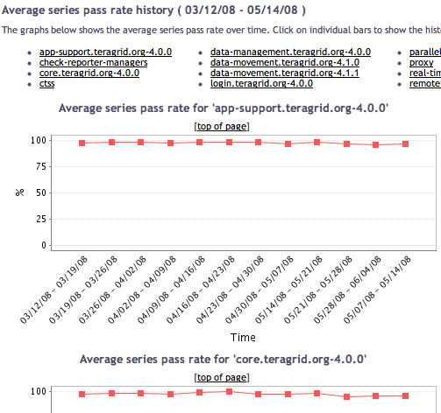
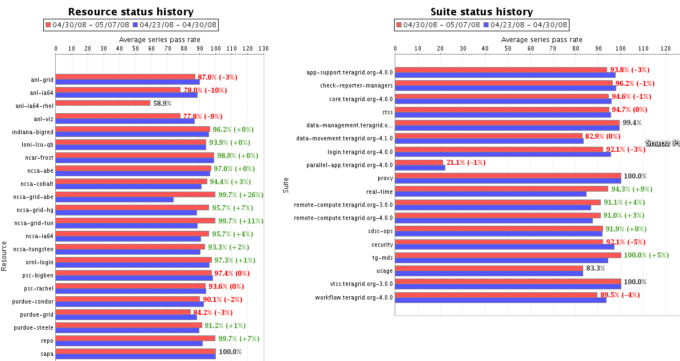
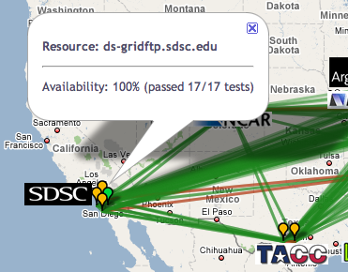
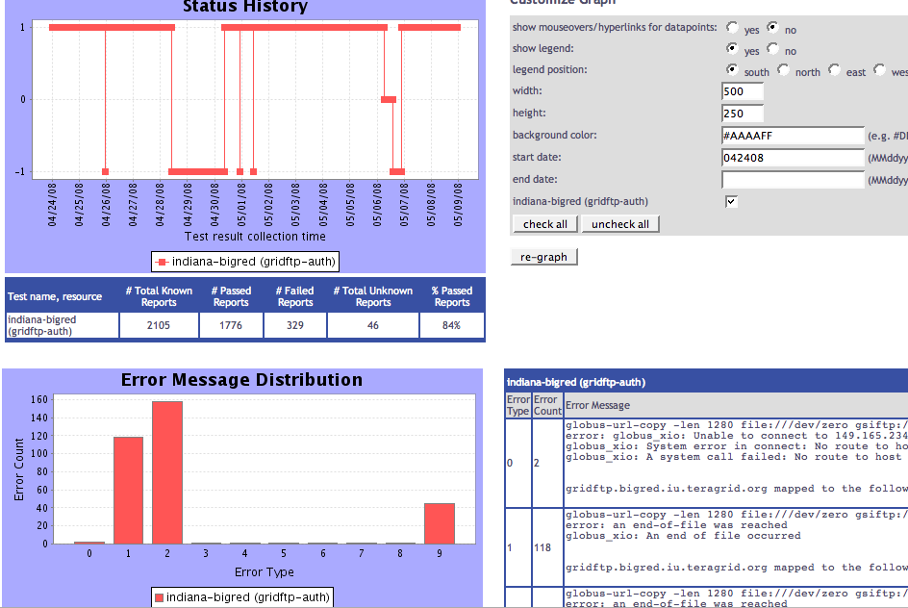
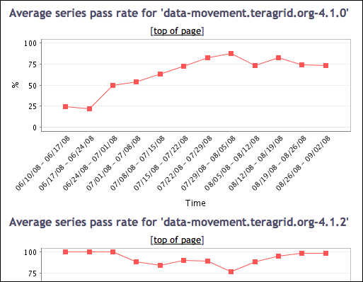
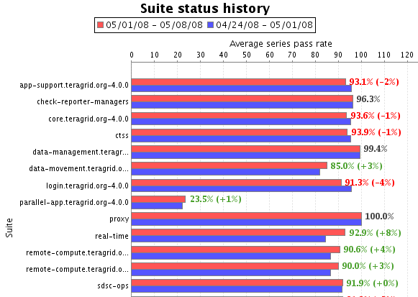
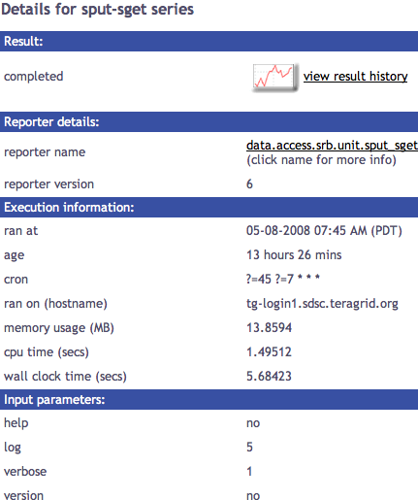
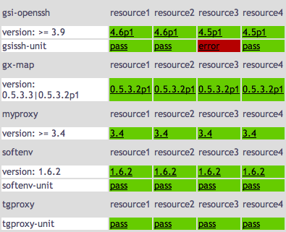
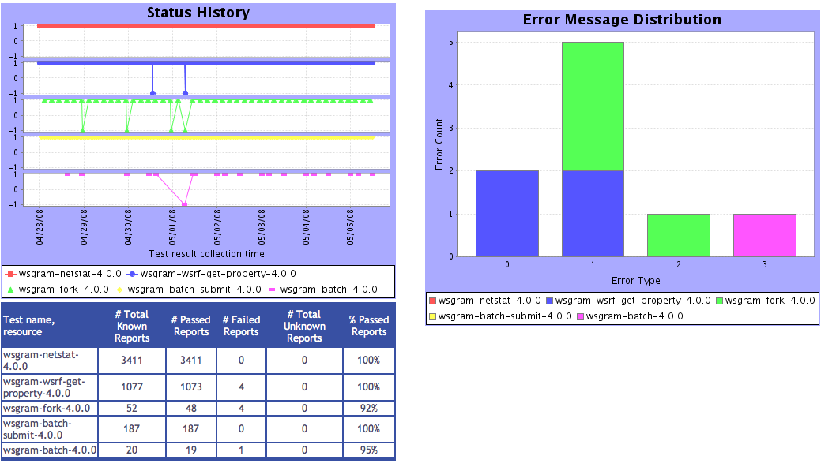
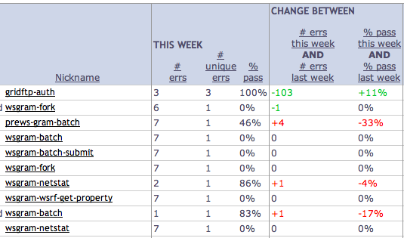
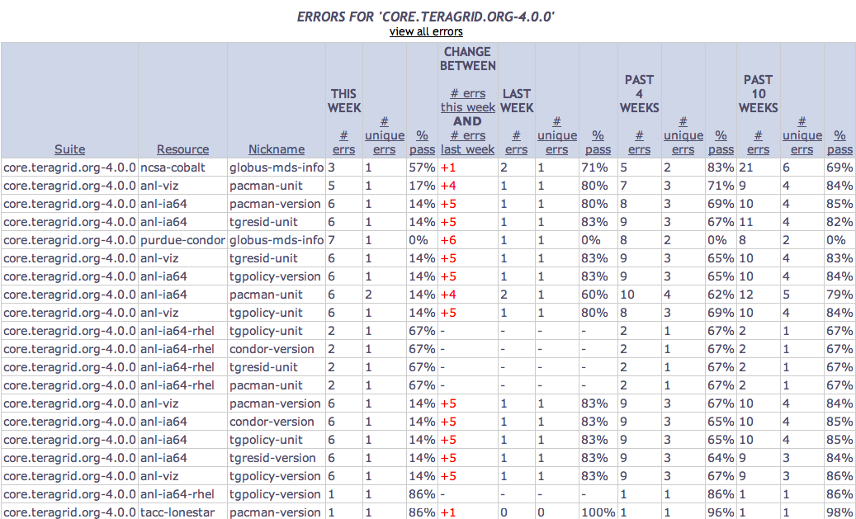
Tests
Summary
Weekly status report
Cumulative test status by resource
Resource status history
Inca’s status pages provide multiple levels of details
Error history summary
Test status by package and resource
Related test histories
Individual test result details
Test
Details
Individual test history
Historical
Current status

Slide 18







Software status and deployments
Current software version: 2.4
(available from Inca website)
http://inca.sdsc.edu

Slide 19
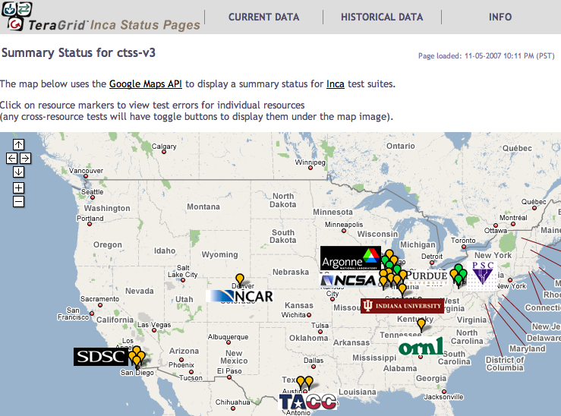
Inca TeraGrid deployment
Running since 2003
Total of ~2400 tests running on 20 login nodes, 3 grid nodes, and 3 servers
Coordinated software and services
Cross-site tests
GRAM usage
CA certificate and CRL checking
Resource registration in information services
Screenshot of Inca status pages for TeraGrid
http://inca.teragrid.org/

Slide 20
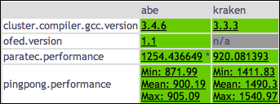
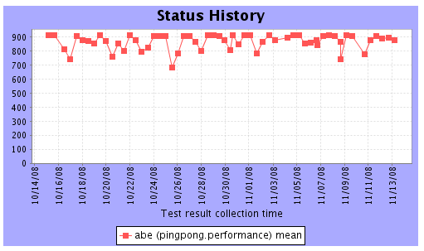

Measuring Performance Variation on the TeraGrid
Stage 1: MPI ping pong
Collecting results since Oct 1
Runs every 12 hours on 16 processors, <10 minutes
Running on NCSA’s Abe, NICS’ kraken
Stage 2: PARATEC
Collecting results since November 1
Runs every 12 hours on 256 processors, <30 min
Running on NCSA’s Abe, NICS’ kraken
Latest PingPong and PARATEC results
Mean MPI ping pong bandwidth history
Notes:
PingPong reports min, max, mean ??
Paratec reports wall time, %comm, MPI call statistics
Grayed out machines we got results from initially but then removed
Mostly focused on functionality of TeraGrid. But Inca is capable of collecting a wide variety of data and most recently we have been collaborating with the Pmac group at SDSC to execute instrumented application to TG resources thru Inca. These apps are instrumented with IPM, which provides performance data that Inca report. Before, we just have simple tests of the batch system to ensure jobs can be submitted. But this actually allows us to collect more details user-level data by leveraging the information that IPM reports

Slide 21

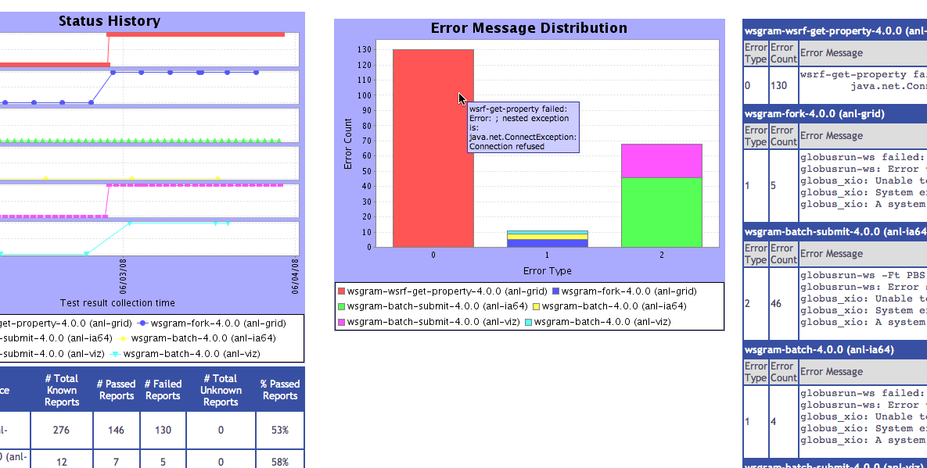
Inca monitoring benefits end users
“Inca reported errors mirror failures we’ve observed and as they are addressed we’ve noticed an improvement in TeraGrid’s stability.”
-- Suresh Marru (LEAD developer)
Tests resources and services used by LEAD. E.g.
Pings service every 3 mins
Verifies batch job submission every hour
Automatically notifies admins of failures
Show week of history in custom status pages

Slide 22
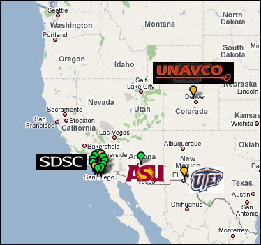
Inca GEON deployment
Running since Feb 2008
Total of 206 tests running on 5 login nodes and 6 servers
LiDAR workflow services
Web servers
Ssh connectivity
Base system information (Rocks, Gcc, Java, etc.)
Screenshot of Inca status map for GEON
http://inca-geon.sdsc.edu

Slide 23

Benefits of using Inca
Detect problems before the users notice them
Easy to write and share tests and benchmarks
Easy to deploy and maintain
Flexible and comprehensive displays

Slide 24

Inca Information
Announcements: inca-users@sdsc.edu
Email: inca@sdsc.edu
Website: http://inca.sdsc.edu
Supported by:

