Slide 1
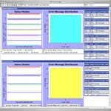
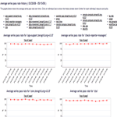
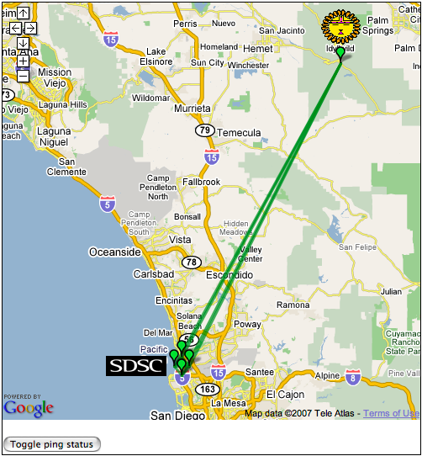
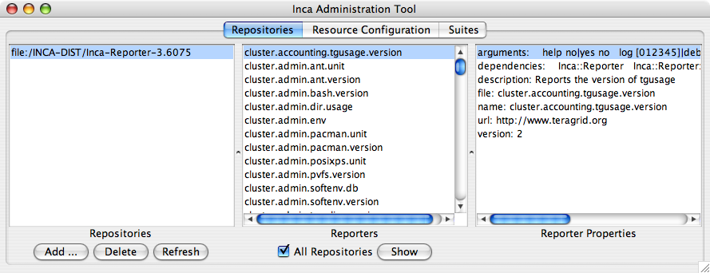

Inca architecture reference
Reporter
Repository
R
Data Consumers
Incat
C
Agent
S
Depot
A typical Inca installation
S
S
r
r
Server Components:
Centrally manage, store and display reporter results
Inca GUI:
Configure reporters
Reporter Managers:
Execute reporters
R
R
Reporter
Manager
Reporter
Manager
…
Grid Resource
Grid Resource
Agent
An Agent is a server that implements the configuration specified by the Inca administrator.
R
A Reporter is an executable program that tests or measures some aspect of the system or installed software.
Data
Consumers
A Data Consumer is a web container that serves requests to display data from the Depot.
C
A Config describes an Inca deployment on a set of resources.
Depot
A Depot is a server that is stores and archives data produced by reporters.
S
A Suite describes a set of reporters to execute on a resource.
Incat
Incat is a GUI used by the Inca administrator to control and configure the Inca deployment on a set of resources.
r
A Report is the XML output from an executed reporter.
Reporter
Manager
A Reporter Manager is responsible for managing the schedule and execution of reporters on a single resource
Reporter
Repository
A Reporter Repository contains a collection of reporters and is available via an URL.
Notes:
The Admin Tool is a user interface (java GUI) used by the Inca admin to administer all parts of an Inca deployment; it connects to the Reporter Agent
The Reporter Agent is a server which is the access point to an Inca deployment and is responsible for managing the control flow of an Inca installation
The Reporter Repository is responsible for storing Reporters (scripts that gather data from resources); reporters are packaged as RPMs; can be shared among multiple Inca deployments
The Reporter Manager is responsible for managing the schedule and execution of Reporters on a single resource; receives instructions from one and only one reporter agent.
The Depot is a server that is responsible for storing the data produced by reporters.
The Suite describes where to run the reporters, frequency of execution, and optionally expected values (I.e., instructions for how to collect data)

