Slide 1
Writing an Inca consumer
Shava Smallen
ssmallen@sdsc.edu
Inca Workshop
August 27, 2010

Slide 2
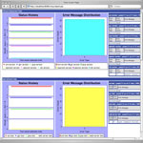
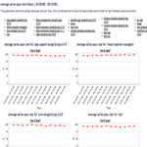
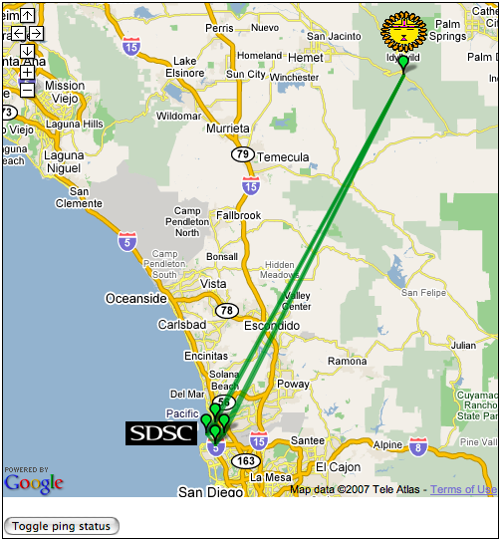
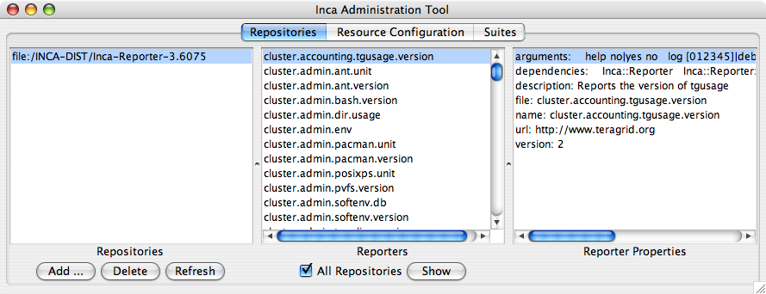
Reporter
Repository
Data Consumer
Incat
R
C
XML
C
Agent
Depot
Writing a data consumer
S
Extend the bundled data consumer to format data differently or provide new views (i.e., add new JSP or new XSL)
Use Inca Client APIs to query data from depot and agent and display data outside of bundled data consumer
S
r
R
r
S
R
Reporter
Manager
Reporter
Manager
…
Grid Resource
Grid Resource
Notes:
Unhighlight the other boxes – just keep C and XML

Slide 3
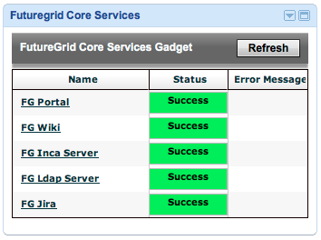
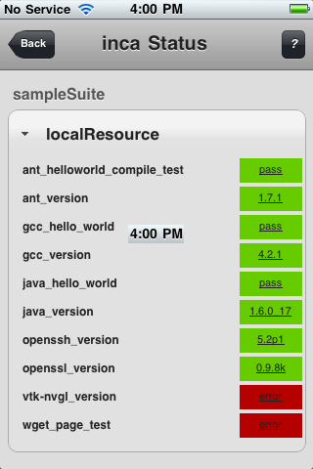
Custom Inca consumer examples
iPhone webapp
Google
gadget
Text History
% ./bin/getIncaHistory -a '2010-01-01' ranger.tacc.utexas.edu gram-gatekeeper-ping
18:12:29,157 INFO [main] IncaHistory:118 - Attempting to connect to http://sapa.sdsc.edu:8001
2010-01-01 00:00:08.0 true
2010-01-01 00:00:08.0 true
...

Slide 4
Inca provides support for custom data consumers
Inca Client APIs
  Provide access to report data from the depot and configuration information from the agent (REST, Web Services, Java, Perl)
Inca XML schemas
  Provide data for reporting all test details or summaries

Slide 5
Overview of Client Methods
Client
  connect()
  ping()
DepotClient
  insertReport(resource, report, sysusage, stderr, context)
  queryDatabase()
  queryGuids()
  queryHql(hql)
  queryInstance(nickname, resource, collected)
  queryLatest(expr)
  queryPeriod(begin, end, expr)
  queryStatusHistory(period, begin, end, select)
  updateSuite(xml)
AgentClient
  getCatalog()
  getConfig
  setConfig(xml)
Notes:
AgentClient and DepotClient used by Consumer, incaws
AgentClient used by incat

Slide 6
DepotClient queryHql
Takes an HQL (Hibernate’s SQL dialect) query as a parameter
Returns an array of XML, one element per object selected
Example:
  client.queryHql("select ii from Report r, InstanceInfo ii where ii.reportId= r.id
  and r.resource = 'repo'") =>
<instance>
<collected>2008-09-03 14:25:03.0</collected>
<commited>2008-09-03 14:25:04.108</commited>
<cpuUsageSec>1.462776</cpuUsageSec>
<memoryUsageMB>25.132812</memoryUsageMB>
<wallClockTimeSec>2.002927</wallClockTimeSec>
</instance>
…
Notes:
AgentClient and DepotClient used by Consumer, incaws
AgentClient used by incat

Slide 7
DepotClient queryGuids
Returns an array of suite identifiers
Example:
  client.queryGuids() =>
  incas:/sapa.sdsc.edu:6323/app-support.teragrid.org-4.0.3
  incas:/sapa.sdsc.edu:6323/app-support.teragrid.org-4.2.0
  incas:/sapa.sdsc.edu:6323/check-reporter-managers
  incas:/sapa.sdsc.edu:6323/core.teragrid.org-4.0.0
  incas:/sapa.sdsc.edu:6323/core.teragrid.org-4.0.2
  incas:/sapa.sdsc.edu:6323/core.teragrid.org-4.1.0
  incas:/sapa.sdsc.edu:6323/core.teragrid.org-4.2.0
  incas:/sapa.sdsc.edu:6323/core.teragrid.org-4.2.1
  incas:/sapa.sdsc.edu:6323/coscheduling.teragrid.org-1.0.0
  incas:/sapa.sdsc.edu:6323/data-management.teragrid.org-4.0.0
  incas:/sapa.sdsc.edu:6323/data-movement-clients.teragrid.org-4.2.0
  incas:/sapa.sdsc.edu:6323/data-movement-servers.teragrid.org-4.2.0
  ...
Notes:
AgentClient and DepotClient used by Consumer, incaws
AgentClient used by incat

Slide 8
DepotClient queryLatest
Takes a select WHERE clause as a parameter
Returns combined latest report instance info for each series
Example:
  client.queryLatest("suite.guid = 'incas://hogg.sdsc.edu:6323/sampleSuite'") =>
<reportSummary xmlns="http://inca.sdsc.edu/queryResult/reportSummary_2.0">
<hostname xmlns="">localResource</hostname>
<uri xmlns="">file:///users/u4/train31/IncaInstall/bin/../Inca-Reporter-5.10644/bin/grid.wget.unit</uri>
<nickname xmlns="">wget_page_test</nickname>
<seriesConfigId xmlns="">10</seriesConfigId>
<instanceId xmlns="">169</instanceId>
<gmt xmlns="">2008-09-03T14:40:01.000-07:00</gmt>
<gmtExpires xmlns="">2008-09-03T15:00:01.869-07:00</gmtExpires>
<body xmlns="">
<unitTest xmlns:rep="http://inca.sdsc.edu/dataModel/report_2.1">
<ID>wget</ID>
</unitTest>
</body>
<errorMessage xmlns=""></errorMessage>
</reportSummary>
…
Notes:
AgentClient and DepotClient used by Consumer, incaws
AgentClient used by incat

Slide 9
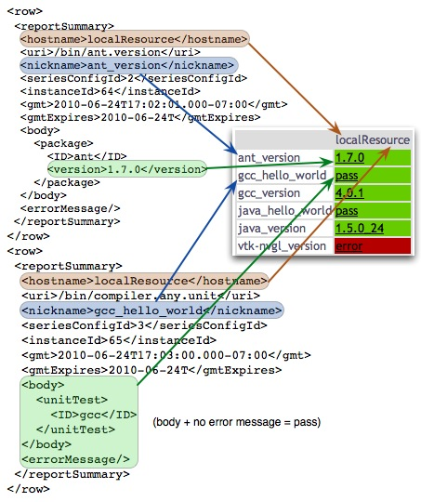
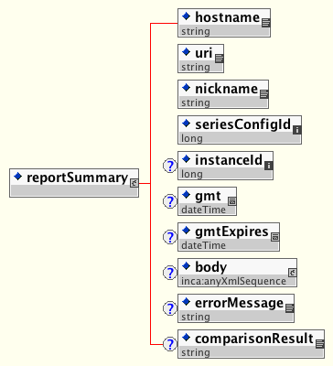
ReportSummary schema getLatest()
Functions

Slide 10
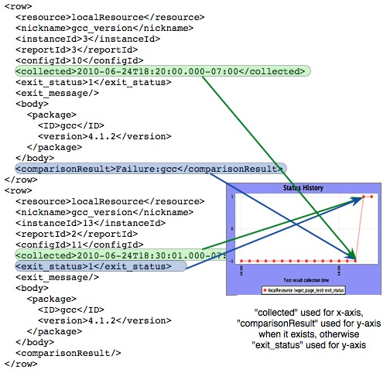
Sidebar: interpreting status
if ( exists comparisonResult ) {
if ( comparisonResult == 'Success' ) {
println "Pass"
} else {
println "Failed: " + comparisonResult;
if ( exists errorMessage ) {
println errorMessage;
}
}
} else {
if ( body != '' ) {
println "Pass";
} else {
println errorMessage;
}
}

Slide 11
DepotClient queryPeriod
Takes a time period (ms) and a select WHERE clause as a parameter
Returns combined report history instance summary info for each series
Example:
  client.queryPeriod(1282685125000, 1282771525000, "suite.guid = 'incas://hogg.sdsc.edu:6323/sampleSuite'") =>
<graphInstance>
<resource>localResource</resource>
  <nickname>java_hello_world</nickname> <instanceId>2</instanceId> <reportId>2</reportId>
  <configId>5</configId>
  <collected>2010-08-25T16:45:10.000-07:00</collected>
  <exit_status>1</exit_status>
  <exit_message/>
  <body>
  <unitTest xmlns:rep="http://inca.sdsc.edu/dataModel/report_2.1">
  <ID>javac</ID>
  </unitTest>
  </body>
  <comparisonResult>Success</comparisonResult>
</graphInstance>
…
Notes:
AgentClient and DepotClient used by Consumer, incaws
AgentClient used by incat

Slide 12
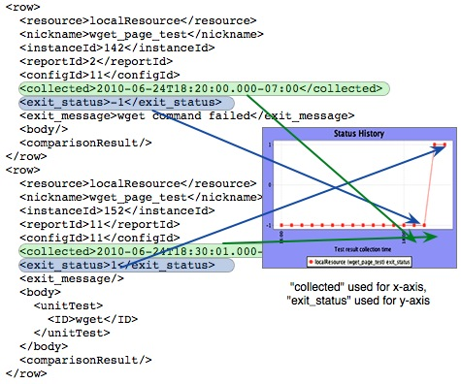
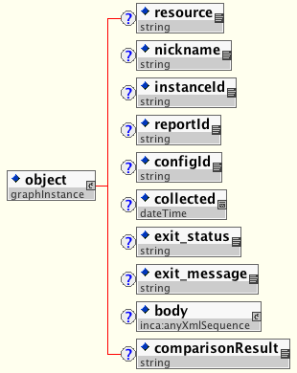
GraphInstance schema getPeriod

Slide 13
DepotClient queryStatusHistory
Takes a time period (ms), begin, end, and a select WHERE clause as parameters
Returns report history statistics for each series
Example:
  client.queryPeriod(“WEEK”, 1282685125000, 1282771525000, "suite.guid = 'incas://hogg.sdsc.edu:6323/sampleSuite'") =>
  <series>
  <guid>incas://gw41.quarry.iu.teragrid.org:6323/Cluster</guid>
  <nickname>test_batch_job</nickname>
  <resource>iu-xray</resource>
  <period>
  <begin>1280432084455</begin>
  <end>1281036884454</end>
  <success>42</success>
  </period>…
  <period>
  <begin>1282246484455</begin>
  <end>1282851284454</end>
  <success>162</success>
  <failure><message>BATCH: Unable to retrieve reporter output</message><count>2</count></failure>
  <failure><message>BATCH: Unable to submit reporter perl /mnt/lustre_server/u/inca/incaReporterManager/sub32351.pl: System call failure. qsub: cannot connect to server (null) (errno=15010) System error:
  </message><count>1</count></failure>
  </period>
  </series> …
Notes:
AgentClient and DepotClient used by Consumer, incaws
AgentClient used by incat

Slide 14
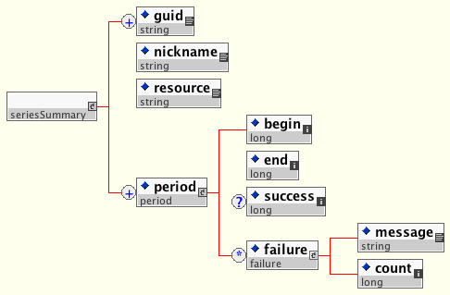
seriesSummary used to display historical stats queryStatusHistory()

Slide 15
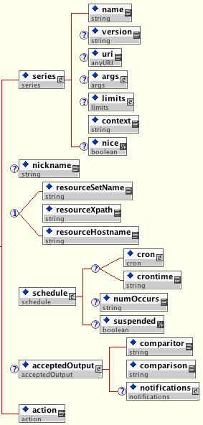
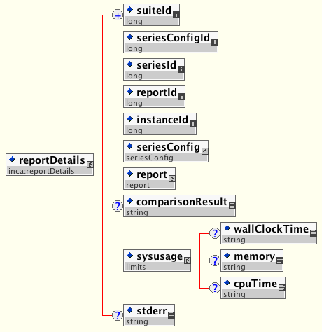
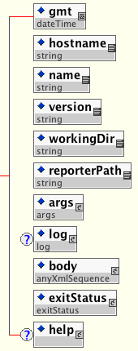
ReportDetails used to display all instance info getInstance()

Slide 16
AgentClient getConfig
Returns XML for Inca installation configuration
Example:
  client.getConfig() =>
<inca:inca xmlns:inca="http://inca.sdsc.edu/dataModel/inca_2.0">
<repositories><repository>file:/users/u4/train31/IncaInstall/bin/../Inca-Reporter-5.10644</repository></repositories>
<resourceConfig><resources><resource>
<name>defaultGrid</name>
<xpath>//resource[matches(name, "localSite")]</xpath>
<macros> … </macros>
</resource></resources></resourceConfig>
<suites><suite><seriesConfigs><seriesConfig>
<series>
<name>cluster.admin.ant.unit</name>
<args>
<arg><name>version</name><value>no</value></arg>
</args>
<context>@pre@@@@post@</context>
</series>
<nickname>ant_helloworld_compile_test</nickname>
<resourceSetName>defaultGrid</resourceSetName>
<schedule><crontime>1-59/10 * * * *</crontime></schedule>
<action>add</action>
</seriesConfig></seriesConfigs></suite></suites>
…
Notes:
AgentClient and DepotClient used by Consumer, incaws
AgentClient used by incat

Slide 17
AgentClient getCatalog
Returns Packages.gz contents for a given Reporter Repository
Example:
  client.getCatalog('http://inca.sdsc.edu/repository/latest') =>
version:2
name:viz.tools.imagemagick.version
url:http://www.imagemagick.org/
file:bin/viz.tools.imagemagick.version
description:Reports the version of the ImageMagick toolkit
arguments:
help no|yes no
log [012345]|debug|error|info|system|warn 0
verbose [012] 1
version no|yes no
dependencies:
Inca::Reporter
Inca::Reporter::Version
version:2
name:viz.tools.netpbm.version
url:http://netpbm.sourceforge.net/
file:bin/viz.tools.netpbm.version
…
Notes:
AgentClient and DepotClient used by Consumer, incaws
AgentClient used by incat

Slide 18
Overview of Inca Client APIs
REST URLs - Access to subset of DepotClient functions
Web Services API - Access to subset of DepotClient and AgentClient functions
Java API – Access to full set of DepotClient and AgentClient functions. Requires a valid credential.
Perl API - Access to full set of DepotClient and AgentClient functions. Requires a valid credential.

Slide 19
REST URLs
Subset of functionality provided by getLatest and getPeriod
http://hostname:8080/inca/XML/rest/
<suiteName>|<queryName>
[/<resourceId>
[/<seriesNickname>
[/week|month|quarter|year]]]
E.g.,
  http://hostname:8080/inca/XML/rest/sampleSuite
  http://hostname:8080/inca/XML/rest/sampleSuite/localResource/ant_version

Slide 20
Web Services API
use SOAP::Lite;
my $ws = SOAP::Lite->service
("file:/home/inca/2.6/etc/IncaWS.wsdl");
# check agent and depot are available
print $ws->pingAgent('hello agent'), "\n";
print $ws->pingDepot('hello depot'), "\n";
# get the Inca configuration
print $ws->getConfig(), "\n";
my $guid = $ws->queryGuids();
# get the latest instances of a suite
my $results = $ws->querySuite( $guid );
for my $result ( @{$results} ) { print $result;}
http://inca.sdsc.edu/releases/2.6/wsdocs/IncaWS_wsdl.html

Slide 21
Perl APIs
use Inca::AgentClient;
print "Please enter a password: ";
chomp( my $pass = <STDIN> );
my $agentclient = new Inca::AgentClient( host => 'localhost’, port => 6323,
auth => 1, cert => 'etc/clientcert.pem’, key => 'etc/clientkey.pem’, password => $pass, trusted => 'etc/trusted/51b63f6c.0’ );
if ( defined $agentclient->getError() ) {
die "Unable to connect:" . $agentclient->getError();
}
# check agent is available
print $agentclient->ping('hello agent'), "\n";
# get the Inca configuration
print $agentclient->getConfig(), "\n";
http://inca.sdsc.edu/releases/2.6/wsdocs/index.html

Slide 22
Java APIs
import edu.sdsc.inca.AgentClient;
public class AgentClientTest {
public static void main(String args[]) {
AgentClient agentClient = new AgentClient();
agentClient.setServer("rocks-101.sdsc.edu", 6323);
agentClient.setCertificatePath("clientcert.pem");
agentClient.setKeyPath("clientkey.pem");
agentClient.setTrustedPath("trusted");
// read password from stdin
agentClient.setPassword(password);
try {
agentClient.connect();
System.out.println(agentClient.commandPing("hello agent”));
System.out.println(agentClient.getConfig());
} catch ( Exception e ) {}
}
http://inca.sdsc.edu/releases/2.6/javawsdocs/overview-summary.html

Slide 23
Inca provides support for custom data consumers
Inca Client APIs
  REST URLs
  Web Services
  Java
  Perl
Inca XML schemas
  Report Summaries
  Graph Instances
  Series Summary
  Report Details

Slide 24
Agenda -- Day 2
9:00 - 9:30 | Inside the Inca Depot
9:30 – 10:10 | Data display (data consumers)
10:20 - 11:00 | Writing data consumers
11:00 - 12:00 | Hands-on: Data display (data consumers)

