Slide 1
Inca Monitoring
Shava Smallen
October 2, 2009

Slide 2
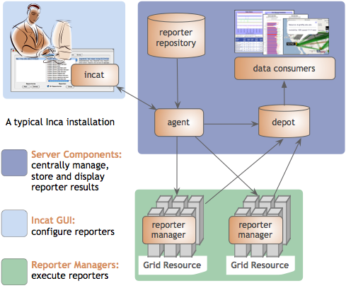
Inca provides user-level grid monitoring
Automates consistent user-level testing across resources
Easy to configure and maintain
Supports a large variety of “reporters”
Captures context of monitoring result as it is collected
Archived results support troubleshooting
Comprehensive views of data

Slide 3

Reporters collect monitoring data
Executable programs that measure some aspect of the system or installed software
Supports a set of command-line options and writes XML to stdout
Schema supports multiple types of data
Extensive library support for perl and python scripts (most reporters < 30 lines of code)
Inca project repository contains 150+ reporters

Slide 4
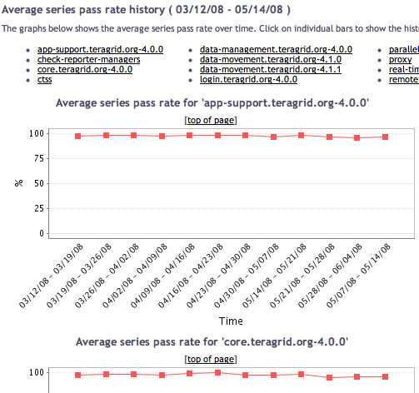
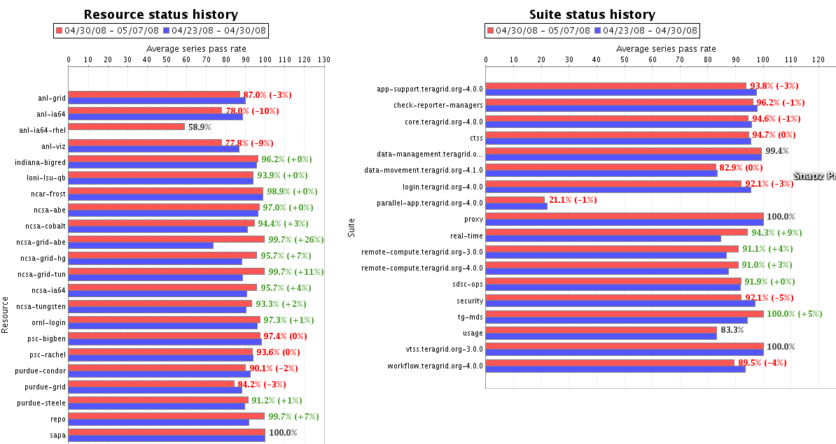
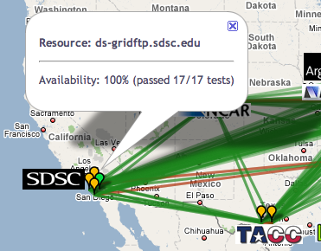
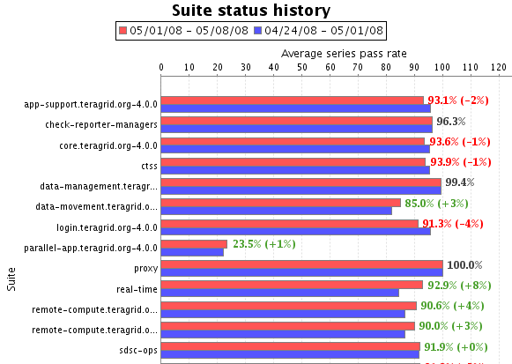
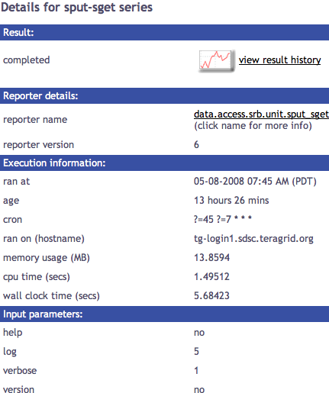
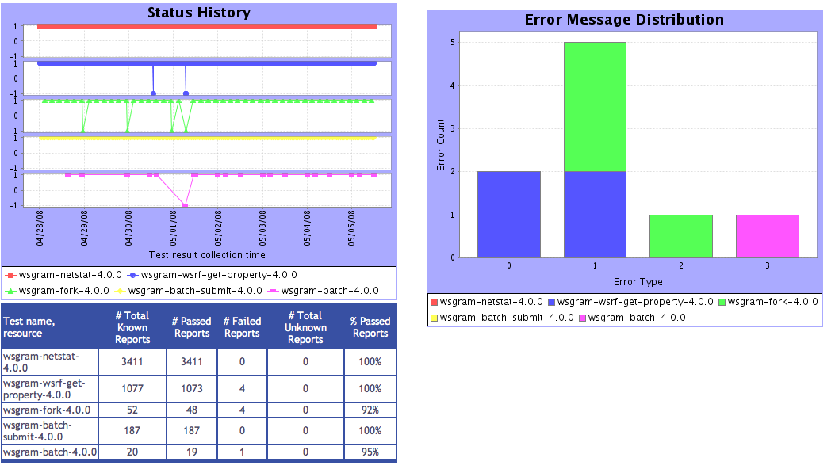
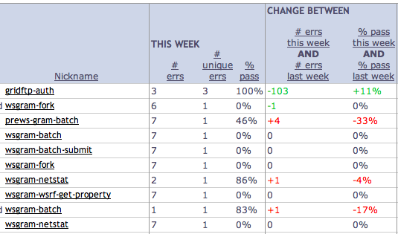
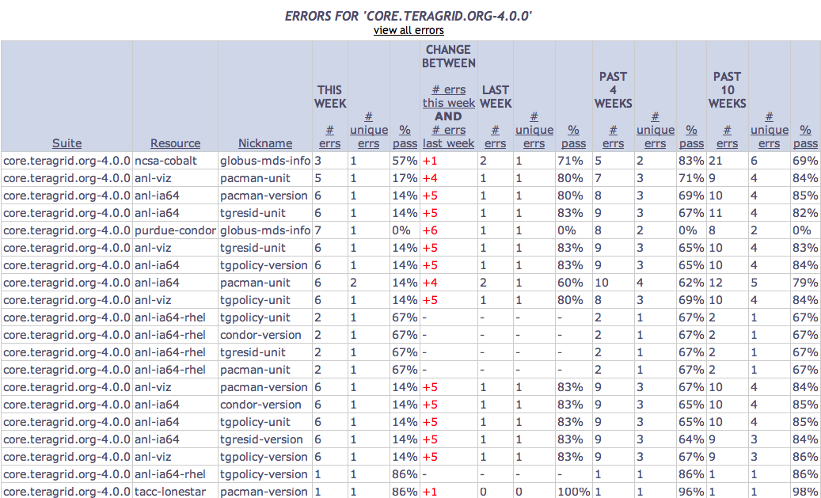
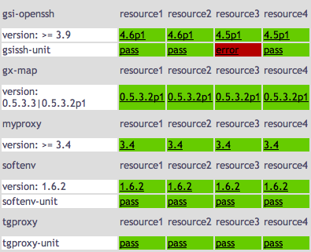
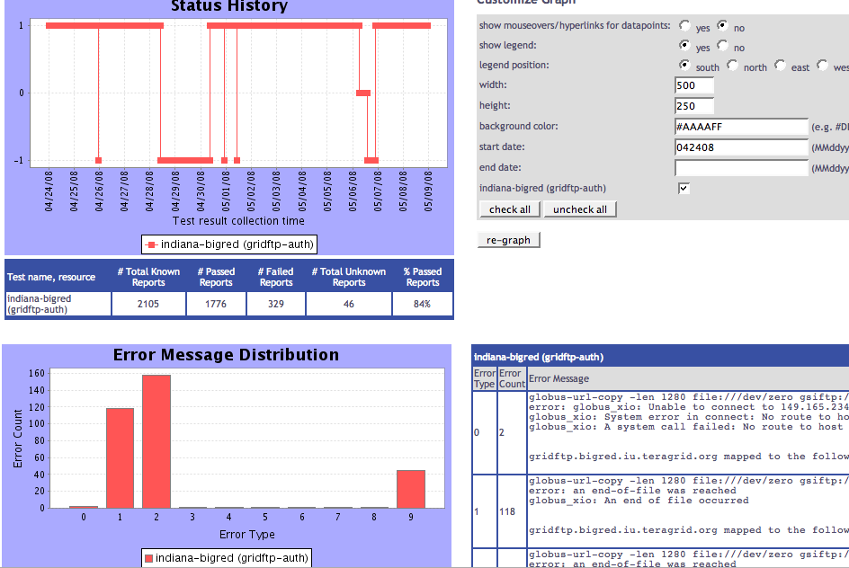
Tests
Summary
Weekly status report
Cumulative test status by resource
Resource status history
Inca’s status pages provide multiple levels of details
Error history summary
Test status by package and resource
Related test histories
Individual test result details
Test
Details
Individual test history
Historical
Current status

Slide 5
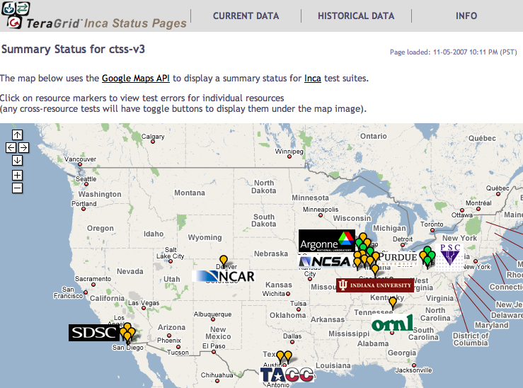

Inca TeraGrid deployment
Running since 2003
Verifies registered kit packages on resources
Total of ~2200 tests running on 18 login nodes, 2 grid nodes, and 3 servers
Testing frequency varies from 3–10 min, 1 hr, 4 hours, 12 hours, or 24 hours
Email notifications to help@teragrid.org for critical services
Reviewed during biweekly-ish operations calls
Custom views for LEAD and TG portal
Info.teragrid.org
XSL
CTSS kit
registrations
XML
http://inca.teragrid.org/
Notes:
24 kits (versions)

Slide 6
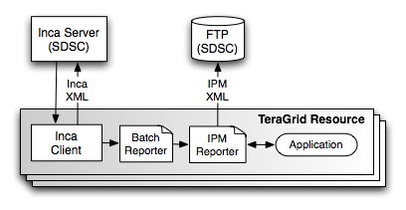
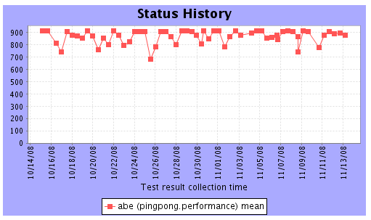
Using Inca and IPM to measure performance variation on TeraGrid
Joint work with Nick Wright (LBL) and PMaC group
Performance variation makes code optimization challenging
Benchmarks: Paratec, WRF, PingPong, and HPCC (naturally ordered ring and random ring)
Machines: NCSA Abe, NICS Kraken, and TACC Ranger
256 processors twice a day during March 2009
Variance due to network contention; higher for WRF
Mean MPI ping pong bandwidth history
Wright, N., Smallen, S., Olschanowsky, C., Hayes, J., Snavely, A. “Measuring and Understanding Variation in Benchmark Performance”, published in HPCMP UGC 2009

Slide 7
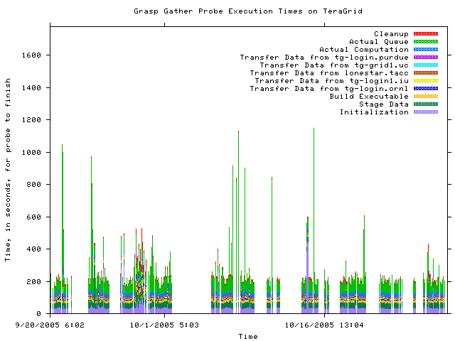
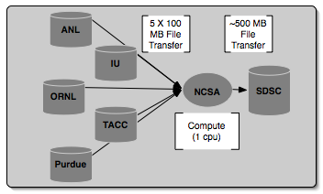
Using Inca to execute Grid Assessment Probes (GrASP)
Set of probes designed to emulate Grid applications
Gather, Circle, PreCo
Deployed to GEON (3 months) and TeraGrid (6 months)
Re-executed for proposal
Gather probe on TeraGrid
O. Khalili, J. He, C. Olschanowsky, A. Snavely, and H. Casanova. “Measuring the Performance and Reliability of Production Computational Grids”, Proceedings of the 7th IEEE/ACM International Conference on Grid Computing, 2006.

Slide 8








Software status and deployments
Current software version: 2.5
(available from Inca website)
http://inca.sdsc.edu

