Slide 1
Inca TeraGrid Status
Kate Ericson
November 2, 2006

Slide 2
Outline
Inca 2 overview
CTSSv3 Inca deployment
Current views of data
Future work

Slide 3
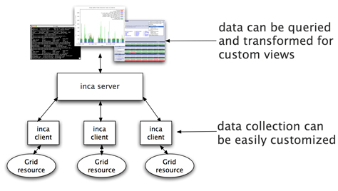
Inca
Inca is a framework for the automated testing, benchmarking and monitoring of Grid resources
Inca:
  schedules execution
  of information gathering
  scripts (reporters)
  collects, archives,
  publishes data
Notes:
For those who might not be as familiar, we developed about Inca 3 years ago with the goal of doing V&V of the TG software stack and environment. We designed to be general enough to
It provides scheduled execution of information gathering scripts on the various grid resources which we call reporters. A reporter is typically a test of a grid service, a benchmark, or a version query of a grid software package and then formats the result in XML
The framework provides collection of the data generated by reporters on each of the resources, storage and archiving of that data, and then making it available for query/ or publishing the data where it can be displayed by a web page.

Slide 4
Motivation for Inca 2
Inca 1 was a prototype
Experiences using Inca:
  Testing is an iterative refinement process
  Testing is a trade-off between freshness of data and impact on resource
  Needed more scalable and flexible data storage
Notes:
So what were are motivations for developing Inca 2.
Firstly, for better or worse, version 1 can really be described as a prototype. The main concern we addressed with this version was speed of development, So, naturally, you don’t have the luxury of pondering the best scalable and secure design or time to develop a good set of unit and integration tests. Without tests, software becomes fragile and difficult to maintain software because you have limited capabilities to test changes.
Address scalability, security, and maintainability thru testing
Second, there were a number of things we had learned from our experiences deploying Inca on TeraGrid that we wanted to take into account into this new version:
Second, one of the things that we observed or realized is that testing is really an iterative refinement process. And there are 2 main reasons for that 1) tests have to be ported to several arch/Oses and depending on their complexity, you run into the same complexities of porting an application on the Grid and 2) we’re often asked to test before the documentation is available so we may not know that a site requires a particular parameter unti we deploy it, it fails, and the sys admins complain. So, you frequent reporter and configuration updates are a reality and in Inca v1 most of it was handled manually which was somewhat tedious when you had 5 resources and now with 18 resources become very tedious.
Third we found that oftentimes multiple views of the collected data - nice to have flexible querying interfaces to filter data, etc.
Finally, we had had complaints that Inca testing was taking up too much resources on a machine so we
Enabling multiple views of the collected data

Slide 5
Inca 2 Feature: Improved installation and configuration control
GUI tool for centralized administration
Reporter sharing via repositories
Proxy management via MyProxy
Incat screenshot
Notes:
Going back to one of the things we wanted to incorporate in the new design, lots of configuration and reporter changes which was handled in a mostly manual fashion
So, one of the key new features is that we provide centralized control so that we can make a change in one place and it will be automatically propagated to each resource. We also added a GUI front end which makes it easier to make changes (where is in Inca 1, we edit XML files)
Tests of Grid services need valid proxies and this was another thing that was handled manually. Another feature designed to faciliate deployment was to handle proxy renewal via MyProxy.
3rd, we created reporter repositories for publishing the reporter - this facilitates sharing of reporters and updates

Slide 6
Inca 2 feature: Full Report Archiving
Inca report - completed
Inca report - error
…
<body>
<benchmark>
<ID>download</ID>
<statistic>
<ID>bandwidth</ID>
<value>105.26</value>
<units>kb/sec</units>
</statistic>
</benchmark>
</body>
<exitStatus>
<completed>1</completed>
</exitStatus>
…
…
<body></body>
<exitStatus>
<completed>0</completed>
<errorMessage>wget command failed: --15:29:23-- http://www.nosite/
=&gt; `/dev/null'
Resolving www.nosite... failed: Host not found.
</errorMessage>
</exitStatus>
…
Inca 1 archiving
Inca 2 archiving
Notes:
A reporter is …
These boxes show the result of a simple reporter that just measures the time it takes to download a particular web page. So, we have result which shows the bandwidth that wget returned and then a report result that failed because the site didn’t exist.
So, in version 1 we cached the full reports but were only able to archive numerical data indicated by the cyan.
In version 2, we are able to archive the full reports

Slide 7
Inca 2: Additional features
Flexible querying interface - relational db backend (postgres for TG)
Profile reporter system usage
Inca components communicate using SSL

Slide 8
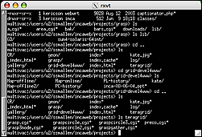
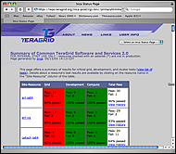

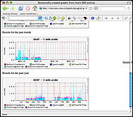
Inca 2 Architecture
4. Data consumers display collected data (reports) by querying the depot
reporter
repository
incat
data consumers
suite
R
1. The user creates a suite using incat and submits it to the agent
agent
suite
depot
suite
2. The agent
- fetches reporters from the reporter repository
- creates a reporter manager on each resource
- sends the suite and reporters to each reporter manager.
suite
suite
R
R
R
R
R
reporter
manager
reporter
manager
reporter
manager
…
Resource 1
Resource 2
Resource N
3. Each reporter manager executes reporters according to its schedule and sends results (reports) to the depot
Notes:
The Admin Tool is a user interface (java GUI) used by the Inca admin to administer all parts of an Inca deployment; it connects to the Reporter Agent
The Reporter Agent is a server which is the access point to an Inca deployment and is responsible for managing the control flow of an Inca installation
The Reporter Repository is responsible for storing Reporters (scripts that gather data from resources); reporters are packaged as RPMs; can be shared among multiple Inca deployments
The Reporter Manager is responsible for managing the schedule and execution of Reporters on a single resource; receives instructions from one and only one reporter agent.
The Depot is a server that is responsible for storing the data produced by reporters.
The Suite describes where to run the reporters, frequency of execution, and optionally expected values (I.e., instructions for how to collect data)

Slide 9
Scalable Design
VO B
Incat
Reporter
Repository
VO A
Incat
Reporter
Repository
Forward suite
Reporter
Agent
Reporter
Agent
Depot
Depot
Forward results
Reporter
Manager
Reporter
Manager
Reporter
Manager
Reporter
Manager
Reporter
Manager
Resource 4
Resource 5
Resource 1
Resource 2
Resource 3
Notes:
Inca designed to be scalable in wrt to data collection and storage (e.g., depots can be arranged hierarchically)
For example, suppose VO B has access to resources on VOA. Rather than VO B running duplicate reporters on VO A resources, VO B can request data from VO A (securely) and then VO A will send the results to VO B.

Slide 10
Outline
Inca 2 overview
CTSSv3 Inca deployment
Current views of data
Future work

Slide 11
Inca 2 TeraGrid Deployment: CTSSv3
32 packages:
Globus, SRB, Condor-G, MPICH, Softenv, etc.
123 possible Inca tests:
45 unit or functionality tests
  Services: BLAS, uberftp, etc.
29 compatible version tests
  Version: HDF, Condor-g, etc.
49 cross-site functionality tests
  Cross-site: Globus GRAM, GridFTP, gsissh

Slide 12
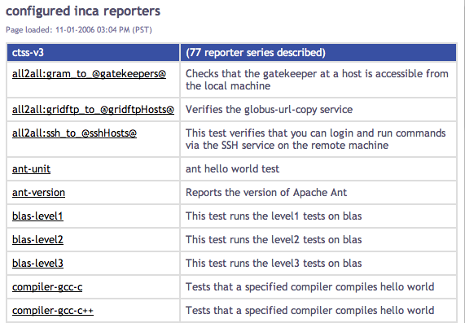
List of Running Tests

Slide 13
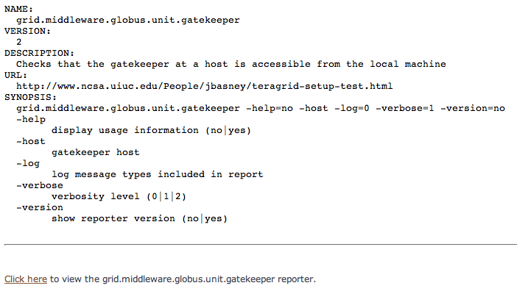
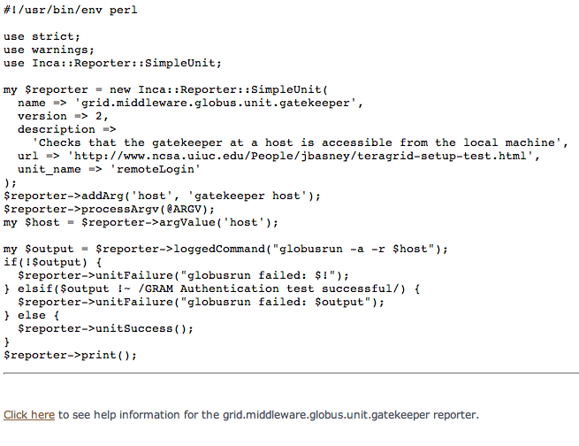
List of Running Tests (cont)

Slide 14
Outline
Inca 2 overview
CTSSv3 Inca deployment
Current views of data
Future work

Slide 15
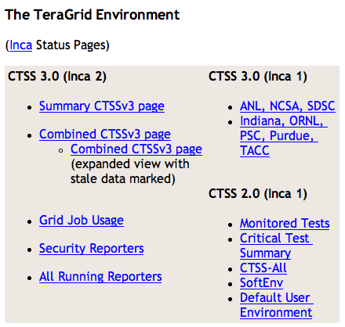
Current Pages Linked from Repo

Slide 16
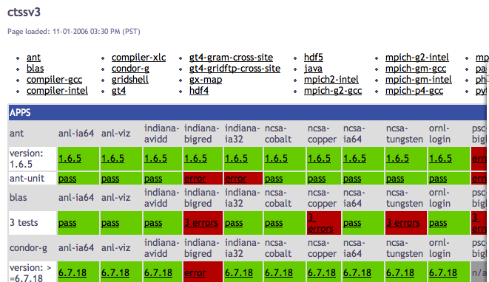
Software Stack Detail View
Resources
SW
packages

Slide 17
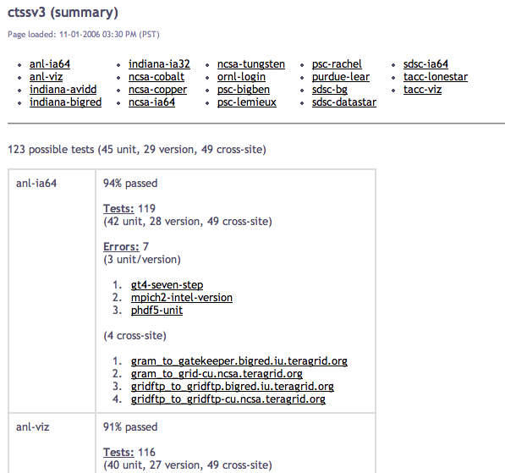
Software Stack Summary View

Slide 18
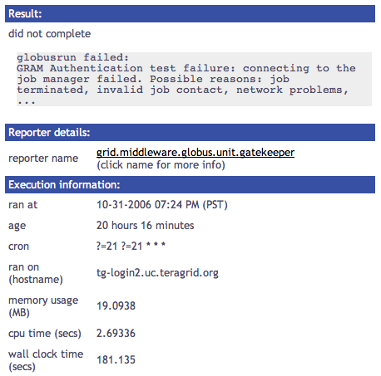
Single Result View

Slide 19
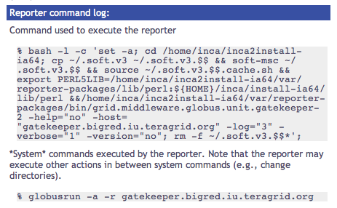
Single Result View (cont.)

Slide 20
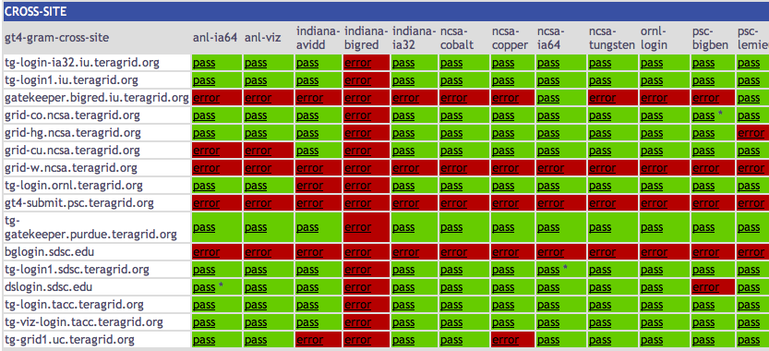
Cross-site Tests
Notes:
Blue gene - get assigned a failure for each machine can’t reach its server, nobody else gets failure for not reaching BG
Big red get client failure for each machine can’t reach
Both client/server get failures in case where others can reach them (datastar, bigben)

Slide 21
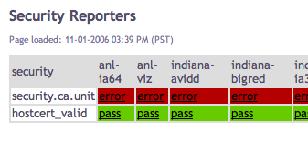
Security Status Page

Slide 22
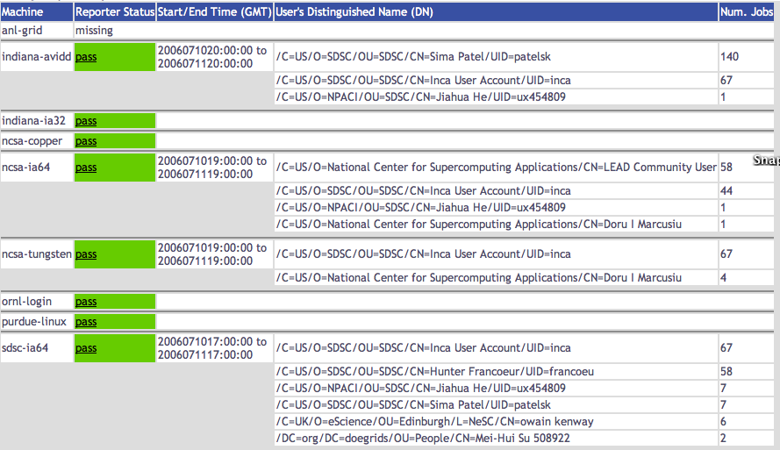
Grid Jobs Status Page (Users)

Slide 23
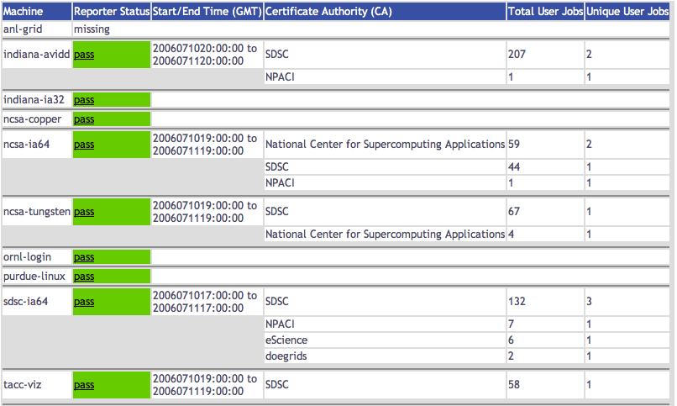
Grid Jobs Status Page (CA)

Slide 24
Outline
Inca 2 overview
CTSSv3 Inca deployment
Current views of data
Future work

Slide 25
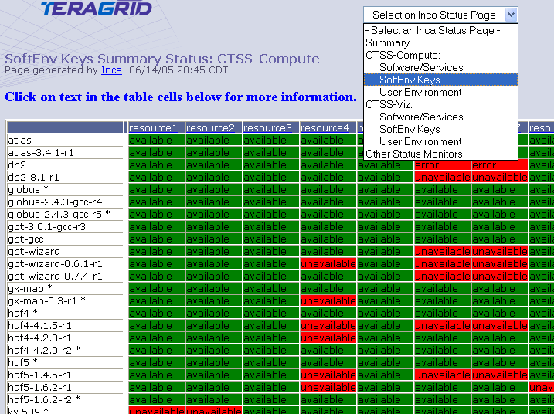
Softenv Status Page
Resources
Softenv
keys

Slide 26
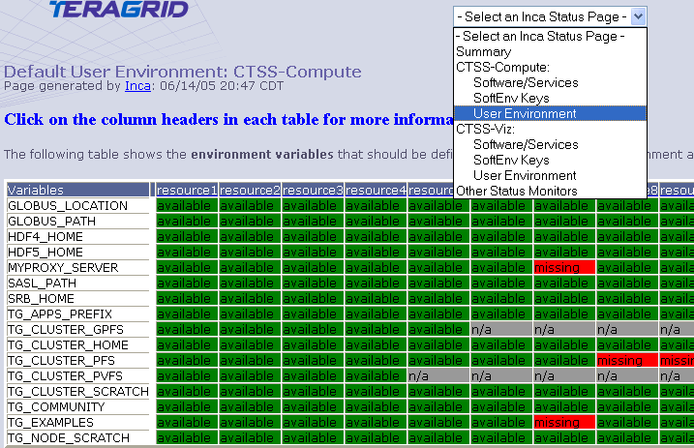
Default Environment Status Page
Resources
Environ
variables

Slide 27
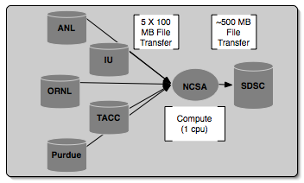
Inca 2 in Use: Grid benchmarks
GrASP: Grid Assessment Probes
  Set of probes designed to emulate Grid applications
  Deployed to GEON and TeraGrid
Gather probe on TeraGrid
Notes:
Collect Grid benchmark measurements using GrASP (Grid Assessment Probes) developed by Henri Casanova and Allan Snavely’s groups
Requested queue time is 1 hour, actual compute is less than a minute

Slide 28
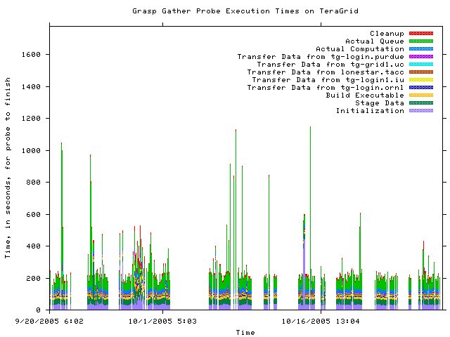
GrASP: Measuring Grid middleware performance
Notes:
This is about 2 months of results from the gather probe running on TG
Y axis is execution time in seconds and x axis the time at which the measurement was taken
Colors indicate stage in execution of the probe
See how the performance varies over time - queue time most variable
white areas indicate probe did not complete due to an error - with version 2, we archive the error messages and can see what types of error messages are occurring

Slide 29
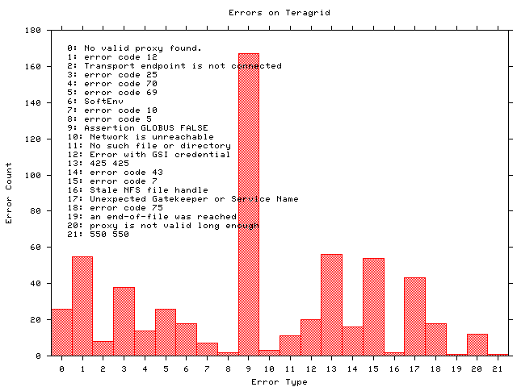
GrASP: Monitoring Grid middleware reliability
Notes:
Histogram shows what types of errors are occuring the most often - error messages are truncated
The highest number of occurrrences in 9 which is the result of a documented Globus 2.0 bug when the GRAM server is under high load
A full report of errors on TG found by the grasp gather probe. This is a new capability in Inca 2.0 -- Inca 1 was unable to archive error messages.

Slide 30
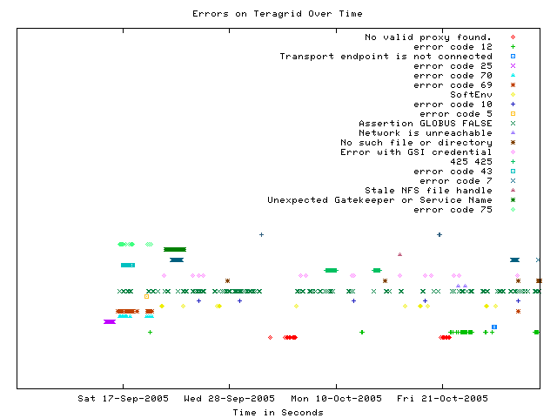
GrASP: Error tracking over time
Notes:
This graph shows when a certain type of error occurs over time
Most errors only occur for a few days before being fixed - for example, the dark green * “Unexpected Gatekeeper of service name” is a configuration error
Dark green xxx’s represent the Globus 2.0 bug over time - a transient error occurs continuously

Slide 31
More information
Inca Web Page:
  http://inca.sdsc.edu
TeraGrid Inca Status Pages
  http://repo.teragrid.org
Email
  inca@sdsc.edu

