Slide 1
Inca Data Display
(data consumers)
Shava Smallen
Inca Workshop
September 5, 2008

Slide 2
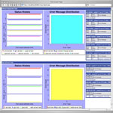
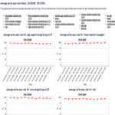
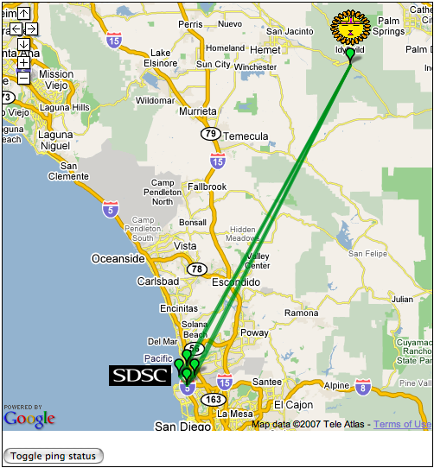
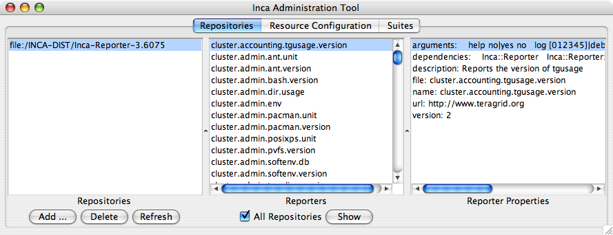
Reporter
Repository
Data Consumers
Incat
C
R
Agent
Depot
Data Consumers
S
Technically -- anything that queries and digests data from the depot
Inca distribution includes a container and webapp to provide Web view of Inca deployment -- grid operators, system administrators, and users
S
r
R
r
S
R
Reporter
Manager
Reporter
Manager
…
Grid Resource
Grid Resource
Notes:
2 main components are RA and RM
Because we want to have a minimal impact on the resources we are monitoring, the RMs are designed to be minimal functionality needed to schedule and execute reporters and send data to the depot. The RMs also will profile reporter system usage and limit that usage through timeouts.
Because working at the reporter manager level is cumbersome (I.e., v1 did this), we introduce the RA to handle higher level coordination and control flow. This addresses the goals about installation and maintenance being easy.

Slide 3
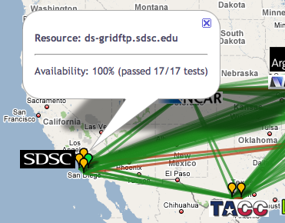
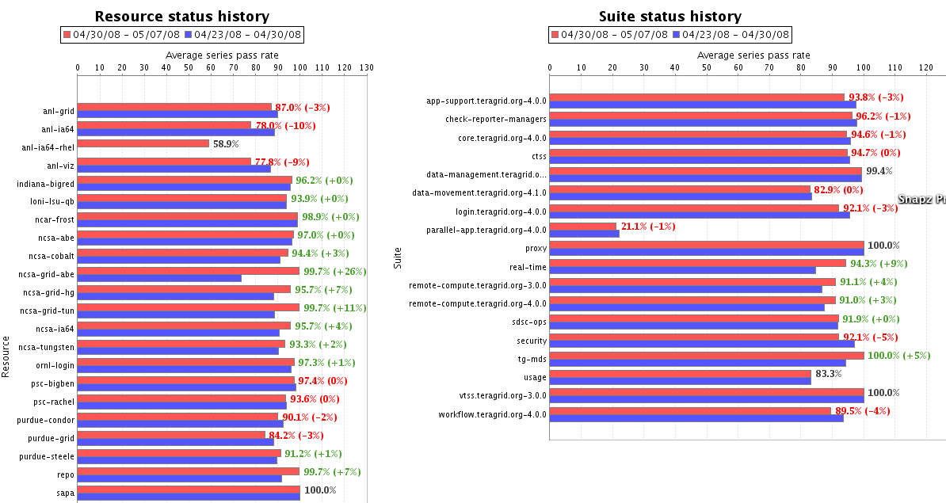
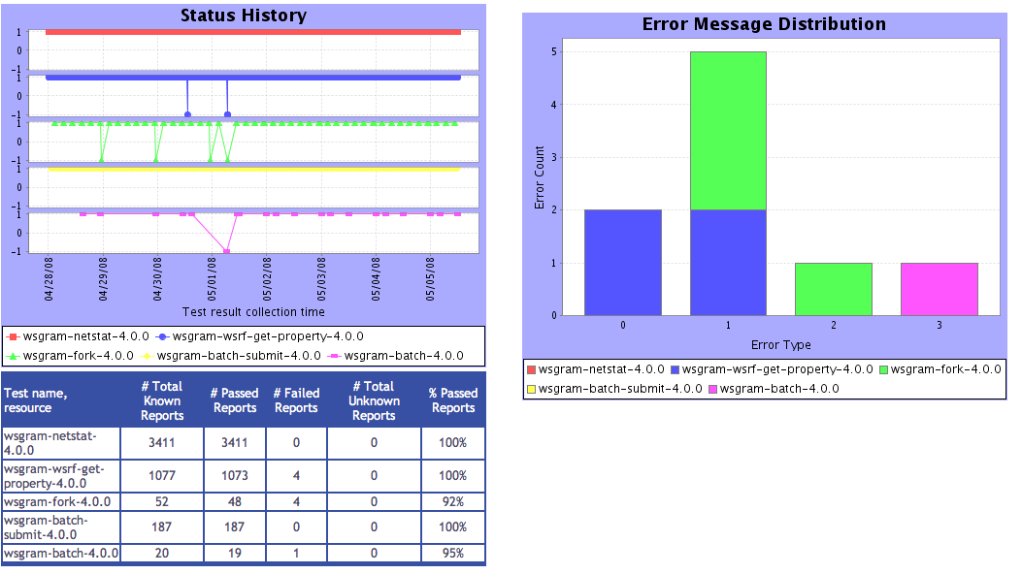



Consumer displays data
Current and historical views
Web application packaged with Jetty
JSP 2.0 pages/tags to query data and format using XSLT
CeWolf/JFreeChart to graph data
Consumer
HTML
Graphs
charts
JSP
XML
JSP
JSP
XSL
query results (XML)
query
Depot
Notes:
The data is displayed by the Inca component called the data consumer which offers current and historical views of data. It is a web application packaged with Jetty, a container that can be embedded into an application so pages can be served out of the box w/o setting up a Tomcat server.
The webapp uses JSP pages and tags to query the data and then we use XSLT to format the data into HTML pages.
For graphing, we use CeWolf which utilizes JFreeChart.

Slide 4
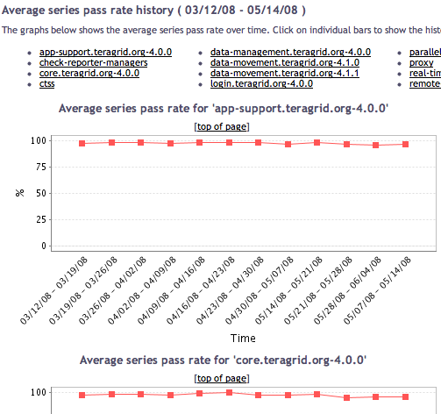
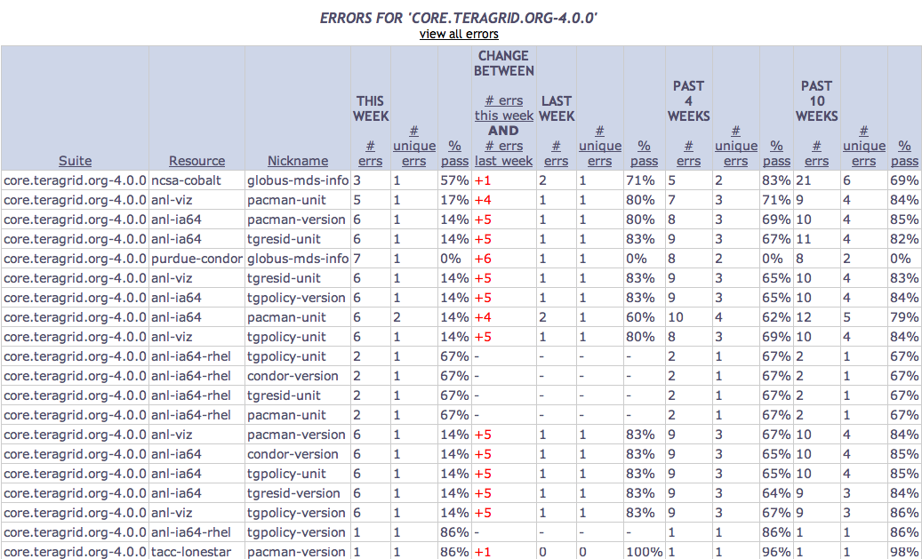
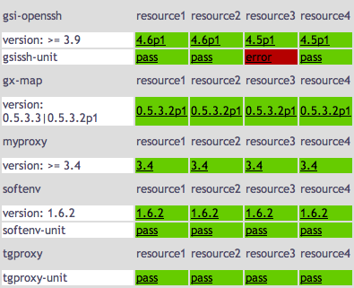
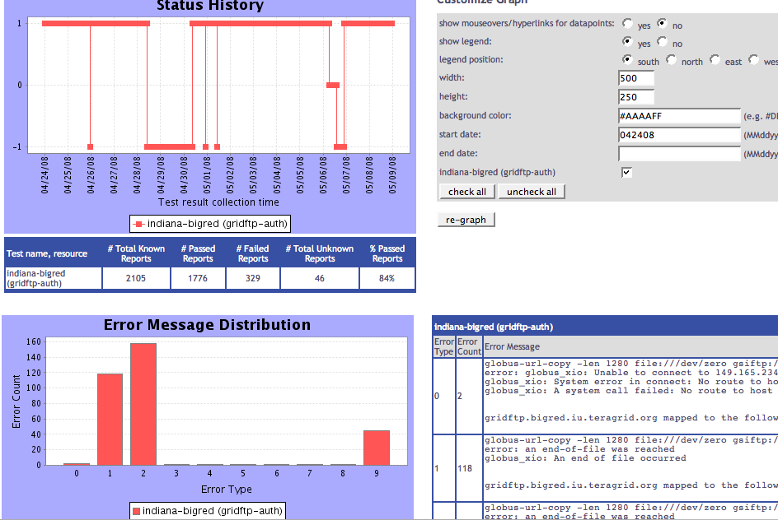
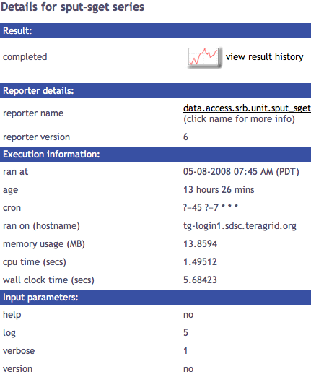
Tests
Summary
Weekly status report
Cumulative test status by resource
Average kit test pass rate history
Inca’s status pages provide multiple levels of details
Error history summary
Test status by package and resource
Related test histories
Individual test result details
Test
Details
Individual test history
Historical
Current status

Slide 5
Tests
Summary
Weekly status report
Cumulative test status by resource
Average kit test pass rate history
Inca’s status pages provide multiple levels of details
Error history summary
Test status by package and resource
Related test histories
Individual test result details
Test
Details
Individual test history
Historical
Current status

Slide 6
View cumulative test status by resource
Register for a Google Map API key
http://code.google.com/apis/maps/signup.html
Specify size of map, center of map, zoom level
Define sites -- logo and resources
Optionally change icons or colors
Consumer
HTML
google.xml
status.jsp
google.xsl
query results (XML)
query
Depot
Notes:
The data is displayed by the Inca component called the data consumer which offers current and historical views of data. It is a web application packaged with Jetty, a container that can be embedded into an application so pages can be served out of the box w/o setting up a Tomcat server.
The webapp uses JSP pages and tags to query the data and then we use XSLT to format the data into HTML pages.
For graphing, we use CeWolf which utilizes JFreeChart.

Slide 7
Google map view configured via XML
<google>
  <key>ABQIAAAA_4IHDoSvxQqISMa1RKFLQBSAw7Yim1cIRTlscO</key>
  <width>800</width>
  <height>500</height>
  <center>
    <latitude>37</latitude>
    <longitude>982</longitude>
  </center>
  <magnificationLevel>4</magnificationLevel>
  <sites> <site>
  <name>SDSC</name>
  <latitude>32.8724</latitude>
  <longitude>-117.23769900</longitude>
  <logo>…
  <resources>
    <resource>ia64</resource>…
  </resources>
  </site>
  …
Size of map
Center of map -- default is middle of US
Site name and location
List of resources

Slide 8
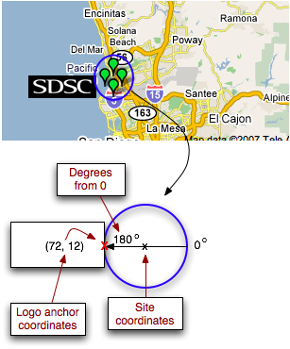
Specify a logo for a site
<logo>
  <url>http://inca.sdsc.edu/www/images/sdsc_black.gif</url>
  <width>72</width>
  <height>24</height>
  <angle>180</angle>
  <logoAnchorX>72</logoAnchorX>
  <logoAnchorY>12</logoAnchorY>
</logo>

Slide 9
Tests
Summary
Weekly status report
Cumulative test status by resource
Average kit test pass rate history
Inca’s status pages provide multiple levels of details
Error history summary
Test status by package and resource
Related test histories
Individual test result details
Test
Details
Individual test history
Historical
Current status

Slide 10
View test status by package and resource
Specify list of suite(s) and resource(s) in URL
http://host:8080/inca/jsp/status.jsp?
  suiteNames=s1,s2
  resourceIds=r
  or
http://host:8080/inca/jsp/status.jsp?
  suiteNames=s1,s2
  resourceIds=r1,r2
Consumer
HTML
status.jsp
default.xsl
query results (XML)
query
Depot
Notes:
The data is displayed by the Inca component called the data consumer which offers current and historical views of data. It is a web application packaged with Jetty, a container that can be embedded into an application so pages can be served out of the box w/o setting up a Tomcat server.
The webapp uses JSP pages and tags to query the data and then we use XSLT to format the data into HTML pages.
For graphing, we use CeWolf which utilizes JFreeChart.

Slide 11
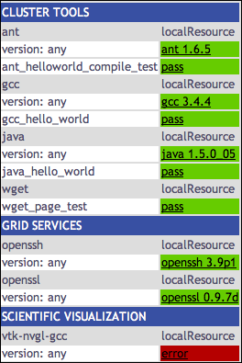
View test status by package and resource (categories)
Specify list of suite(s), resource(s), xml(s) in URL
http://host:8080/inca/jsp/status.jsp?
  xsl=swStack.xsl
  suiteNames=s1[,s2, …]
  resourceIds=r1[,r2, …]
  xml=x1[,x2, …]
Consumer
HTML
swStack.xml
status.jsp
swStack.xsl
query results (XML)
query
Depot
Notes:
The data is displayed by the Inca component called the data consumer which offers current and historical views of data. It is a web application packaged with Jetty, a container that can be embedded into an application so pages can be served out of the box w/o setting up a Tomcat server.
The webapp uses JSP pages and tags to query the data and then we use XSLT to format the data into HTML pages.
For graphing, we use CeWolf which utilizes JFreeChart.

Slide 12
View test status by package and resource (categories)
<stack>
<id>Software and Services</id>
<category>
<id>Cluster Tools</id>
<package>
<id>ant</id>
<version>any</version>
<tests>
<version><id>ant_version</id></version>
<unitalias>
<id>ant_helloworld_compile_test</id>
</unitalias>
</tests>
</package>
…
Notes:
The data is displayed by the Inca component called the data consumer which offers current and historical views of data. It is a web application packaged with Jetty, a container that can be embedded into an application so pages can be served out of the box w/o setting up a Tomcat server.
The webapp uses JSP pages and tags to query the data and then we use XSLT to format the data into HTML pages.
For graphing, we use CeWolf which utilizes JFreeChart.

Slide 13
Caching

Slide 14
Depot Queries
Depot -> XML -> XSL -> CSS -> JSP -> Jetty -> User
Currently two types of queries return XML:
  Series instance: report collected at a particular point in time with
  its set of arguments and context on a particular host
  Latest suite: set of series
  (in this case the latest series instances in a suite)
Query with Inca protocol
(soon webservices)
Supported queries are easily extended
(DB backend)
  historical series queries pre-production
  graphing, general SQL, etc. post-production

Slide 15
Depot Queries: Series Results
Depot -> XML -> XSL -> CSS -> JSP -> Jetty -> User
Results from a series instance:
<suiteId>1</suiteId>
<reportSeriesConfigId>5</reportSeriesConfigId>
<reportSeriesId>5</reportSeriesId>
<reportId>1</reportId>
<instanceId>73</instanceId>
<reportSeries>
<uri>http://inca.sdsc.edu/2.0/repository/bin/cluster.compiler.any.unit</uri>
<args>
<arg>
<name>version</name>
<value>no</value>
</arg>
…
</args>
<setup/>
<cleanup/>
<nice>false</nice>
<description>java_hello_world</description>
<hostname>Kate-Ericsons-Computer.local</hostname>
</reportSeries>
Notes:
Given config & instance ID

Slide 16
Depot Queries: Series Results
Depot -> XML -> XSL -> CSS -> JSP -> Jetty -> User
Results from a series instance (cont.):
<report>
<gmt>February 7, 2006 6:38 PM</gmt>
<age>7 mins 4 secs </age>
<hostname>Kate-Ericsons-Computer.local</hostname>
<name>cluster.compiler.any.unit</name>
<args>
<arg>
<name>version</name>
<value>no</value>
</arg>
…
</args>
<args/>
<body>
<unitTest>
<ID>javac</ID>
</unitTest>
</body>
<exitStatus>
<completed>true</completed>
<errorMessage/>
</exitStatus>
</report>
<schedule>
<cron>
<min>8-59/10</min>
<hour>*</hour>
<mday>*</mday>
<wday>*</wday>
<month>*</month>
<suspended>false</suspended>
</cron>
</schedule>
<report>…</report>
<comparisonResult/>
<sysusage>
<wallClockTime>3.004813</wallClockTime>
<memory>10.578125</memory>
<cpuTime>1.475999</cpuTime>
</sysusage>
Notes:
Given config & instance ID

Slide 17
Depot Queries: Suite Results
Depot -> XML -> XSL -> CSS -> JSP -> Jetty -> User
Array of report summaries for the latest instance of
each series in the suite:
<reportSummary>
<hostname>Kate-Ericsons-Computer.local</hostname>
<uri>http://repository/cluster.compiler.any.unit</uri>
<description>java_hello_world</description>
<reportSeriesConfigId>5</reportSeriesConfigId>
<instanceId>73</instanceId>
<body>
<body>
<package>
<ID>openssl</ID>
<version>0.9.7i</version>
</package>
</body>
</body>
<completed>true</completed>
</reportSummary>
<reportSummary>…</reportSummary>
<reportSummary>…</reportSummary>
<reportSummary>…</reportSummary>
Notes:
- Series was high level of detail, for summary get suite of series
- Given SuiteName (e.g. TestSuiteLocal)

Slide 18
Displaying Queries: Suite Results
Depot -> XML -> XSL -> CSS -> JSP -> Jetty -> User
Combine XML:
Suite report summaries (from depot)
Resource config information (from agent)
<resources>
<resource>
<name>siteA</name>
<macros>
<macro>
<name>.regexp</name>
<value>Kate-Ericsons-Computer.local</value>
</macro>
</macros>
</resource>
</resources>
3) XML file ($INCA_INSTALL/etc/common/swStack.xml)
Notes:
EXTRA XML file could be anything - we describe sw stack, but could be used to organize benchmarks, fs quota, anything returned from reporter
Run sample data consumer without xsl see this combined xml

Slide 19
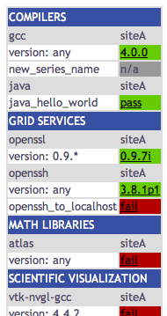
Displaying Queries: Suite Results
Depot -> XML -> XSL -> CSS -> JSP -> Jetty -> User
Edit $INCA_INSTALL/etc/common/swStack.xml
to change HTML table:
<package>
<id>gcc</id>
<category>Compilers</category>
<version>any</version>
<versionRE>(^.*)</versionRE>
<tests>
<version>gcc_version</version>
<unitalias>new_series_name</unitalias>
</tests>
</package>
<tests>: same as series name in incat
Notes:
explain FORMAT of swStack.xml - packages array & what <tests> is

Slide 20
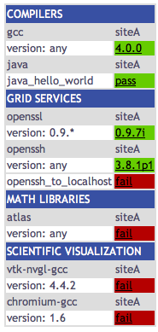
Displaying Queries: Suite Results
Depot -> XML -> XSL -> CSS -> JSP -> Jetty -> User
Print combined XML (see slides 6,7):
http://localhost:8080/xslt.jsp?
resourceID=defaultvo&
suiteName=TestSuiteLocal
Print combined XML and apply XSL (display HTML table):
http://localhost:8080/xslt.jsp?
resourceID=defaultvo&
suiteName=TestSuiteLocal&
xsl=http://localhost:8080/swStack.xsl
Notes:
XSL (Extensible Stylesheet Language):
XSL is a language for expressing stylesheets.
Given arbitrarily structured XML documents, designers
use XSL stylesheets to express how the XML
should be presented
(e.g. transformed into HTML)

Slide 21
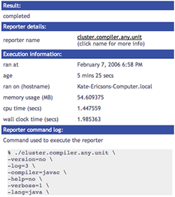
Displaying Queries: Series Results
Depot -> XML -> XSL -> CSS -> JSP -> Jetty -> User
Print series XML (see slides 4,5):
http://localhost:8080/xslt.jsp?
instanceID=209&
configID=5
Print series XML and apply XSL (HTML table):
http://localhost:8080/xslt.jsp?
instanceID=209&
configID=5&
xsl=http://localhost:8080/swStack.xsl

Slide 22
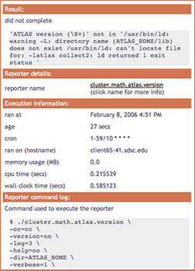
Displaying Queries: Customization
Depot -> XML -> XSL -> CSS -> JSP -> Jetty -> User
Edit XSL:
$INCA_INSTALL/etc/swStack.xsl
XML formatting (e.g. add row to display cron)
swStack.xsl has two main templates,
“test” to display series results and
“suite” to display suite results
Edit CSS (Cascading Style Sheet):
$INCA_INSTALL/etc/inca.css
colors (e.g. change .header background-color)
fonts

Slide 23
Displaying Queries: JSP
Depot -> XML -> XSL -> CSS -> JSP -> Jetty -> User
JavaServer Page (xslt.jsp)
  script that uses Java to create dynamic web content
JavaServer Pages (JSP) tag libraries
  define declarative, modular functionality that can be reused by any JSP page
  reduce the amount of Java code in JSP pages (move tag functionality into tag implementation classes)

Slide 24
Displaying Queries: JSP tag libraries
Depot -> XML -> XSL -> CSS -> JSP -> Jetty -> User
Tag Library Descriptor (TLD)
  XML document that describes the library
  contains information about the library and each library tag
  used by a JSP container to validate the tags
TLD calls in JSP
  xslt.jsp calls getXML,
  printXML, applyXSL
<%@ taglib uri="xslt.tld" prefix="xslt" %>
<xslt:printXML xml="<%=xml%>"/>
<tag>
<name>printXML</name>
<tagclass>edu.sdsc.inca.consumer.tag.PrintXML</tagclass>
<info>print a file line by line</info>
<attribute>
<name>xml</name>
<required>true</required>
</attribute>
</tag>

Slide 25
Displaying Queries: Jetty
Depot -> XML -> XSL -> CSS -> JSP -> Jetty -> User
Jetty, a Java HTTP server and servlet container, runs Inca’s xslt.jsp data consumer
Separate Web server (e.g. Apache) is NOT required
.jsp, .xsl, .css, and libs packed into a .war (or "web archive") file for Jetty. A war file is a packaged webapp directory created using the Java jar tool.
Jetty starts on port 8080 by default, but can be configured to start on another port

Slide 26
Hands-on session
HTML table layout (swStack.xml)
Style (swStack.xsl and inca.css)
Jetty port

