Slide 1
Basic functionality, performance, and application reporters for Inca
Shava Smallen
9/30/05

Slide 2
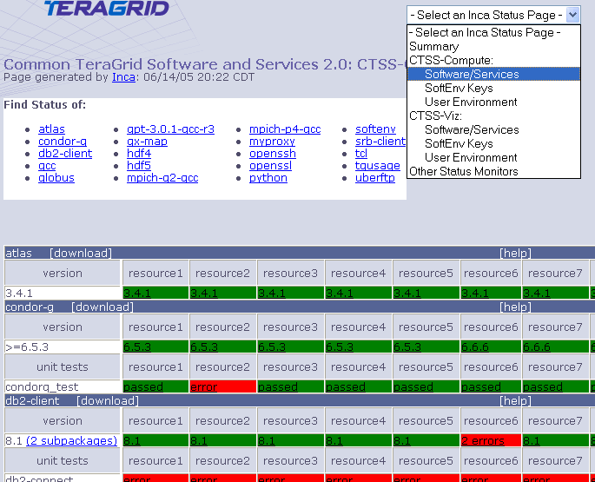
Inca on TeraGrid Today
Validation & Verification of CTSS
  123 tests/resource:
    Services: Globus GRAM, GridFTP, MDS, SRB, DB2, MyProxy, OpenSSH
    Cross-site: Globus GRAM, GridFTP, OpenSSH
  Compatible versions of SW
  SoftEnv and default environment checking
Screenshot of Inca Status page: Core Software stack

Slide 3
Goal
“… the development of an extensive suite of interoperability, functionality, and application level tests.”
FTEs:
  Yifeng Cui
  Shava Smallen
  (Kate Ericson)

Slide 4
Timeline
10/1/04 | Project started
1/05-2/05 | Gathered requirements from user services; created preliminary reporter listing
1/05-3/05 | Set up contract with Sci Tac
3/05 | Created survey for TeraGrid
4/05 | Posted survey to TeraGrid WGs; spec’d out reporters
5/1/05-8/31/05 | Contract with Sci Tac: Ray Swartz
8/05 | Reporter testing
Now: need your feedback to deploy reporters

Slide 5
Outline
Introduction
Brief description of Inca
Survey results & new reporters
Performance reporters
Deployment options
Inca 2.0

Slide 6
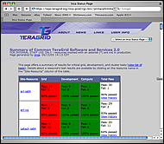
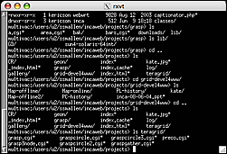
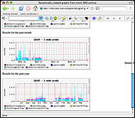
Inca
Framework for the automated testing, benchmarking and monitoring of Grid systems
  Schedule execution of information gathering scripts (reporters)
  Collect, archive, publish, and display results
Inca
Server
Inca
Client
Inca
Client
Inca
Client
…
Resource N
Resource 1
Resource 2

Slide 7
Inca Reporters
Script or executable that outputs XML conforming to Inca specification
Context of execution is required - important for repeatability
Communicate more than pass/fail
  Body XML can be reporter specific - flexibility
  E.g., SRB throughput (unusual drop in SRB performance)
Perl APIs for writing reporters
Users can run reporters independent of framework

Slide 8
Outline
Introduction
Brief description of Inca
Survey results & new reporters
Performance reporters
Deployment options
Inca 2.0

Slide 9
Survey Results
31 responses; survey questions included:
  Rank proposed basic functionality tests [1-5]
    60% answered, average rankings ranged 3.21 - 4.58, total average=3.91,stdev=.47
  Rank proposed performance info [1-5]
    47% answered, average rankings ranged 2.57 - 3.92, total average=3.05, stdev=.41
  Rank proposed application tests [1-5]
    27% answered, average rankings ranged 2.62 - 2.89, total average=2.76, stdev=.11
Slightly modified list
More summary results and comments at:
http://inca.sdsc.edu/survey/results
Notes:
Rank the current tests of software package functionality [1-5]
57% answered, rankings ranged from 2.08 to 4.6
Is package version compatibility required for TeraGrid roaming? [yes/no]
28% answered, 42%, stdev 23%

Slide 10
New reporter summary
Basic Functionality (13)
Performance (2)
Application (2)

Slide 11
Basic Functionality
File Transfer: transfer a file or directory to a remote machine, transfer it back, and check it is the same. Optionally, report the time to transfer and bandwidth.
  File transfer tool: scp, gsiscp, tgcp, gridftp (globus-url-copy), uberftp
  File size
  Number of files
  RFT (Reliable File Transfer): on or off when applicable to tool
  Striped: on or off when applicable to tool
  Report performance: on or off

Slide 12
Basic Functionality
Grid Job Submission: submit an executable using Globus and Condor-g. Check job status and delete from queue if job doesn’t complete within given timeframe.
  Type [condor-g | globus-job-run | globus-job-submit | globusrun]
  Maximum run time for the job
  maximum wait time for the job to complete
  number of nodes
  Project charge ID
  Globus contact string
  Path to the executable to submit

Slide 13
Basic Functionality
File System Availability: List a given directory. If the directory is writeable, try to touch a file there and cleanup.
Site Job Submission: Submit a job. If it does not complete within a given amount of time, delete it from the queue. If the job completes within the given amount of time, check the result.

Slide 14
Basic Functionality
Compiler Inter-language: Compile ‘hello world’ code to make sure the compilers are available and check for compiler inter-language compatibility
  compiler [intel | gnu | mpich-gm-intel | mpich-gm-gcc | mpich-vmi-intel | mpich-vmi-gcc]
  languages to test (e.g., f,c,c+f,cpp+c)
SU Usage: Run the command ‘tgusage’ and match a regular expression
Remote Site Access: Ping a machine

Slide 15
Basic Functionality
HPSS: steps through the list of node numbers, and for each node will transfer the list of files to the HPSS. When finished, the list will be transferred out of the HPSS. If desired, the performance will be calculated for the transfer in each direction.
Interconnect: runs a short MPI program that tests the interconnection of the batch nodes.
Policy: Run ‘tg-policy -a’ and match regular expression

Slide 16
Basic Functionality
PHDF: Compiles simple program PHDF program which generates an output file. The output file is then examined to determine if it is an appropriate PHDF data structure.
FFTW: checks for fftw-wisdom program and runs it to determine the configuration necessary to solve a canonical set of problem sizes on the local machine.
PETSc: runs sets of programs in PETSc’s examples directory

Slide 17
Performance
SRB: tests file transfer rates to and from the SRB. Uses Sput/Sget commands using serial transfer, –M (threaded transfer – single file), and –b (bulk transfer – directory of files).
Effective Bandwidth: tests the effective accumulated bandwidth of the communications network of a distributed computing system. The b_eff executable sends messages of various sizes through the system and measures the time for the messaging.

Slide 18
Application
NAMD: runs the NAMD parallel molecular dynamics code and reports the success/failure of the job (*almost complete)
AWM: runs an earthquake simulation program and reports the success/failure of the job

Slide 19
Outline
Introduction
Brief description of Inca
Survey results & new reporters
Performance reporters
Deployment options
Inca 2.0

Slide 20
Previous Sci Tac work
bonnie: Simple speed measurement for reading and writing to a disk-based filesystem
hpl: Dense matrix multiplication on multiple processors
ior_create: Measure of the performance of file creation and deletion.
ior_mpiio: Mpi based reads/writes to/from a file using mpi-io
ior_posix: Posix read/write to files.
iozone: A suite of file read/write operations.
lmbench: Collection of the small benchmarks of type bandwidth, latency, and``other''.

Slide 21
Previous Sci Tac work
Matvec: Multiplying random square matrices.
Milc: Physics-based model of su3 gauge calculations.
Noncontig: Speed measure of contiguous/noncontiguous file and memory io.
npb: NASA NAS Parallel Benchmark (NPB) v. 2.4
pio: Speed measurement of parallel IO.
pmb: Pallas MPI Benchmark (PMB) v. 2.2.1 a.
stream2: Sustainable memory bandwidth measurement.
swe: Solution of a Shallow Wave Equation.

Slide 22
Outline
Introduction
Brief description of Inca
Survey results & new reporters
Performance reporters
Deployment options
Inca 2.0

Slide 23
Deploying Reporters
Plan:
  Deploy to SDSC
  Deploy to TeraGrid
Need your feedback to determine:
  Inputs
  Execution frequency?
    Boot-time
    During maintenance cycle
    Periodic - e.g., daily, weekly, etc.
Deploy using Inca 2

Slide 24
Outline
Introduction
Brief description of Inca
Survey results & new reporters
Performance reporters
Deployment options
Inca 2.0

Slide 25
Inca 2.0
Initial version of Inca focused on basic functionality
New features:
  Improved archiving capabilities
  Scalability - control and data storage
  Usability - improved installation and configuration control
  Performance - self-monitoring
  Security - SSL, proxy delegation
Public release early 2006

Slide 26
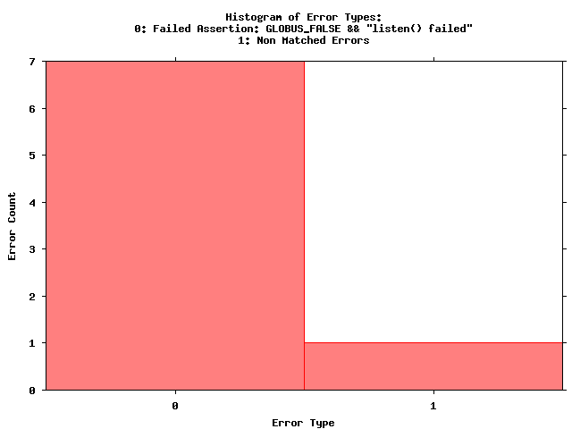
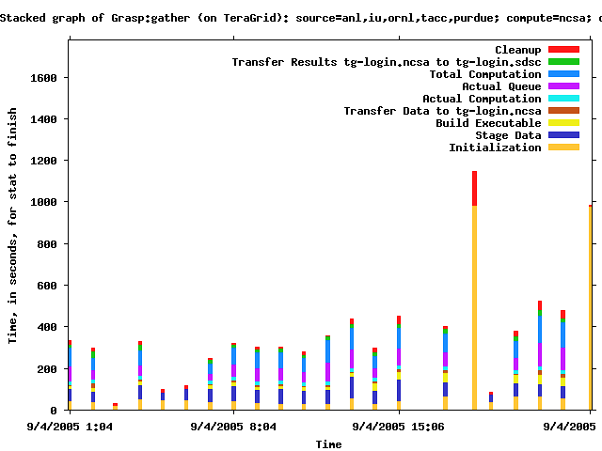
Early Example - GRASP
Globus 2 bug at SDSC
Globus 2 bug at ORNL
Globus 2 bug at ANL
Globus 2 bug at Purdue

Slide 27
More Information
Survey results:
  http://inca.sdsc.edu/survey/results/
Reporters:
  http://inca.sdsc.edu/projects/newReporters
Documentation for software-wg:
  https://repo.teragrid.org/wg/Software/inca.html
Inca Web Page:
  http://inca.sdsc.edu

