Slide 1
User-level Grid Functionality Testing with Inca v2.0
Jim Hayes jhayes@sdsc.edu

Slide 2
Is the User’s Grid Working?
Can user X run application[s] Y on Grid[s] Z? Access dataset[s] N?
  Can user login?
  Are Grid services the application[s] use available? Compatible versions?
  Are dataset[s] N accessible to user X? Credentials?
  …
Notes:
Now when we look at what this means for the user, the Grid is up if they can run their particular application on their set of resources, access their dataset, and get “good” performance.
This may seem straightforward but there are actually a lot of things that need to be working underneath the hood in order to make that happen. For example, …
And as you consider the requirements of a community of users and multiple communities of users, those set of requirements can grow quite large.

Slide 3
Testing a Grid
Iteratively define a set of concrete requirements
Write tests to verify requirements
Periodically run tests and collect data
Publish data
Inca aims to automate steps 3 and 4
Notes:
One way to veriify the user’s requirements are being met is through periodic, automated testing (as you do with software) so that you can have some confidence that when a user logs in, they can get work done
The way you go about this is to define a set of concrete requirements (I.e., machine-readable). These can then be be tested automatically and periodically (important in these dynamic Grid environments).
Some places where you can get requirements from are user documentation, talking to users, proposals, etc.
Note, this is not a simple matter of sitting down once and defining a complete set of requirements
This will be an iterative process as requirements are refined and because the Grid environment will change over time as packages are upgraded, etc.

Slide 4

What type of testing?
Deployment testing
  Automated, continuous checking of Grid services, software, and environment
  Installed? Configured correctly? Running? Accessible to users? Acceptable performance?
  E.g., gatekeeper ping or scaled down application
Junit,
PyUnit, Tinderbox
Software Package
(unit, integrated)
Software Stack
(interoperability)
NMI
Software
Deployment
Notes:
When we refer to testing, we’re talking about testing at the deployment level
This is different than the type of testing you do at the software package level where you’re looking at detailed testing of the software features and checking that it works on all architectures using something like junit, tinderbox, etc.
This is also different than the type of testing that occurs at the software stack level where you’re looking at package version interoperability (e.g., NMI)
We are checking whether packages are installed, running, and configured correctly.
This tests can be something as simple as pinging a Globus gatekeeper service to a more complicated test such as a scaled down version of an application

Slide 5
Who are the consumers?
Grid/VO management
  Responsible for designing & maintaining requirements
  Verify requirements are fulfilled by resource providers
System administrators
  Notified of problems
  Enough information to understand context of problem
End users
  View results and compare to problems they are having
  Debug user account/environment issues
  Feedback to Grid/VO
Notes:
There are different consumers of the testing results: Grid/VO, system administrators, and end users
Our view is that responsibility of the testing should occur at the Grid/VO level. Based on the goals of the Grid, they decide what should be tested and then collect the results - the goal being to detect problems before the users do
While the Grid/VO will decide what to test, system administrators from each of the participating sites will need to be notified of failures and be able to understand how the test was conducted so they can debug their system. This implies that the need to trust the results.
While ideally, we hope that the failures will be caught before users notice them, in practice this is hard to achieve. Therefore, the results of our testing should be made available to users so if they’re having a problem, they can check the results to see if it might be system related.
They should also be able to use the tests to debug user account/environment issues specific to their account (e.g., removing an environment variable accidentally prevents a package from working)
For more advanced users, they could even feedback useful tests to the Grid/VO level.

Slide 6
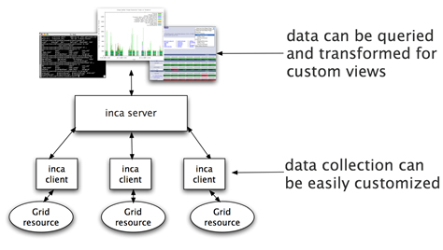
Inca
Inca is a framework for the automated testing, benchmarking and monitoring of Grid resources
Inca:
  schedules execution
  of information gathering
  programs (reporters)
  collects, archives,
  publishes data
Notes:
Inca is… we developed about Inca 3 years ago with the goal of doing Verification&Validation of the TG software stack and environment.
It provides scheduled execution of information gathering scripts on the various grid resources which we call reporters. A reporter is typically a test of a grid service, a benchmark, or a version query of a grid software package and then formats the result in XML
The framework collects data generated by reporters on each of the resources, storage and archiving of that data, and then making it available for query/ or publishing the data where it can be displayed by a web page.

Slide 7








Related Grid monitoring tools
MDS
Hawkeye
Inca’s primary objective: user-level Grid functionality testing and performance measurement
Notes:
Over the past couple years, several monitoring tools have been developed that are at a high-level similar to Inca wrt to data collection, data storage, and data dissemination
We feel the main difference between Inca and these tools is that ….
Because some of these tools support aggregation like MonALISA and MDS, Inca could be used to feed information into these systems.
Backup
Archiving of the data
some systems use a relational DB like Big Brother (Sybase), GridICE (postgres), MonALISA (MySQL, PostgreSQL, Microsoft SQL Server)
Ganglia uses RRDTool and Nagios uses logs
Tools like MonALISA and GridICE do a lot wrt accounting/job monitoring -- not something we’ve addressed but we could
Inca could complement MonALISA, GridICE, MDS since they are aggregate data.
There’s also the NCSA TestGrid and GITS -- not frameworks
We’re working with GITS’ David Baker to incorporate tests into Inca

Slide 8
Unique features of Inca
Debugging a deployment
  Runs under a regular user account
  Flexibly expresses results
  Captures test context
  Securely re-runs tests
  Archives full reports
  Tests can be run outside Inca framework
Notes:
Here’s what sets us apart as unique -- based on our experience with real Grid deployment on TG. Places noted as v2 will be available to the public early 2006.
Run under regular user account enables user-level testing
Express more than test pass/fail for example different types of performance information
Capture context of reporter execution (script, what machine it ran on, time it ran, inputs, selected environment variables, etc.)
Easy to *securely* re-trigger a test (sys admin fixes a problem -- update the result)
Reports fully archived to understand the how the Grid behaves over time - for example to understand how a service fails over time and if it fails with the same type of error
Reporters can be run outside of the framework by a sysadmin debugging a problem or a user…eventually integrated into a knowledge base

Slide 9
Unique features of Inca (cont.)
Compares results to a specification
Easily and securely configured
  Data collection
  Installation
Profiles and logs Inca component resource use
Notes:
Because analyzing information from resources for display can sometimes be resource-intensive, Inca provides support for comparing results to a specification and storing it (for example, a software stack specification). Comparisons are done each time a new result is collected so the cost is amortized over time rather than doing each time a web page is displayed.
The method to specify the data collection is very expressive to make it easy to configure Inca. Also easy to make changes to an existing deployment (important because resources change over time); uses SSL authentication to make that secure
There’s such a thing as testing too often -- tradeoff of between freshness of data and impact on resource

Slide 10
Outline
Inca in use
Architecture overview
Project status

Slide 11




Inca In Use
Inca Version 1 first put into production in 2004
Inca Version 2 currently beta
Both versions of Inca used in production environments
Notes:
What we have today
First public release in April 2004
Used by handful of projects
Second major release 2006 - number of substantial improvements based on our experience with deploying version 1

Slide 12
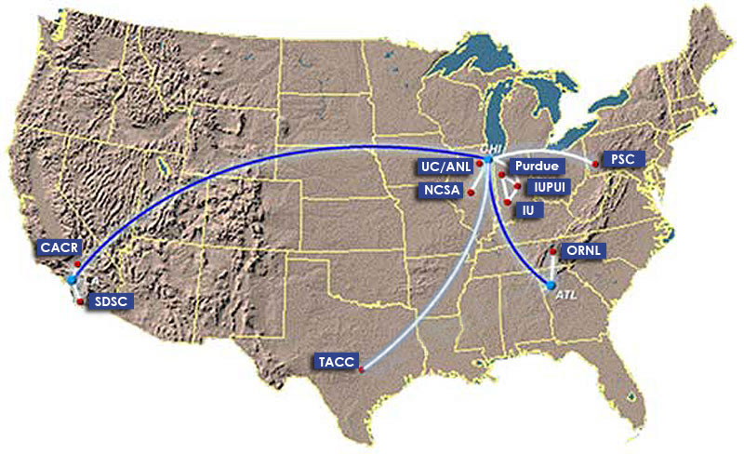
Inca in use: TeraGrid software stack V&V
TeraGrid - an “enabling cyberinfrastructure” for scientific research
  ANL, Indiana Univ., NCSA, ORNL, PSC, Purdue Univ., SDSC, TACC
  40+ TF, 1+ PB, 40Gb/s net
Common TeraGrid Software & Services
  Common user environment across heterogeneous resources
  TeraGrid VO service agreement
Notes:
TeraGrid first grid to use inca to verify its software stack requirements
8 sites, 17 resources

Slide 13
Inca 2 TeraGrid Deployment: CTSSv3
32 packages:
Globus, SRB, Condor-G, MPICH, Softenv, etc.
123 Inca tests:
45 unit/functionality tests
  Services: BLAS, uberftp, etc.
29 compatible version tests
  Version: HDF, Condor-g, etc.
49 cross-site functionality tests
  Cross-site: Globus GRAM, GridFTP, gsissh

Slide 14
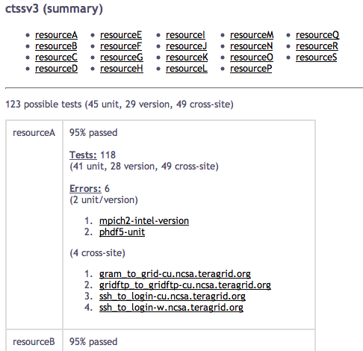
Software Stack Summary View

Slide 15
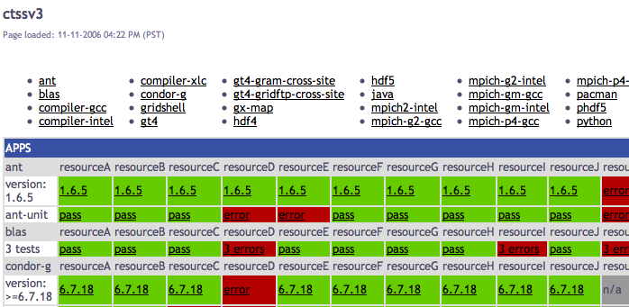
Software Stack Detail View
Resources
SW
packages

Slide 16
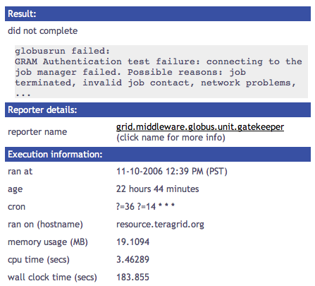
Single Result View

Slide 17
Outline
Inca in use
Architecture overview
Project status

Slide 18
Inca Components
Inca Control System
  Reporter Managers manage Inca on a single host
  Agent installs and oversees Reporter Managers
  Incat provides an administration GUI
Inca Data System
  Reporters perform tests; collected in external repositories
  Depot stores and retrieves test results (DB)
  Consumer provides web-based access to test results

Slide 19

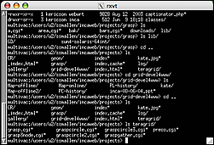
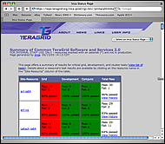
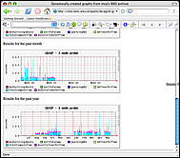
1. The user creates a suite using incat and submits it to the agent
4. Data consumers display collected data (reports) by querying the depot
reporter
repository
incat
data consumers
suite
R
agent
2. The agent
- fetches reporters from the reporter repository
- creates a reporter manager on each resource
- sends the suite and reporters to each reporter manager.
suite
depot
suite
suite
suite
3. Each reporter manager executes reporters according to its schedule and sends results (reports) to the depot
R
r
r
R
R
r
reporter
manager
reporter
manager
reporter
manager
…
Resource 1
Resource 2
Resource N

Slide 20
Inca Component Design Goals
Minimal impact on monitored resources
  Most administrative duties handled by Agent
  Component profiling; Reporter profiling/limits
Easy installation and maintenance
  Centralized administration control
  Automated staging of Reporter Managers and Reporters
Flexible reporter scheduling and configuration
  On-demand and periodic scheduling
  Reporters independent of Inca deployment
Notes:
Requirement: The Inca framework should have a minimal impact on the resources it is monitoring.
･In order to maintain a low impact on the system, we identify two distinct components of the control system: a reporter manager and a reporter agent. A reporter manager is a thin client which resides on a resource to manage the execution of a reporter suite. A reporter agent manages one or more reporter managers and handles the bulk of the control processing.
･The reporter manager will need to have multiple threads of control in order to accept commands from the reporter agent and local command-line GUI plus perform scheduling and monitoring of reporters. These threads of control will be implemented efficiently in order to avoid unnecessary memory consumption.
･Each reporter will be profiled while it executes. This information will be used to create timeouts on either wall clock time, CPU time, and/or memory. It will also be sent back with the report and logged in the depot so system administrators can use the information to tune the impact on the system. (also addresses Self Monitoring requirement)
Requirement: Data collection should be configurable and extensible on a per-resource basis.
･There will be two types of data collection: scheduled and on-demand. Scheduled execution will run a single reporter or group of reporters continuously on its own schedule. There will be a set of schedulers to choose from such as: a queue scheduler, cross-site scheduler, pairwise measurement scheduler, etc. The scheduling engine resides on the reporter agent.
Requirement: Installation, setup, and maintenance of the Inca deployment should be simple, straightforward, configurable, and pain-free.･Once installed (see Section 2.5), the user should be able to describe their VO and the reporters they want to run using a GUI or configuration file.･The configuration of an Inca deployment should be done from a single machine. The user should be able to describe their requirements and the reporter suites they want to run using a GUI or configuration file.
Each participating site will have some local control on their reporter manager as well and should be able to use a GUI to interact with it.･Changes to an Inca deployment configuration should be done from a single machine and propagated down to the reporter managers.Requirement: In order to test Grid functionality, access to a valid credential is needed from a reporter.･The reporter manager will run under a regular user account with a valid set of credentials with a DN that maps to that account.

Slide 21
Inca Component Design Goals (cont.)
Security
  Certificate-based authentication by all components
  Provide credentials to reporters that need it
Flexible data content
  No required schema for test output
Efficient storage and retrieval of data
  Storage in a selection of databases via Hibernate
  Schema designed to reduce redundant data
Flexible access to data
  Access to all data via SQL queries
  Depot protocol provides predefined queries; extensible
  Depot retains history of reporter output
  Queries via Inca protocol and web service interface

Slide 22
Inca Data Consumer

Slide 23
Inca Reporter
Executable program that measures some aspect of the system or installed software
Requirements:
  Supports specific command-line options
  Writes XML (Inca Reporter schema) to stdout
Extensive Library support for perl scripts

Slide 24
Example: openssh version
use Inca::Reporter::Version;
my $reporter = new Inca::Reporter::Version(
version => 1.8,
description => 'Reports the version of openssh',
url => 'http://www.openssh.org',
package_name => 'openssh'
);
$reporter->processArgv(@ARGV);
$reporter->setVersionByExecutable('ssh -V', 'OpenSSH_([\w\.]+)|GSI ([\w\.]+)');
$reporter->print();

Slide 25
Incat Administration Tool
Centralized configuration of Inca installation
Reporter repositories, resources/hosts, suites

Slide 26
Outline
Inca in use
Architecture overview
Project status

Slide 27
Inca v2 Development
Version 1 being phased out
Version 2 beta released 11/06
Production version available “soon”
Future work
  Scalable design
  Improved displays
  Extended package support

Slide 28
Scalable design
VO B
Incat
Reporter
Repository
VO A
Incat
Reporter
Repository
Reporter
Agent
Forward suite
Reporter
Agent
Depot
Depot
Forward results
Reporter
Manager
Reporter
Manager
Reporter
Manager
Reporter
Manager
Reporter
Manager
Resource 4
Resource 5
Resource 1
Resource 2
Resource 3
Notes:
Inca designed to be scalable in wrt to data collection and storage (e.g., depots can be arranged hierarchically)
For example, suppose VO B has access to resources on VOA. Rather than VO B running duplicate reporters on VO A resources, VO B can request data from VO A (securely) and then VO A will send the results to VO B.

Slide 29
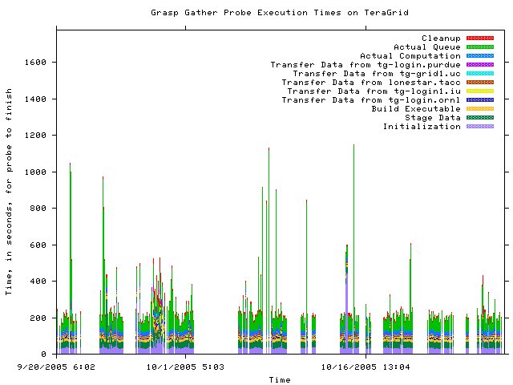
Historical Graphs
Notes:
This is about 2 months of results from the gather probe running on TG
Y axis is execution time in seconds and x axis the time at which the measurement was taken
Colors indicate stage in execution of the probe
See how the performance varies over time - queue time most variable
white areas indicate probe did not complete due to an error - with version 2, we archive the error messages and can see what types of error messages are occurring

Slide 30
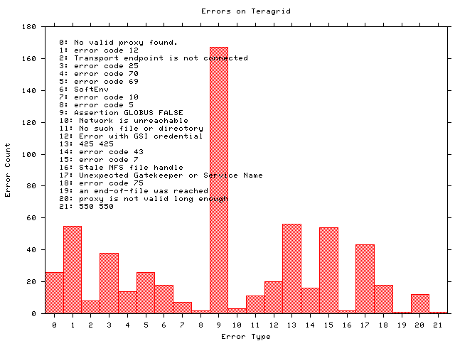
Historical Graphs
Notes:
Histogram shows what types of errors are occuring the most often - error messages are truncated
The highest number of occurrrences in 9 which is the result of a documented Globus 2.0 bug when the GRAM server is under high load
A full report of errors on TG found by the grasp gather probe. This is a new capability in Inca 2.0 -- Inca 1 was unable to archive error messages.

Slide 31
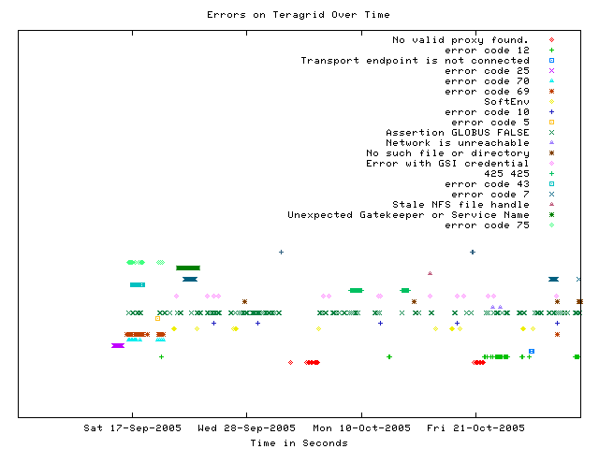
Error tracking over time
Notes:
This graph shows when a certain type of error occurs over time
Most errors only occur for a few days before being fixed - for example, the dark green * “Unexpected Gatekeeper of service name” is a configuration error
Dark green xxx’s represent the Globus 2.0 bug over time - a transient error occurs continuously

Slide 32
Extended Package Support
Reporter Repositories can presently contain scripts, perl modules, and .tar.gz packages
Add support for .rpm, other formats
Support retrieval from CPAN

Slide 33
More information
Inca Web Page:
  http://inca.sdsc.edu
Email
  inca@sdsc.edu

