Slide 1
Hands-on: Inca deployment
Part 2

Slide 2
Administrative Tasks Covered
Stopping/starting Inca components
Adding a reporter to a suite
Adding a new resource using Globus access method
Adding a new suite
Adding a new repository
Adding/using macros
Committing changes
Changing the depot backend database to Postgres

Slide 3
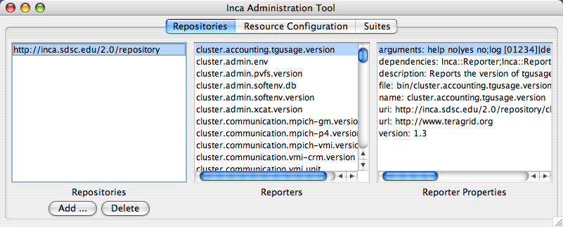
Step 1: Start incat
% inca start incat -A localhost:6323 &

Slide 4
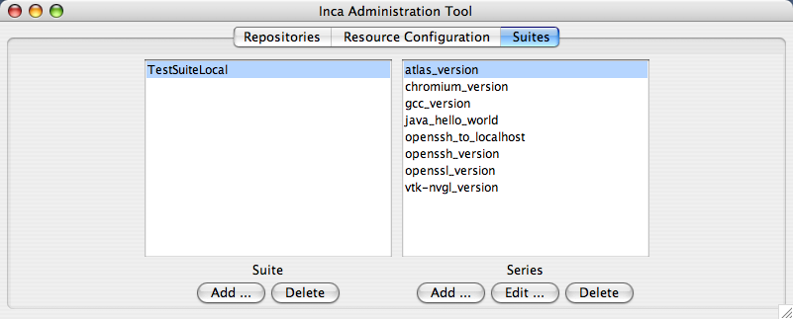
Step 2: Add a reporter to TestSuiteLocal
Click on Suites tab
Click on Add button

Slide 5
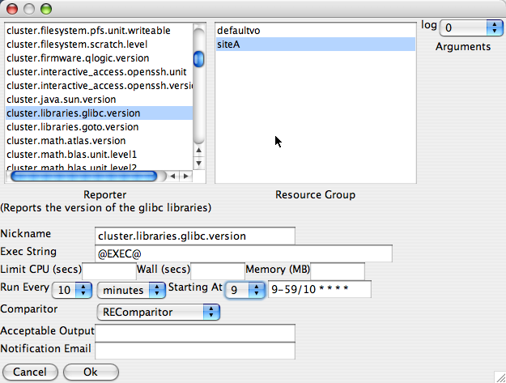
Step 2: Add a reporter to TestSuiteLocal (cont.)
Choose the glibc version reporter
Choose siteA
Choose an execution time. This shows every 10 minutes starting at minute 9. Note, if the current time is say 2:00pm, the first time the glibc reporter will be executed is at
2:09pm. If you want to see the result show up on the web page sooner, set Starting At to 2 so that the reporter will run at 2:02pm.

Slide 6
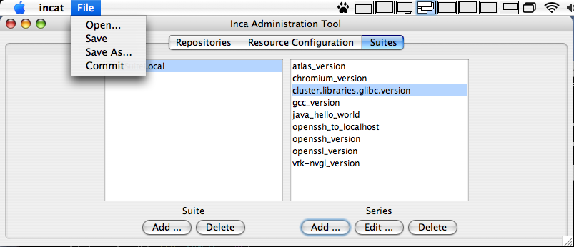
Step 2: Add a reporter to TestSuiteLocal (cont.)
Choose Commit

Slide 7
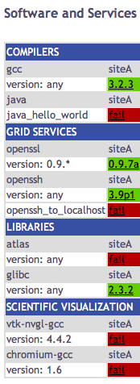
Step 2: Add a reporter to TestSuiteLocal (cont.)
Verify result by swStack.xml located in $INCA_INSTALL/etc/common with
http://inca.sdsc.edu/workshop/swStack.xml
  cd $INCA_LOCATION/etc/common
  rm swStack.xml
  wget \ http://inca.sdsc.edu/workshop/swStack.xml
Reload web page and wait for result

Slide 8
Step 3: Modify default configuration
Before adding remote resources, edit inca.properties and provide the fqdn of the machine using the following steps:
Stop the Inca server components
% inca stop all
Close incat window.
Edit inca.properties in $INCA_INSTALL/etc/common and replace all instances of localhost with the fqdn of the machine you are using (e.g., hogg.sdsc.edu).
Start the Inca server components
% inca start all
Start Incat
% inca start incat -A localhost:6323

Slide 9
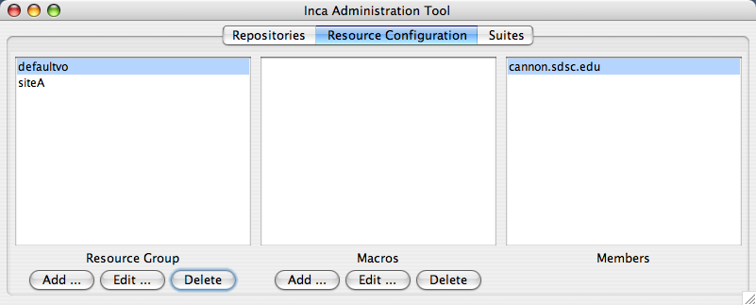
Step 4: Add new resource
Click the Resource Configuration tab.
Click Add under Resource Group

Slide 10
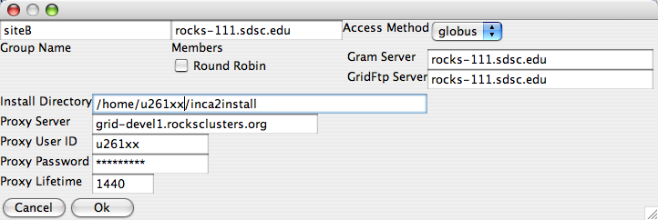
Step 4: Add a new resource (cont.)
Add one of the following resources using Globus as the access method called siteB:
  rocks-111.sdsc.edu
  rocks-112.sdsc.edu
  rocks-113.sdsc.edu
  rocks-104.sdsc.edu

Slide 11
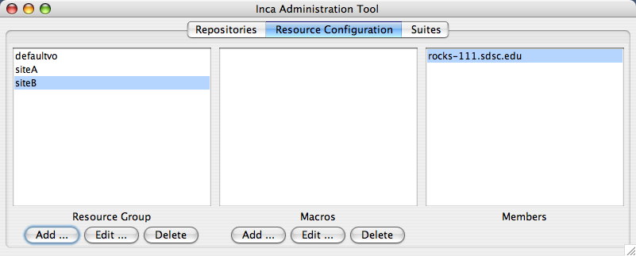
Step 5: Define a resource macro
Highlight siteB and click the Add button under Macros.

Slide 12

Step 5: Define a resource macro (cont.)
Define the macro GLOBUS_HOSTS with values
rocks-111.sdsc.edu rocks-112.sdsc.edu
Click Ok button.

Slide 13
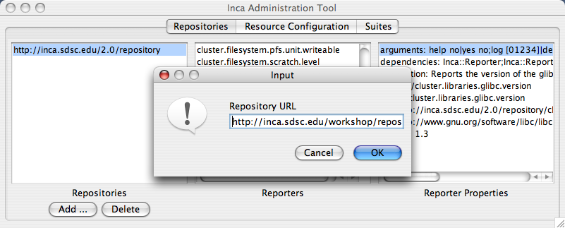
Step 6: Add a new repository
Click on Repositories tab
Click the Add button under Repositories and type in http://inca.sdsc.edu/workshop/repository

Slide 14
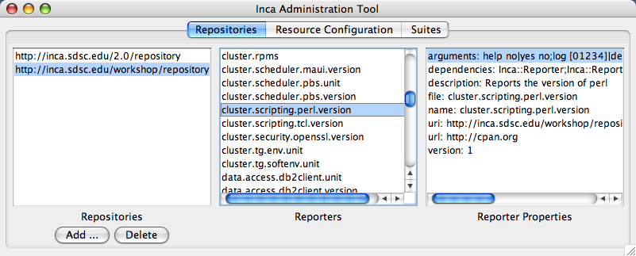
Step 6: Add a new repository (cont.)
You should see a “Retrieving info from Agent” message.
Once complete, scroll down to see the new reporter: cluster.scripting.perl.version

Slide 15
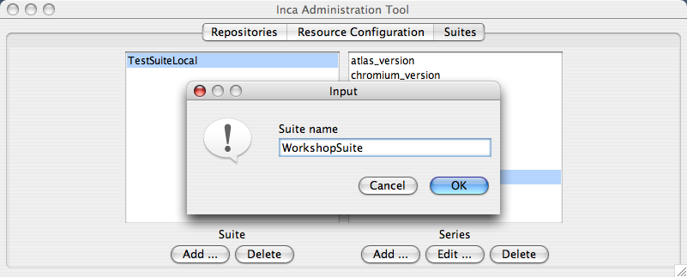
Step 7: Create a new suite
Click on Suites tab.
Click the Add button under Suite and type in WorkshopSuite as the name for your new suite

Slide 16
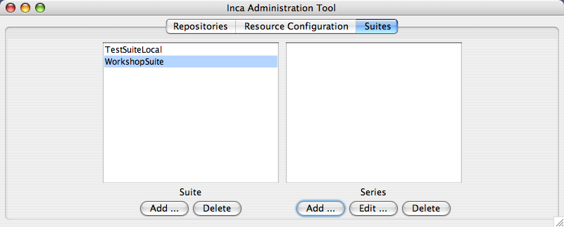
Step 8: Add perl version reporter to suite
Click on the Add button under Series

Slide 17
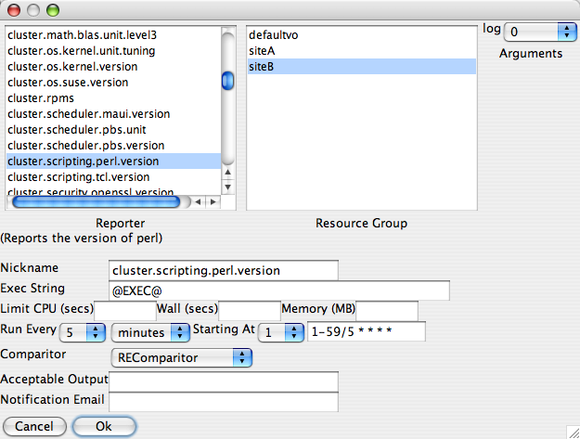
Step 8: Add perl version reporter to suite (cont.)
Choose perl version reporter
Choose siteB.
Choose an execution time. This shows every 5 minutes starting at minute 1.
Click Ok.

Slide 18
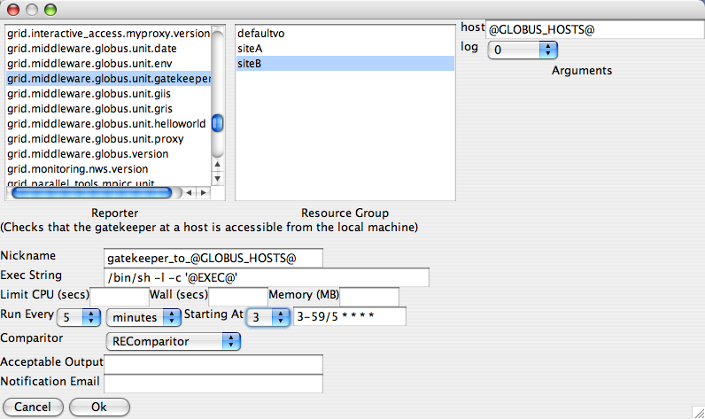
Step 9: Add globus gatekeeper test to suite
Choose globus gatekeeper test reporter
Choose siteB
Choose @GLOBUS_HOSTS@ as the host argument.
Choose gatekeeper_to_@GLOBUS_HOSTS@ as the Nickname.
Choose /bin/sh -l -c '@EXEC@’ as the Exec string
Choose an execution time. This shows every 5 minutes starting at minute 3.
Click Ok.

Slide 19
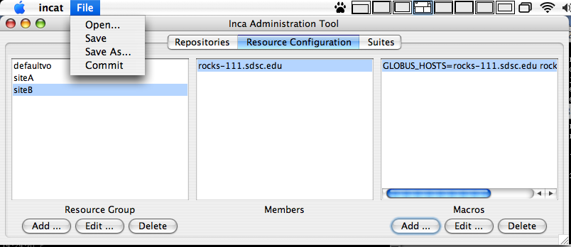
Step 10: Commit changes
Choose Commit

Slide 20
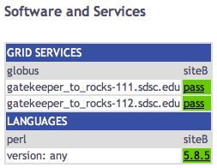
Step 11: View result
Copy swStack2.xml from
http://inca.sdsc.edu/workshop/swStack2.xml
into $INCA_INSTALL/etc/common
  cd $INCA_INSTALL/etc/common
  wget \ http://inca.sdsc.edu/workshop/swStack2.xml
Open page:
http://host.sdsc.edu:8080/xslt.jsp?xsl=http://host.sdsc.edu:8080/swStack.xsl&resourceID=siteB&suiteName=WorkshopSuite&xmlFile=swStack2.xml

Slide 21
Step 12: Use postgres as db backend
Stop the depot
% inca stop depot
Edit $INCA_INSTALL/etc/hibernate.properties
  Comment out the first 5 lines which specifies for hibernate to use hsql as its backend database:
#hibernate.dialect=org.hibernate.dialect.HSQLDialect
#hibernate.connection.driver_class=org.hsqldb.jdbcDriver
#hibernate.connection.url=jdbc:hsqldb:test
#hibernate.connection.username=sa
#hibernate.connection.password=

Slide 22
Step 12: Use postgres as db backend (cont.)
  Uncomment the second block of lines 8-13 which specifies for hibernate to use postgres:
# Settings for a local PostgreSQL database.
hibernate.dialect=org.hibernate.dialect.PostgreSQLDialect
hibernate.query.substitutions=yes 'Y', no 'N'
hibernate.connection.driver_class=org.postgresql.Driver
hibernate.connection.url=jdbc:postgresql:test
hibernate.connection.username=test
hibernate.connection.password=

Slide 23
Step 12: Use postgres as db backend (cont.)
  Replace the value jdbc:postgresql:test for property hibernate.connection.url on line 11 with the following:
  hibernate.connection.url=
    jdbc:postgresql://rocks-111.sdsc.edu/u261xx
    where u261xx is your username.
  Replace the value “test” for property hibernate.connection.username on line 12 with your username
  hibernate.connection.username=u261xx

Slide 24
Step 12: Use postgres as db backend (cont.)
Download the postgres jdbc jar file pg74.216.jdbc3.jar to your $INCA_INSTALL/lib directory
  cd $INCA_INSTALL/lib
  wget \
    http://inca.sdsc.edu/workshop/pg74.216.jdbc3.jar
Initialize the depot (set up the Inca tables)
inca depot -d
You should see something like the following message:
Initializing c3p0 pool…
…
Database Initialization Completed

Slide 25
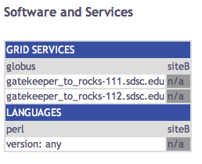
Step 12: Use postgres as db backend (cont.)
Start the depot
% inca start depot
Reload your web page from Step 2 or Step 11. The results will be n/a (because you are using a fresh database that has not been configured to run any reporters)

Slide 26
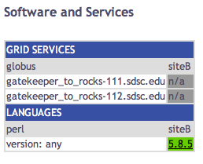
Step 12: Use postgres as db backend (cont.)
Use incat to delete WorkshopSuite. Re-add the WorkshopSuite with the perl version reporter as shown in Step 7 & 8. Wait for web page to update.

