Slide 1
User-level Grid monitoring with Inca 2
Shava Smallen
ssmallen@sdsc.edu
June 25, 2007
Notes:
Presenting a tool that we’ve developed at SDSC for use on TeraGrid. This effort was started in 2003 and we are now in our 2nd major version that I will be presenting here.
Audience:
Other grid monitoring tool developers.
gather info directly from resources
Goal: what Inca does differently from that
those that aggregate data
Goal: entice them to want to interface to Inca
Those attending that are interesting in seeing what monitoring tools are out there:
why user-level monitoring is useful and how Inca is the only tool to provide that
lots of tests, good plugability
easy to use

Slide 2
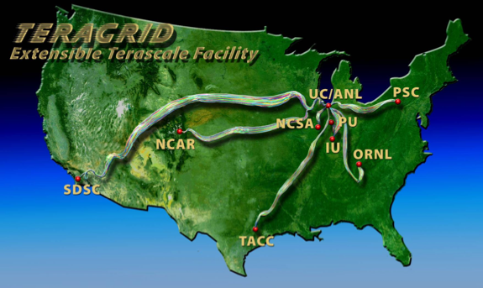
TeraGrid
Origins: national supercomputer centers, funded by the NSF
9 TeraGrid sites, 18 resources
Mix of Architectures:
  ia64, ia32: LINUX
  Cray XT3
  Alpha: True 64
  SGI SMPs
Connected via dedicated multi-Gbps links
1000s of CPUs, > 250 teraflops
> 30 petabytes of online and archival data storage
Coordinated user environment across heterogeneous resources
  CTSS (Coordinated TeraGrid Software & Services)
Notes:
Motivation for work was TeraGrid
TeraGrid serves a general user community and there are various levels of users that it supports. Many users log into resources directly from any of the 9 sites while others access TG via a science gateway portal. One of its TeraGrid’s activities in order to support and encourage the execution of Grid applications is to provide a coordinated user environment known as CTSS. This was so developers and users could focus their effort of porting their Grid applications to machine architecture differences rather than the middleware.
When CTSS was first deployed, there were many inconsistencies between sites due to misunderstandings of the requirements or misconfigurations of the software itself. These inconsistencies along with software failures in general is something we wanted to monitor.
These days the software stack is modularilzed into capability kits (core, data, compute, etc.) and therefore provides sites with more flexiibility in what they decide to deploy (ie.g., somebody could decide to support the data transfer kit but not the scientific workflow kit).
Now initially, one of the biggest problems when CTSS was first deployed back in 2003 was that deploying a common user environment was very difficult because there is no universal deployment system. Each site individually built and configured the packages of a software stack which resulted in either things not working at all or
These days the builds and deployments are a lot more automated but the problem still exists because not everything is and can be automated and many inconsistencies can arise.

Slide 3
User-level Grid monitoring
Testing and performance measurement from a generic, impartial user’s perspective in order to detect and fix Grid infrastructure problems before the user’s notice them.
User-level Grid monitoring system:
  Runs from a standard user account
  Executes using a standard GSI credential
  Uses tests that are developed and configured based on user documentation
  Verifies user-accessible Grid access points
  Centrally manages monitoring configuration
  Automates periodic execution of tests
  Easily updates and maintains monitoring deployment
Notes:
The approach we’ve developed over the years to address this is an active monitoring approach that we call user-level monitoring and the idea is that to attempt to emulate a user of the Grid and test the various services and software. In order to provide user-level monitoring a system would need to…
First testing should be done from a standard user account that’s no different than what a new user of a Grid receives. Early on, we found that testing was done from sys admin accounts which oftentimes have special privileges and have custom shell initialization file. So when users logged on to the system, things would not work for them due to permission problems, environment variables, etc.
Second, because many Grid services require a valid GSI credential, testing needed be run with a standard GSI credential that was mapped on resources to our standard user account
Third we really try to develop the tests that are meaningful and as such are based on the commands written in the user documentation because that is what user’s will using. Likewise, all are test are configured using data from the user documentation. In practice, this is sometimes difficult to achieve because management asks you to test before user documentation is available. But these should be closely coordinated activities. This provides some checks and balances for cases when sysadmins change something but forget to notify user documentation. This helps to ensure that user documentation is correct. And what we’re moving towards now in TeraGrid is pulling data from the same source (MDS4).
Fourth, is that rather than allowing each sites to configure tests for their resources, the configuration of tests is done centrally and the goal of that is to ensure that resources are being tested consistently across TeraGrid. So, for example sometimes sysadmins will “fix” a test so that it passes for that site but their fix is actually a misunderstanding of the deployment requirements.
Fifth, due to the dynamic nature of the Grid, it is important for a system to be able to adapt to changes when new versions of software are installed and updated. Another difficulty we’ve encountered is writing tests perfectly the first time around. And the reason for that is the same as writing a Grid application, you have to worry about bugs, porting issues and ensuring that the test is testing the right thing…sometimes we discover bugs in the user documentation
Next, while we do have a number of tests for TeraGrid, we don’t have tests for everything and a lot of that is just getting the time to write them and there are a course load issues when you use active monitoring. But you want to shoot for a representative number of tests and that can often be accomplished by ensuring testing the commands in the user documentation are tested and having one basic test for each software component.
Next, as you know, it is important to execute tests periodically because the Grid is so dynamic. And as such, archiving those results will help us understand the Grid behavior over time.
Last, in TeraGrid, a user can log in from any of the 9 sites so has been important for us to run locally on each resource and verify that CTSS is available, there and working, etc.
User-level Grid monitoring
Top-down approach
Supports xxx - Information to sysadmins
Centralized configuration or uniform testing
Definition of user-level monitoring - comparison to other approaches (3)
Inca 2 features (1)
Inca architecture (5)
Reporters & repos
Incat/Agent
Rm
Depot
Data consumer/Web services
Use cases
Teragrid (2)
Grasp (1)

Slide 4
Inca
Provides user-level monitoring of Grid functionality and performance
Features:
  Collects wide variety of monitoring results
  Captures context of monitoring result as it executes
  Eases the writing and deploying of new tests or benchmarks
  Supports sharing of tests and benchmarks
  Stores and archives monitoring results
  Securely manages short-term proxies
  Measures system impact of tests and benchmarks

Slide 5
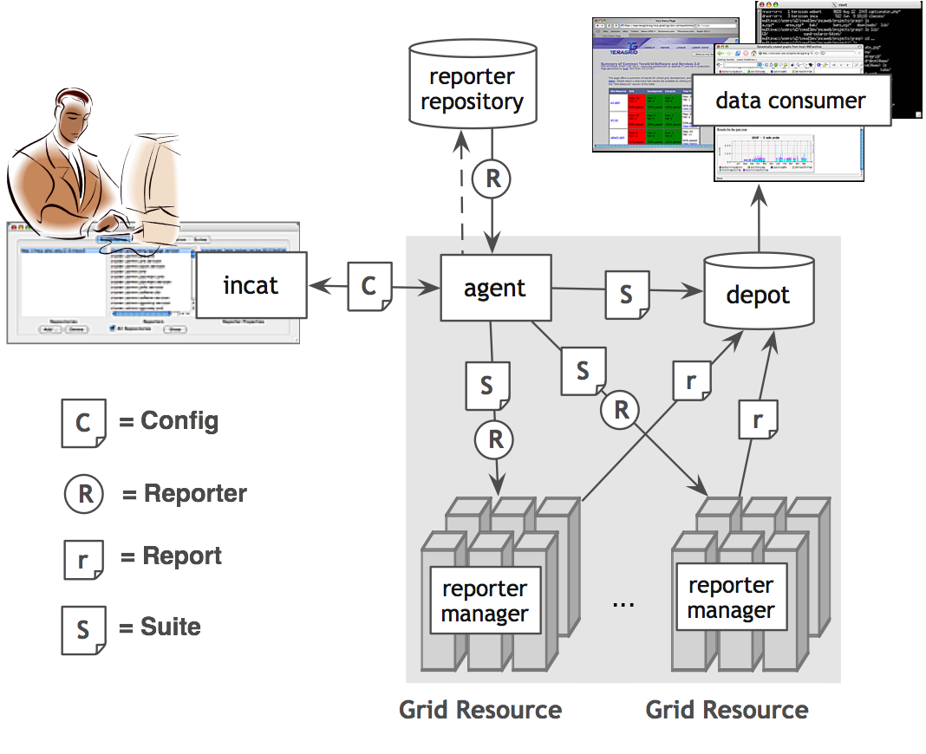
Inca Architecture
Notes:
Inca is composed of a lightweight component that runs on the resource itself to collect monitoring results, a storage component called the depot, and a web server component called the data consumer which displays the monitoring data

Slide 6
Collecting Monitoring Data
Reporters
  Executable program that measures some aspect of the system or installed software
  Requirements:
    Supports specific command-line options
    Writes XML (Inca Reporter schema) to stdout
  Supports multiple types of data
  Extensive library support for perl scripts
  Most reporters < 30 lines of code
  Independent of other Inca components
Notes:
Our method of collecting monitoring data from resources is via an executable called a reporter.
The only requirements is that it supports some specific command-line options like help and verbose and that it outputs the result to stdout in XML that complies to a specific schema.
The schema is flexible to allow multiple types of data to be expressed. It really is just some header and footer tags and then any snippet of xml can be placed in the middle.
It is also independent of the other Inca components so for example sys admins can execute the usually script by hand while they’re debugging a problem.
We also want these reporters to be easy to write so we provide a number of Perl APIs to make it easy to write tests. These APIs take care of the formatting of data in the Inca reporter XML and a number of convenience functions for cleaning up temporary files and timing out system commands. There are also some logging functions which can be useful for showing what commands a reporter executes so for sysadmins who don’t want to read a perl script.
A reporter repository is a collection of these reporters which is accessible via a URL
Lots of reporters to choose from
Lots available
Iterative process to write the portable ones
Interested in what we can share with others

Slide 7
Sharing Reporters
Repositories: collection of reporters available via a URL
  Supports package dependencies (Perl modules, Makefile, autoconf)
Screenshot of a repository using Inca GUI tool
  Packages versioned to allow for automatic updates
  Inca repository contains 157 reporters
    Version, unit test, performance benchmark reporters
    Grid middleware and tools, compilers, math libraries, data tools, and viz tool
Notes:
TODO: insert picture of web display of reporter

Slide 8
Centralized configuration and deployment
Incat
  GUI interface to enable a large number of monitoring results to be collected with a minimum of effort
  Configure the reporters to execute on a set of resources
  Configuration stored in a XML file and sent to Agent
Agent
  Implements the configuration specified by Inca administrator
  Stages and launches a reporter manager on each resource
  Sends package and configuration updates
Notes:
Centralized admin
Gui interface

Slide 9
Storing data
Depot
  Stores configuration information and monitoring results
  Uses relational database backend via Hibernate
  Provides full archiving of reporter output
  Supports SQL queries and provides predefined queries for latest monitoring results, report instance, and report history
  Supports notifications
Notes:
Stores data
Minimize repetitive data

Slide 10
Displaying and publishing data
Data Consumer
  Web application that queries and displays monitoring data
  Packaged with Jetty
  JSP tags to query data and format using XSL
Web services
  Query data from depot and return as XML
Notes:
Display of data to sysadmins
Regular red/green pages

Slide 11
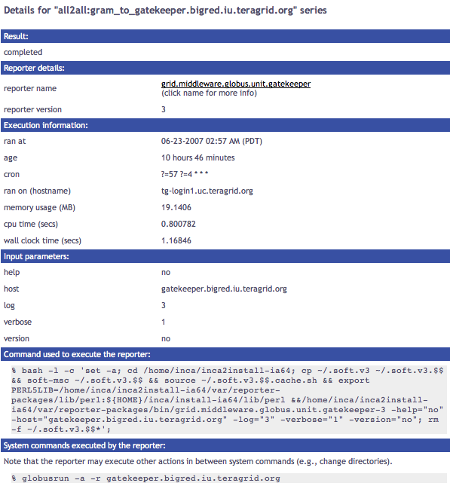
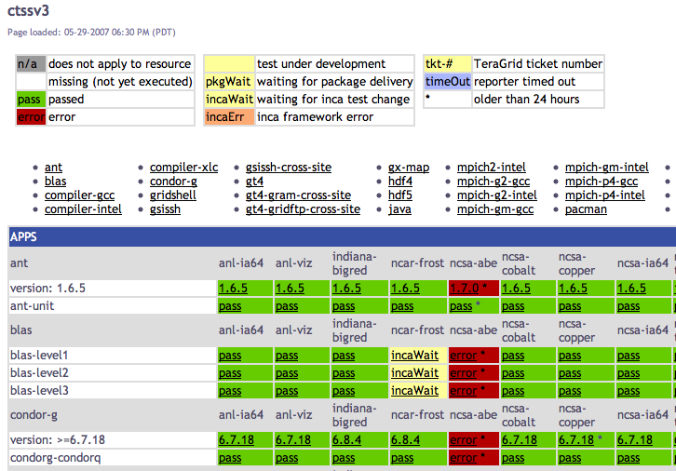
Inca in Use: TeraGrid
Currently monitoring all 18 allocated TeraGrid resources
  Monitoring of CTSSv3
  Monitoring of CTSSv4 (in progress)
  Grid jobs (Globus gatekeeper logs)
  CA certificate and CRL checking (notify if 2 weeks from expiration)
  Resource registration in MDS

Slide 12
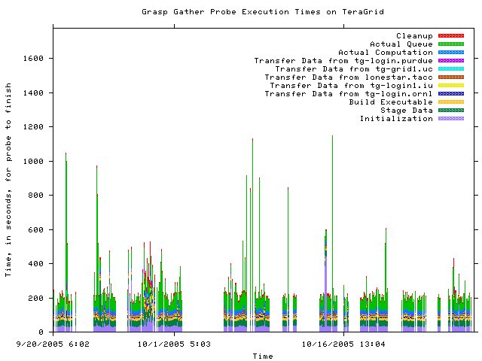
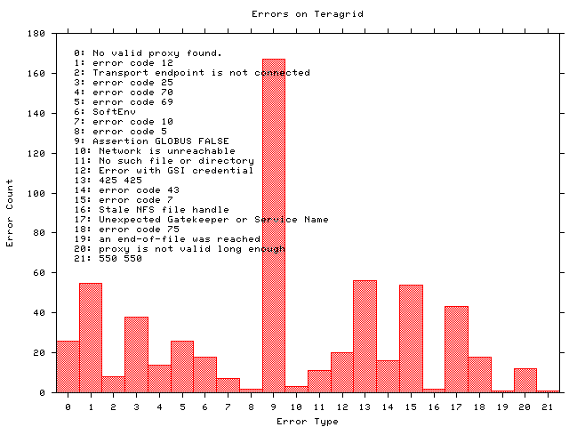
Inca in use: Grid Assessment Probes
Set of probes designed to emulate Grid applications
Deployed using Inca to GEON and TeraGrid
Notes:
Other types of data that we’ve collected is benchmark

Slide 13



Software Status
Current software version: 2.03
(available from Inca website)
http://inca.sdsc.edu
Other Inca deployments:

Slide 14
Summary
User-level Grid monitoring: Testing and performance measurement from an impartial user perspective to detect problems before the users notice them
Standalone reporter APIs and repositories make it easy to write and share tests and benchmarks (reporters)
Centralized configuration enables uniform monitoring and makes it easy to deploy Inca monitoring to a set of resources
Data consumer and web services interface enable publishing and displaying of Inca monitoring data
Notes:
Inca is designed to support testing and measurement from a general user’s perspective

Slide 15


More Information
Website:
http://inca.sdsc.edu
Announcements:
inca-users@sdsc.edu
Email:
inca@sdsc.edu
Supported by:

Slide 16
Sample Reporter
use Inca::Reporter::SimpleUnit;
my $reporter = new Inca::Reporter::SimpleUnit(
name => 'grid.globus.gramPing',
version => 2,
description => 'Checks gatekeeper is accessible from local machine',
url => 'http://www.globus.org',
unit_name => 'gramPing'
);
$reporter->addDependency('Inca::Reporter::GridProxy');
$reporter->addArg('host', 'gatekeeper host');
$reporter->processArgv(@ARGV);
my $host = $reporter->argValue('host');
my $out = $reporter->loggedCommand("globusrun -a -r $host", 30);
if (!$out) {
$reporter->unitFailure("globusrun failed: $!");
} elsif($out !~ /GRAM Authentication test successful/) {
$reporter->unitFailure("globusrun failed: $out");
} else {
$reporter->unitSuccess();
}
$reporter->print();
Notes:
TODO: Add descriptions of fields

Slide 17
Scheduling and Execution
Reporter manager
  Manages and schedules the execution of reporters on a single resource
  Executes under regular user account
  Monitors reporter system usage and enforces limits
  Sends monitoring result to a depot
Notes:
Enable execution of reporters

