Slide 1
Inca Control Infrastructure
Shava Smallen
ssmallen@sdsc.edu
Inca Workshop
September 4, 2008
Notes:
Components of Inca which handle reporter staging, execution, and collection of data from resources

Slide 2
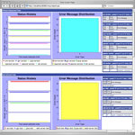
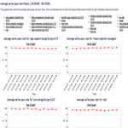
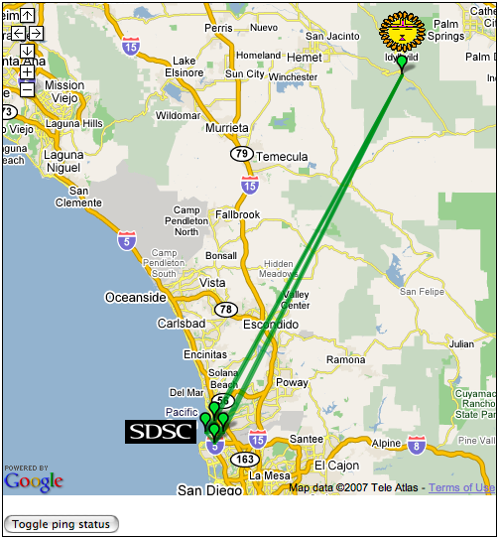
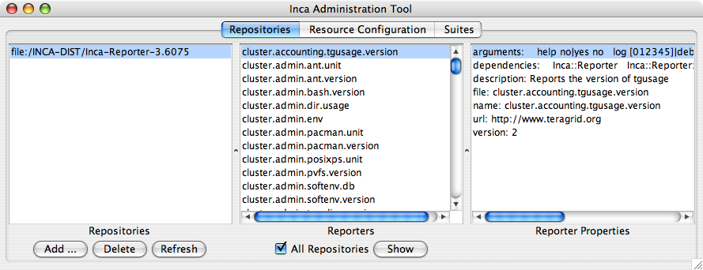
Reporter
Repository
Data Consumers
Incat
R
C
Agent
Depot
Control Infrastructure
S
Minimal impact on monitored resources
Flexible reporter scheduling and configuration options
Easy installation and maintenance
Proxy credential available to reporters for user-level execution
S
r
R
r
S
R
Reporter
Manager
Reporter
Manager
…
Grid Resource
Grid Resource
Notes:
2 main components are RA and RM
Because we want to have a minimal impact on the resources we are monitoring, the RMs are designed to be minimal functionality needed to schedule and execute reporters and send data to the depot. The RMs also will profile reporter system usage and limit that usage through timeouts.
Because working at the reporter manager level is cumbersome (I.e., v1 did this), we introduce the RA to handle higher level coordination and control flow. This addresses the goals about installation and maintenance being easy.

Slide 3
Agent provides centralized configuration and management
Implements the configuration specified by Inca administrator
Stages and launches a reporter manager on each resource
Sends package and configuration updates
Manages proxy information
Administration via GUI interface (incat)
Screenshot of Inca GUI tool, incat, showing the reporters that are available from a local repository

Slide 4
A configuration is a description of an Inca deployment
Which resources do you want to monitor?
What do you want to monitor?
How do you want to monitor?

Slide 5
Step 1a: Defining your resources
A resource can be a cluster, supercomputer, or server
TeraGrid
SDSC
NCSA
A resource group is two or more related resources
  Shared characteristic
  (e.g., ia64 arch)
  Site
  VO
onDemand
IA-64
Cluster
IA-64
Cluster
…
IA-64
Resource Group
Resource

Slide 6
Step 1b: Describing your resources
Attributes (or variables) that describe your resource -- macros
Macros can be defined in a resource or in a resource group
Macros can be inherited -- most specific value wins
Can have multiple values
TeraGrid
myproxyHost = myproxy.teragrid.org
DataStar
NCSA IA-64 Cluster
gatekeeper = dslogin.sdsc.edu
nativeCC = xlc
chargeId = SDSC-02
gatekeeper = tg-login.ncsa.edu
nativeCC = icc
chargeId = NCSA-24

Slide 7
Step 1c: Automating access to resource
Local
Access
Uses Java Runtime exec
Agent
Grid Resource
Local
Remote
Ssh
Access
Globus
Access
…
Uses Java CoG - (supports Globus pre-WS servers)
Uses SSHTool’s Java SSH API
Grid Resource
Grid Resource
Installs in $HOME/incaReporterManager by default

Slide 8
A configuration is a description of an Inca deployment
Which resources do you want to monitor?
What do you want to monitor?
How do you want to monitor?

Slide 9
Step 2: Selecting or creating reporters
Use local repository
  Copy of the standard Inca reporter repository installed by default
  Use file:// or http:// (recommended)
Use Inca project reporter repository + local repository
  Receive updates

Slide 10
A configuration is a description of an Inca deployment
Which resources do you want to monitor?
What do you want to monitor?
How do you want to monitor?

Slide 11
What is a report series?
A set of reports collected at different points in time by executing a reporter with a set of arguments in a context on a particular host

Slide 12
Step 3a: Find reporter to execute
E.g., can you submit a batch job via Globus WS-GRAM to Grid resources
Select reporter: grid.middleware.globus.unit.wsgram.jobsubmit
% grid.middleware.globus.unit.wsgram.jobsubmit \
-host="tg-condor.purdue.teragrid.org:8443" \
-log="5" \
-maxMem="2048" \
-nodes="1" \
-project="TG-STA060008N" \
-queue="standby" \
-scheduler="Condor"
Notes:
Report series specification

Slide 13
Step 3b: Decide where to run reporter
TeraGrid
Select a single resource name or resource group
E.g.,
  sdsc-ia64
  SDSC
  TeraGrid
  IA-64
SDSC
NCSA
onDemand
IA-64
Cluster
IA-64
Cluster
…
IA-64
Resource Group
Resource
Notes:
e.g., myproxy reporter run on all of teragrid

Slide 14
Step 3c: Configure reporter arguments
% grid.middleware.globus.unit.wsgram.jobsubmit \
-host=”@gramContact@" \
-log="5" \
-maxMem="2048" \
-nodes="1" \
-project=”@projectId@" \
-queue=”@queue@" \
-scheduler=”@scheduler@"
Resource group macro
Resource macros
TeraGrid
projectId = TG-STA060008N
DataStar
NCSA IA-64 Cluster
gramContact = dslogin.sdsc.edu
queue = default
scheduler = LSF
gramContact = tg-login.ncsa.edu
nativeCC = standby
chargeId = PBS

Slide 15
Agent “expands” macro values in series
TeraGrid
SDSC IA-64
grid.middleware.globus.unit.wsgram.jobsubmit \
-host=”tg-login.sdsc.edu:8443" \
-log="5" \
-maxMem="2048" \
-nodes="1" \
-project=”TG-STA060008N" \
-queue=”@queue@" \
-scheduler=”@scheduler@"
grid.middleware.globus.unit.wsgram.jobsubmit \
-host=”@gramContact@" \
-log="5" \
-maxMem="2048" \
-nodes="1" \
-project=”@projectId@" \
-queue=”@queue@" \
-scheduler=”@scheduler@"
NCSA IA-64
grid.middleware.globus.unit.wsgram.jobsubmit \
-host=”tg-login.ncsa.edu:8443" \
-log="5" \
-maxMem="2048" \
-nodes="1" \
-project=”TG-STA060008N" \
-queue=”standby” \
-scheduler=”PBS”

Slide 16
Agent “expands” multi-valued macro values in series
NCSA IA-64
NCSA IA-64
grid.performance.ping \
-host=tg-login.sdsc.edu
grid.performance.ping \
-host=@hosts@
NCSA IA-64
grid.performance.ping \
-host=tg-login.uc.edu
Reporter will be executed once for each value in macro.
hosts = tg-login.sdsc.edu,
tg-login.uc.edu,
tg-login.psc.edu
NCSA IA-64
grid.performance.ping \
-host=tg-login.psc.edu

Slide 17
Agent “expands” multiple multi-valued macro values in series
Multiple multi-valued macros ⇒ cross product
  E.g.,
  data.transfer.unit -host=@gridftpServers@ -dir=@dirs@
  @gridftpServers@ = bglogin.sdsc.edu, tg.ncsa.edu
  @dirs@ = /gpfs/inca, /users/inca, /scr/inca
  Will expand to:
data.transfer.unit -host=bglogin.sdsc.edu -dir=/gpfs/inca
data.transfer.unit -host=bglogin.sdsc.edu -dir=/users/inca
data.transfer.unit -host=bglogin.sdsc.edu -dir=/scr/inca
data.transfer.unit -host=tg.ncsa.edu -dir=/gpfs/inca
data.transfer.unit -host=tg.ncsa.edu -dir=/users/inca
data.transfer.unit -host=tg.ncsa.edu -dir=/scr/inca

Slide 18
Step 3d: Specify an execution context
Optional execution string can be used to set the context the reporter runs under
E.g., run reporter under fresh shell:
/bin/sh -l -c ‘@EXEC@’
/bin/sh -l -c ‘net.benchmark.wget -page=…’
E.g., softenv/modules configuration
soft add +atlas; @EXEC@
soft add +atlas; cluster.math.atlas.version …

Slide 19
Step 3e: Choose a scheduling frequency
Expressed in modified cron syntax
minute hour dayOfMonth month dayOfWeek
minute = The minute of the hour the reporter will be executed (range: 0-59)
hour = The hour of the day the reporter will be executed (range: 0-23)
dayOfMonth = The day of the month the reporter will be executed (range: 0-23)
month = The month the reporter will be executed (range: 1-12)
dayOfWeek = The day of the week the reporter will be executed (range: 0-6)
"?" in the field tells Inca to pick a random time within the specified range -- spreads out load
  ? * * * * = run anytime every hour
  ?-59/10 * * * * = run anytime every 10 minutes

Slide 20
Step 3f: Specify a unique nickname
Should be unique for a resource
Can contain macros
E.g., atlas_version
E.g., gridftp_test_to_@site@

Slide 21
Step 3g: Limit resource usage of reporter
(optional)
Wall clock time
  E.g., no more than 10 seconds
Cpu seconds
  E.g., no more than 2 cpu seconds
Memory
  E.g., no more than 20 MB
Reporter will be killed and an error report will be sent indicating the resource usage exceeded

Slide 22
What is a suite?
A set of report series that share a common theme. E.g.,
  data management
  job management
  file transfer
  LiDAR workflow

Slide 23
Inside the agent
Reporter
Repository
Incat
R
C
Refresh
repository
Expand series
S
C
S
Depot
Download reporters
Distribute
S
S
S
S
S
S
Repository
cache
Suites
RM
r
RM
controller
r
S
S
Configuration contains:
Repository URLs
Resources
Suites
R
R
Reporter
Manager
Reporter
Manager
…
Grid Resource
Grid Resource

Slide 24
Agent supports proxy credentials
Case 1:
Case 2:
Reporter
Agent
MyProxy
Server
Reporter
Agent
MyProxy
Server
P
Java CoG
Proxy retrieved to launch Reporter Manager using Globus access method
Myproxy
info
P
Reporter
Manager
Proxy retrieved to provide credential for reporters
Reporter
Manager

Slide 25
Agent supports “run now” execution for debugging
Each series can be scheduled for immediate execution
Run a series before its next scheduled execution time to update a series result

Slide 26
Agent monitors reporter managers
Pings reporter managers every 10 minutes
Attempts to restart every hour
If multiple hosts specified for a resource, will try each host
Best practice: specify a shortname for a resource
sdsc-ia64
tg-login1
tg-login2
tg-login3
tg-login4

Slide 27
Reporter Manager
Minimal functionality to limit load on resource
Receives from reporter agent that started it:
  Reporters and libraries
  Reporter configuration and schedules
Executes reporters periodically (cron) or on-demand and forwards reports to the depot
Profiles reporter system usage and enforces timeouts

Slide 28
Summary
Agent and reporter manager provide for minimal impact on monitored resources
Flexible reporter scheduling and configuration options
Macros, access methods, and automatic package updates ease installation and maintenance
Proxy credential available to reporters for user-level execution

