Slide 1
Measuring Software and Service Integrity
Detecting Grid failures using the Inca framework
Supercomputing 2005
Notes:
What is Inca?
Problem description - Monitor/testing
What Inca provides
How Inca compares to other tools out there (Nagios, MonaLISA, Clumon/Ganglia, LCG monitoring, Big Brother, Hawkeye
Inca in use
Software Stack validation (TG, UK, DEISA)
Benchmarks (GRASP, BW?)
Architecture Overview
Sales Pitch
V2 improvements, new GUIs, install/admin
Release schedule & workshop
Contact information
-- circulate email list

Slide 2
Grid Reliability
“You know you have [a distributed system] when the crash of a computer you've never heard of stops you from getting any work done.” -- Leslie Lamport
Sources of failures:
  Software - failed installation, misconfiguration, environment problem, bugs, not scalable
  Hardware - power failures, overheating, cable unplugged
  Networking problems
Grid computing: The ability to dynamically link resources together as an ensemble to support the execution of large-scale, resource-intensive, and distributed applications
Notes:
Motivation of our work is the issue of reliability in today’s production Grids (e.g., TeraGrid, NEESGrid, etc.)
By definition, running an application on the Grid implies a dependency on multiple resources and the software and services deployed there.
As verbalized in the famous quote by Leslie Lamport, as the number of dependencies increase so does the probability of failures
In a Grid platform, the sources of failures can be software, hardware, and/or networking related

Slide 3
Is the Grid up?
Can user X run application[s] Y on Grid[s] Z? Access dataset[s] N? Performance?
  Can I login?
  Are Grid services the application[s] use available? Compatible versions?
  Are dataset[s] N accessible to user X? Credentials?
  …
Notes:
Now when we look at what this means for the user, the Grid is up if they can run their particular application on their set of resources, access their dataset, and get “good” performance.
This may seem straightforward but there are actually a lot of things that need to be working underneath the hood in order to make that happen. For example, …
And as you consider the requirements of a community of users and multiple communities of users, those set of requirements can grow quite large.

Slide 4
Testing a Grid
Iteratively define a set of concrete requirements (machine-readable)
Write tests to verify requirements
Periodically run tests and collect data
Publish data
Automate Steps 3 and 4
Notes:
One way to address this is through automated testing (as you do with software) so that you can have some confidence that when a user logs in, they can get work done
The way you go about this is to define a set of concrete requirements (I.e., machine-readable). These can then be be tested automatically and periodically (important in these dynamic Grid environments).
Some places where you can get requirements from are user documentation, talking to users, proposals, etc.
Note, this is not a simple matter of sitting down once and defining a complete set of requirements
This will be an iterative refinement process because requirements can be interpreted differently between sites and the requirements will change over time especially as packages are upgraded etc.

Slide 5

What type of testing?
Deployment testing
  Automated, continuous checking of Grid services, software, and environment
  Installed? Running? Configured correctly? Accessible to users? Acceptable performance?
  E.g., gatekeeper ping or scaled down application
Junit,
PyUnit, Tinderbox
Software Package
(unit, integrated)
Software Stack
(interoperability)
NMI
Software
Deployment
Notes:
When we refer to testing, we’re talking about testing at the deployment level
This is different than the type of testing you do at the software package level where you’re looking at detailed testing of the software features and checking that it works on all architectures using something like junit, tinderbox, etc.
This is also different than the type of testing that occurs at the software stack level where you’re looking at package version interoperability (e.g., NMI)
Testing at the software deployment level is more coarse-grained and involves automated continuous checking of the available Grid software services, software, and environment.
We are checking whether packages are installed, running, and configured correctly.
We also want to check that applications could achieve good performance. That is we want to detect soft failures in addition to hard failures.
This tests can be something as simple as pinging a Globus gatekeeper service to a more complicated test such as a scaled down version of an application

Slide 6
Who are the consumers?
Grid/VO Management
  Responsible for designing & maintaining requirements
  Verify requirements are fulfilled by resource providers
System administrators
  Notified of problems
  Enough information to understand context of problem
End users
  View results and compare to problems they are having
  Debug user account/environment issues
  Advanced users: feedback to Grid/VO
Notes:
There are different consumers of the testing results: Grid/VO, system administrators, and end users
Our view is that responsibility of the testing should occur at the Grid/VO level. Based on the goals of the Grid, they decide what should be tested and then collect the results - the goal being to detect problems before the users do
While the Grid/VO will decide what to test, system administrators from each of the participating sites will need to be notified of failures and be able to understand how the test was conducted so they can debug their system. This implies that the need to trust the results.
While ideally, we hope that the failures will be caught before users notice them, in reality we’re still a long way to achieving this. Therefore, the results of our testing should be made available to users so if they’re having a problem, they can check the results to see if it might be system related.
They should also be able to use the tests to debug user account/environment issues specific to their account (e.g., removing an environment variable accidentally prevents a package from working)
For more advanced users, they could even feedback useful tests to the Grid/VO level.

Slide 7
Inca
Inca is a framework for the automated testing, benchmarking and monitoring of Grid systems
Inca provides:
  Scheduled execution of information gathering scripts (reporters)
  Data management
    collection
    archiving
    publishing
Notes:
To this end, we’ve developed Inca as a …
It provides …
We started Inca 2 years ago in the context of the TeraGrid project to do V&V of the software stack and environment. When we started there were only a few testing projects out there like the NCSA TestGrid project but no frameworks.

Slide 8
Similarities to other Grid monitoring tools
Data collection customized with plug-ins
  Scheduled Execution:
    Nagios, Big Brother, MonALISA, Hawkeye, Ganglia
  Aggregators
    MDS, MonALISA, GridICE
Data Storage
  Caching
    Nagios, Big Brother, MDS, GridICE, MonALISA, Hawkeye, Ganglia,
  Archiving
    Nagios, Big Brother, GridICE, MonALISA, Ganglia
Data Dissemination
  Notifications
    Nagios, GridICE, MDS4, Hawkeye, MonALISA
  Display data in web page
    Nagios, Big Brother, GridICE, MonALISA
Notes:
Over the past couple years, several monitoring tools have been developed that are at a high-level similar to Inca wrt to data collection, data storage, and data dissemination
Starting with data collection, there are 2 main features that these tools provide
Scheduled execution of information gathering scripts
Aggregation (I.e., fed information from more fine grained monitoring tools like Ganglia). Aggregation is not our mainstay but is possible
In data storage, there are 2 main features
Caching of the data (I.e., the last test result)
Archiving of the data
some systems use a relational DB like Big Brother (Sybase), GridICE (postgres), MonALISA (MySQL, PostgreSQL, Microsoft SQL Server)
Ganglia uses RRDTool and Nagios uses logs
Most systems disseminate the info through some type of email notification and then web page display of the data. Colors like red/green indicate success/failure and there is usually some type of summary status page.
Tools like MonALISA and GridICE do a lot wrt accounting/job monitoring -- not something we’ve addressed but we could
Inca could complement MonALISA, GridICE, MDS since they are aggregate data.
There’s also the NCSA TestGrid and GITS -- not frameworks
We’re working with GITS’ David Baker to incorporate tests into Inca

Slide 9
Unique features of Inca
Understanding and debugging failures
  Run under a regular user account (v1, v2)
  Flexibility in expressing results (v1, v2)
  Context of the test execution (machine information, key commands executed) (v1, v2)
  Reporters designed to be run independently of the framework (v1)
  Easy to securely re-run a test (v2)
Notes:
But as they say “the devil is in the details”. Here’s what sets us apart as unique -- based on our experience with real Grid deployment on TG. Places noted as v1 is a feature we have in our current release and v2 will be available to the public early 2006.
Archiving
A test can be run standalone of the Inca framework to aid in debugging -- although we haven’t done it yet, we feel this could be effectively integrated into a knowledge base/troubleshooting tool (think GridMD)
A test is not simple pass/fail (e.g., performance problems) -- you can report back a block of XML
There’s such a thing as testing too often -- tradeoff of between freshness of data and impact on resource
Resources can provide different capabilities -- it should be easy to specify how to test resources (e.g., if a resource has a PFS, run these tests)
Testing effectively is a continuous refinement process --- configuration changes should be easy!
Easy to *securely* re-trigger a test (I fixed it -- update the result) -

Slide 10
Unique features of Inca
Effective testing is a continuous refinement process
  Expressive and configurable testing instructions (v2)
  Configuration changes are easy (e.g., type of data, frequency of execution) - (v2)
Balance impact of testing on resources with data freshness
  Logs CPU, memory, and execution time to understand impact on resource (v2)
Separates data specification and collection
  Provide comparison engine
Stores reporter series
Notes:
But as they say “the devil is in the details”. here’s what sets us apart as unique -- based on our experience with real Grid deployment on TG
A test can be run standalone of the Inca framework to aid in debugging -- although we haven’t done it yet, we feel this could be effectively integrated into a knowledge base/troubleshooting tool (think GridMD)
A test is not simple pass/fail (e.g., performance problems) -- you can report back a block of XML
There’s such a thing as testing too often -- tradeoff of between freshness of data and impact on resource
Resources can provide different capabilities -- it should be easy to specify how to test resources (e.g., if a resource has a PFS, run these tests)
Testing effectively is a continuous refinement process --- configuration changes should be easy!
Easy to *securely* re-trigger a test (I fixed it -- update the result) -

Slide 11
Outline

Slide 12





Inca Today
Software available at:
http://inca.sdsc.edu
Current version: 0.10.3
Also available in NMI R7
Users:
Notes:
What we have today
Note about Inca 2.0

Slide 13
Section 2: Inca in use
Detecting hard failures
  Software, hardware, networking failures
    TeraGrid software stack monitoring (v1)
Detecting soft failures
  Understanding the performance
    Network measurement gathering (v1)
    Grid benchmarking (v2)
  Detecting a problem
Both released versions of Inca are currently being used in production environments
Notes:
Uses today include
hard failures verifying software environment
soft failures (e.g., performance drop) -- this is not easy because you have to first
Understand what is normal performance -- open research question
Detect when there is a problem -- historical comparison
Grid middleware - We’re working on the first part now -- joint work with Allan Snavely & Henri C
Network performance

Slide 14
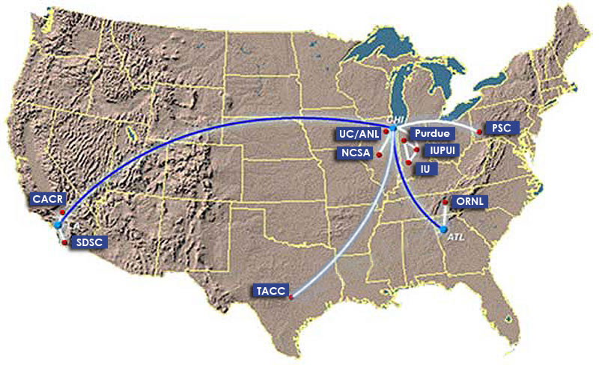
TeraGrid software stack monitoring
TeraGrid - an “enabling cyberinfrastructure” for scientific research
  ANL, Caltech, Indiana Univ., NCSA, ORNL, PSC, Purdue Univ., SDSC, TACC
  40+ TF, 1+ PB, 40Gb/s net
Common TeraGrid Software & Services
  Common user environment across heterogeneous resources
  TeraGrid VO service agreement

Slide 15
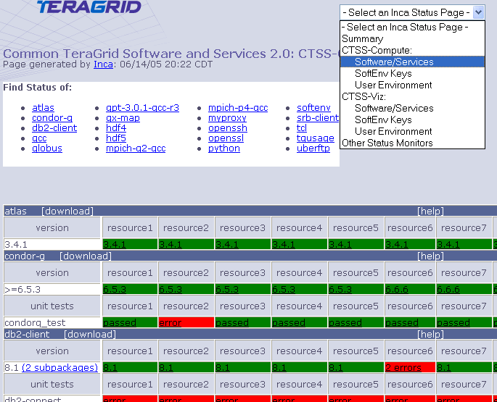
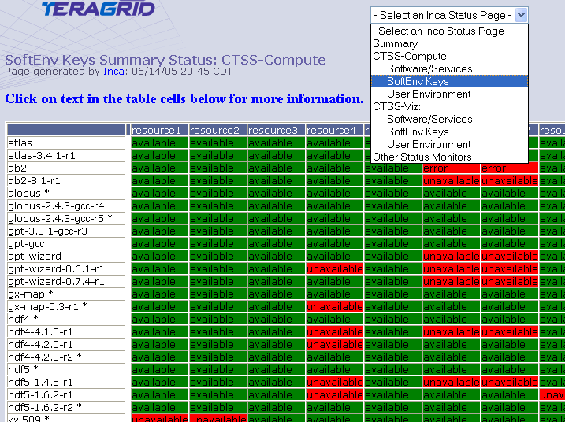
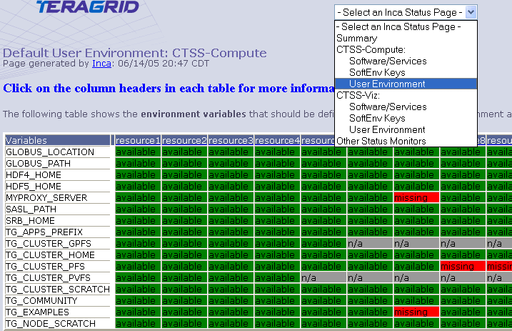
Detailed Status Views
Resources
SW
packages

Slide 16
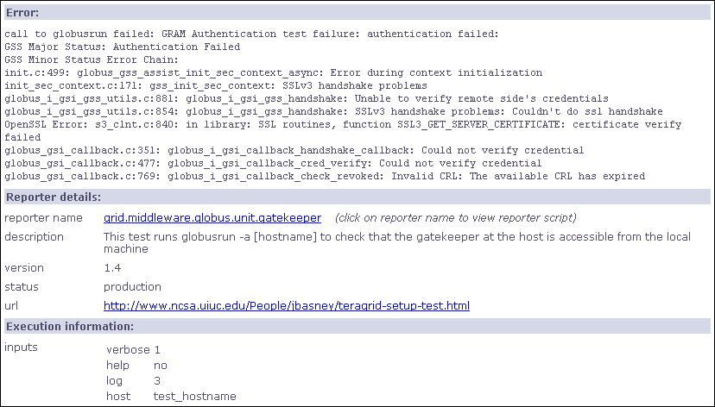
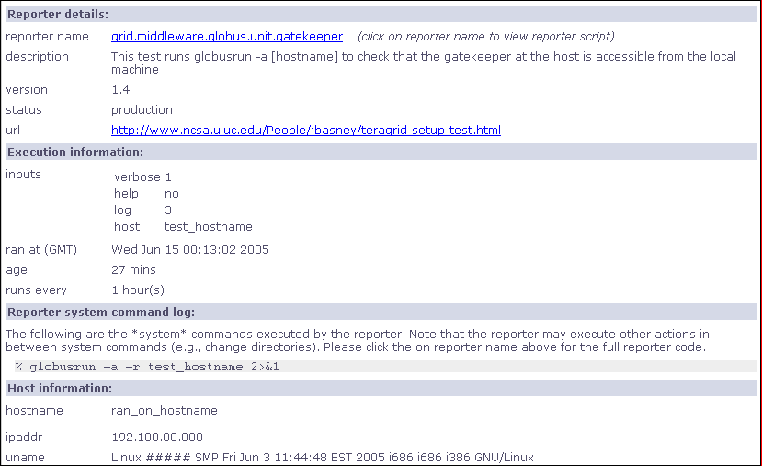
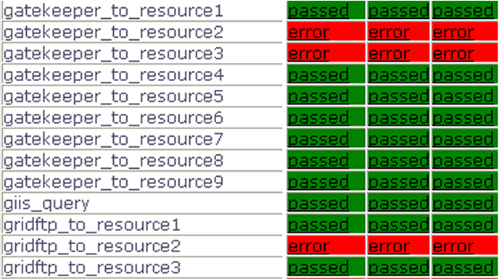
Drill-down capability

Slide 17
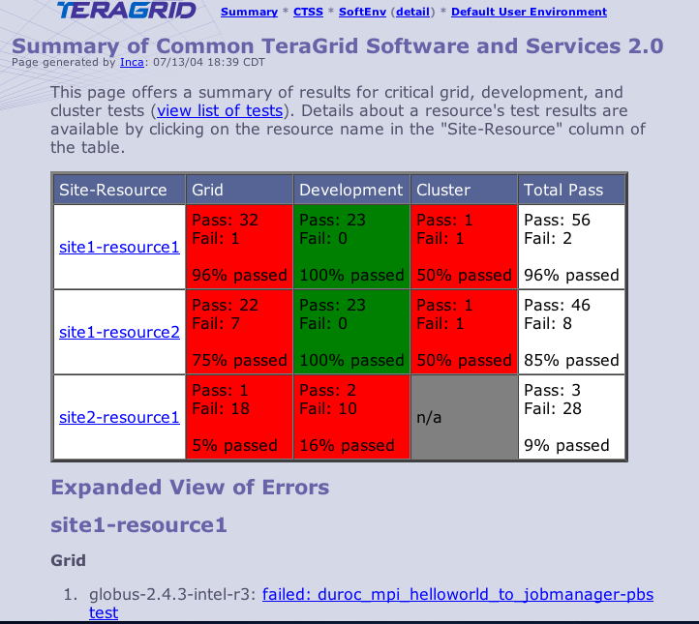
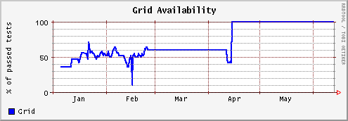
Summary Status
All tests passed: 100%
One or more tests failed: < 100%
Tests not applicable to machine or have not yet been ported
Key
History of percentage of tests passed in “Grid” category for a 6 month period

Slide 18
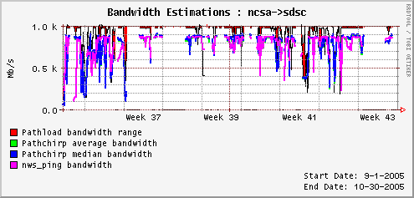
Comparison of End-to-end Bandwidth Measurement Tools
Joint work with Margaret Murray (TACC) and Martin Swany (UDel)
Tools:
  Pathload [Dovrolis et al]
  Pathchirp Ribeiro][
  NWS [Wolski]

Slide 19
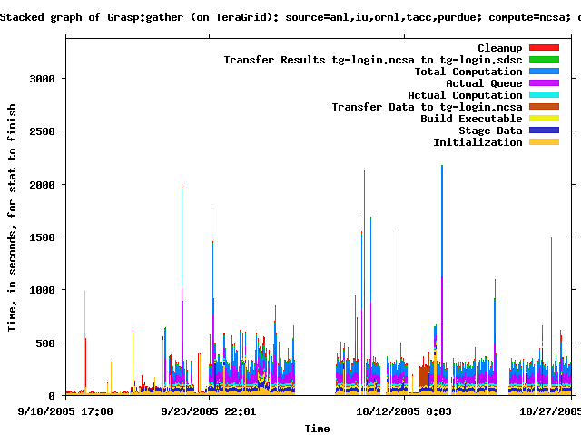
Measuring Grid Middleware Performance
Notes:
This is the gather probe on TG -- white areas indicate no data and bars with incomplete colors indicate that the probe did not complete.
C. Olschanowsky, et. Al, “Acquiring and Using Benchmark Data from Computational Grids”, submitted to Sigmetrics 2006

Slide 20
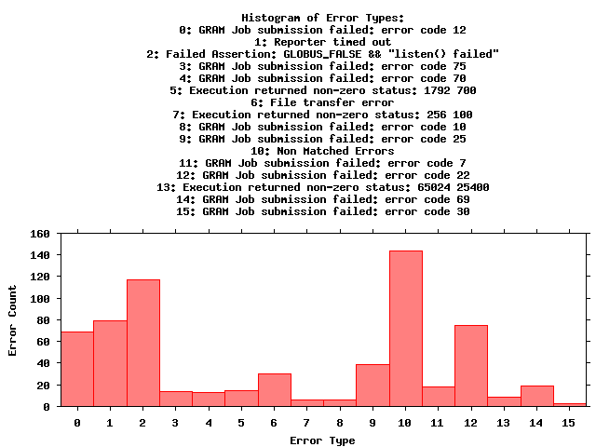
Monitoring Grid Middleware Reliability
Notes:
A full report of errors on TG found by the grasp gather probe. This is a new capability in Inca 2.0 -- Inca 1 was unable to archive error messages.

Slide 21
Section 3: Inca 2 Architecture Overview
Test specification
R
Reporters are scripts that gather data from resources.
Reporter
Repository
The Reporter Repository is responsible for storing Reporters.
Suite
The Suite describes where to run the reporters, frequency of execution, and optionally expected values.
Notes:
Use this slide to introduce the vocabulary we use to describe our architecture. The next slide will go into more of how these pieces fit together.
Need to tie our non-unique and unique features to the architecture

Slide 22
Section 3: Inca 2 Architecture Overview
Administration and control
Reporter
Manager
The Reporter Manager is responsible for managing the schedule and execution of Reporters on a single resource.
Reporter
Agent
The Reporter Agent is a server that is responsible
for managing the control flow of an Inca installation
Admin
Tool
The Admin Tool is a user interface used by the Inca admin to administer all parts of an Inca installation.
Notes:
Use this slide to introduce the vocabulary we use to describe our architecture. The next slide will go into more of how these pieces fit together.
Need to tie our non-unique and unique features to the architecture

Slide 23
Section 3: Inca 2 Architecture Overview
Data Storage and Display
Depot
The Depot is a server that is responsible for storing the data produced by reporters.
Notes:
Use this slide to introduce the vocabulary we use to describe our architecture. The next slide will go into more of how these pieces fit together.
Need to tie our non-unique and unique features to the architecture

Slide 24
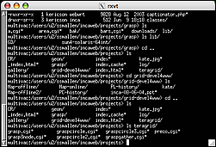
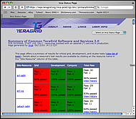
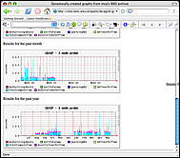
Inca 2 Architecture
GUIs can display collected data by querying Depot
Reporter
Repository
Admin
Tool
Create a “suite”
Suite
changes
R
Suite
Reporter
Agent
Submit suite to Reporter Agent
Depot
3. Reporter Agent invokes Reporter Managers
S
S
S
Admin change to suite
R
R
R
5. Reporter Managers send data to Depot
Reporter
Manager
Reporter
Manager
Reporter
Manager
…
4. Reporter Agent
distributes suite to Reporter Managers
Resource N
Resource 1
Resource 2

Slide 25
Scalable Design
VO B
Admin
Tool
Reporter
Repository
VO A
Admin
Tool
Reporter
Repository
Forward subscription
Reporter
Agent
Reporter
Agent
Depot
Depot
Forward results
Reporter
Manager
Reporter
Manager
Reporter
Manager
Reporter
Manager
Reporter
Manager
Resource 4
Resource 5
Resource 1
Resource 2
Resource 3

Slide 26
Summary
Notes:
Summarize
Why should you use Inca?
Why should you use Inca 2.0?
Something about our software quality? Following the same principles

Slide 27
Inca 2.0
Initial version of Inca focused on basic functionality
New features:
  Improved archiving capabilities
  Scalability - control and data storage
  Usability - improved installation and configuration control
  Performance - self-monitoring
  Security - SSL, proxy delegation
  Condor integration
Release early 2006
Notes:
Software status

Slide 28
Inca 2.0 Improvements for TeraGrid
Email notifications of failures (if requested)
Improved GUIs
  User can select only information interested in
Historical Non-numerical data
  Error messages
  Resource usage (CPU/memory used by reporters)
More functionality tests

Slide 29
Future Work
Automatic tuning
Integration with Knowledge base
Smart failure notification - analyzing the data
Resource for CS research
Provide Python or C APIs for reporters
Standardize suites
  "certify" that your Grid passes a standard suite (e.g. gt4)
  tie suite to a common application (e.g. preco certify your Grid).
  a standard suite would come with a gui side for viewing
Notes:
Some sexy advanced ideas

Slide 30


More Information
Email:
inca@sdsc.edu
Website:
http://inca.sdsc.edu
Supported by:
NMI

Slide 32
How Inca compares to other tools
Nagios (http://www.nagios.org)
  Nagios is a host and service monitor designed to inform you of network problems before your clients, end-users or managers do. It has been designed to run under the Linux operating system, but works fine under most *NIX variants as well. The monitoring daemon runs intermittent checks on hosts and services you specify using external "plugins" which return status information to Nagios. When problems are encountered, the daemon can send notifications out to administrative contacts in a variety of different ways (email, instant message, SMS, etc.). Current status information, historical logs, and reports can all be accessed via a web browser.
  Similarities:
    Plugins are like Reporters
    Has clients and server similar to Reporter Managers and Reporter Agents/Depot
    Notifications
  Differences:
    History is stored using log files... so ours is a bit more space efficient andﾊqueries "should" be faster.
    Output from our reporters is a bit more flexible - can express more.
    At this point we have only email notifications -- they have more

Slide 33
How Inca compares to other tools
Big Brother (http://www.quest.com/bigbrother/)
  Big Brother simplifies the management of networks of computers. It features tests to notify administrators when defined events occur. This facilitates proactive problem resolution and prevents critical outages. With Big Brother, system administrators can visually assess the health of a network through a color-coded web interface. Designed around simplicity, anyone looking at the interface can understand the red, yellow, and green display. Big Brother is able to monitor and alert on almost anything in your network. The product supports common operating systems including the major flavors of Windows, Unix and Linux. In addition, the huge user community has greatly contributed to the extensibility of the product. An enormous repository of user-contributed scripts makes Big Brother highly customizable to your environment.
  Similarities:
    Uses a database to store data (Sybase)
    server/client very similar
    extensible
  Differences:
    Inca is not tied to a specific database
    Centered around pass/fail -- don't know that it could handle the measurements that we do?
    Owned by Quest, there is a free and a for purchase version

Slide 34
How Inca compares to other tools
GridICE (http://infnforge.cnaf.infn.it/gridice/)
  “GridICE is a distributed monitoring tool designed for Grid systems. Its design is based on requirements given by different type of users, each of them dealing with a different abstraction level of a Grid: the Virtual Organization level, the Grid Operation Center level, the Site Adminstration level and the End-User level. This work was started in 2003 during the European DataTAG project and is being evolved in the framework of the EGEE project.”
  The implementation is more like an aggregator like Monalisa though
    cluster monitoring system (they use Lemon but ganglia could also be used) -> MDS2/GLUE Schema -> Nagios -> Postgres -> email notifications/PHP viz
Similarities:
    Goal:
      detect and notify fault situations, contract violations, user-defined events
      Usage, behavior, and performance
    Scalable (in theory MDS is scalable)
    Extensible - push new data through MDS
  Differences:
    Able to handle dynamic grids where resources can join/unjoin
    Wants to collect fine-grained data (not just coarse-grained data)
    Uses Postgres, Inca is not tied to a specific database -- don’t know they’re schema
    Not as configurable -- With MDS, you have to declare your schema ahead of time - not easy to change data & frequency
    It looks like the only data they are collecting currently is GLUE data which is more about jobs and their status than tests although the paper claims that’s they’re goal

Slide 35
How Inca compares to other tools
MDS4 (http://www.globus.org/toolkit/mds/)
  “The Globus Toolkitﾕs Monitoring and Discovery System (MDS) implements a standard Web Services interface to a variety of local monitoring tools and other information sources. MDS4 can be understood as a “protocol hourglass” defining standard protocols for information access and delivery and standard schemas for information representation. Below the neck of the hourglass, MDS4 interfaces to different local information sources, translating their diverse schemas into appropriate XML schema (based on standards such as the GLUE schema whenever possible). Above the neck of the hourglass, various tools and applications can be constructed that take advantage of the uniform Web Services query, subscription, and notification interfaces to those information source that MDS4 implements.”
  Information providers push information or can be pulled to put data into MDS4.
  MDS4 provides an Index service and a trigger service (email notifications)
Similarities:
    Caches data like the depot and is scalable
Differences:
    Can be compared to the Depot but doesn’t do archiving.
    Does provide trigger services that we don’t have yet

Slide 36
How Inca compares to other tools
MonALISA (http://monalisa.caltech.edu/)
  The MonALISA framework is based on Dynamic Distributed Service Architecture and is able to provide complete monitoring, control and global optimization services for complex systems.The MonALISA system is designed as an ensemble of autonomous multi-threaded, self-describing agent-based subsystems which are registered as dynamic services, and are able to collaborate and cooperate in performing a wide range of information gathering and processing tasks. These agents can analyze and process the information, in a distributed way, to provide optimization decisions in large scale distributed applications. An agent-based architecture provides the ability to invest the system with increasing degrees of intelligence, to reduce complexity and make global systems manageable in real time. The scalability of the system derives from the use of multithreaded execution engine to host a variety of loosely coupled self-describing dynamic services or agents and the ability of each service to register itself and then to be discovered and used by any other services, or clients that require such information. The system is designed to easily integrate existing monitoring tools and procedures and to provide this information in a dynamic, customized, self describing way to any other services or clients.
  Similarities:
    monitoring modules like reporters, distributed agents, web service, security
    uses database to store data (ML supports MySQL, PostgreSQL, Microsoft SQL Server and the embedded Mckoi database system)
  Differences:
    ApMon can be used by any application to push monitoring information to MonALISA services (inca can also?)
    MonALISA seems to collect more network/hardware/job information than user V&V info

Slide 37
How Inca compares to other tools
Product: Clumon
URL: http://clumon.ncsa.uiuc.edu
Overview: The Clumon performance monitoring system was created to give another view of what the current state of the cluster was at a glance. This requires information from both the scheduler and the hosts themselves. The system was also needed to provide for a common structure and single point of access so that the many users and administrators would not overload the cluster itself with redundant requests for the same information. The primary requirements for the system were: scalability, low bandwidth, use freely-available components, versatility, controllability. Scalability was first and foremost. The system had to be able to potentially thousands of hosts and, at the same time, not create too large a load on the hosts from which data was being collected or the network layer. This also led to the requirement of controllability. Since there are many, many different potential configurations for clusters, the system needed to be flexible enough to be tuned to work on abroad range of clusters. Monitoring performance data is a trade off between detail, scale & frequency versus load & bandwidth. Therefore, the performance monitor's administrator should be able to adjust the frequency and amount of data collected since the scale and bandwidth of a cluster is commonly a fixed value. This should allow an administrator to balance the amount of resources used for performance monitoring versus those required for computation.Versatility is a requirement in any system such as this one, because it is to be used by different categories of users, including the users that are doing computation on the cluster, the system administrators keeping an eye on things,and developers and engineers doing testing and debugging.
Similarities:
  Archival (MySQL) of data
Differences:
  Cluster view of resources, rather than VO
  Extraction of data only in raw DB form
  Not (yet) extensible?
  Limited (MySQL) authentication
  Tight coupling to SGI PCP, Linux
  Periodicity fixed?

Slide 38
How Inca compares to other tools
Product: Hawkeye
URL: http://www.cs.wisc.edu/condor/hawkeye
Overview: Hawkeye utilizes the technologies already present in Condor and ClassAds to provide rich mechanisms for collecting, storing, and using information about computers. A Hawkeye system can be used to monitor various attributes of a collection of systems. The monitoring mechanism may also be used then to further the management of systems. Hawkeye works by configuring Condor such that it periodically executes specified program(s). These programs are typically scripts. A program produces output in the form of ClassAd attribute/value pairs. These pairs are then added (using defined naming conventions) to the machine ClassAd. The machine ClassAd then contains attributes which may be used in expressions (such as START and SUSPEND, as well as the submit description file REQUIREMENTS expression). A ClassAd may be displayed using condor_status.
Similarities:
  Similar server/client (Reporter Manager/Depot => Hawkeye/Collector)
  Tests extensible
  Certificate-based authentication
  Dynamic configuration
Differences:
  Tight coupling to Condor
  Monolithic update of system information (no separate series)
  No archiving
  Machine is the only resource

Slide 39
How Inca compares to other tools
Product: Ganglia
URL: http://ganglia.sourceforge.net
Overview: Ganglia is a scalable distributed monitoring system for high-performance computing systems such as clusters and Grids. It is based on a hierarchical design targeted at federations of clusters. It leverages widely used technologies such as XML for data representation, XDR for compact,portable data transport, and RRDtool for data storage and visualization. It uses carefully engineered data structures and algorithms to achieve very low per-node overheads and high concurrency. The implementation is robust, has been ported to an extensive set of operating systems and processor architectures,and is currently in use on over 500 clusters around the world. It has been used to link clusters across university campuses and around the world and can scale to handle clusters with 2000 nodes.
Similarities:
  Similar server/client (Reporter Manager/Depot => gmetad/gmond)
  Easy extraction of data in XML format
Differences:
  Archival of numeric series only
  Extension only by injecting data
  Limited (IP) authentication
  Machine is the only resource
  Periodicity fixed
  Configuration only on start-up

Slide 40
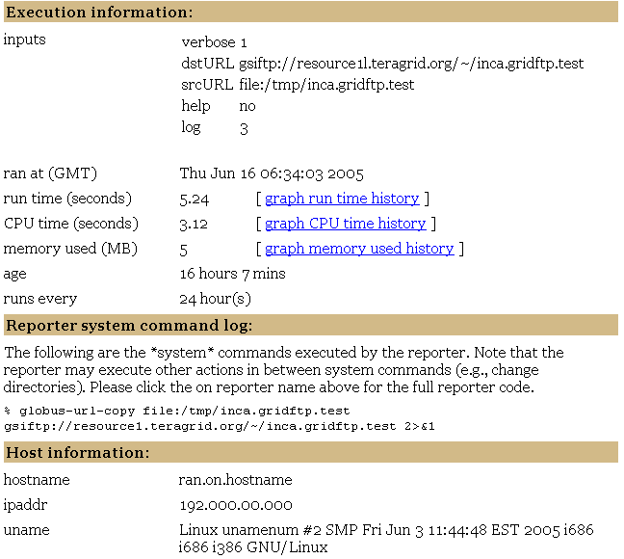
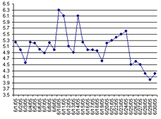
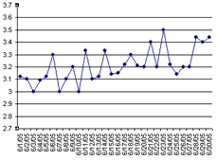
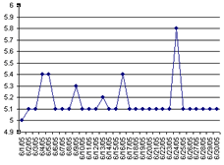
Self Monitoring

