Slide 1
Inca Data Display
(data consumers)
Inca Workshop
August 27, 2010

Slide 2
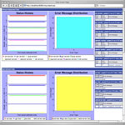
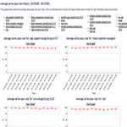
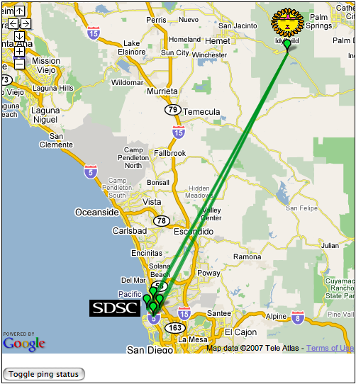
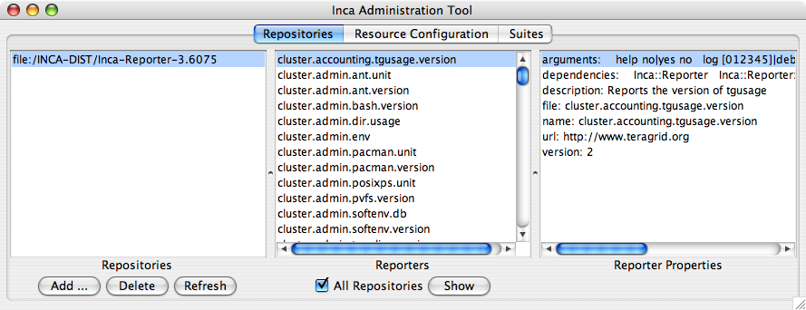
Reporter
Repository
Data Consumers
Incat
R
C
Agent
Depot
Data Consumers
S
Anything that queries and digests data from the depot
Inca distribution includes a container and webapp to provide Web view of Inca deployment
Designed for grid operators, system administrators, and users
S
r
R
r
S
R
Reporter
Manager
Reporter
Manager
…
Grid Resource
Grid Resource

Slide 3
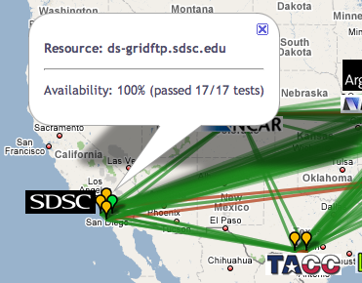
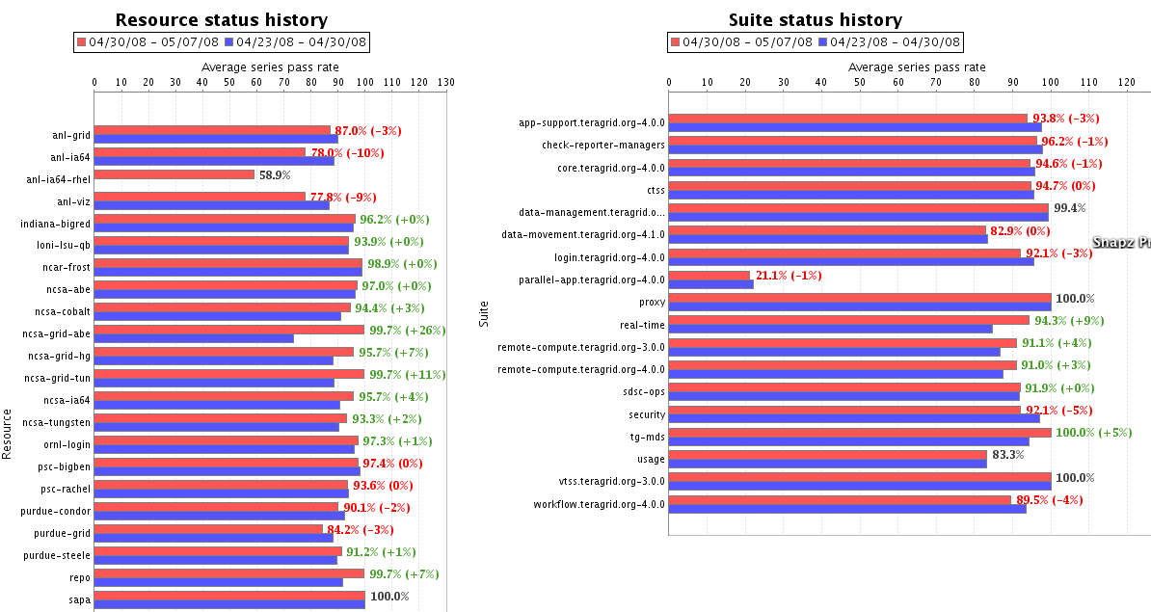
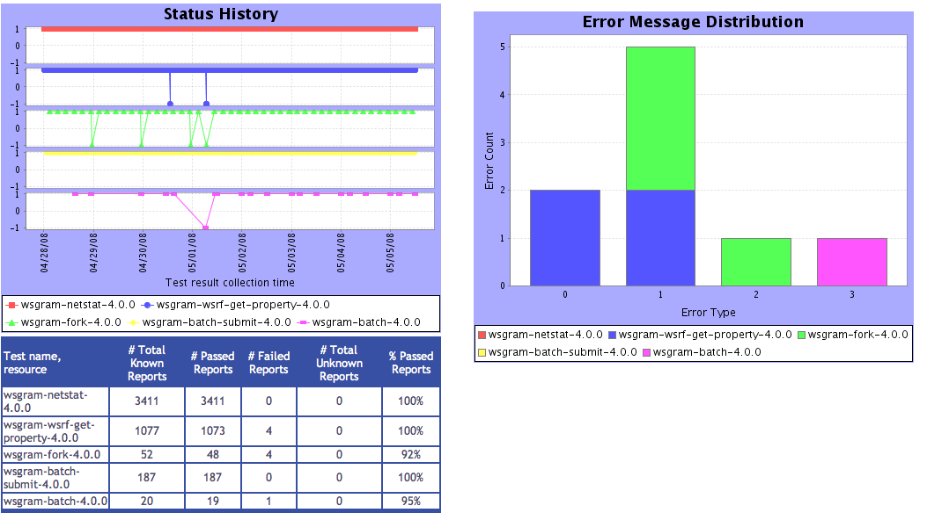



Consumer displays data
Current and historical views
Web application packaged with Jetty
JSP 2.0 pages/tags to query data and format using XSLT
CeWolf/JFreeChart to graph data
Extensible
Consumer
HTML
Graphs
charts
JSP
XML
JSP
JSP
XSL
query results (XML)
query
Depot
Notes:
what we provide by default, but can extend and will describe in shava's talk

Slide 4
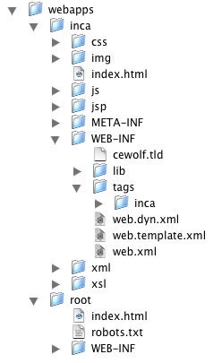
Files for customization
Inca webapp runs inside Jetty 6 container
Config colors
Config authentication
Config files for views

Slide 5
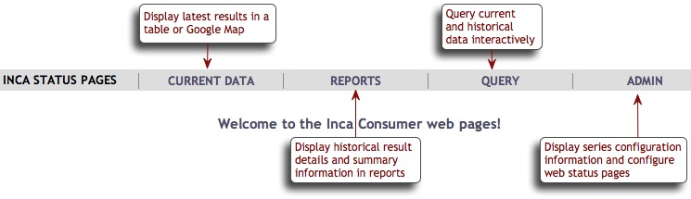
Default Status Pages

Slide 6
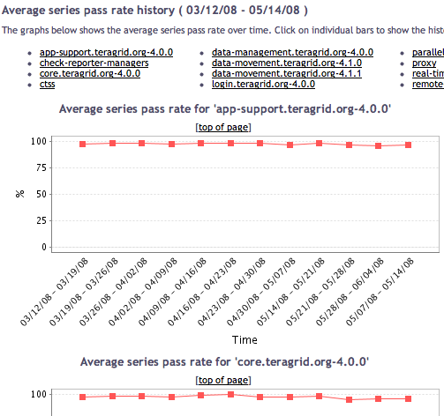
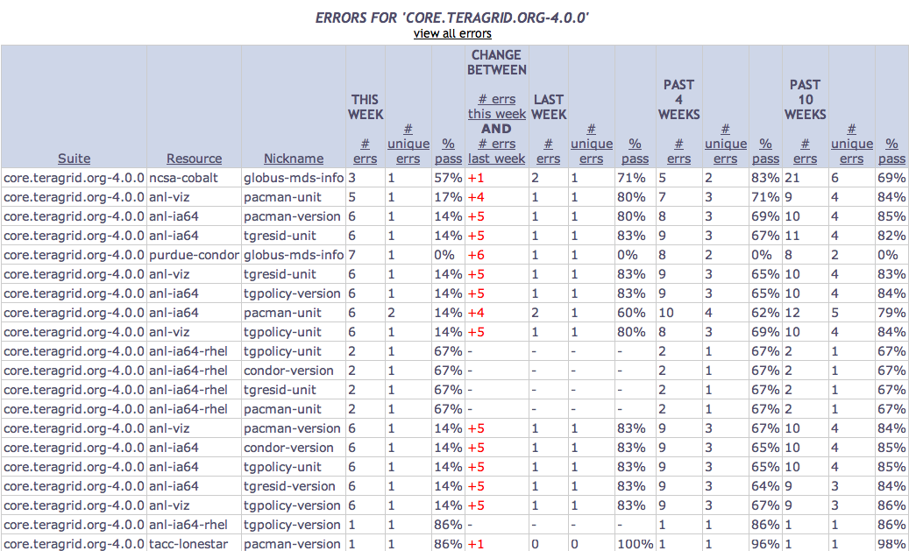
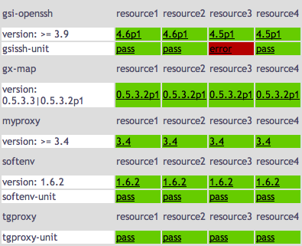
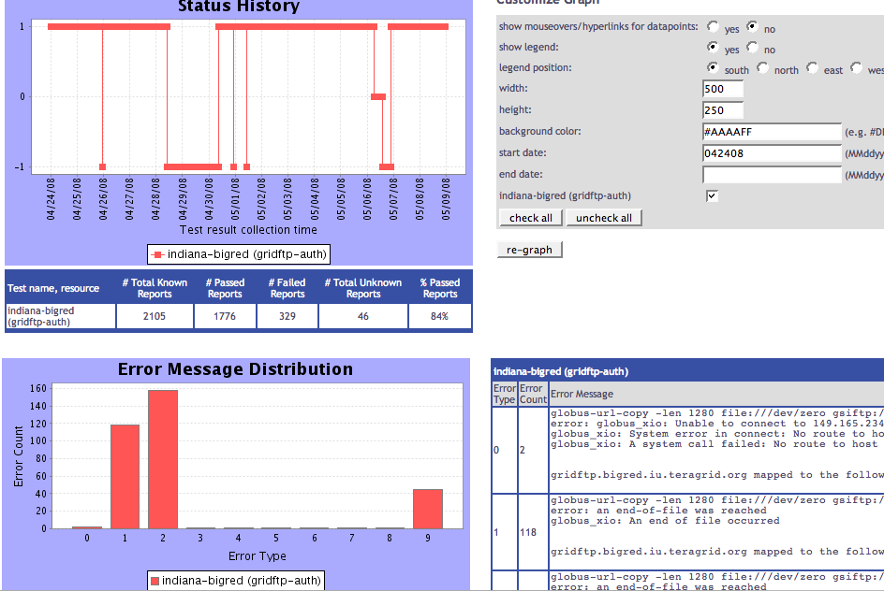
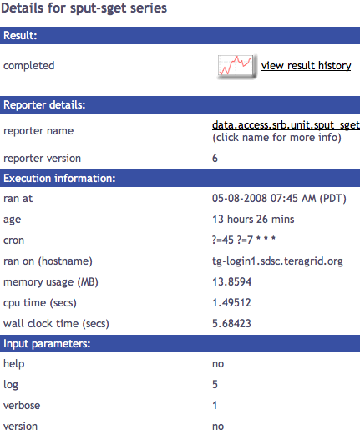
Series
Summary
Weekly status report
Cumulative series status by resource
Suite & resource histories
Inca’s status pages provide multiple levels of details
Error history summary
Series status by package and resource
Related series histories
Individual series history
Individual report details
Series
Details
Historical
Current status

Slide 7

Series
Summary
Weekly status report
Cumulative series status by resource
Suite & resource histories
Inca’s status pages provide multiple levels of details
Error history summary
Series status by package and resource
Related series histories
Individual series history
Individual report details
Series
Details
Historical
Current status

Slide 8
View cumulative series status by resource
Register for a Google Map API key
http://code.google.com/apis/maps/signup.html
Specify size of map, center of map, zoom level
Define sites -- logo and resources
Optionally change icons or colors
Consumer
HTML
google.xml
status.jsp
google.xsl
query results (XML)
query
Depot

Slide 9
Series
Summary
Weekly status report
Cumulative series status by resource
Average suite & resource series pass rate history
Inca’s status pages provide multiple levels of details
Error history summary
Series status by package and resource
Related series histories
Individual report details
Series
Details
Individual series history
Historical
Current status

Slide 10
View series status by package and resource
Specify list of suite(s) and resource(s) in URL
http://host:8080/inca/jsp/status.jsp ?
  suiteNames=s1[,s2,…]
  resourceIds=r1[,r2,…]
  REST equivalent:
  http://host:8080/inca/HTML/rest/s1/r1
Consumer
HTML
status.jsp
default.xsl
query results (XML)
query
Depot

Slide 11
Series
Summary
Weekly status report
Cumulative series status by resource
Suite & resource histories
Inca’s status pages provide multiple levels of details
Error history summary
Series status by package and resource
Related series histories
Individual series history
Individual report details
Series
Details
Historical
Current status

Slide 12
View individual report details
Linked from other views
Specify series nickname, resource, and collected time
http://host:8080/inca/jsp/instance.jsp ?
  nickname=ant_version &
  resource=localResource &
  collected=2010-08-11T20:51:08.000-07:00
  REST equivalent (latest instance):
  http://host:8080/inca/HTML/rest/sampleSuite/localResource/ant_version
Consumer
HTML
instance.jsp
instance.xsl
query results (XML)
query
Depot

Slide 13
Series
Summary
Weekly status report
Cumulative series status by resource
Suite & resource histories
Inca’s status pages provide multiple levels of details
Error history summary
Series status by package and resource
Related series histories
Individual series history
Individual report details
Series
Details
Historical
Current status

Slide 14
View individual series history
Linked from individual report details page
Requires series nickname, resource, and title
By default for week, month, quarter or year
Options:
  Mouseovers and links
  Legend ( and position)
  Width, Height
  Background color
Consumer
HTML
Graphs
charts
graph.jsp
query results (XML)
query
Depot

Slide 15
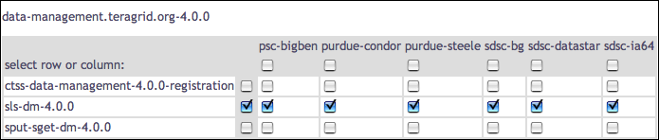
Choose selected series histories
Is an error related to the resource or the software?
What is the reliability of a service (viewing multiple tests)?

Slide 16
Series
Summary
Weekly status report
Cumulative series status by resource
Suite & resource histories
Inca’s status pages provide multiple levels of details
Error history summary
Series status by package and resource
Related series histories
Individual series history
Individual report details
Series
Details
Historical
Current status

Slide 17
View related series histories
Requires multiple series nickname, resource, and title
Two weeks of history by default
Options:
  Mouseovers and links
  Legend ( and position)
  Width, Height
  Background color
Consumer
HTML
Graphs
charts
graph.jsp
query results (XML)
query
Depot
Notes:
Result of checking boxes

Slide 18
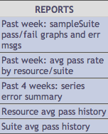
View related series histories as report
Requires multiple series nickname, resource, and titles described in XML file
Two weeks of history by default
Consumer
HTML
Graphs
charts
report.jsp
status
Report.xml
Options:
  Mouseovers and links
  Legend ( and position)
  Width, Height
  Background color
  Metrics
query results (XML)
query
Depot
Notes:
Admin GUI interfac

Slide 19
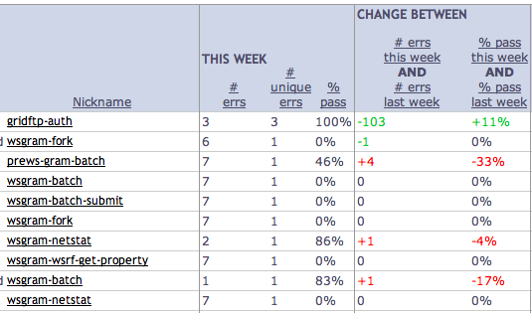
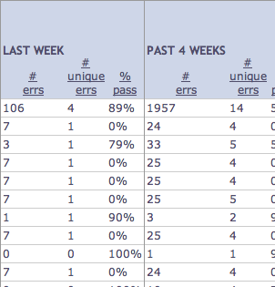
Series
Summary
Weekly status report
Cumulative series status by resource
Suite & resource histories
Inca’s status pages provide multiple levels of details
Error history summary
Series status by package and resource
Related series histories
Individual series history
Individual report details
Series
Details
Historical
Current status
Notes:
View motivated by TG – doing better or worse

Slide 20
View error history summary
( “diff” )
Designed for daily/weekly review
Uses cached historical query
Four weeks of history by default
Sortable by column
Consumer
HTML
Graphs
charts
status.jsp
week
Summary.xml
query results (XML)
query
Depot

Slide 21
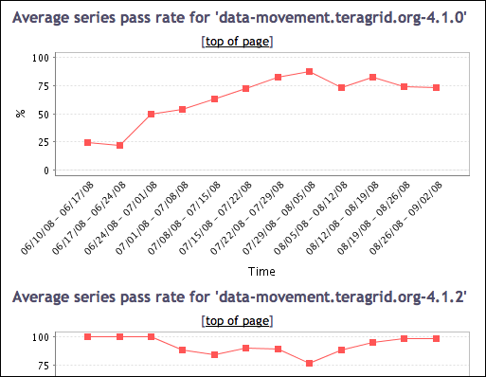
Series
Summary
Weekly status report
Cumulative series status by resource
Suite & resource histories
Inca’s status pages provide multiple levels of details
Error history summary
Series status by package and resource
Related series histories
Individual series history
Individual report details
Series
Details
Historical
Current status

Slide 22
View average suite and resource histories
Designed for daily/weekly review
Uses cached historical query
Four weeks of history by default
Click to view further details
Consumer
HTML
Graphs
charts
summary
History.jsp
query results (XML)
query
Depot
Notes:
Spread out

Slide 23
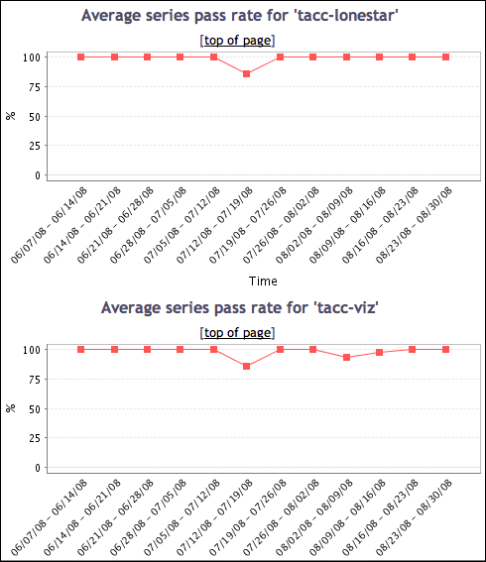
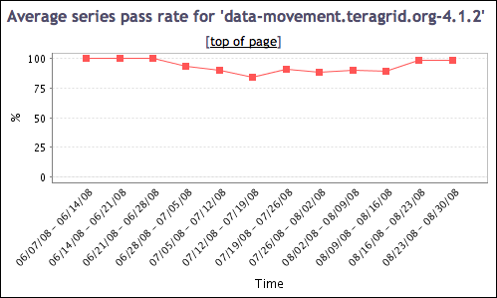
View suite or resource history details
Suite status for each resource
Status of suite on all resources

Slide 24
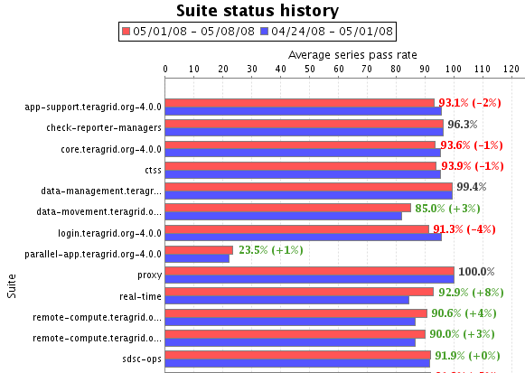
Series
Summary
Weekly status report
Cumulative series status by resource
Suite & resource histories
Inca’s status pages provide multiple levels of details
Error history summary
Series status by package and resource
Related series histories
Individual series history
Individual report details
Series
Details
Historical
Current status

Slide 25
View weekly suite and resource status
Designed for daily/weekly review
Uses cached historical query
Four weeks of history by default
Click to view further details
Consumer
HTML
Graphs
charts
summary.jsp
query results (XML)
query
Depot

Slide 26
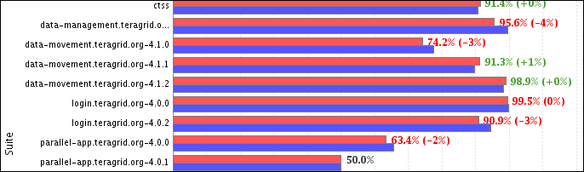
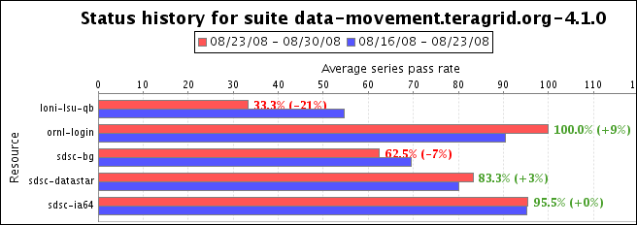
View suite and resource details
Suite status for each resource

Slide 27
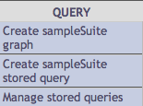
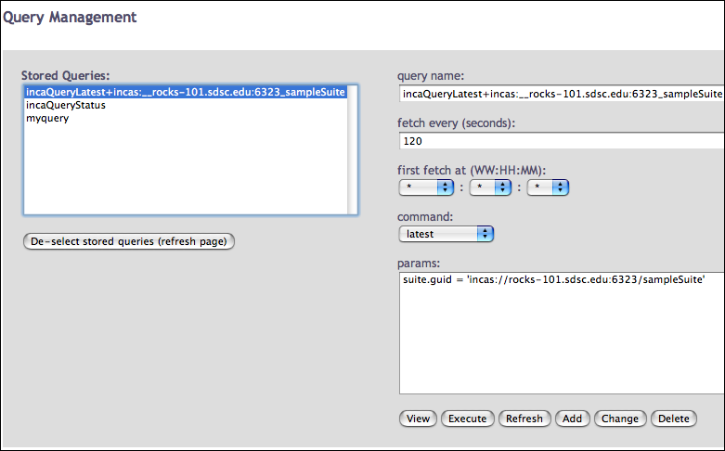
Caching provides quick page load times
Periodically load and store large queries
Latest suite instances cached by default -- frequency from reload property
Query management page allows view, execute, refresh, and modification action on queries (requires authentication)
Query management page
Notes:
Advanced settings – don’t expect many people to have to customize at this level. Running into depot load issues can use
e.g. TG has X series (big deployment) vs default deployment is ~10 series
- Incaquerystatus runs at midnight by default – gets history back by what you specify in admin gui

Slide 28
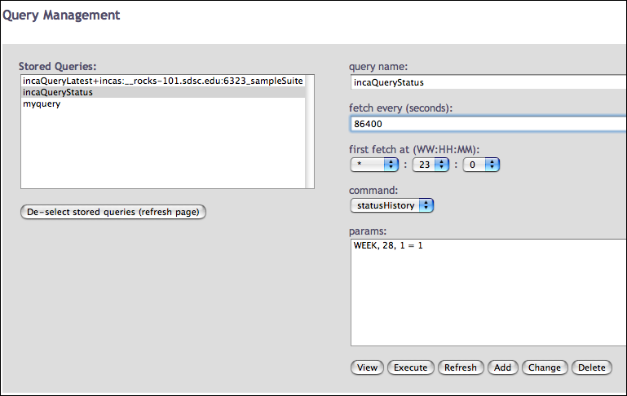
Daily history query analyzes errors
PERIOD, DAYS, CONDITION
where
PERIOD = DAY | WEEK | MONTH | QUARTER
Four weeks of history loaded every day -- time of day from reloadAt property
TeraGrid - 10 weeks of history
(WEEK, 70, 1 = 1)
Query management page
Notes:
70 weeks has to match the admin GUI amount

Slide 29
Daily history query output
<quer:object>
<row><series>
<guid>incas://rocks-101.sdsc.edu:6323/sampleSuite</guid>
<nickname>gcc_hello_world</nickname>
<resource>localResource</resource>
<period>
<begin>1217830004174</begin>
<end>1218434804173</end>
<success>1008</success>
<failure>
<message>gcc: Command not found</message>
<count>2</count>
</failure>
</period> <period>
<begin>1218434804174</begin>
…
suite
series
period 1
num successes
failure

Slide 30
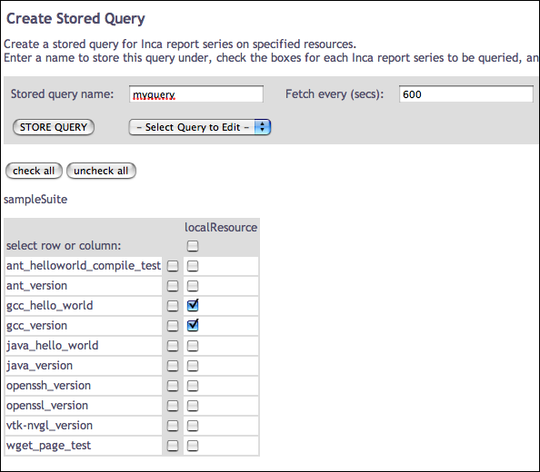
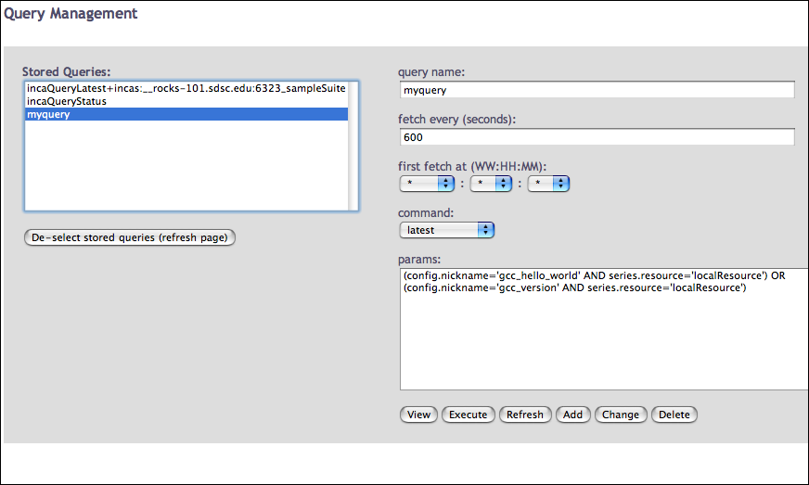
Create a custom query
View subset of series in a suite
View series in multiple suites
Requires authentication and suiteNames

Slide 31
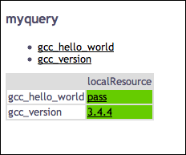
Use custom query name in views
Use queryNames in place of suiteNames
http://host:8080/inca/jsp/status.jsp ?
  queryNames=myquery
  resourceIds=defaultGrid
  REST equivalent:
  http://host:8080/inca/HTML/rest/myquery/defaultGrid

Slide 32
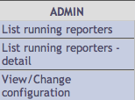
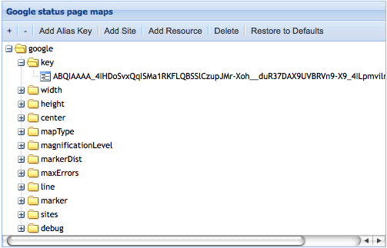
Admin pages: configure Google map view
Size of map
Center of map -- default is middle of US
All options are described in detail in the user guide:
http://inca.sdsc.edu/releases/latest/guide/userguide-one.html#GOOGLE-SETUP
Site name, location, logo and list of resources

Slide 33
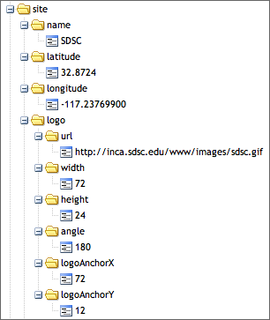

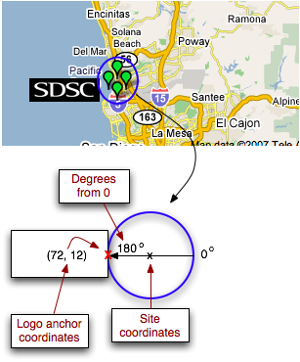
Admin pages: Google map site logos

Slide 34

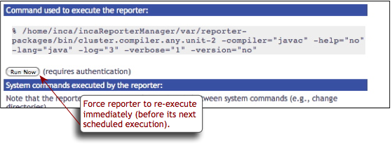
Admin pages: Run Nows
triggers reporter execution on the local machine
useful for admin who have worked on an issue and want to verify that a problem has been resolved
Notes:
Requires quthentication
Can have diff pw than other pages

Slide 35
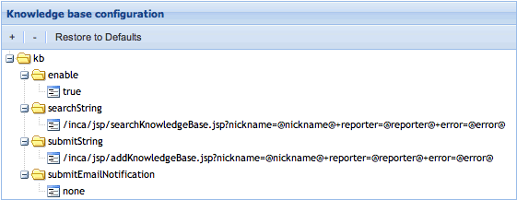
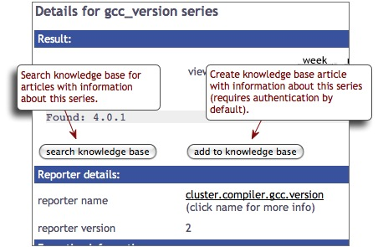
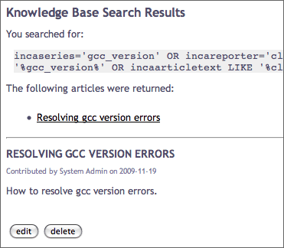
Admin pages: Knowledge Base
designed to collect problem resolution information for tests
used to debug problems
Notes:
- Example of kb – on TG wanted to document where known problem existed to help admins debugging, build repo of info
How customized on TG – change URL to IU KB, details in user guide
Rudimentary KB as placeholder in case don’t have one set up. Want more robust, use link something else in, better paid versions

Slide 36
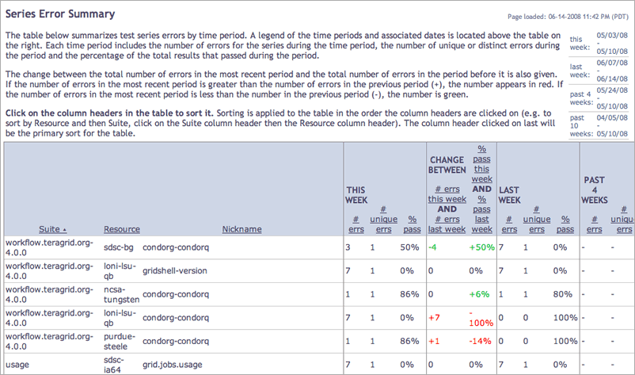
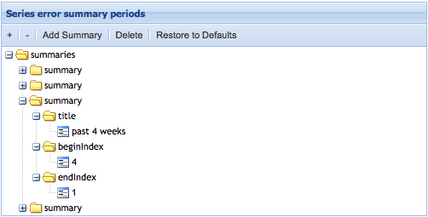
Admin pages: Series Error Summary
summarize test series errors by time period
time periods and titles (i.e., PAST 4 WEEKS) can be customized
Notes:
Go through column headers (sort by suite, see how individual series doing summarized in table)
then talk about changing periods

Slide 37
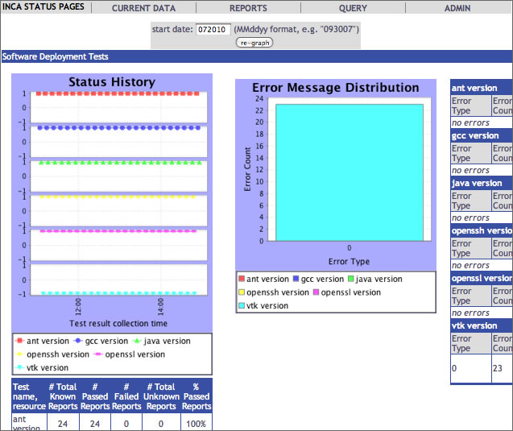
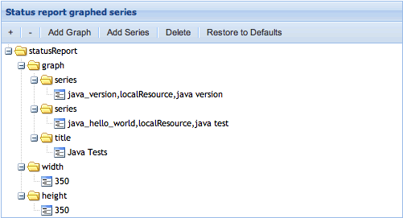
Admin pages: Pass/Fail Reports
historical summary reports with pass/fail status and error information
selected series can be customized

Slide 38
Password authentication can be customized
Ports: HTTP on 8080, HTTPS on 8443
Password protection on query.jsp and status-auth.jsp
(change in $INCA_DIST/webapps/inca/WEB-INF/web.xml)
Password set in $INCA_DIST/etc/realm.properties
username: password

Slide 39
REST Syntax
Fetch suite or stored query data in XML or HTML format using REST URLs.
By default, the consumer recognizes a REST URL using the following format:
http://localhost:8080/inca/XML|HTML/rest/<suiteName>|<queryName>[/<resourceId>[/<seriesNickname>[/week|month|quarter|year]]]
http://inca.sdsc.edu/releases/2.6/guide/userguide-one.html#REST

Slide 40
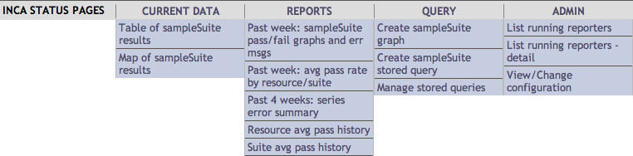
Customize the header
Add logo or background color here
Header can be customized by editing unordered list in header.xsl -- change for your suites
Add logo at top or background color by adding row to table

Slide 41
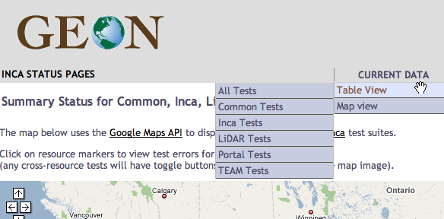
…
<table width="100%" class="subheader">
<tr> <td> <a href="http://www.geongrid.org">
<img src="http://www.geongrid.org/images/logo_lofi.gif"/>
</a></td>
</tr> <tr>
…
<ul>
<li><h2>Current Data</h2>
<ul>
<li>
<a href="{concat($jsp, 'status.jsp?', $all)}">Table View </a>
<ul>
<li><a href="{concat($jsp, 'status.jsp?', $all)}">All Tests</a></li>
<li>
<a href="{concat($jsp,'status.jsp?suiteNames=Common&amp;resourceIds=ROCKS')}">
Common Tests
</a></li>
…
Add GEON logo to top of page

Slide 42
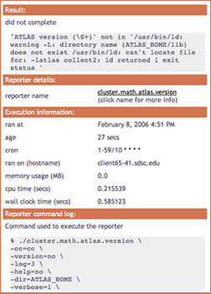
Changing colors in CSS
Edit CSS (Cascading Style Sheet)
to change colors and fonts
E.g. change .header background-color
$INCA_INSTALL/webapps/inca/css/inca.css
.header {
background-color: #D07651;

Slide 43
Summary
A data consumer is anything that queries and digests data from the depot
Inca includes a data consumer -- an embedded Jetty web container that includes a webapp
Inca’s status pages provide multiple levels of details from historical to current data and summary and detail views
Caching of queries is automated to optimize page load times and can be customized
Status pages’ content, look, and security can be customized

