Slide 1
Monitoring TeraGrid
Functionality and Performance with Inca
Shava Smallen, Kate Ericson
San Diego Supercomputer Center

Slide 2
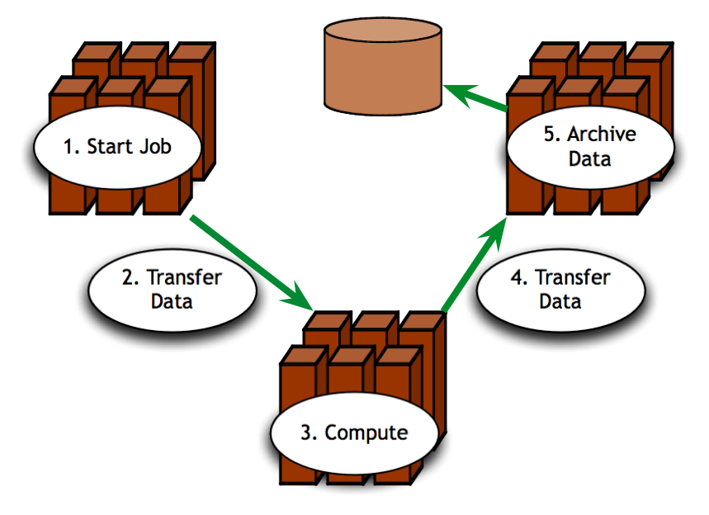
Is TeraGrid functional?
Can TeraGrid users run their applications? Can they access their datasets?
  Can user login?
  Are Grid services the application[s] use available? Compatible versions?
  Are dataset[s] N accessible to user X? Credentials?
  …

Slide 3
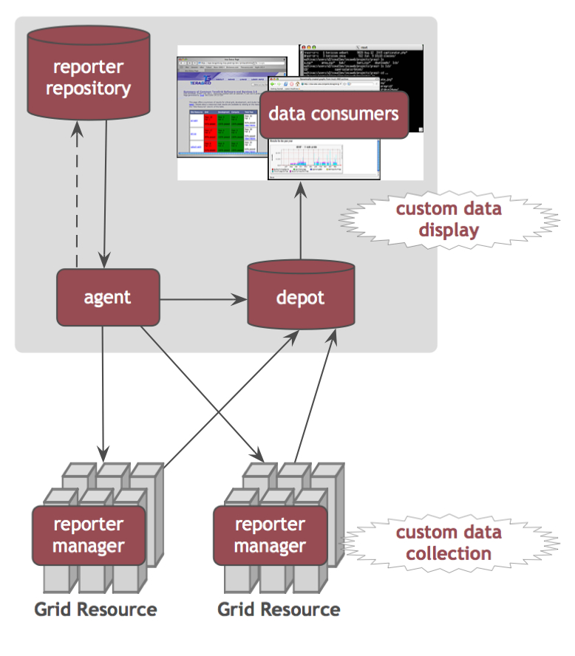
Inca automates monitoring of Grid functionality
  Schedules execution
  of information gathering
  scripts (reporters)
  Collects, archives, and
  publishes data
More information about Inca at
http://inca.sdsc.edu

Slide 4
Inca monitors TeraGrid functionality
Inca monitoring TeraGrid since 2003
  Coordinated TeraGrid
  Software & Services (CTSS)
  Site interoperability
  Host and trusted certificates
  Resource registration in MDS
View Inca pages at
http://inca.teragrid.org

Slide 5
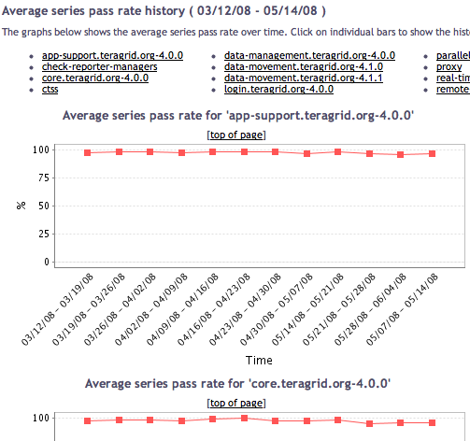
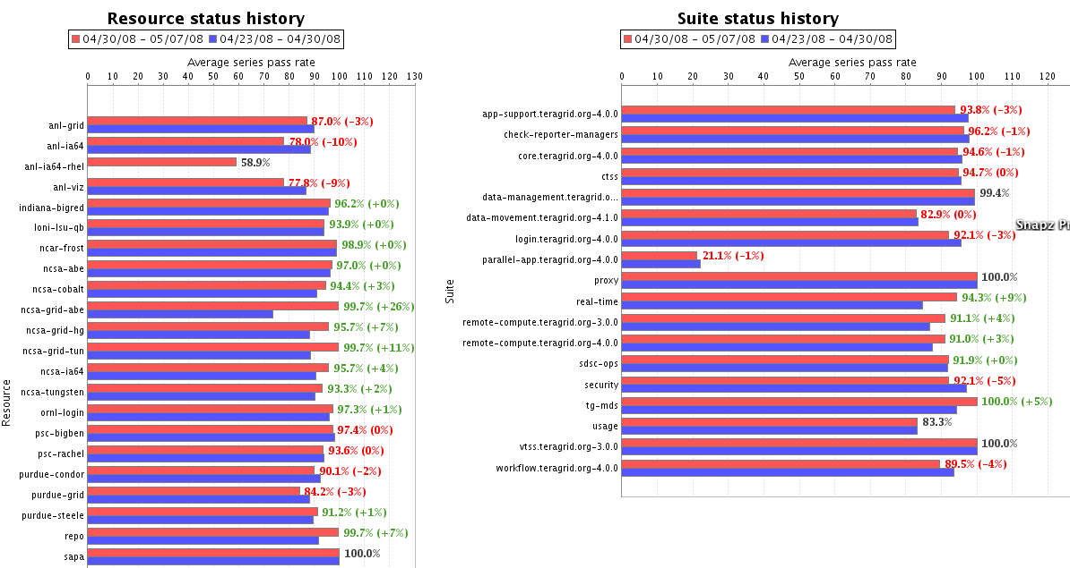
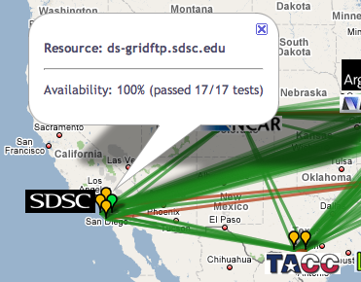
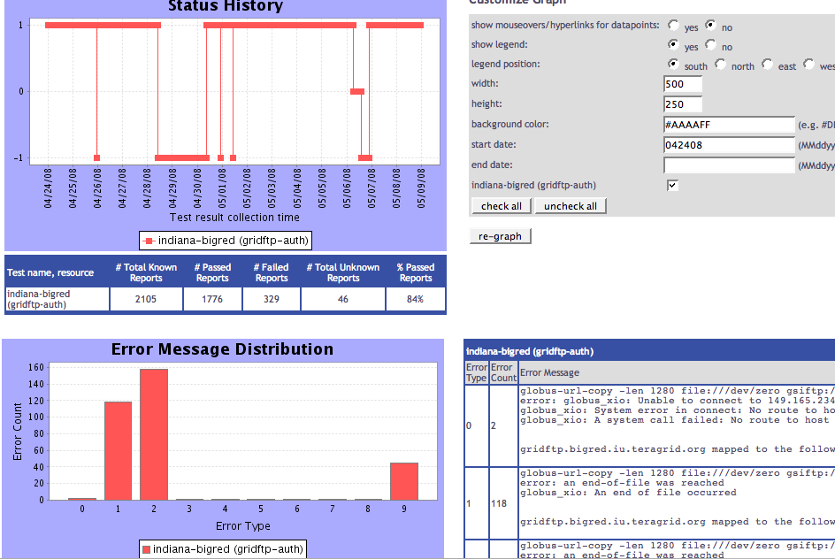
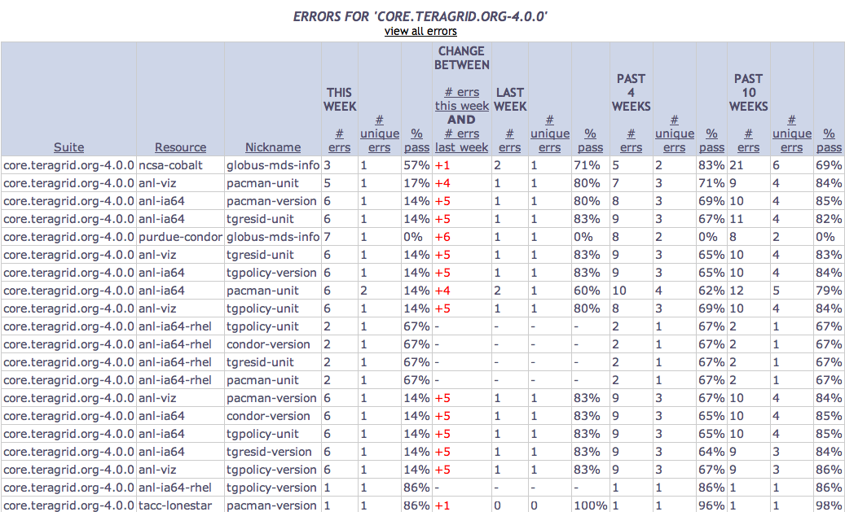
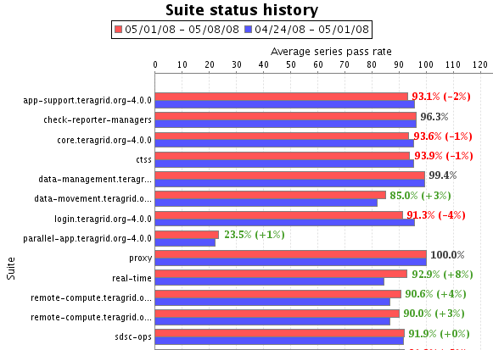
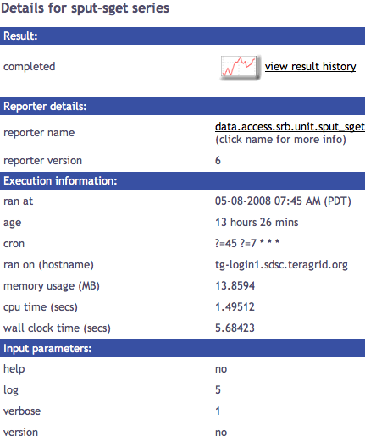
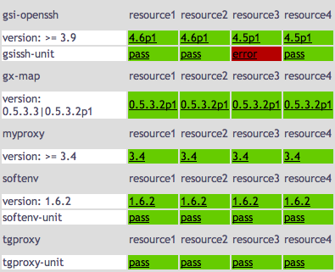
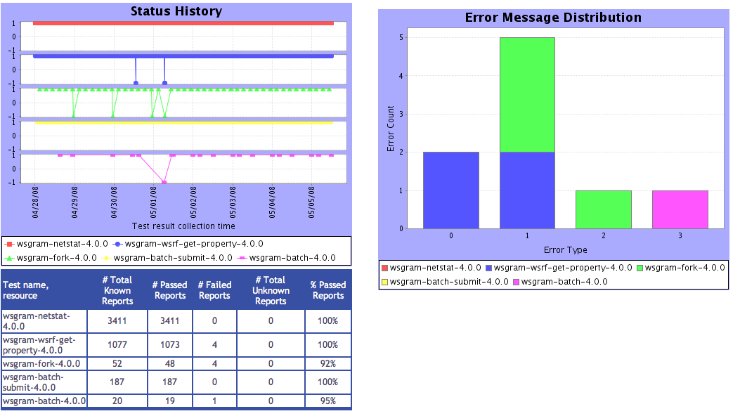
Tests
Summary
Weekly status report
Cumulative test status by resource
Average kit test pass rate history
Inca’s status pages provide multiple levels of details
Error history summary
Test status by package and resource
Related test histories
Individual test result details
Test
Details
Individual test history
Historical
Current status

Slide 6

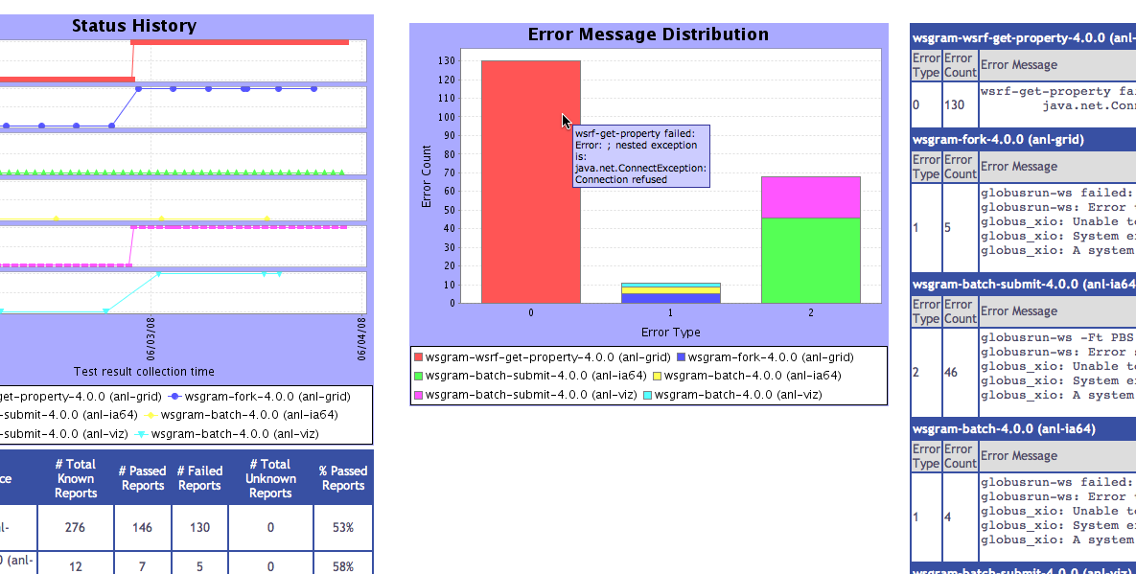
Inca monitoring benefits TeraGrid end users
“Inca reported errors mirror failures we’ve observed and as they are addressed we’ve noticed an improvement in TeraGrid’s stability.”
-- Suresh Marru (LEAD developer)
Tests resources and services used by LEAD. E.g.
  Pings service every 3 mins
  Verifies batch job submission every hour
Automatically notifies admins of failures
Show week of history in custom status pages

Slide 7
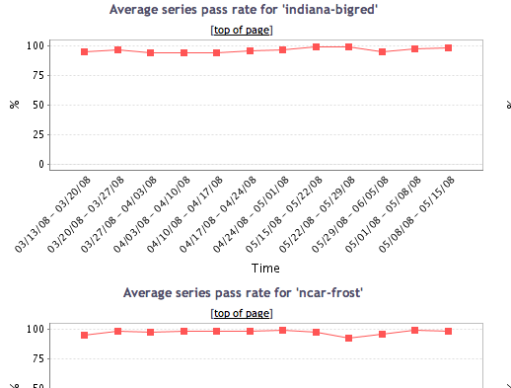
Recent improvements enhance Inca’s effectiveness
  Inca status pages now recognize posted downtimes
  Staff now able view and add their own comments to individual test details
  Test configuration based on CTSS kit implementation wiki pages and MDS registered information
  New status pages show TeraGrid behavior over time
Average kit test pass rate history
Average resource test pass rate history
Weekly status report
Summary of errors this week
Related test histories
Individual test history

Slide 8

More information
Inca Web Page:
  http://inca.sdsc.edu
TeraGrid Inca Status Pages:
  http://inca.teragrid.org
Email:
  inca@sdsc.edu

