Slide 1
Inca Data Display:
Writing Web Page Data Consumers
Kate Ericson, kericson@sdsc.edu
Inca 2.0 Workshop
February 24, 2006

Slide 2
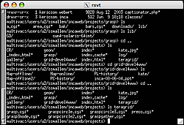
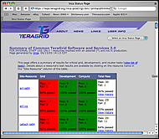
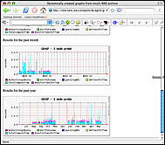
Architecture overview
GUIs display collected data by querying the Depot
Reporter
Repository
Admin
Tool
Suite
R
Reporter
Agent
Depot
Depot
S
S
S
R
R
R
Reporter
Manager
Reporter
Manager
Reporter
Manager
…
Resource N
Resource 1
Resource 2

Slide 3
Depot Queries
Depot -> XML -> XSL -> CSS -> JSP -> Jetty -> User
Currently two types of queries return XML:
  Series instance: report collected at a particular point in time with
  its set of arguments and context on a particular host
  Latest suite: set of series
  (in this case the latest series instances in a suite)
Query with Inca protocol
(soon webservices)
Supported queries are easily extended
(DB backend)
  historical series queries pre-production
  graphing, general SQL, etc. post-production

Slide 4
Depot Queries: Series Results
Depot -> XML -> XSL -> CSS -> JSP -> Jetty -> User
Results from a series instance:
<suiteId>1</suiteId>
<reportSeriesConfigId>5</reportSeriesConfigId>
<reportSeriesId>5</reportSeriesId>
<reportId>1</reportId>
<instanceId>73</instanceId>
<reportSeries>
<uri>http://inca.sdsc.edu/2.0/repository/bin/cluster.compiler.any.unit</uri>
<args>
<arg>
<name>version</name>
<value>no</value>
</arg>
…
</args>
<setup/>
<cleanup/>
<nice>false</nice>
<description>java_hello_world</description>
<hostname>Kate-Ericsons-Computer.local</hostname>
</reportSeries>
Notes:
Given config & instance ID

Slide 5
Depot Queries: Series Results
Depot -> XML -> XSL -> CSS -> JSP -> Jetty -> User
Results from a series instance (cont.):
<report>
<gmt>February 7, 2006 6:38 PM</gmt>
<age>7 mins 4 secs </age>
<hostname>Kate-Ericsons-Computer.local</hostname>
<name>cluster.compiler.any.unit</name>
<args>
<arg>
<name>version</name>
<value>no</value>
</arg>
…
</args>
<args/>
<body>
<unitTest>
<ID>javac</ID>
</unitTest>
</body>
<exitStatus>
<completed>true</completed>
<errorMessage/>
</exitStatus>
</report>
<schedule>
<cron>
<min>8-59/10</min>
<hour>*</hour>
<mday>*</mday>
<wday>*</wday>
<month>*</month>
<suspended>false</suspended>
</cron>
</schedule>
<report>…</report>
<comparisonResult/>
<sysusage>
<wallClockTime>3.004813</wallClockTime>
<memory>10.578125</memory>
<cpuTime>1.475999</cpuTime>
</sysusage>
Notes:
Given config & instance ID

Slide 6
Depot Queries: Suite Results
Depot -> XML -> XSL -> CSS -> JSP -> Jetty -> User
Array of report summaries for the latest instance of
each series in the suite:
<reportSummary>
<hostname>Kate-Ericsons-Computer.local</hostname>
<uri>http://repository/cluster.compiler.any.unit</uri>
<description>java_hello_world</description>
<reportSeriesConfigId>5</reportSeriesConfigId>
<instanceId>73</instanceId>
<body>
<body>
<package>
<ID>openssl</ID>
<version>0.9.7i</version>
</package>
</body>
</body>
<completed>true</completed>
</reportSummary>
<reportSummary>…</reportSummary>
<reportSummary>…</reportSummary>
<reportSummary>…</reportSummary>
Notes:
- Series was high level of detail, for summary get suite of series
- Given SuiteName (e.g. TestSuiteLocal)

Slide 7
Displaying Queries: Suite Results
Depot -> XML -> XSL -> CSS -> JSP -> Jetty -> User
Combine XML:
Suite report summaries (from depot)
Resource config information (from agent)
<resources>
<resource>
<name>siteA</name>
<macros>
<macro>
<name>.regexp</name>
<value>Kate-Ericsons-Computer.local</value>
</macro>
</macros>
</resource>
</resources>
3) XML file ($INCA_INSTALL/etc/common/swStack.xml)
Notes:
EXTRA XML file could be anything - we describe sw stack, but could be used to organize benchmarks, fs quota, anything returned from reporter
Run sample data consumer without xsl see this combined xml

Slide 8
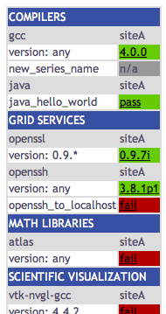
Displaying Queries: Suite Results
Depot -> XML -> XSL -> CSS -> JSP -> Jetty -> User
Edit $INCA_INSTALL/etc/common/swStack.xml
to change HTML table:
<package>
<id>gcc</id>
<category>Compilers</category>
<version>any</version>
<versionRE>(^.*)</versionRE>
<tests>
<version>gcc_version</version>
<unitalias>new_series_name</unitalias>
</tests>
</package>
<tests>: same as series name in incat
Notes:
explain FORMAT of swStack.xml - packages array & what <tests> is

Slide 9
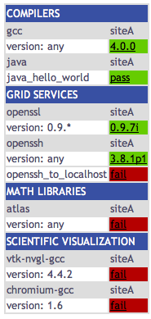
Displaying Queries: Suite Results
Depot -> XML -> XSL -> CSS -> JSP -> Jetty -> User
Print combined XML (see slides 6,7):
http://localhost:8080/xslt.jsp?
resourceID=defaultvo&
suiteName=TestSuiteLocal
Print combined XML and apply XSL (display HTML table):
http://localhost:8080/xslt.jsp?
resourceID=defaultvo&
suiteName=TestSuiteLocal&
xsl=http://localhost:8080/swStack.xsl
Notes:
XSL (Extensible Stylesheet Language):
XSL is a language for expressing stylesheets.
Given arbitrarily structured XML documents, designers
use XSL stylesheets to express how the XML
should be presented
(e.g. transformed into HTML)

Slide 10
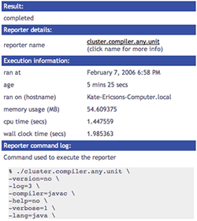
Displaying Queries: Series Results
Depot -> XML -> XSL -> CSS -> JSP -> Jetty -> User
Print series XML (see slides 4,5):
http://localhost:8080/xslt.jsp?
instanceID=209&
configID=5
Print series XML and apply XSL (HTML table):
http://localhost:8080/xslt.jsp?
instanceID=209&
configID=5&
xsl=http://localhost:8080/swStack.xsl

Slide 11
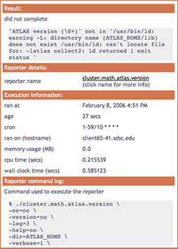
Displaying Queries: Customization
Depot -> XML -> XSL -> CSS -> JSP -> Jetty -> User
Edit XSL:
$INCA_INSTALL/etc/swStack.xsl
XML formatting (e.g. add row to display cron)
swStack.xsl has two main templates,
“test” to display series results and
“suite” to display suite results
Edit CSS (Cascading Style Sheet):
$INCA_INSTALL/etc/inca.css
colors (e.g. change .header background-color)
fonts

Slide 12
Displaying Queries: JSP
Depot -> XML -> XSL -> CSS -> JSP -> Jetty -> User
JavaServer Page (xslt.jsp)
  create dynamic web content
JavaServer Pages (JSP) tag libraries
  define declarative, modular functionality that can be reused by any JSP page
  reduce the amount of Java code in JSP pages (move tag functionality into tag implementation classes)

Slide 13
Displaying Queries: JSP tag libraries
Depot -> XML -> XSL -> CSS -> JSP -> Jetty -> User
Tag Library Descriptor (TLD)
  XML document that describes the library
  contains information about the library and each library tag
  used by a JSP container to validate the tags
TLD calls in JSP
  xslt.jsp calls getXML,
  printXML, applyXSL
<%@ taglib uri="xslt.tld" prefix="xslt" %>
<xslt:printXML xml="<%=xml%>"/>
<tag>
<name>printXML</name>
<tagclass>edu.sdsc.inca.consumer.tag.PrintXML</tagclass>
<info>print a file line by line</info>
<attribute>
<name>xml</name>
<required>true</required>
</attribute>
</tag>

Slide 14
Displaying Queries: Jetty
Depot -> XML -> XSL -> CSS -> JSP -> Jetty -> User
Jetty, a Java HTTP server and servlet container, runs Inca’s xslt.jsp data consumer
Separate Web server (e.g. Apache) is NOT required
.jsp, .xsl, .css, and libs packed into a .war (or "web archive") file for Jetty. A war file is a packaged webapp directory created using the Java jar tool.
Jetty starts on port 8080 by default, but can be configured to start on another port

