Slide 1
Monitoring TeraGrid
Functionality and Performance with Inca
Shava Smallen, Kate Ericson
San Diego Supercomputer Center
Notes:
Using inca to monitor TG func and perf

Slide 2
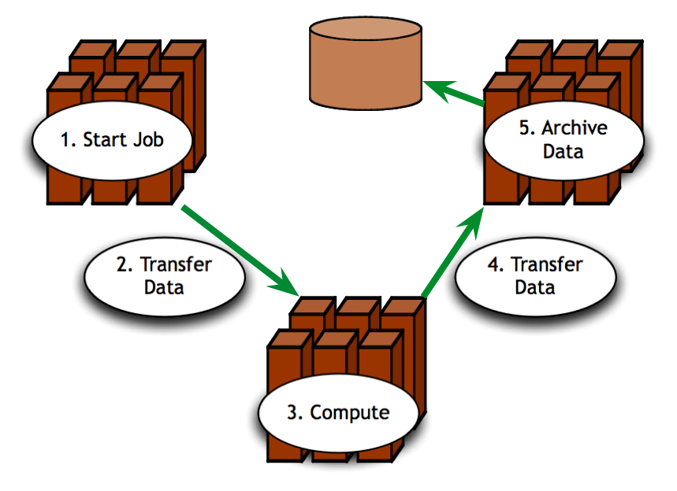
Is TeraGrid working?
Can TeraGrid users run their applications? Can they access their datasets?
  Can user login?
  Are Grid services the application[s] use available? Compatible versions?
  Are dataset[s] N accessible to user X? Credentials?
  …
Notes:
From a user’s perspective, TeraGrid is working if they can run their particular application on the set of resources they want, access their dataset, and get “good” performance.
users need to be able to login and find that the software and services their application requires function as expected. This graphic could represent the requirements of a single user’s application - being able to start a job on one resource, transfer data to another resource for computation and finally transfer the results for archival
If you consider the requirements of a community of users and multiple communities of users, like the science gateways, those set of requirements can grow quite large.

Slide 3

How can user requirements be tested?
User-level deployment testing
  Automated, continuous checking of Grid services, software, and environment
  Installed? Configured correctly? Running? Accessible to users? Acceptable performance?
  E.g., gatekeeper ping or scaled down application
Notes:
Testing to verify whether or not a user or user community’s requirements are being met is different than the type of testing you might do to get system-level information about resource utilization, for example.
Because we’re checking whether packages are installed, running, and configured correctly for an average user, user-level deployment testing tries to emulate what a generic user would experience.
User-level tests could be something as simple as pinging a Globus gatekeeper service to a more complicated test such as a scaled down version of an application

Slide 4
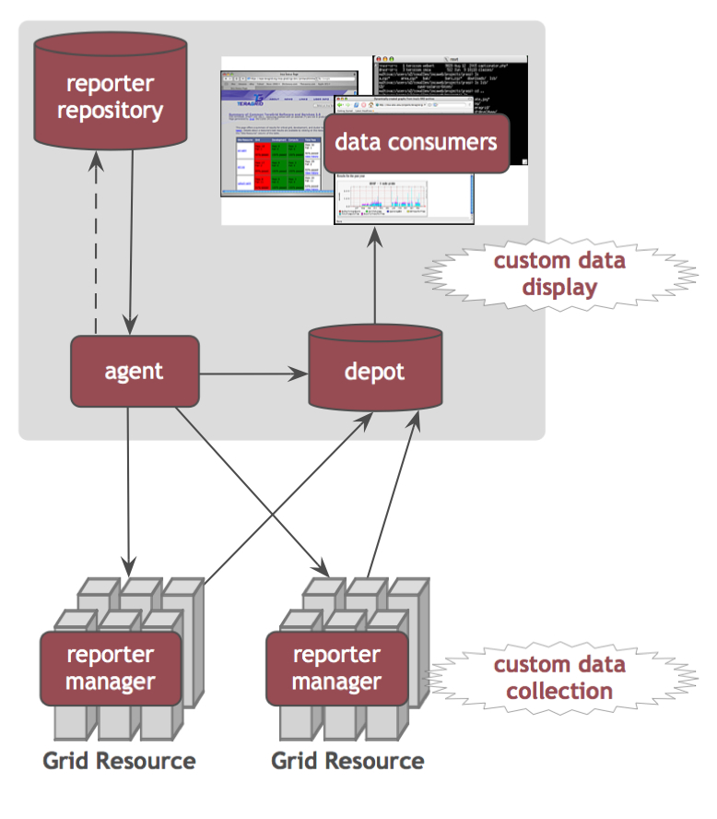
Inca
Inca automates user-level testing and benchmarking of TeraGrid’s services, software and environment
  schedules execution
  of information gathering
  scripts (reporters)
  collects, archives,
  publishes data
Notes:
About 4 years ago Inca was developed in order to verify and validate the TG software stack and environment.
Inca performs user-level testing by providing scheduled execution of information gathering scripts on the various grid resources which we call reporters. A reporter is typically a test of a grid service, a benchmark, or a version query of a grid software package whose results are formatted in XML
The Inca system collects data generated by reporters on each of the resources, stores and archives that data, and then makes it available for query or display (like on a web page).
The type of data that inca collects and displays can be easily customized for a particular user or user community.
An Inca reporter is an executable program that tests or measures some aspect of a system or installed software. A reporter could be a simple Globus gatekeeper ping test or a more complex Grid application benchmark. Reporters must support certain command line options and produce XML according to the Inca reporter schema.
The Admin Tool is a user interface (java GUI) used by the Inca admin to administer all parts of an Inca deployment; it connects to the Reporter Agent
The Reporter Agent is a server which is the access point to an Inca deployment and is responsible for managing the control flow of an Inca installation
The Reporter Repository is responsible for storing Reporters (scripts that gather data from resources); reporters are packaged as RPMs; can be shared among multiple Inca deployments
The Reporter Manager is a lightweight process responsible for managing the schedule and execution of Reporters on a single resource; receives instructions from one and only one reporter agent.
The Depot is a server that is responsible for storing the data produced by reporters.
The Suite describes where to run the reporters, frequency of execution, and optionally expected values (I.e., instructions for how to collect data)

Slide 5
Some Features of Inca
  Automates periodic execution of tests
  User-level Grid monitoring
  Centrally manages monitoring configuration for easy deployment updates and maintenance
  Stores and archives a wide variety of monitoring results
  Captures context of monitoring result as it is collected
  Eases the writing, deploying, and sharing of new tests or benchmarks
  Flexible and comprehensive web status pages
  Secure
Notes:
Run under generic user account enables user-level testing
Reports fully archived to understand the how the Grid behaves over time - for example to understand how a service fails over time and if it fails with the same type of error
The method to specify the data collection is very expressive to make it easy to configure Inca. Also easy to make changes to an existing deployment (important because resources and requirements change over time)
There’s such a thing as testing too often -- profiling- tradeoff of between freshness of data and impact on resource
Components use ssl to communicate, myproxy used to install reporter managers and for tests that need a proxy

Slide 6


User-level Grid Monitoring
  Runs from a standard user account
  Executes using a standard GSI credential
  Has tests that are developed and configured based on user documentation
  Verifies user-accessible Grid access points
Notes:
Run under generic user account enables user-level testing
Reports fully archived to understand the how the Grid behaves over time - for example to understand how a service fails over time and if it fails with the same type of error
The method to specify the data collection is very expressive to make it easy to configure Inca. Also easy to make changes to an existing deployment (important because resources and requirements change over time)
There’s such a thing as testing too often -- profiling- tradeoff of between freshness of data and impact on resource
Components use ssl to communicate, myproxy used to install reporter managers and for tests that need a proxy

Slide 7
TeraGrid’s Inca Deployment
Running since 2003 and currently monitoring:
  All allocated TeraGrid resources
  Coordinated TeraGrid
  Software & Services (CTSS)
  Services for Science Gateways (LEAD)
  Cross-site tests
  GRAM usage
  CA certificate and CRL checking
  Resource registration in MDS
Notes:
Currently on all…
Have been using inca since 2003 to monitor ctssv2, currently using to monitor ctssv3 and ctssv4

Slide 8
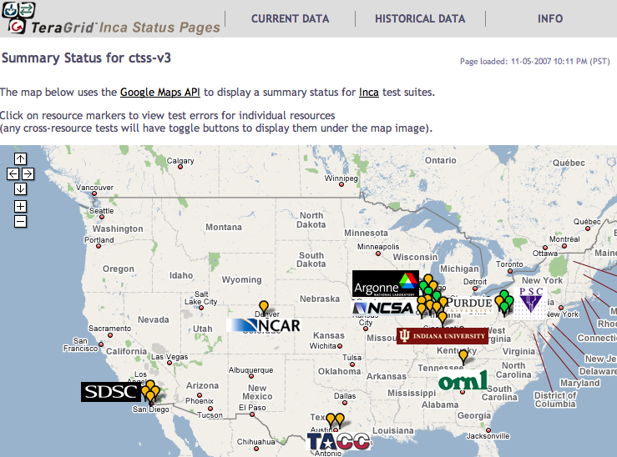
Current Inca Data Display
  All status pages linked from inca.teragrid.org
Screenshot of Inca status pages for TeraGrid

Slide 9
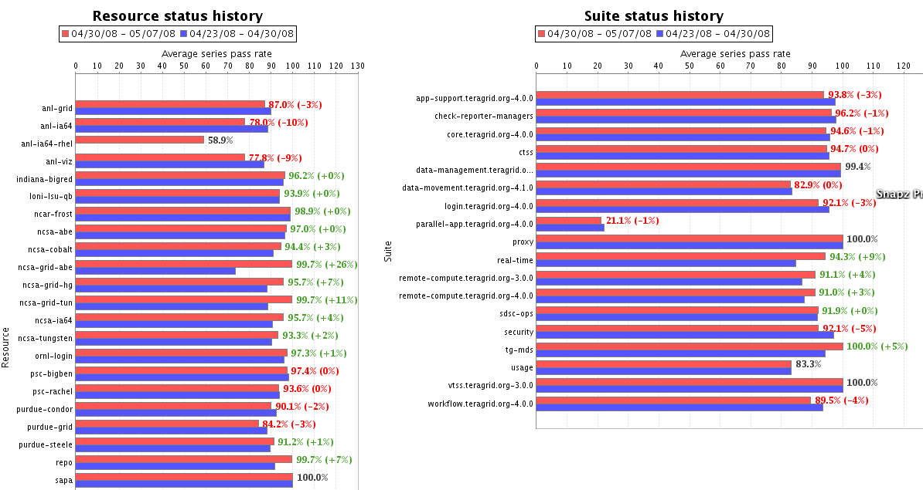
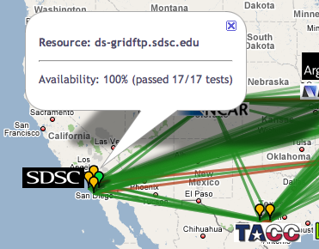
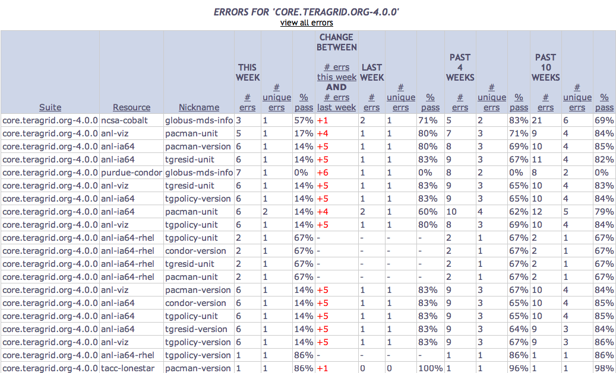
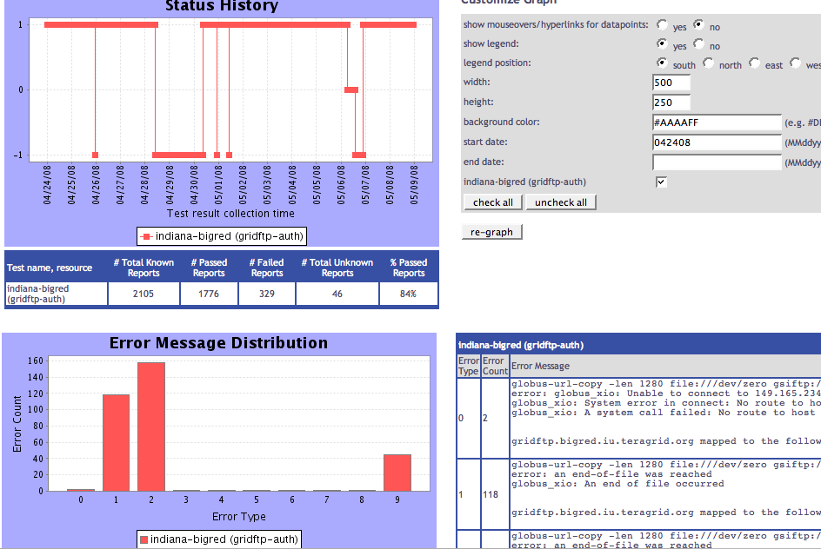
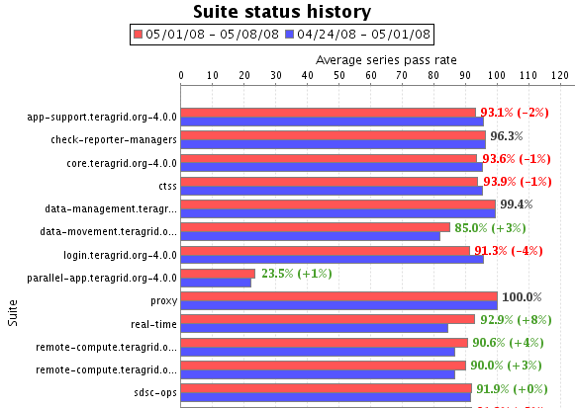
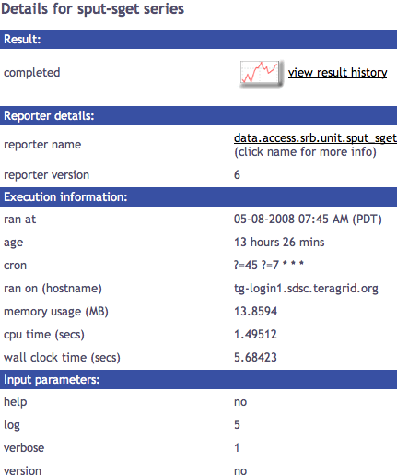
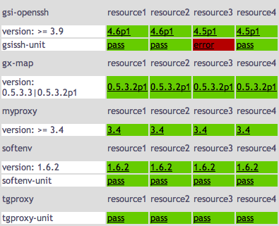
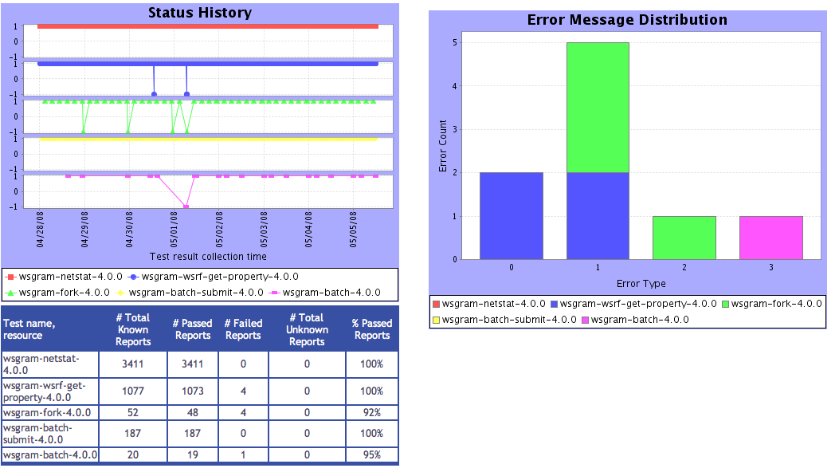
Tests
Summary
Average test pass rate
Cumulative test status by resource
Consumer displays range from summaries to details
Summary of errors this week
Test status by package and resource
Related test histories
Individual test result details
Test
Details
Individual test history
Historical
Current status

Slide 10
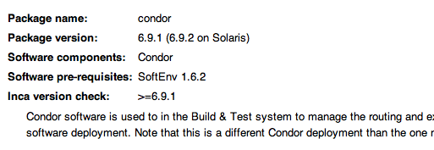
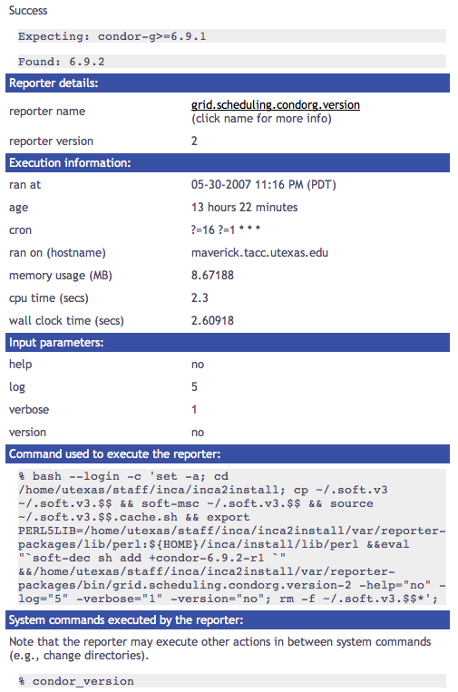
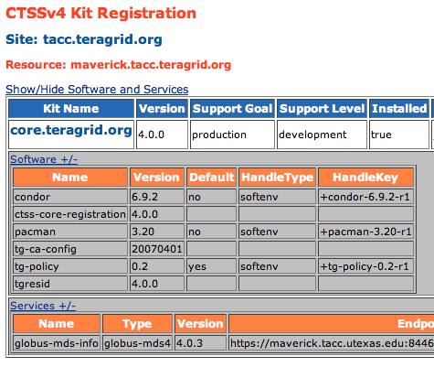
Current Inca Data Display: CTSSv4
Configured based on kit Integration Implementation wiki pages and MDS registered information
Notes:
Example of reporter details in a single result view

Slide 11
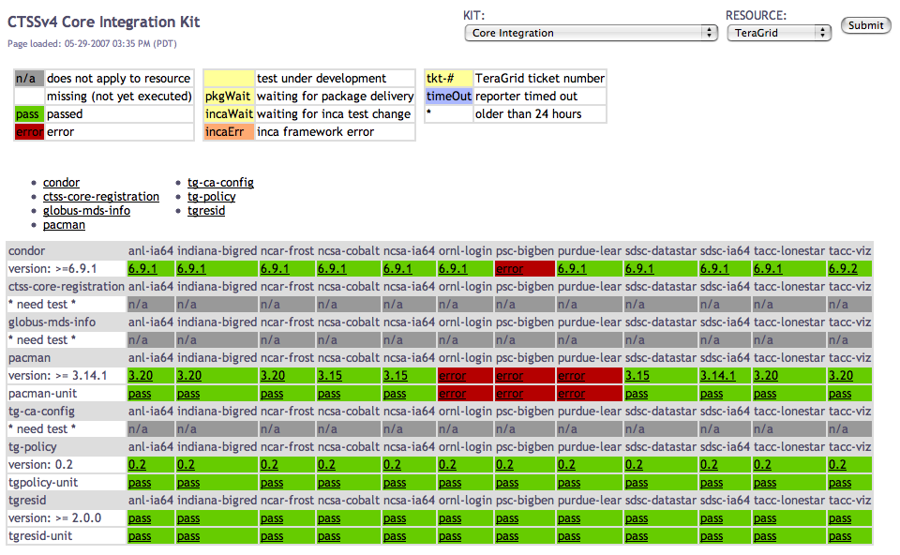
Current Inca Data Display: CTSSv4
Status of selected kit(s) on selected resource(s)
Notes:
Mock-up of a ctssv4 kit status page

Slide 12
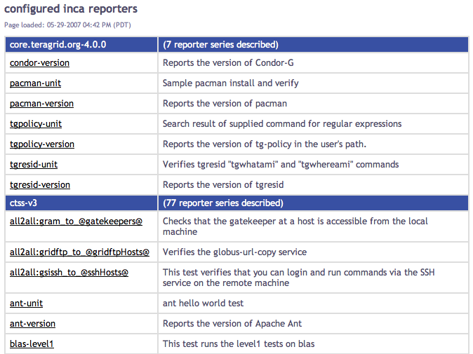
Current Inca Data Display:
List of Running Tests

Slide 13
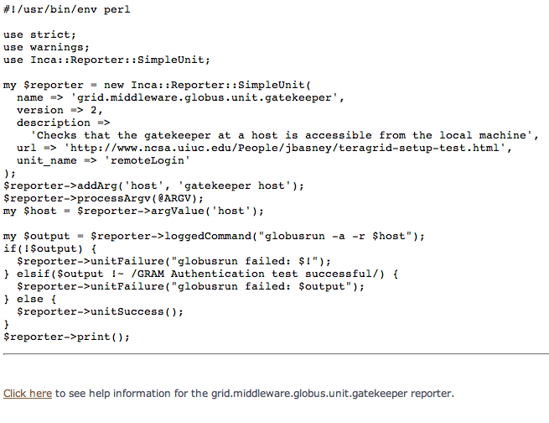
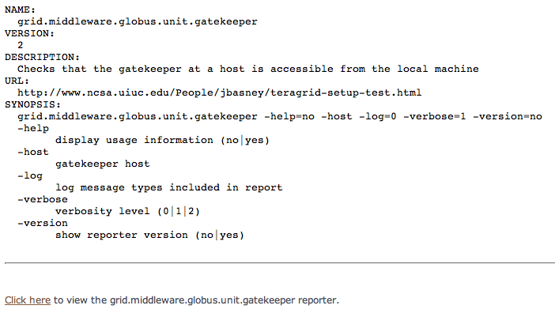
Current Inca Data Display:
List of Running Tests (cont)

Slide 14
Development Plans
Run now capability for system admins:
  ability to execute configured reporters on demand and send reports to depot immediately
  wiki instructions: Inca_Information_for_System_Administrators
  password same as repo.teragrid.org
Comments form (near completion):
  staff will be able to view reporter execution details and add their own comments

Slide 15
Development Plans
Downtime handling:
  tests will not execute during planned downtime and status pages will display news with downtime information
State change reports (weekly ops call):
  report a summary of test status changes for a selected time period

Slide 16
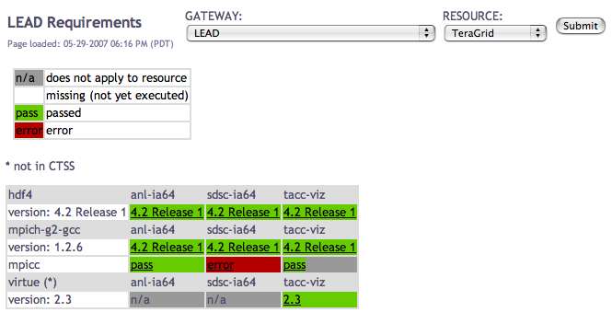
Custom Science Gateway Status
  Customize views of existing data, in future add new tests for gateway application
  Allow users to test and confirm that their Grid applications’ requirements are being met
Notes:
Application test suite - hypothetical

Slide 17
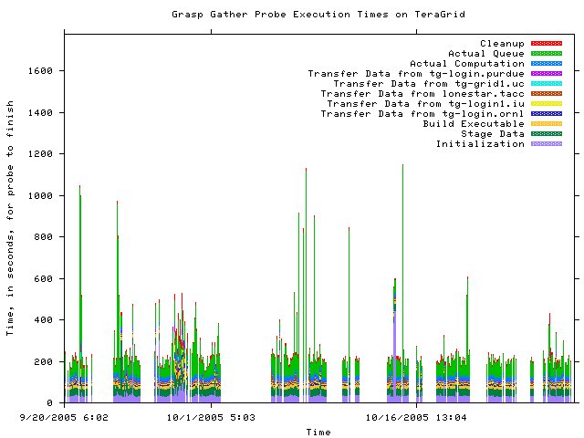
Historical Graphs
Notes:
Next three slides are example of historical graphs, not actively running
right now we have csv historical information
This is about 2 months of results from the gather probe running on TG in 2005
Y axis is execution time in seconds and x axis the time at which the measurement was taken
Colors indicate stage in execution of the probe
See how the performance varies over time - queue time most variable
white areas indicate probe did not complete due to an error - with version 2, we archive the error messages and can see what types of error messages are occurring

Slide 18
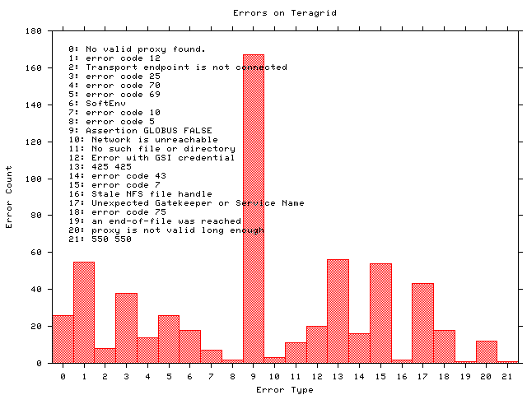
Historical Graphs
Notes:
Histogram shows what types of errors are occuring the most often - error messages are truncated
The highest number of occurrrences in 9 which is the result of a documented Globus 2.0 bug when the GRAM server is under high load
A full report of errors on TG found by the grasp gather probe. This is a new capability in Inca 2.0 -- Inca 1 was unable to archive error messages.

Slide 19
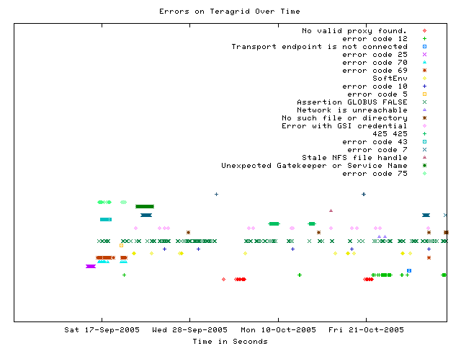
Displaying errors over time
Notes:
This graph shows when a certain type of error occurs over time
Most errors only occur for a few days before being fixed - for example, the dark green * “Unexpected Gatekeeper of service name” is a configuration error
Dark green xxx’s represent the Globus 2.0 bug over time - a transient error occurs continuously

Slide 20

More information
Inca Web Page:
  http://inca.sdsc.edu
TeraGrid Inca Status Pages:
  http://inca.teragrid.org
Email:
  inca@sdsc.edu
Notes:
That was our current plan for future development, we’ll be updating system administrators about the status of work on the call
if science gateway interested in setting up custom view of data for their application, please come talk

