Slide 1

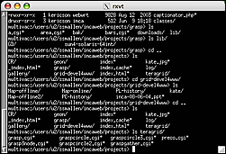
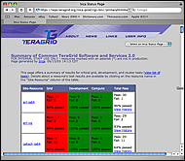
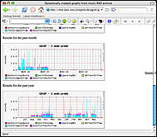
1. The user creates a suite using incat and submits it to the agent
4. Data consumers display collected data (reports) by querying the depot
reporter
repository
incat
data consumers
suite
R
agent
suite
depot
2. The agent
- fetches reporters from the reporter repository
- creates a reporter manager on each resource
- sends the suite and reporters to each reporter manager.
suite
suite
suite
R
r
r
R
R
r
reporter
manager
reporter
manager
reporter
manager
…
Resource 1
Resource 2
Resource N
3. Each reporter manager executes reporters according to its schedule and sends results (reports) to the depot
Notes:
The Admin Tool is a user interface (java GUI) used by the Inca admin to administer all parts of an Inca deployment; it connects to the Reporter Agent
The Reporter Agent is a server which is the access point to an Inca deployment and is responsible for managing the control flow of an Inca installation
The Reporter Repository is responsible for storing Reporters (scripts that gather data from resources); reporters are packaged as RPMs; can be shared among multiple Inca deployments
The Reporter Manager is responsible for managing the schedule and execution of Reporters on a single resource; receives instructions from one and only one reporter agent.
The Depot is a server that is responsible for storing the data produced by reporters.
The Suite describes where to run the reporters, frequency of execution, and optionally expected values (I.e., instructions for how to collect data)

