Slide 1
Inca User-level Grid Monitoring
Shava Smallen
ssmallen@sdsc.edu
Notes:
What are Grids and why do they need to be monitored

Slide 2
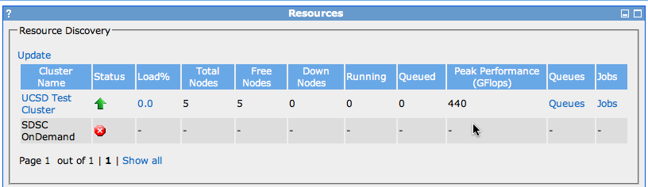
Things fail …
For example,
Resource does not display in portal (MDS not running)
Cannot submit job (WS-GRAM not running)
Distributed System: “You know you have one when the crash of a computer you've never heard of stops you from, getting any work done.”
-Leslie Lamport

Slide 3


Goal: reliable grid software and services for users
Grids provide unified access to resources that advance scientific exploration
Unfortunately, complex to deploy and maintain
Detect and analyze failures
1+ PFlop compute power,
30+ PB of online and archival data storage,
multi-Gpbs links
Notes:
The primary goal in the creation of Grids is to provide unified and coherent
access to distributed computing, data storage and analysis, instruments, and
other resources to advance scientific exploration.
The resources of a Grid provide hundreds to thousands services which adds more capabilities but also adds more complexity which leads to an increased probabillity that something will fail. This is complicated by the fact that Gridst span several administrative domains.
One such Grid is the TeraGrid is a project funded by NSF and is a collaboration of several supercomputer centers across the US. provides 21 resources across 11 sites
, the problem we are addressing with Inca is the issue of reliability in Grids.
One of its TeraGrid’s activities in order to support and encourage the execution of Grid applications is to provide a coordinated software environment known as CTSS. CTSS contains packages such as Globus, Storage Resource Broker, MyProxy, and GSI-SSH and environment setup using a tool called SoftEnv. The goal of this was so developers and users could focus their effort of porting their Grid applications to machine architecture differences rather than the middleware. When CTSS was first deployed, there were many inconsistencies between sites due to misunderstandings of the specifications or misconfigurations of the software itself. These inconsistencies along with software failures in general is something we wanted to monitor in order to provide a stable environment to users.

Slide 4

Who benefits from grid monitoring?
Grid managers
Verify requirements are fulfilled by resource providers
Identify failure trends
System administrators
Email notification
Debugging support
End users
Higher availability
Debug user account/environment issues
System
administrators

Slide 5
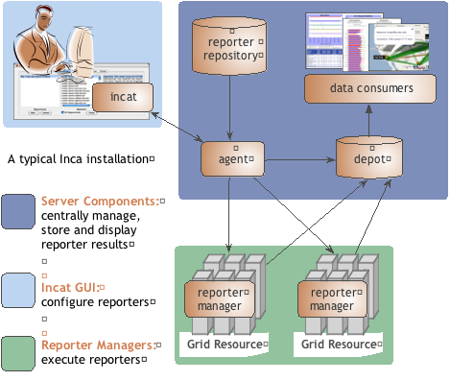
Inca provides user-level grid monitoring
Enables consistent user-level testing across resources
Easy to configure and maintain
Easy to collect data from resource
Archived results support troubleshooting
Large variety of tests
Comprehensive views of data
Notes:
The architecture of Inca is illustrated in the figure. It is composed of a number of server components which control, store, and display results, and a lightweight component which runs on each of the monitored resources. Some of the key features that Inca provides is to
Enables consistent user-level testing across resources: - Ensures consistent testing across resources with centralized test configuration.
Easy to configure and maintain: Manages and collects a large number of results through a GUI interface (incat).
Easy to collect data from resources: Data is collected by reporters, executables that measure some aspect of the system and output the result as XML. Multiple types of data can be collected. Perl APIs are provided to make it easy to write reporters; most are less than 30 lines of code.
Large variety of tests: Inca offers a number of prewritten test scripts, calledreporters, for monitoring Grid health. Reporter APIs make it easy to create new Inca tests.
Archived results support troubleshooting Furthers understanding of Grid behavior by storing and archiving complete monitoring results.
Allows system administrators to debug detected failures using archived execution details.
Comprehensive views of data: Offers a variety of Grid data views from cumulative summaries to reporter execution details and result histories.
We designed Inca to implement this user-level Grid monitoring and In addition to the features presented in the previous slide, Inca…
Collects more than pass/fail data such as error messages, version information, and performance information.
Inca also captures the context of a monitoring result as it executes such as the script name, version, arguments, etc so that when Inca reports an error, there is enough information for a system admin to understand how the result was collected for so they can either debug the problem or inform us that the test is testing the wrong thing. It also reports the system usage so that the impact of the testing can be understood so that you can reduce the frequency of a test if it’s taking too much resources. Mention in future work automatically tune frequency based on impact and past history
Inca also provides mechanisms to make it easy to write a new test or benchmark and propagate it out the monitored resources. More later.
Finally, because we are testing Grid services, a valid GSI credential is needed to authenticate to services. Inca provides facilities to securely download a short-term proxy for a particular test or benchmark and then cleans it off the system so as to a proxy is only on the machine for the time that it’s needed. Finally, all components communicate using SSL.
The figure here shows the architecture of a typical Inca deployment. The components inside the gray box indicate the core components of Inca. So, the way it works is that an administrator for Inca would have a set of monitoring data they want to collect from resources. The admin would use a GUI client called Incat to generate a configuration (stored in XML) for that monitoring data that contains the names of the tests they want to run, their parameters, execution frequency, and resources. That configuration is then sent to the agent component which downloads the tests from a repository and stages and launches a client called the reporter manager on each monitored resource. As each RM runs a test at its scheduled time, the data is stored in a component called the depot where it can be queried and displayed by a data consumer in a web page for example.
Talk a bit more about each component using from the bottom-up.

Slide 6
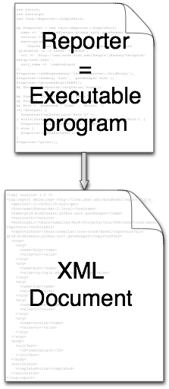
Reporters collect monitoring data
Executable programs that measure some aspect of the system or installed software
Supports a set of command-line options and writes XML to stdout
Schema supports multiple types of data
Extensive library support for perl and python scripts (most reporters < 30 lines of code)
Independent of other Inca components

Slide 7
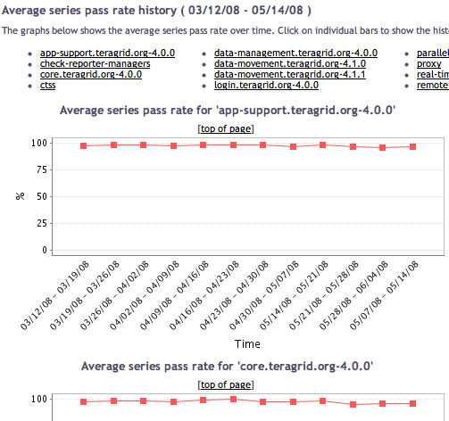
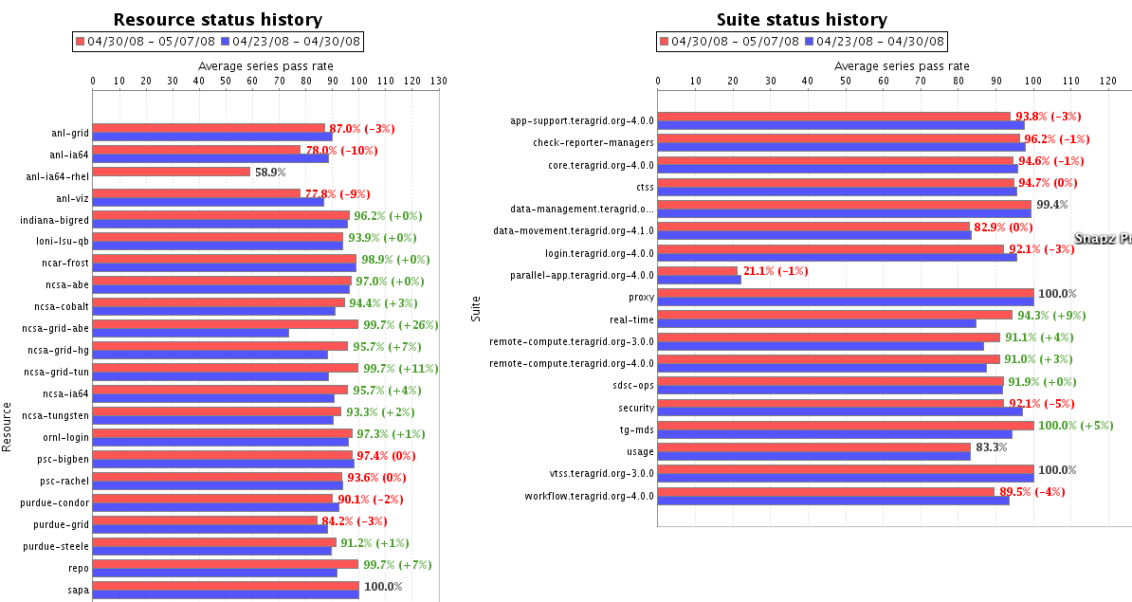
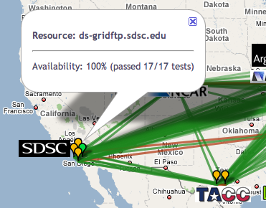
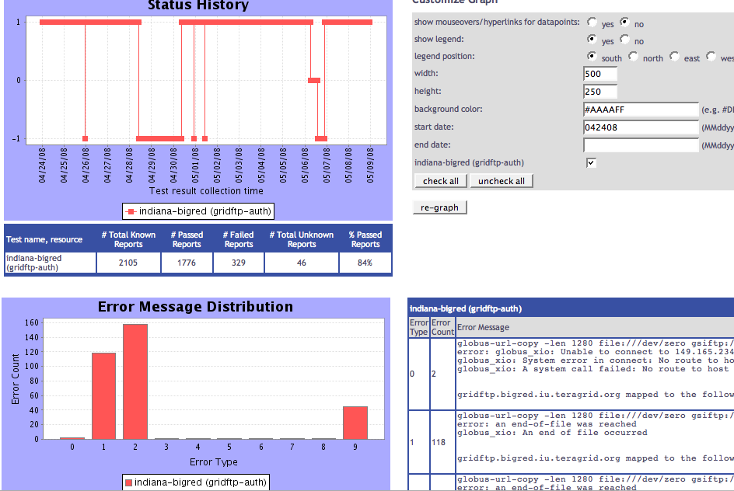
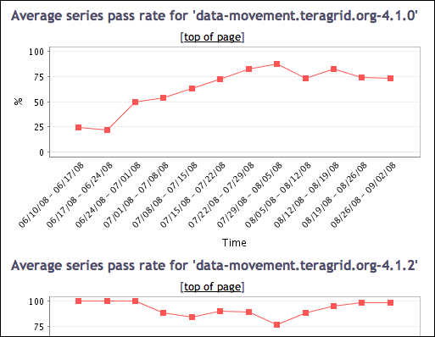
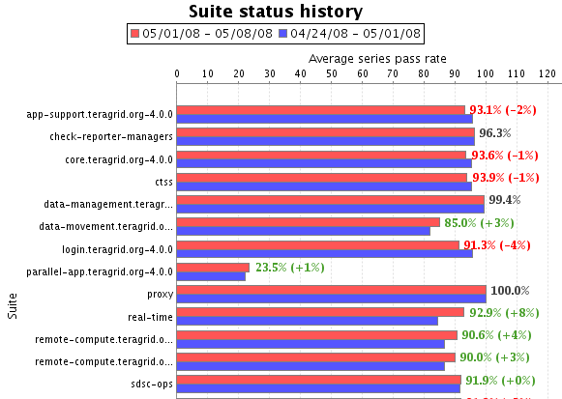
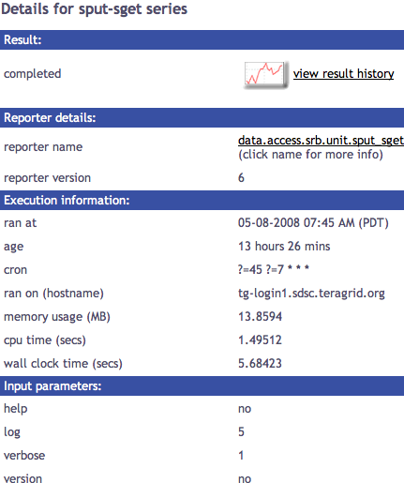
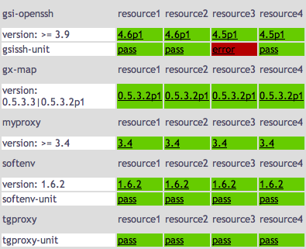
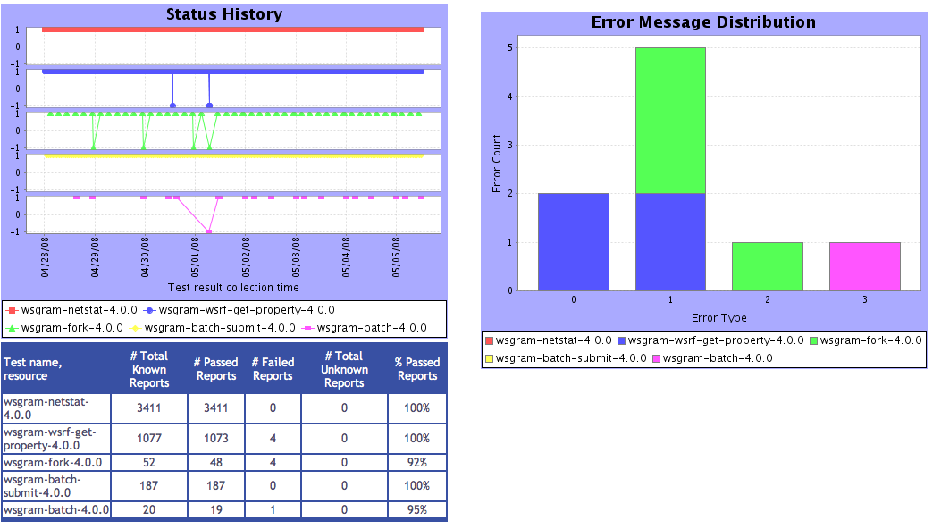
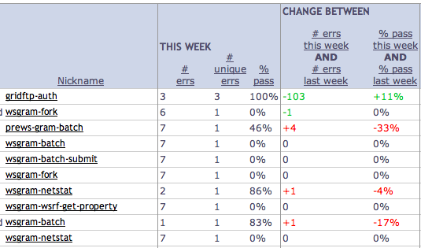
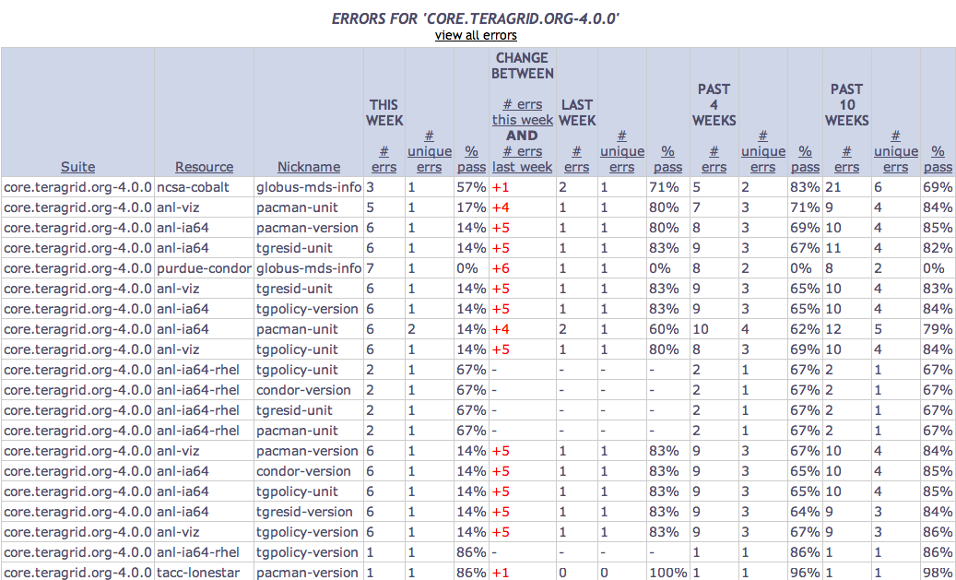
Tests
Summary
Weekly status report
Cumulative test status by resource
Resource status history
Inca’s status pages provide multiple levels of details
Error history summary
Test status by package and resource
Related test histories
Individual test result details
Test
Details
Individual test history
Historical
Current status

Slide 8
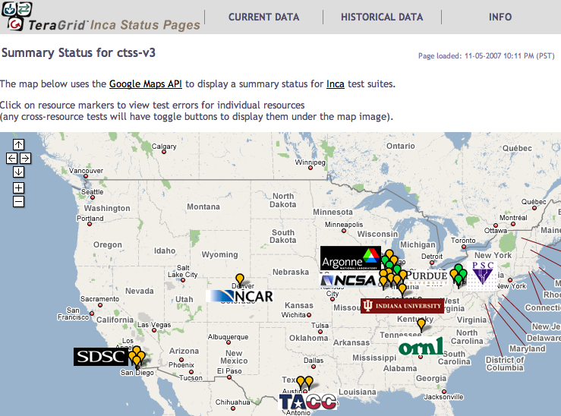
Inca TeraGrid deployment
Running since 2003
Total of 2 tests running on 20 login nodes, 3 grid nodes, and 3 servers
Coordinated software and services
Cross-site tests
GRAM usage
CA certificate and CRL checking
Resource registration in information services
Screenshot of Inca status pages for TeraGrid
http://inca.teragrid.org/

Slide 9
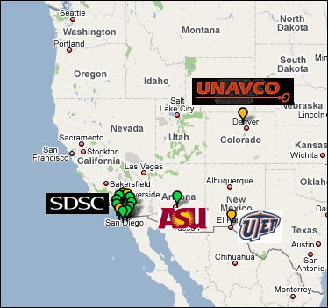

Inca GEON deployment
Running since Feb 2008
Total of 206 tests running on 5 login nodes and 6 servers
LiDAR workflow services
Web servers
Ssh connectivity
Base system information (Rocks, Gcc, Java, etc.)
Screenshot of Inca status map for GEON
http://inca-geon.sdsc.edu

Slide 10
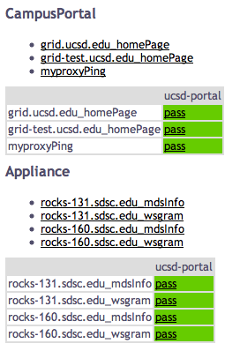
Monitoring UCSD’s campus portal
At first glance: (remote tests)
Tomcat/Gridsphere
MyProxy
MDS
WS-GRAM

Slide 11
Possibilities for expanding monitoring
What other services should be monitored?
Expand to more campuses?

Slide 13

Inca Information
Announcements: inca-users@sdsc.edu
Email: inca@sdsc.edu
Website: http://inca.sdsc.edu
Supported by:

Slide 14






Related Grid monitoring tools
Inca’s primary objective: user-level Grid monitoring
Notes:
There weren’t any Grid monitoring systems when we started Inca but today here is a sampling of the most common onethat have either been developed or adapted to do Grid monitoring. One key difference is Inca’s ability to collect a wide variety of monitoring data from functionality to performance data. But the main difference between Inca and these other tools is our the method of monitoring. A lot of these tools focus on aggregating each site’s system-level monitoring data such such as queue information while we focus on emulating a user’s experience.

