Slide 1
Inca Monitoring
Shava Smallen
October 2, 2009
Notes:
What is inca and what does it look like – reporters and data consumers
Software status
Should be able to leverage a lot from our TG install – info svc
Performance experiments with GrASP and IPM
Will need to modify Inca to monitor VM environments

Slide 2
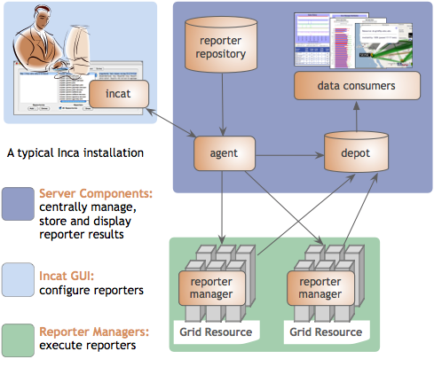
Inca provides user-level grid monitoring
Automates consistent user-level testing across resources
Easy to configure and maintain
Supports a large variety of “reporters”
Captures context of monitoring result as it is collected
Archived results support troubleshooting
Comprehensive views of data
Notes:
The approach we’ve developed over the years to address this is an active monitoring approach that we call user-level monitoring and the idea is that to attempt to emulate a user of the Grid and test the various services and software. The goal being to detect Grid infrastructure problems before the user’s notice them. In order to provide user-level monitoring a system would need to…
Enables consistent user-level testing across resources
Runs from a standard user account and uses a standard GSI credential
First testing should be done from a standard user account that’s no different than what a new user of a Grid receives. Early on, we found that testing was done from sys admin accounts which oftentimes have special privileges and have custom shell initialization file. So when users logged on to the system, things would not work for them due to permission problems, environment variables, etc.
Second, because many Grid services require a valid GSI credential, testing needed be run with a standard GSI credential that was mapped on resources to our standard user account
Verifies user-accessible Grid access points
In TeraGrid, a user can log in from any of the sites so has been important for us to run locally on each resource and verify that CTSS is available, there and working, etc.
Centrally manages monitoring configuration
Fourth, is that rather than allowing each sites to configure tests for their resources, the configuration of tests is done centrally and the goal of that is to ensure that resources are being tested consistently across TeraGrid. So, for example sometimes if a site has installed an incompatible version of software, this type of monitoring will detect that. And this is the same model as a user executing a Grid application…they will have a configuration file for their application.
Easy to configure and maintain
- Automates periodic execution of tests
-Manages and collects a large number of results through a GUI interface (incat)
Easy to collect a wide variety of data from resource
Data is collected by reporters, executables that measure some aspect of the system and output the result as XML. Multiple types of data can be collected. Perl APIs are provided to make it easy to write reporters; most are less than 30 lines of code.
Large variety of tests: Inca offers a number of prewritten test scripts, calledreporters, for monitoring Grid health. Reporter APIs make it easy to create new Inca tests.
Eases the writing, deploying, and sharing of new tests or benchmarks
We designed Inca to implement this user-level Grid monitoring and In addition to the features presented in the previous slide, Inca…
Collects more than pass/fail data such as error messages, version information, and performance information.
Inca also captures the context of a monitoring result as it executes such as the script name, version, arguments, etc so that when Inca reports an error, there is enough information for a system admin to understand how the result was collected for so they can either debug the problem or inform us that the test is testing the wrong thing. It also reports the system usage so that the impact of the testing can be understood so that you can reduce the frequency of a test if it’s taking too much resources. Mention in future work automatically tune frequency based on impact and past history
Inca also provides mechanisms to make it easy to write a new test or benchmark and propagate it out the monitored resources. More later.
Finally, because we are testing Grid services, a valid GSI credential is needed to authenticate to services. Inca provides facilities to securely download a short-term proxy for a particular test or benchmark and then cleans it off the system so as to a proxy is only on the machine for the time that it’s needed. Finally, all components communicate using SSL.
The figure here shows the architecture of a typical Inca deployment. The components inside the gray box indicate the core components of Inca. So, the way it works is that an administrator for Inca would have a set of monitoring data they want to collect from resources. The admin would use a GUI client called Incat to generate a configuration (stored in XML) for that monitoring data that contains the names of the tests they want to run, their parameters, execution frequency, and resources. That configuration is then sent to the agent component which downloads the tests from a repository and stages and launches a client called the reporter manager on each monitored resource. As each RM runs a test at its scheduled time, the data is stored in a component called the depot where it can be queried and displayed by a data consumer in a web page for example.
Talk a bit more about each component using from the bottom-up.

Slide 3

Reporters collect monitoring data
Executable programs that measure some aspect of the system or installed software
Supports a set of command-line options and writes XML to stdout
Schema supports multiple types of data
Extensive library support for perl and python scripts (most reporters < 30 lines of code)
Inca project repository contains 150+ reporters

Slide 4
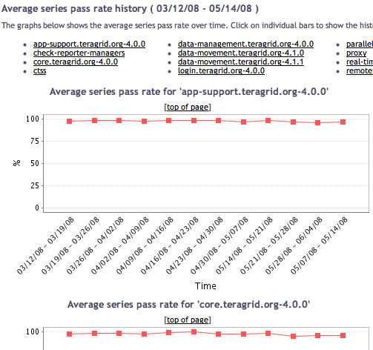
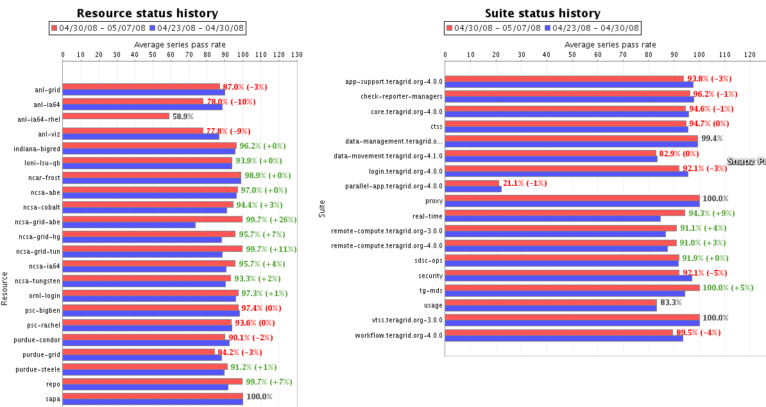
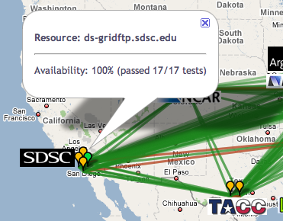
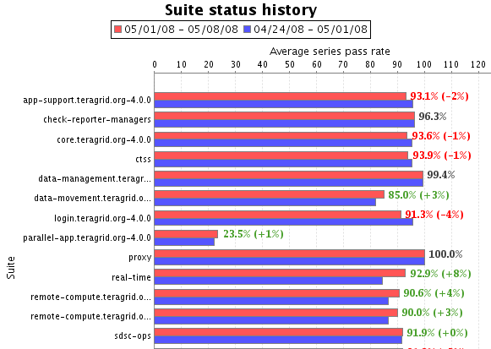
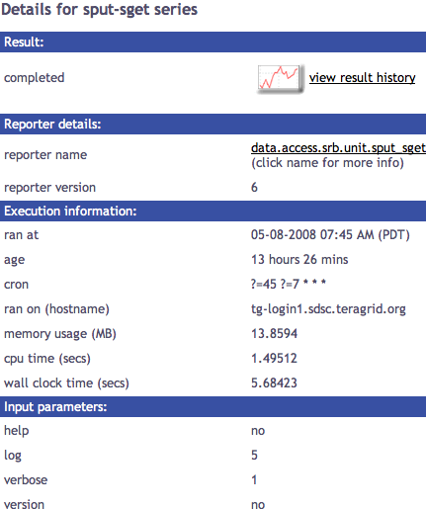
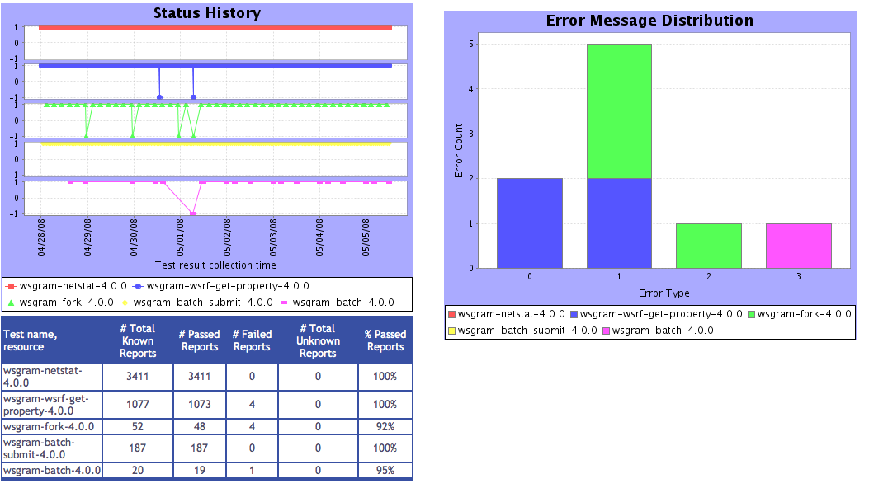
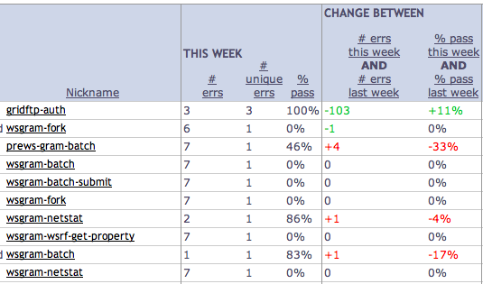
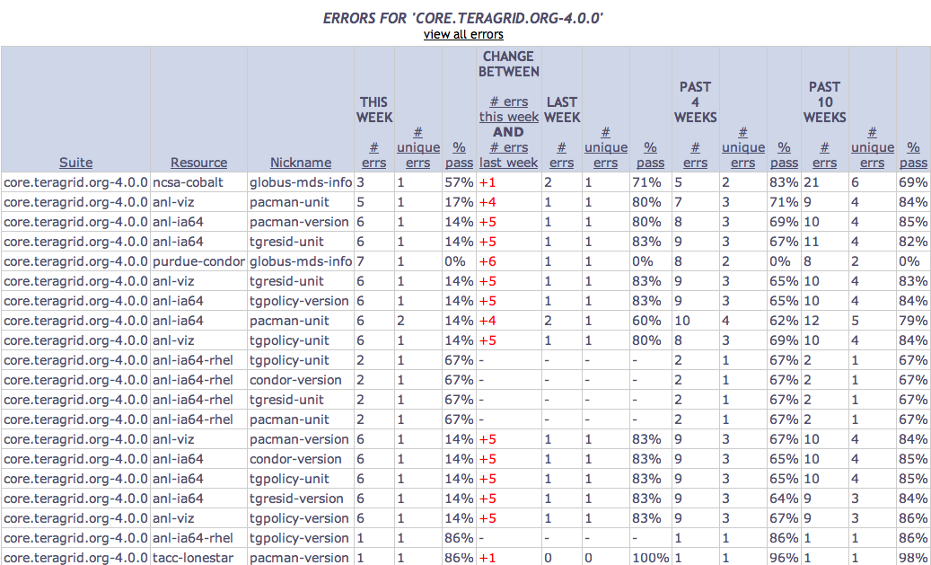
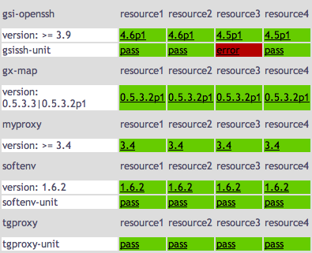
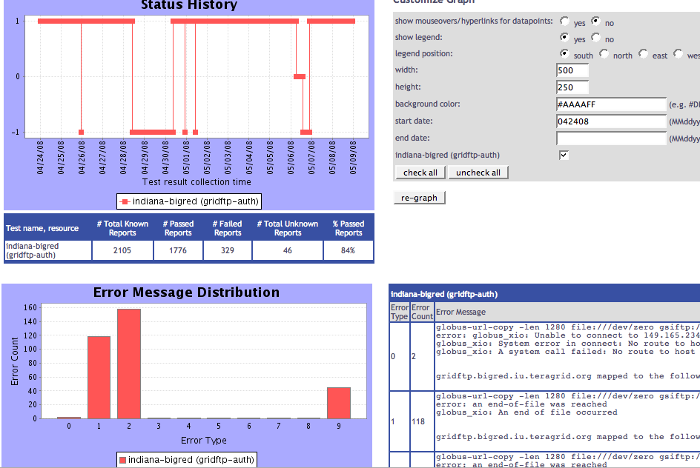
Tests
Summary
Weekly status report
Cumulative test status by resource
Resource status history
Inca’s status pages provide multiple levels of details
Error history summary
Test status by package and resource
Related test histories
Individual test result details
Test
Details
Individual test history
Historical
Current status

Slide 5
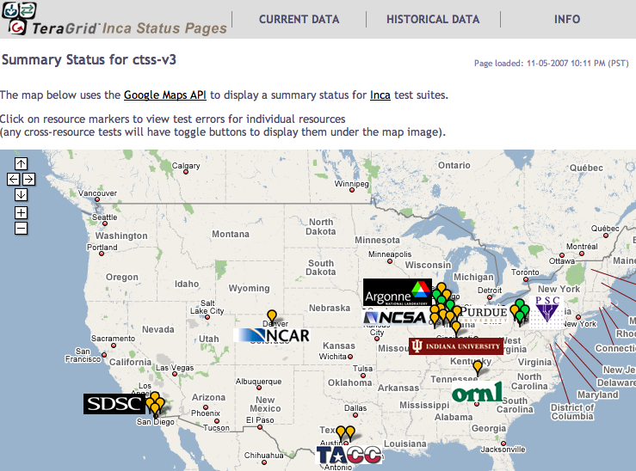

Inca TeraGrid deployment
Running since 2003
Verifies registered kit packages on resources
Total of ~2200 tests running on 18 login nodes, 2 grid nodes, and 3 servers
Testing frequency varies from 3–10 min, 1 hr, 4 hours, 12 hours, or 24 hours
Email notifications to help@teragrid.org for critical services
Reviewed during biweekly-ish operations calls
Custom views for LEAD and TG portal
Info.teragrid.org
XSL
CTSS kit
registrations
XML
http://inca.teragrid.org/
Notes:
24 kits (versions)

Slide 6
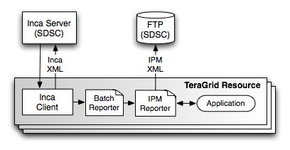
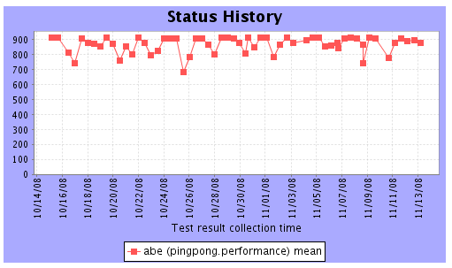
Using Inca and IPM to measure performance variation on TeraGrid
Joint work with Nick Wright (LBL) and PMaC group
Performance variation makes code optimization challenging
Benchmarks: Paratec, WRF, PingPong, and HPCC (naturally ordered ring and random ring)
Machines: NCSA Abe, NICS Kraken, and TACC Ranger
256 processors twice a day during March 2009
Variance due to network contention; higher for WRF
Mean MPI ping pong bandwidth history
Wright, N., Smallen, S., Olschanowsky, C., Hayes, J., Snavely, A. “Measuring and Understanding Variation in Benchmark Performance”, published in HPCMP UGC 2009
Notes:
PingPong reports min, max, mean ??
Paratec reports wall time, %comm, MPI call statistics
Grayed out machines we got results from initially but then removed
Mostly focused on functionality of TeraGrid. But Inca is capable of collecting a wide variety of data and most recently we have been collaborating with the Pmac group at SDSC to execute instrumented application to TG resources thru Inca. These apps are instrumented with IPM, which provides performance data that Inca report. Before, we just have simple tests of the batch system to ensure jobs can be submitted. But this actually allows us to collect more details user-level data by leveraging the information that IPM reports

Slide 7
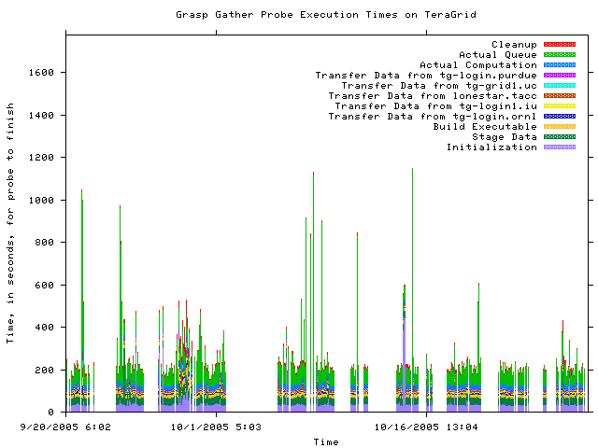
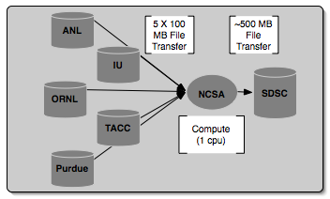
Using Inca to execute Grid Assessment Probes (GrASP)
Set of probes designed to emulate Grid applications
Gather, Circle, PreCo
Deployed to GEON (3 months) and TeraGrid (6 months)
Re-executed for proposal
Gather probe on TeraGrid
O. Khalili, J. He, C. Olschanowsky, A. Snavely, and H. Casanova. “Measuring the Performance and Reliability of Production Computational Grids”, Proceedings of the 7th IEEE/ACM International Conference on Grid Computing, 2006.
Notes:
Collect Grid benchmark measurements using GrASP (Grid Assessment Probes) developed by Henri Casanova and Allan Snavely’s groups
Requested queue time is 1 hour, actual compute is less than a minute

Slide 8








Software status and deployments
Current software version: 2.5
(available from Inca website)
http://inca.sdsc.edu

Slide 9


Inca Information
Supported by:
http://inca.sdsc.edu
http://inca.teragrid.org

