Slide 1

Monitoring User-Level Grid Functionality and Performance using
Shava Smallen
ssmallen@sdsc.edu
May 15, 2008
Notes:
Tool for monitoring Grids. I’m going to discuss a little of our motivation for developing Inca, its features, the software status, a couple of Inca deployments, and some of our plans for the future. Inca is a tool that was originally developed for the TeraGrid project back in 2003 and served as a motivation for our work.
Audience: current and potential users
* current - what’s new
* potential users - what is it and why use it (easy, robust, and

Slide 2


Motivation: Monitoring TeraGrid
Over 250 TF
Over 30 PB of online and archival data storage
Connected via dedicated multi-Gbps links
30-63 software packages and 6-23 services per resource
10 TeraGrid sites, 19 resources
Goal: Reliable Grid software and services for users
Notes:
So, TeraGrid is a project funded by NSF and is a collaboration of several supercomputer centers across the US. TeraGrid serves a general user community and there are various levels of users that it supports. Many users log into resources directly from any of the 9 sites while others access TG via a science gateway portal. One of its TeraGrid’s activities in order to support and encourage the execution of Grid applications is to provide a coordinated user environment known as CTSS. CTSS contains packages such as Globus, Storage Resource Broker, MyProxy, and GSI-SSH and environment setup using a tool called SoftEnv. The goal of this was so developers and users could focus their effort of porting their Grid applications to machine architecture differences rather than the middleware. When CTSS was first deployed, there were many inconsistencies between sites due to misunderstandings of the specifications or misconfigurations of the software itself. These inconsistencies along with software failures in general is something we wanted to monitor in order to provide a stable environment to users.

Slide 3


User-level Grid monitoring
Runs from a standard user account
Executes using a standard GSI credential
Uses tests that are developed and configured based on user documentation
Centrally manages monitoring configuration
Automates periodic execution of tests
Verifies user-accessible Grid access points
Easily updates and maintains monitoring deployment
Notes:
The approach we’ve developed over the years to address this is an active monitoring approach that we call user-level monitoring and the idea is that to attempt to emulate a user of the Grid and test the various services and software. The goal being to detect Grid infrastructure problems before the user’s notice them. In order to provide user-level monitoring a system would need to…
First testing should be done from a standard user account that’s no different than what a new user of a Grid receives. Early on, we found that testing was done from sys admin accounts which oftentimes have special privileges and have custom shell initialization file. So when users logged on to the system, things would not work for them due to permission problems, environment variables, etc.
Second, because many Grid services require a valid GSI credential, testing needed be run with a standard GSI credential that was mapped on resources to our standard user account
Third we really try to develop the tests that are meaningful and as such are based on the commands written in the user documentation because that is what user’s will using. Likewise, all our tests are configured using data from the user documentation. In practice, this is sometimes difficult to achieve because management asks you to test before user documentation is available. But these should be closely coordinated activities. This provides some checks and balances for cases when sysadmins change something but forget to notify user documentation. This helps to ensure that user documentation is correct. And so what we have now in TeraGrid is pulling data from the same source (MDS4). While we do have a number of tests for TeraGrid, it’s impractical to test everything because it takes time to write tests and also if you test too much, you can load down a system because active monitoring. But you want to shoot for a representative number of tests and that can often be accomplished by ensuring testing the commands in the user documentation are tested and having one basic test for each software component. And in our experience, that is enough to catch many errors.
Fourth, is that rather than allowing each sites to configure tests for their resources, the configuration of tests is done centrally and the goal of that is to ensure that resources are being tested consistently across TeraGrid. So, for example sometimes sysadmins will “fix” a test so that it passes for that site but their fix is actually a misunderstanding of the deployment requirements.
Next, as you know, it is important to execute tests periodically because the Grid is so dynamic. And as such, archiving those results will help us understand the Grid behavior over time.
Fifth, due to the dynamic nature of the Grid, it is important for a system to be able to adapt to changes when new versions of software are installed and updated. Another difficulty we’ve encountered is writing tests perfectly the first time around. And the reason for that is the same as writing a Grid application, you have to worry about bugs, porting issues and ensuring that the test is testing the right thing…sometimes we discover bugs in the user documentation
Last, in TeraGrid, a user can log in from any of the 9 sites so has been important for us to run locally on each resource and verify that CTSS is available, there and working, etc.

Slide 4
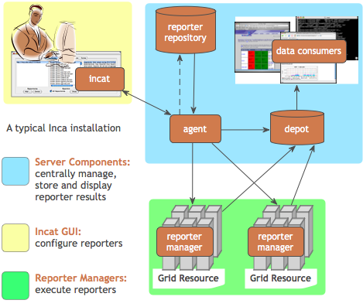
Additional features of Inca
Stores and archives a wide variety of monitoring results
Captures context of monitoring result as it is collected
Eases the writing, deploying, and sharing of new tests or benchmarks
Flexible and comprehensive web status pages
Secure
Notes:
We designed Inca to implement this user-level Grid monitoring and In addition to the features presented in the previous slide, Inca…
Collects more than pass/fail data such as error messages, version information, and performance information.
Inca also captures the context of a monitoring result as it executes such as the script name, version, arguments, etc so that when Inca reports an error, there is enough information for a system admin to understand how the result was collected for so they can either debug the problem or inform us that the test is testing the wrong thing. It also reports the system usage so that the impact of the testing can be understood so that you can reduce the frequency of a test if it’s taking too much resources. Mention in future work automatically tune frequency based on impact and past history
Inca also provides mechanisms to make it easy to write a new test or benchmark and propagate it out the monitored resources. More later.
Finally, because we are testing Grid services, a valid GSI credential is needed to authenticate to services. Inca provides facilities to securely download a short-term proxy for a particular test or benchmark and then cleans it off the system so as to a proxy is only on the machine for the time that it’s needed. Finally, all components communicate using SSL.
The figure here shows the architecture of a typical Inca deployment. The components inside the gray box indicate the core components of Inca. So, the way it works is that an administrator for Inca would have a set of monitoring data they want to collect from resources. The admin would use a GUI client called Incat to generate a configuration (stored in XML) for that monitoring data that contains the names of the tests they want to run, their parameters, execution frequency, and resources. That configuration is then sent to the agent component which downloads the tests from a repository and stages and launches a client called the reporter manager on each monitored resource. As each RM runs a test at its scheduled time, the data is stored in a component called the depot where it can be queried and displayed by a data consumer in a web page for example.
Talk a bit more about each component using from the bottom-up.

Slide 5
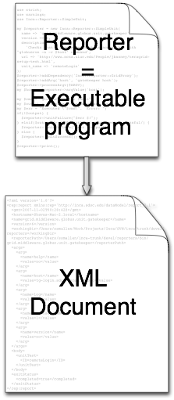
Reporters collect monitoring data
Executable programs that measure some aspect of the system or installed software
Supports a set of command-line options and writes XML to stdout
Schema supports multiple types of data
Extensive library support for perl scripts (most reporters < 30 lines of code)
Independent of other Inca components
Notes:
So, the first component of Inca I will discuss are reporters, the mechanism by which Inca collect monitoring data from a resource.
A reporter is …
Examples of reporters can include a simple test that executes a ping of a Globus GRAM service to something more complex such as a scaled down version of an application and performance benchmarks.
The requirements of the reporter executable is that it supports some specific command-line options like help and verbose and that it outputs the result to stdout in XML that complies to a specific schema.
The schema is flexible to allow multiple types of data to be expressed. There are some required header tags that store information about the reporter and the configuration it was run with, footer tag that express whether the reporter completed successfully or not, and then any snippet of xml can be placed in the middle. That snippet can be information detailed test information, software versions, or performance or usage numbers. This allows us to report more than just a pass/fail status.
We also want these reporters to be easy to write so we provide a number of Perl APIs to make it easy to write tests. These APIs take care of the formatting of data in the Inca reporter XML and a number of convenience functions for cleaning up temporary files and timing out system commands. There are also some logging functions which can be useful for showing what commands a reporter executes so for sysadmins who don’t want to read a perl script. Goal of that is to provide sys admins with the information they need in order to understand how a particular monitoring result was collected, for example when debugging a detected failure.
It is also independent of the other Inca components so for example sys admins can execute the usually script by hand while they’re debugging a problem. We are also talking with the developer of SAM which is a monitoring system developed by CERN about running reporters within the SAM infrastructure.

Slide 6
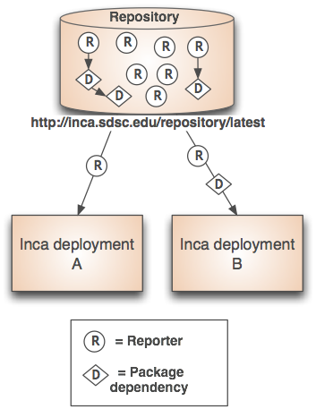
Benefits of reporter repositories
Collection of reporters available via a URL
Shared across Inca deployments
Supports package dependencies
Packages versioned to allow for automatic updates
Inca project repository contains 167 reporters
  Version, unit test, performance benchmark reporters
  Grid middleware and tools, compilers, math libraries, data tools, and viz tool
Notes:
So, once we have a set of reporters, we store them in a repository where they can be accessed by an Inca deployment. When configured by an Inca admin, Inca will propagate those selected reporters out to all monitored resources lowering the effort to setup an Inca deployment.
Since the repository is accessible via a URL, a repository can be shared and leveraged across multiple Inca deployments. This is to encourage re-use of testing code which takes some effort to do.
The repository also has the notion of package dependencies. So, if your reporter uses a CPAN Perl library, you can place it on the repository and declare it as a dependency of your reporter. Inca will then download the Perl package and install it automatically for that reporter to use when it executes. This also lowers the effort of setting up and mantaining an Inca deployment. Other types of dependencies that are supported are tar.gz that have a Makefile, autoconf file.
Another feature of the repository is that reporters are versioned. When you need to update a particular reporter or dependency, just upload it to the repository and Inca will take care of automatically propagating that out to resources. We’ve found this feature to be particularly useful because tests often need to be updated due to changes in software versions or bugs in the test.
Project repository has 3 types of reporters, version (reports version of software so can be checked for compatibility with a software stack), unit test reporters (test one or more services), and performance reporters that measure a file transfer or run a Grid app benchmark.

Slide 7
Agent provides centralized configuration and management
Implements the configuration specified by Inca administrator
Stages and launches a reporter manager on each resource
Sends package and configuration updates
Manages proxy information
Administration via GUI interface (incat)
Screenshot of Inca GUI tool, incat, showing the reporters that are available from a local repository
Notes:
I mentioned that in previous slide how reporters, their dependencies, and upgrades get automatically propagated to monitored resources. This is done by the agent Inca component. It takes a configuration which is a set of reporters, their arguments, frequency of execution, and resources and then stages and launches a client called the reporter manager on each monitored resource.
It sends the reporter manager the reporters it needs along with their dependencies and a schedule of execution and the reporter manager will execute each reporter at its scheduled time.
Whenever an Inca administrator makes an update to the configuration, the agent will propagate them to the reporter managers mimizing the effort to deploy and manager Inca.
It will also store information about a proxy stored in a MyProxy server and reporter managers can request it when they run a reporter that needs a proxy and fetch one for execution.
The Inca administrator generates and changes the configuration using a GUI interface called incat shown here in the figure. This particular snapshot shows the reporters available from a repository that can then be scheduled to resources.

Slide 8
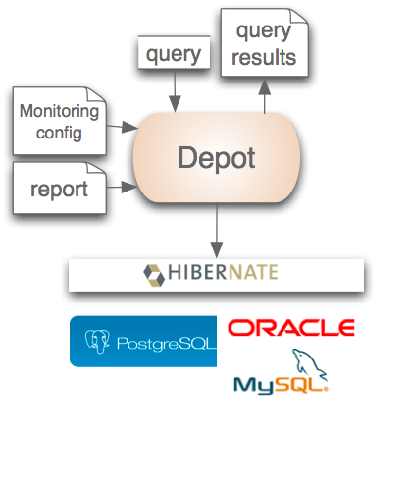
Depot stores and publishes data
Stores configuration information and monitoring results
Provides full archiving of reports
Uses relational database backend via Hibernate
Supports HQL and predefined queries
Supports email notifications
Logs downtimes via plugin
Web services - Query data from depot and return as XML
Notes:
Now when a reporter manager executes a reporter, the output and system usage is sent to the Depot, a component which stores and archives the monitoring results. The depot also stores the configuration specified by the Inca administrator and all the information is available for query.
The depot is implemented using a relational database backend which it accesses using Hibernate. So, any hibernated supported database such as Postgres, Oracle, or MySQL can be used. The database schema for is designed to reduce redundant data so for example, when a new reporter comes in and it’s the same as its previous, only the timestamps and system usage are stored as new entries.
Data can be queries using a HQL string or calling one of the predefined queries that for example get the latest results from reporters or history of a specific report.
The depot also supports email notifications that are highly configurable so when a result comes in that matches a certain pattern, email will be sent to the appropriate admins for the resource.
Finally there is a web services interface by which data can be queried as well

Slide 9
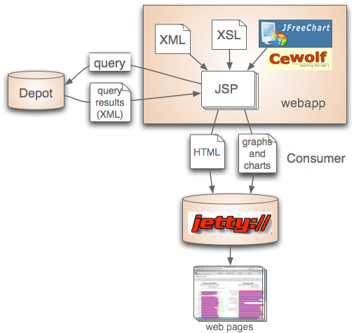
Consumer displays data
Current and historical views
Web application packaged with Jetty
JSP 2.0 pages/tags to query data and format using XSLT
CeWolf/JFreeChart to graph data
Notes:
The data is displayed by the Inca component called the data consumer which offers current and historical views of data. It is a web application packaged with Jetty, a container that can be embedded into an application so pages can be served out of the box w/o setting up a Tomcat server.
The webapp uses JSP pages and tags to query the data and then we use XSLT to format the data into HTML pages.
For graphing, we use CeWolf which utilizes JFreeChart.

Slide 10
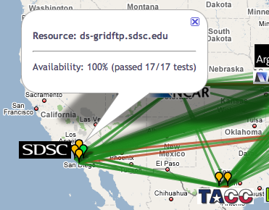
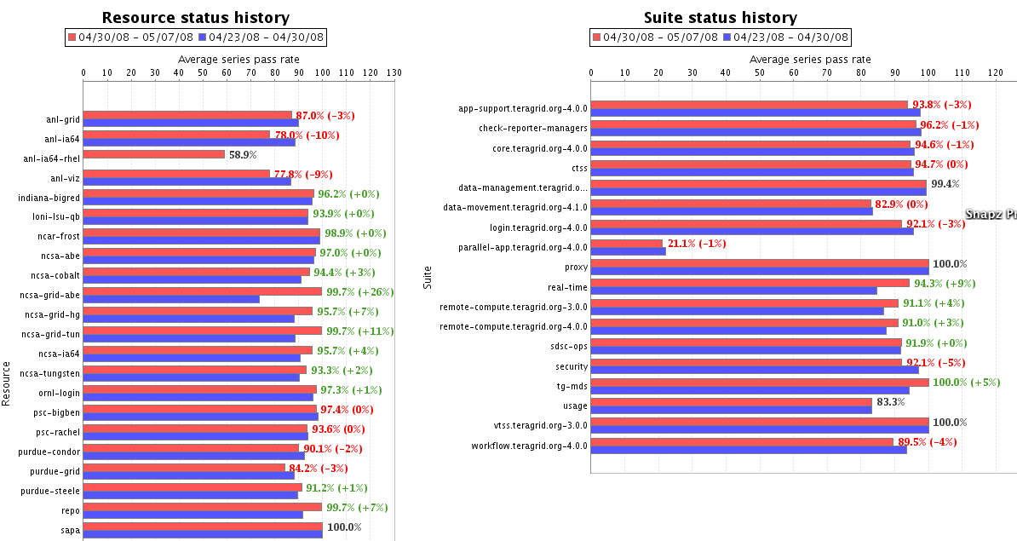
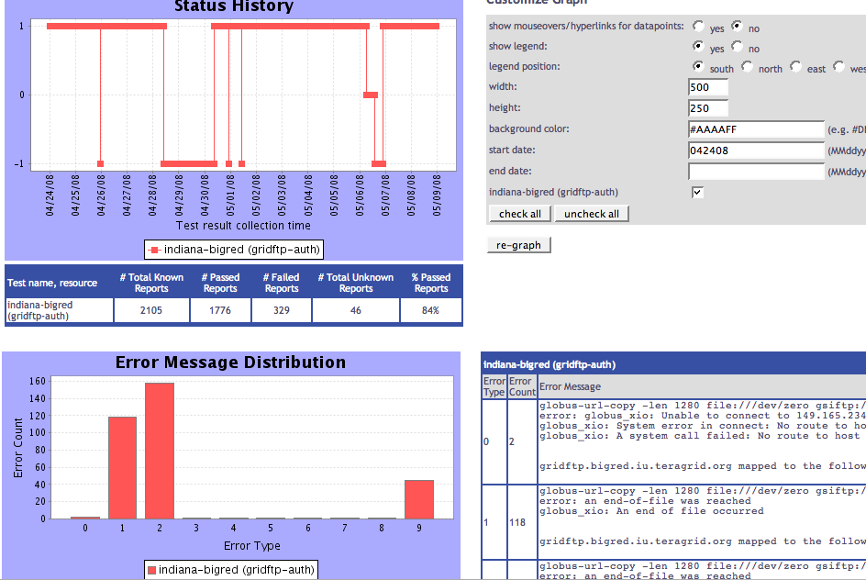
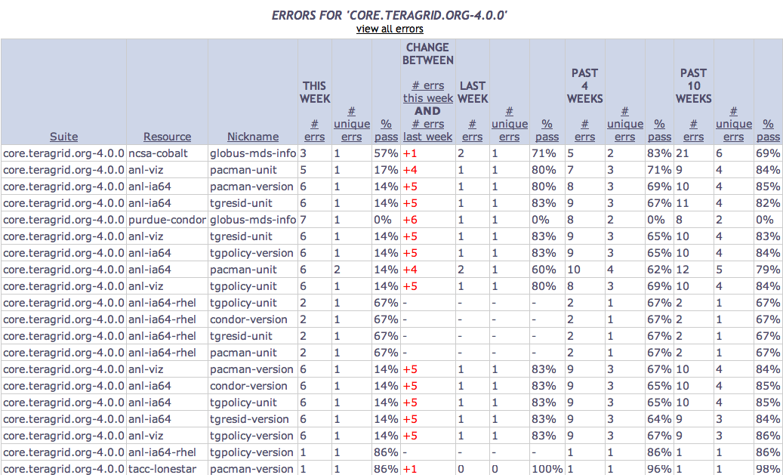
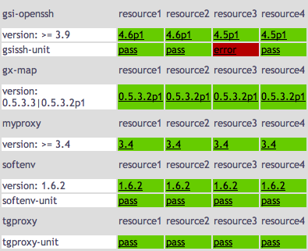
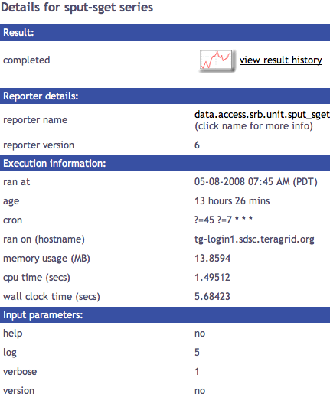
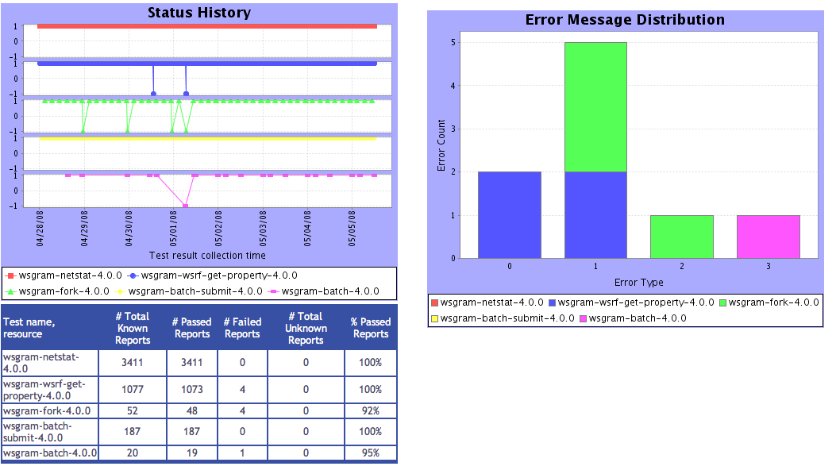
Tests
Summary
Cumulative test status by resource
Average test pass rate
Status pages display variety of views
Summary of errors this week
Test status by package and resource
Related test histories
Individual test result details
Test
Details
Individual test history
Current status
Historical

Slide 11







Software status and deployments
Current software version: 2.3
(available from Inca website)
http://inca.sdsc.edu
Notes:
The current version of our software is 2.2 which we released at the beginning of this month. You can download it from our website and there is a user guide to help you get started.
As I mentioned, Inca started as a TeraGrid project but we now have a number of other Grid projects using Inca as well such as DEISA in Europe, the NGS in the UK, GridAustralia. We also did a deployment for the NEON testbed at SDSC and James Reserve. And very recently, on GLEON.
I’m going to discuss a little bit more about our TeraGrid deployment which is our largetst and longest running deployment. And then I’m going to talk about GLEON, which is our newest deployment that we just started late last month.

Slide 12
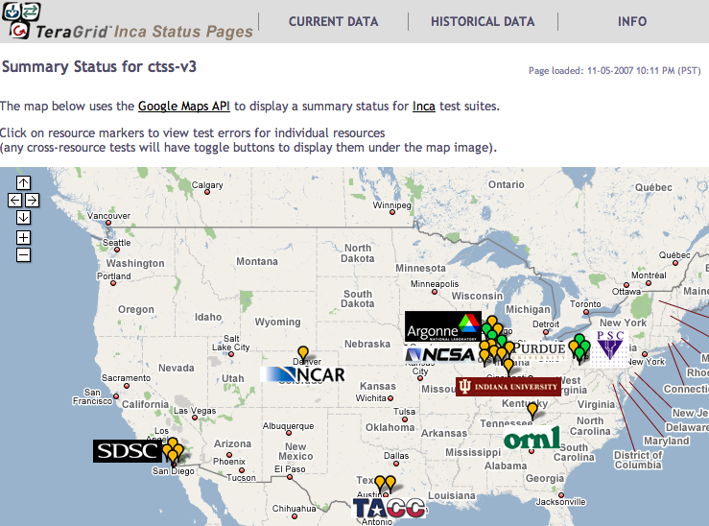
Inca TeraGrid deployment
Running since 2003
Testing for CTSS
Cross-site tests
GRAM usage
CA certificate and CRL checking
Resource registration in MDS
Screenshot of Inca status pages for TeraGrid
Notes:
So, as I mentioned earlier, Inca was started back in 2003 and that’s when we did our first deployment on TeraGrid with our first version of Inca. We developed a second version of Inca which was deployed a year ago and has been running since. Our primary focus in monitoring when we first started was the monitoring of CTSS. When we started TeraGrid was fairly homogenous and there was a single software stack and environment setup that we were to monitor. So we developed version tests to check for compatible versions of software and a set of unit tests to test the various service such as Globus GRAM, GridFTP, GSI-SSH, and so on. As the number of resources have come in and out, we’ve been able to use the flexibiility of Inca to adapt our testing configuration appropriately. These days the software stack is divided into kits and each site can decide which ones they intend to support and we have adapted to that as well.
We also have a few tests that run cross-site or all2all. These tests have proven to be very useful and are used to check for site to site specific configuration problems such as not having a trusted CA or not being in the host allow list. The cross-site tests we have are for GSI-SSH, GRAM ping, and GridFTP
We also collect usage of GRAM information by grabbing data from the globus-gatekeeper logs every day.
Other monitoring we provide is checking the lifetime of f host certificates and CRLs to make sure they are up-to-date. Email notifications are sent are then sent to help@teragrid.org if there is 2 weeks or less left on a certificate.
Finally, Inca checks that resources are registering in MDS
All in all, 2240 pieces of data being collected on TeraGrid. Each resource has about 100-151 reporters running per resource, most at 24 hour frequency and a few running on 3-10 minute scale as part our or real-time monitoring suite.
The screenshot here shows the cumulative test status by resource for the all2all tests for CTSS using our Google Map view.

Slide 13
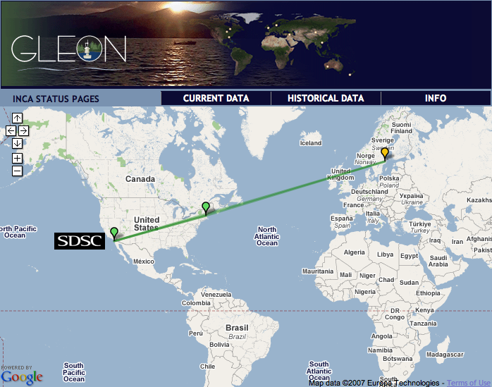

Inca GLEON deployment
Sensors in lake: dissolved oxygen level, temperature, velocity (some), etc.
Monitoring Data Turbine deployments since Oct. 24
Currently deployed for Lake Sunapee and Lake Erken
Notes:
One of our newest deployments that we have been involved with is GLEON a lake observatory project.
Sensors are deployed on lakes across the world to measure the dissolved oxygen level, temperature at different levels, water velocity (sometimes), temperature, pressure - buouy - windspeed, velocity
Data is collected at a PoP (point of presence node) and streamed back to Wisconsin using Data Turbine. We have been fortunate to work with Tony Fountain’s group at SDSC to deploy Inca to monitor their Data Turbine deployments.
Currently we have deployed Inca to Lake Sunapeed in New Hampshire and Lake Erken in Sweden and will grow it out as the Data Turbine deployments increase, Taiwan next month, and Florida in Feb.
Monitoring is fairly lightweight in comparison to TG. We have a little bit of software reporting (e.g., version of java and data turbine) and ping test for data turbine. All in all 33 reporters.
- datalogger different companies
- understand sensors - send technician out
- minimize cell calls
- downlink & dataServer on Wisconsin

Slide 14
Future work
Provide better grid reliability and performance data
Develop techniques for managing Inca load on the system
Make it easier to share and deploy test suites
Improve fault tolerance
Notes:
As far as future work, we have a few directions
Topmost, we want to provide more in depth query and analysis capabilities into the consumer to better identify trends and to better understand Grid behavior. We were envisioning “Top” statistics such as what is the most common failure, services with the most failures. Part of this effort is determining what statistics are useful to report and then developing the queries and graphs for them.
Second, as I mentioned one of the features of Inca is that the centralized configuration provides consistency in the monitoring. The downside of this is that sites like to know when changes are made and have some control. So, we’d like to provide the ability for sites to view and approve changes to the testing configuration
Third we want to provide caching capabilities on the components so that data doesn’t get lost when a component is down especially on the reporter manager side.
Fourth, we’d like to introduce automatic tuning of test frequency based 2 criteria 1) on the amount of system usage so that a reporter doesn’t load down a system and 2) based on the past history so if a service isn’t failing that often, we lower the test frequency whereas if it’s failing a lot, we increase the test frequency to better detect failures when they occur.
And last, our views has been mostly focused on system views. We want to make our data available to users and to allow specific communities of users to create custom views of Inca data for the resources and services they use. Particularly we are planning on targetting the science gateways in TeraGrid.

Slide 15
Benefits of using Inca
Detect problems before the users notice them
Easy to write and share tests and benchmarks
Easy to deploy and maintain
Flexible and comprehensive displays
Notes:
In summary, would just like to review some of our key benefits.
First is that our goal is to detect problems before the users notice them by running tests and performance measurements from a regular user account and using a regular GSI credential. We try to develop our tests based on user documentation and real use cases:
Second we try to make the process of writing tests and deploying them to resources as easy as possible by providing APIs to write them, publishing mechanisms them so others can leverage them, and propagating them out to monitored resources automatically.
Third Inca is design to easily adapt to changes in Grid infrastructure such as package updates and new resources coming in and out. This is done by providing a GUI interface to express the changes and then once committed to Inca, will propagate them out to the effected resources.
Finally, we provide a number of views to view the current status of resources from our Google Maps to detailed test data and then one can view the history of a individual reporter and the number of errors that occur. The historical views are new and as I mentioned, we plan to build on those even further to better understand failures.ter

Slide 16


More information
Website:
http://inca.sdsc.edu
Announcements:
inca-users@sdsc.edu
Email:
inca@sdsc.edu
Funded by:

Slide 17
Sample reporter
use Inca::Reporter::SimpleUnit;
my $reporter = new Inca::Reporter::SimpleUnit(
name => 'grid.globus.gramPing',
version => 2,
description => 'Checks gatekeeper is accessible from local machine',
url => 'http://www.globus.org',
unit_name => 'gramPing'
);
$reporter->addDependency('Inca::Reporter::GridProxy');
$reporter->addArg('host', 'gatekeeper host');
$reporter->processArgv(@ARGV);
my $host = $reporter->argValue('host');
my $out = $reporter->loggedCommand("globusrun -a -r $host", 30);
if (!$out) {
$reporter->unitFailure("globusrun failed: $!");
} elsif($out !~ /GRAM Authentication test successful/) {
$reporter->unitFailure("globusrun failed: $out");
} else {
$reporter->unitSuccess();
}
$reporter->print();
Notes:
TODO: Add descriptions of fields

Slide 18
Scheduling and execution
Reporter manager
  Manages and schedules the execution of reporters on a single resource
  Executes under regular user account
  Monitors reporter system usage and enforces limits
  Sends monitoring result to a depot
Notes:
Enable execution of reporters

