Slide 1
Inside the Inca Depot
Paul Hoover
phoover@sdsc.edu
Inca Workshop
August 26-27, 2010

Slide 2
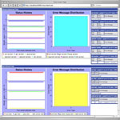
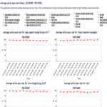
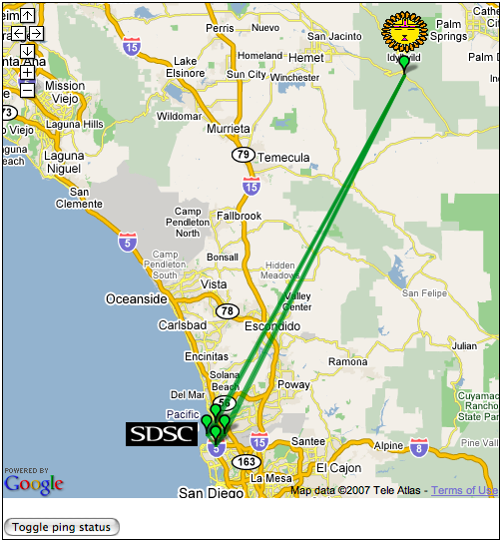
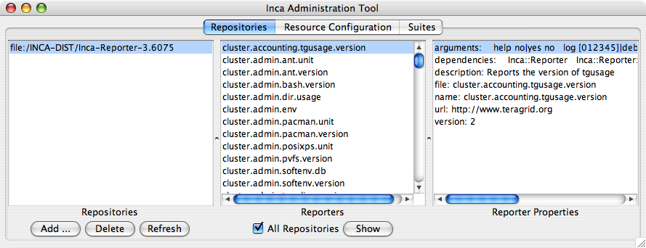
Depot
Reporter
Repository
Data Consumers
R
Incat
C
Agent
Depot
S
Inca report storage goals:
Flexible data content
Efficient storage/retrieval
Flexible access to data
Data security
S
r
S
R
r
R
Reporter
Manager
Reporter
Manager
…
Grid Resource
Grid Resource
Notes:
Focus on storage--leaves decision-making to Agent, data interpretation to consumers
Data security via Inca system security model

Slide 3
Report Body Provides Flexible Data Content
<body>
<performance ID="hpcc">
<benchmark ID="8">
<statistics
EP-STREAM_Triad_GB_s="2.813”
G-STREAM_Triad_GB_s="22.505”
Wall_Mins="74.317”
EP-DGEMM_GFlop_s="8.936”
G-HPL_TFlop_s="0.067”
Random_Ring_Latency_usecs="0.744”
ProcSpeed_GHz="2.60”
Cores="8.000”
HPL_percent="80.639”
G-Random_Access_GFlop_s="0.057”/>
</benchmark>
</performance>
</body>
<body>
<package>
<ID>openssh</ID>
<version>3.6.1p1</version>
</package>
</body>
Notes:
Flexible data content
Efficient storage/retrieval
Flexible access to data
Show hppc result instead

Slide 4
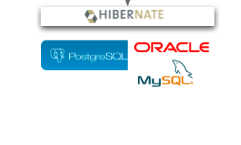
Hibernate Supports Efficient Data Access
Hibernate library provides an abstraction layer to DB applications
Supports PostgreSQL, MySQL, Oracle, HSQLDB, others
Provides HQL object-oriented SQL dialect
Depot
Notes:
Flexible data content
Efficient storage/retrieval
Flexible access to data
Inca well-tested with PostgreSQL, Oracle, HSQLDB

Slide 5
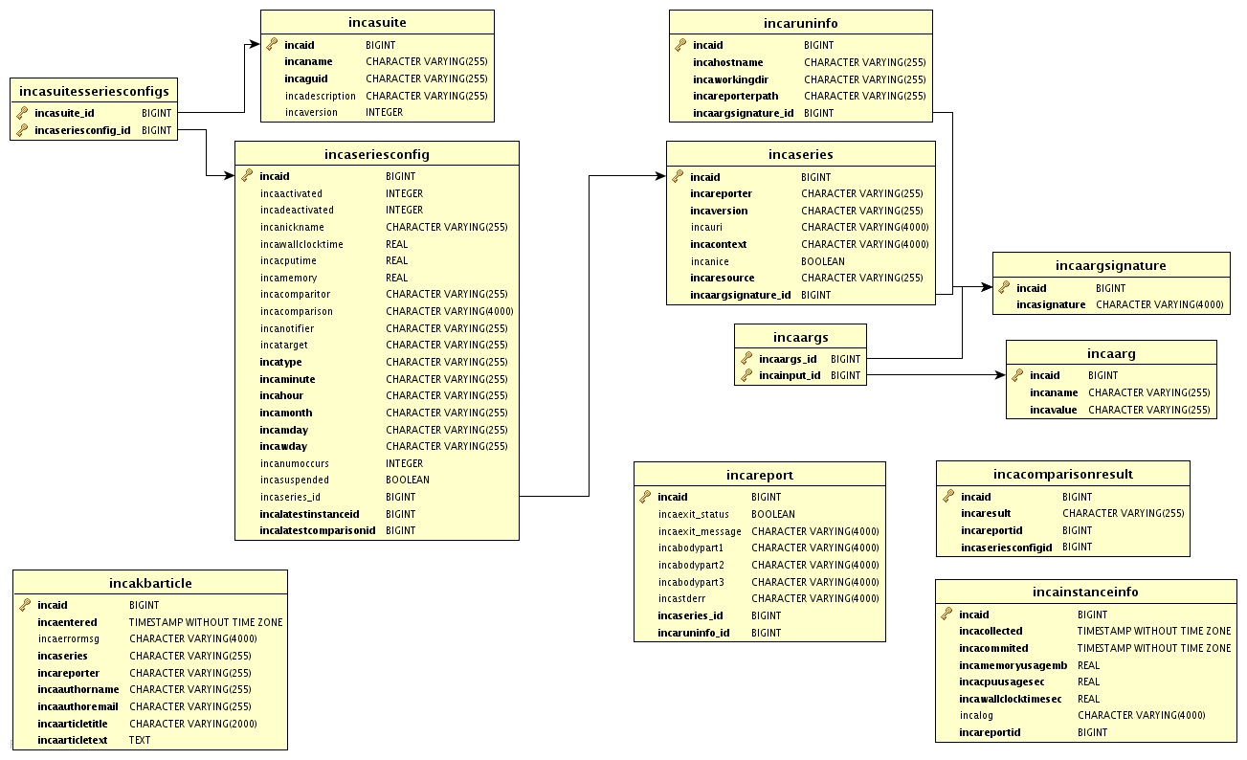
Database Schema

Slide 6
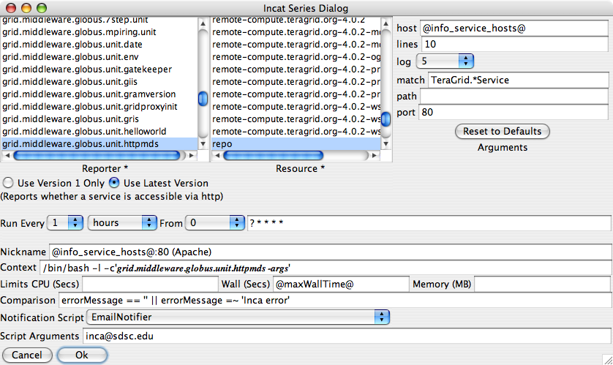
incat Series Edit Dialog
Notes:
Flexible data content
Efficient storage/retrieval
Flexible access to data

Slide 7
Depot Schema Reduces Redundancy
Report bodies often identical; Depot merges them
Instance contains info that varies--timestamps, resource usage
Series defines reporter execution; SeriesConfig manipulates execution and output
SeriesConfig
schedule limits
comparison
Series
reporter
arguments
context
resource
Report
body
stderr
Instance
collected
cpuUsage
wallClockTime
Reporter output
Execution control
Runtime stats
Execution spec
Notes:
Flexible data content
Efficient storage/retrieval
Flexible access to data
Mention Suite – SeriesConfig change for 2.6 release
Add box for Suite above

Slide 8
Depot Provides Flexible Access to Data
Depot retains history of reporter output
Protocol supports direct DB access via HQL queries
Convenience queries provide easy access to common combinations of data
  Single instance
  Latest instance of a set of series
  Instances collected during a specified time period
  Success/failure history of a set of series
Special queries report DB schema, suite list
Notes:
Flexible data content
Efficient storage/retrieval
Flexible access to data
Add schema layout slide

Slide 9
Depot Customization
Switch underlying database engine
Add/modify notifier scripts
Add report filters
Notes:
Also, optimizing underlying DB

Slide 10
Hibernate Supports Multiple DB Engines
PostgreSQL, MySQL, Oracle, HSQLDB, others
Differ in optimizations, tools
Configured via $INCA_DIST/etc/hibernate.properties
Needs appropriate JDBC driver
# Settings for a local PostgreSQL database.
hibernate.dialect=org.hibernate.dialect.PostgreSQLDialect
hibernate.query.substitutions=yes 'Y', no 'N'
hibernate.connection.driver_class=org.postgresql.Driver
hibernate.connection.url=jdbc:postgresql:test
hibernate.connection.username=test
hibernate.connection.password=
# Settings for a remote MySQL database.
# hibernate.dialect=org.hibernate.dialect.MySQLDialect
# hibernate.connection.driver_class=com.mysql.jdbc.Driver
# hibernate.connection.url=jdbc:mysql://192.168.0.6/test
# hibernate.connection.username=test
# hibernate.connection.password=
Notes:
Also note DB optimizations, e.g., indexes

Slide 11
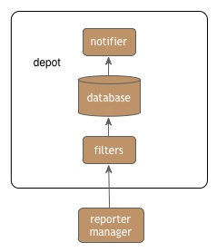
Notifiers and Report Filters

Slide 12

Notifiers Report Comparison Success/Failure
<body>
<package>
<ID>openssh</ID>
<version>3.6.1p1</version>
</package>
</body>
ID/Value pair
Notifier scripts found in installation $INCA_DIST/sbin/
EmailNotifier, LogNotifier provided; custom notifiers supported
Invoked on status change (new/changed failure, new success)

Slide 13
LogNotifier
use Cwd qw(abs_path getcwd);
my $name = $ENV{incanickname} || $ENV{incareporter};
my $log =
"Test '$ENV{incacomparison}' on output of series $name on " .
"$ENV{incaresource} now produces '$ENV{incacomparisonResult}'";
my @timeBits = localtime;
my $timestamp =
sprintf('%02d:%02d:%02d ', $timeBits[2], $timeBits[1], $timeBits[0]);
my $path = abs_path($ARGV[0]);
open(LOG, ">>$path") || die "Unable to open log $path";
print LOG "$timestamp" if defined($timestamp);
print LOG "$log\n";
close(LOG);

Slide 14
Report Filter Clarifies Reports
Cooperates with Consumer for more accurate display
Java class in Depot CLASSPATH extends edu.sdsc.inca.depot.util.ReportFilter
set/get methods for context, report, resource, stderr, sysusage
Invoked by Depot before incoming report is examined or stored
Registered by setting inca.depot.reportFilter property in $INCA_DIST/etc/common/inca.properties
Notes:
Examples, DownTimeFilter, AllToAllFilter
Add diagram

Slide 15
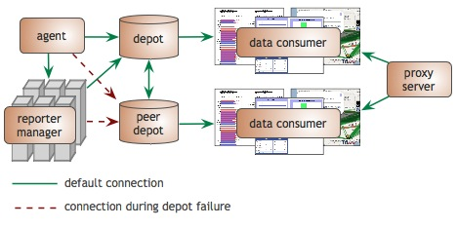
Depot Redundancy
Notes:
Mention one-to-one relationship for consumers and depots

Slide 16
Depot Redundancy
Warm backup for the primary depot
Synchronization with peers occurs at startup
New configuration property
# URIs of peer depots
inca.depot.peers=incas://some.other.peer:6324 incas://yet.another.peer:6324

Slide 17
Agenda -- Day 2
9:00 - 9:30 | Inside the Inca Depot
9:30 - 10:10 | Data display (data consumers)
10:20 - 11:00 | Writing data consumers
11:00 - 12:00 | Hands-on: Data display (data consumers)

