Slide 1
Inca: A Framework for Monitoring Grid Functionality and Performance
Kate Ericson
kericson@sdsc.edu
Supercomputing 2005
Notes:
What is Inca?
Problem description - Monitor/testing
What Inca provides
How Inca compares to other tools out there (Nagios, MonaLISA, Clumon/Ganglia, LCG monitoring, Big Brother, Hawkeye
Inca in use
Software Stack validation (TG, UK, DEISA)
Benchmarks (GRASP, BW?)
Architecture Overview
Sales Pitch
V2 improvements, new GUIs, install/admin
Release schedule & workshop
Contact information
-- circulate email list

Slide 2
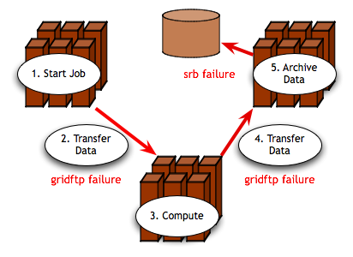
Grid Reliability
Grid computing: The ability to dynamically link resources together as an ensemble to support the execution of large-scale, resource-intensive, and distributed applications
“You know you have [a distributed system] when the crash of a computer you've never heard of stops you from getting any work done.” -- Leslie Lamport
Simple Grid application
Notes:
Main points
Motivation of our work is the issue of reliability in today’s production Grids
Running a Grid application implies the use of multiple resources and the software and services deployed on them
An increase in the number of dependencies result in an increase in the probability of failures
For example, the figure shows a simple Grid application where a user logged into a resource starts an application which transfer data to a resource to run a computation, and then transfers the results to a third resource for data archiving. The red arrows show where a failure in data transfer can occur.
Other sources of failures :
Software - faullty installation, misconfiguration, environment problem, bugs, not scalable
Hardware - power failures, overheating, cable unplugged
Networking problems
TODO: just have gridftp failure -- add X too

Slide 3
Is the Grid up?
Can user X run application[s] Y on Grid[s] Z? Access dataset[s] N?
  Can I login?
  Are Grid services the application[s] use available? Compatible versions?
  Are dataset[s] N accessible to user X? Credentials?
  …
Notes:
Now when we look at what this means for the user, the Grid is up if they can run their particular application on their set of resources, access their dataset, and get “good” performance.
This may seem straightforward but there are actually a lot of things that need to be working underneath the hood in order to make that happen. For example, …
And as you consider the requirements of a community of users and multiple communities of users, those set of requirements can grow quite large.

Slide 4
Testing a Grid
Iteratively define a set of concrete requirements
Write tests to verify requirements
Periodically run tests and collect data
Publish data
Automate Steps 3 and 4
Notes:
One way to veriify the user’s requirements are being met is through periodic, automated testing (as you do with software) so that you can have some confidence that when a user logs in, they can get work done
The way you go about this is to define a set of concrete requirements (I.e., machine-readable). These can then be be tested automatically and periodically (important in these dynamic Grid environments).
Some places where you can get requirements from are user documentation, talking to users, proposals, etc.
Note, this is not a simple matter of sitting down once and defining a complete set of requirements
This will be an iterative process as requirements are refined and because the Grid environment will change over time as packages are upgraded, etc.

Slide 5

What type of testing?
Deployment testing
  Automated, continuous checking of Grid services, software, and environment
  Installed? Configured correctly? Running? Accessible to users? Acceptable performance?
  E.g., gatekeeper ping or scaled down application
Junit,
PyUnit, Tinderbox
Software Package
(unit, integrated)
Software Stack
(interoperability)
NMI
Software
Deployment
Notes:
When we refer to testing, we’re talking about testing at the deployment level
This is different than the type of testing you do at the software package level where you’re looking at detailed testing of the software features and checking that it works on all architectures using something like junit, tinderbox, etc.
This is also different than the type of testing that occurs at the software stack level where you’re looking at package version interoperability (e.g., NMI)
We are checking whether packages are installed, running, and configured correctly.
This tests can be something as simple as pinging a Globus gatekeeper service to a more complicated test such as a scaled down version of an application

Slide 6
Who are the consumers?
Grid/VO management
  Responsible for designing & maintaining requirements
  Verify requirements are fulfilled by resource providers
System administrators
  Notified of problems
  Enough information to understand context of problem
End users
  View results and compare to problems they are having
  Debug user account/environment issues
  Advanced users: feedback to Grid/VO
Notes:
There are different consumers of the testing results: Grid/VO, system administrators, and end users
Our view is that responsibility of the testing should occur at the Grid/VO level. Based on the goals of the Grid, they decide what should be tested and then collect the results - the goal being to detect problems before the users do
While the Grid/VO will decide what to test, system administrators from each of the participating sites will need to be notified of failures and be able to understand how the test was conducted so they can debug their system. This implies that the need to trust the results.
While ideally, we hope that the failures will be caught before users notice them, in practice this is hard to achieve. Therefore, the results of our testing should be made available to users so if they’re having a problem, they can check the results to see if it might be system related.
They should also be able to use the tests to debug user account/environment issues specific to their account (e.g., removing an environment variable accidentally prevents a package from working)
For more advanced users, they could even feedback useful tests to the Grid/VO level.

Slide 7
Inca
Inca is a framework for the automated testing, benchmarking and monitoring of Grid resources
Inca provides:
  Scheduled execution of information gathering scripts (reporters)
  Data management
    collection
    archiving
    publishing
Notes:
To this end, we’ve developed Inca as a …
It provides …
We started almost Inca 3 years ago in the context of the TeraGrid project to do V&V of the software stack and environment. When we started, there were not any projects out there that fulfilled TeraGrid’s requirements.

Slide 8








Related Grid monitoring tools
MDS
Hawkeye
Inca’s primary objective: user-level Grid functionality testing and performance measurement
Notes:
Over the past couple years, several monitoring tools have been developed that are at a high-level similar to Inca wrt to data collection, data storage, and data dissemination
We feel the main difference between Inca and these tools is that ….
Because some of these tools support aggregation like MonALISA and MDS, Inca could be used to feed information into these systems.
Backup
Archiving of the data
some systems use a relational DB like Big Brother (Sybase), GridICE (postgres), MonALISA (MySQL, PostgreSQL, Microsoft SQL Server)
Ganglia uses RRDTool and Nagios uses logs
Tools like MonALISA and GridICE do a lot wrt accounting/job monitoring -- not something we’ve addressed but we could
Inca could complement MonALISA, GridICE, MDS since they are aggregate data.
There’s also the NCSA TestGrid and GITS -- not frameworks
We’re working with GITS’ David Baker to incorporate tests into Inca

Slide 9
Unique features of Inca
Debugging
  Runs under a regular user account
  Flexibly expresses results
  Captures reporter execution context
  Securely re-runs reporters (v2)
  Archives full reports (v2)
  Reporters can be run outside framework
Notes:
Here’s what sets us apart as unique -- based on our experience with real Grid deployment on TG. Places noted as v2 will be available to the public early 2006.
Run under regular user account enables user-level testing
Express more than test pass/fail for example different types of performance information
Capture context of reporter execution (script, what machine it ran on, time it ran, inputs, selected environment variables, etc.)
Easy to *securely* re-trigger a test (sys admin fixes a problem -- update the result)
Reports fully archived to understand the how the Grid behaves over time - for example to understand how a service fails over time and if it fails with the same type of error
Reporters can be run outside of the framework by a sysadmin debugging a problem or a user…eventually integrated into a knowledge base

Slide 10
Unique features of Inca (cont.)
Compares results to a specification (v2)
Easily and securely configured (v2)
  Data collection
  Installation
Profiles and logs reporter resource use (v2)
Notes:
Because analyzing information from resources for display can sometimes be resource-intensive, Inca provides support for comparing results to a specification and storing it (for example, a software stack specification). Comparisons are done each time a new result is collected so the cost is amortized over time rather than doing each time a web page is displayed.
The method to specify the data collection is very expressive to make it easy to configure Inca. Also easy to make changes to an existing deployment (important because resources change over time); uses SSL authentication to make that secure
There’s such a thing as testing too often -- tradeoff of between freshness of data and impact on resource

Slide 11
Outline
Inca in use
Architecture overview
Project plans

Slide 12




Inca today
Version 1
  aka 0.10.3
  available from website and NMI distribution
Version 2
  scheduled for release
  early 2006
Both versions of Inca are currently being used in production environments
Notes:
What we have today
First public release in April 2004
Used by handful of projects
Second major release on Inca January 2006 - number of substantial improvements based on our experience with deploying version 1

Slide 13
Inca in use
Software stack
validation and verification (v1)
Network bandwidth
measurements (v1)
Grid benchmarking (v2)
Notes:
3 examples of Inca used in production environments today

Slide 14
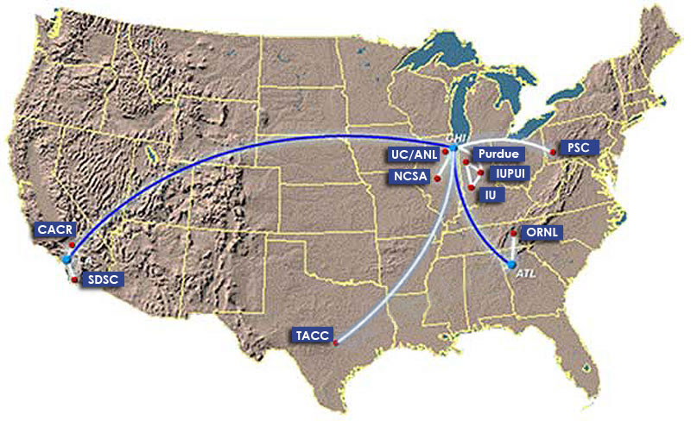
1) Inca in use: TeraGrid software stack V&V
TeraGrid - an “enabling cyberinfrastructure” for scientific research
  ANL, Indiana Univ., NCSA, ORNL, PSC, Purdue Univ., SDSC, TACC
  40+ TF, 1+ PB, 40Gb/s net
Common TeraGrid Software & Services
  Common user environment across heterogeneous resources
  TeraGrid VO service agreement
Notes:
8 sites, 17 resources

Slide 15

1) Inca in use: TeraGrid software stack V&V
Common software stack:
  20 core packages: Globus, SRB, Condor-G, MPICH-G2, OpenSSH, SoftEnv, etc.
  9 viz package/builds: Chromium, ImageMagick, Mesa, VTK, NetPBM, etc.
  21 IA-64/Intel/Linux packages: glibc, GPFS, PVFS, OpenPBS, intel compilers, etc.
50 version reporters: compatible versions of SW
123 tests/resource: package functionality
  Services: Globus GRAM, GridFTP, MDS, SRB, DB2, MyProxy, OpenSSH
  Cross-site: Globus GRAM, GridFTP, OpenSSH
Notes:
34 unit reporters run 123 unit tests per resource

Slide 16
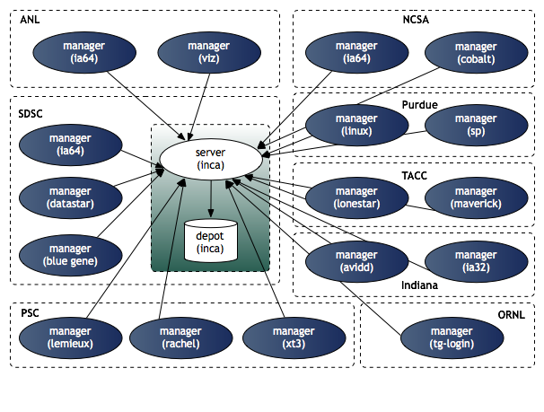
1) Inca in use: TeraGrid deployment
8 sites/17 resources
Run under user account inca

Slide 17
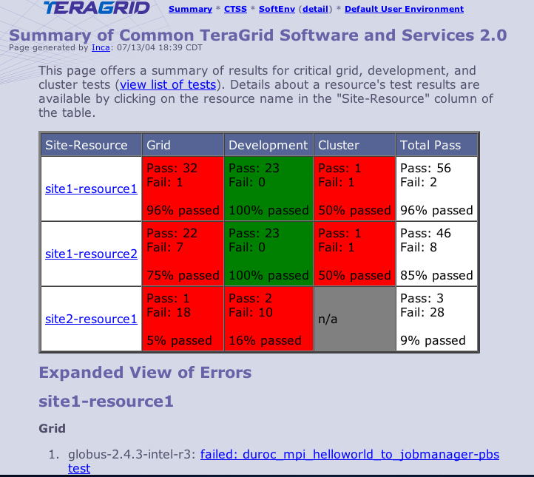
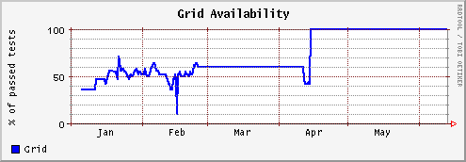
1) Inca in use: Summary status page
All tests passed: 100%
One or more tests failed: < 100%
Tests not applicable to machine or have not yet been ported
Key
History of percentage of tests passed in “Grid” category for a 6 month period
Notes:
Graph shows that it took about 3 months to get the Grid functionality working and then it was fairly stable.

Slide 18
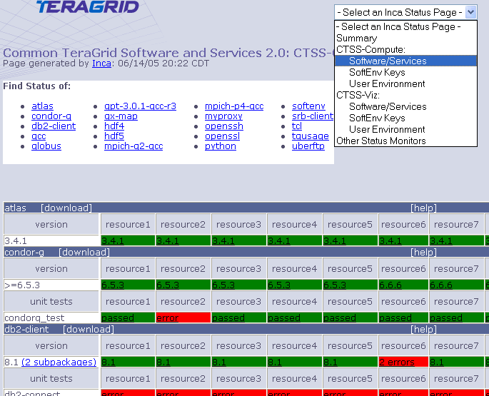
1) Inca in use: Detailed Status View
Resources
SW
packages

Slide 19
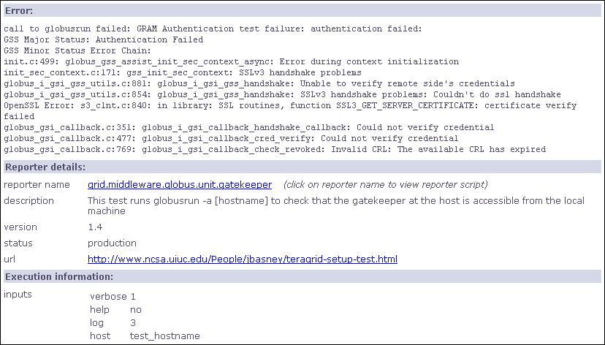
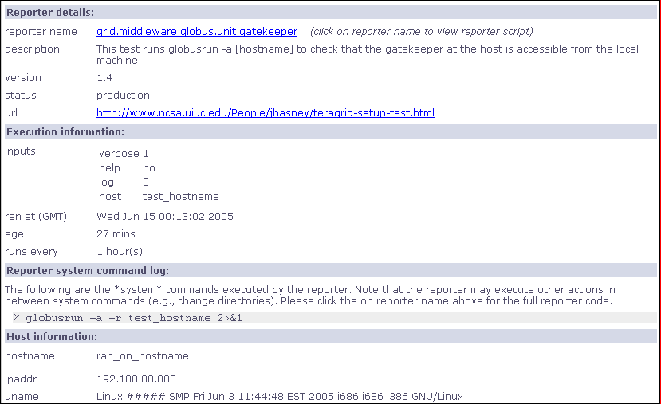
1) Inca in use: Detailed view

Slide 20
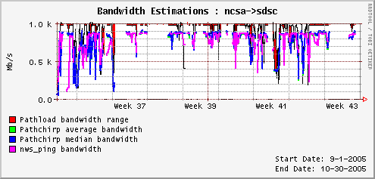
2) Inca in use: Comparison of end-to-end bandwidth measurement tools
Joint work with Margaret Murray (TACC) and Martin Swany (UDel)
Deployed to TeraGrid, GEON
Poster presented at Grid 2005
Compare bandwidth measurement tools:
  Pathload [Dovrolis]
  Pathchirp [Ribeiro]
  NWS ping [Wolski]
Notes:
Compare bandwidth measurements from 3 different bandwidth measurement tools in production Grid environments
Tools measure end-to-end bandwidth using different algorithms and are designed to be non-intruisive
Wrapped tools and deployed them using Inca on TeraGrid and GEON - collected full-mesh of measurements
Figure shows measurements take from NCSA to SDSC over a 2 month period. In this case, Pathchirp (blue and green but green not visible) and NWS (magenta) show close correlation and pathload (red) showing higher bandwidth
Poster describing TeraGrid results presented at Grid 2005 on Monday.
If asked:
NWS send probe data over TCP connection and measures time - on TeraGrid, we use 512 MB
Pathchirp and Pathload send smaller multi-packet probes and measure one-way delay

Slide 21
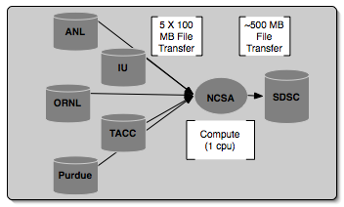
3) Inca in use: Grid benchmarks
GrASP: Grid Assessment Probes
  C. Olschanowsky, O. Khalili, J. He, H. Casanova, A. Snavely. Acquiring and Using Benchmark Data from Computational Grids, submitted for publication
  Set of probes designed to emulate Grid applications
  Deployed to GEON and TeraGrid
Gather probe on TeraGrid
Notes:
Collect Grid benchmark measurements using GrASP (Grid Assessment Probes) developed by Henri Casanova and Allan Snavely’s groups
Requested queue time is 1 hour, actual compute is less than a minute

Slide 22
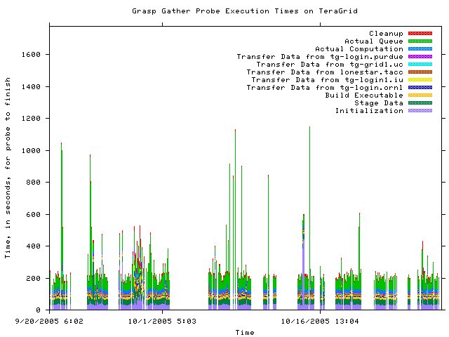
3) Inca in use: Measuring Grid middleware performance
Notes:
This is about 2 months of results from the gather probe running on TG
Y axis is execution time in seconds and x axis the time at which the measurement was taken
Colors indicate stage in execution of the probe
See how the performance varies over time - queue time most variable
white areas indicate probe did not complete due to an error - with version 2, we archive the error messages and can see what types of error messages are occurring

Slide 23
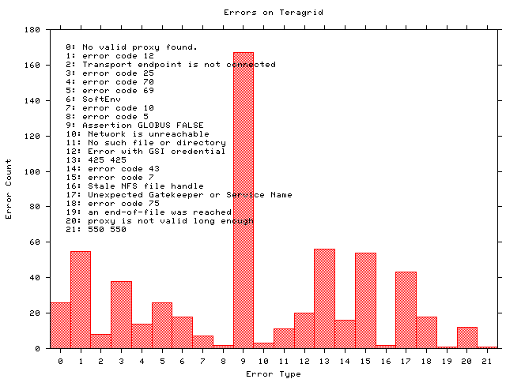
3) Inca in use: Monitoring Grid middleware reliability
Notes:
Histogram shows what types of errors are occuring the most often - error messages are truncated
The highest number of occurrrences in 9 which is the result of a documented Globus 2.0 bug when the GRAM server is under high load
A full report of errors on TG found by the grasp gather probe. This is a new capability in Inca 2.0 -- Inca 1 was unable to archive error messages.

Slide 24
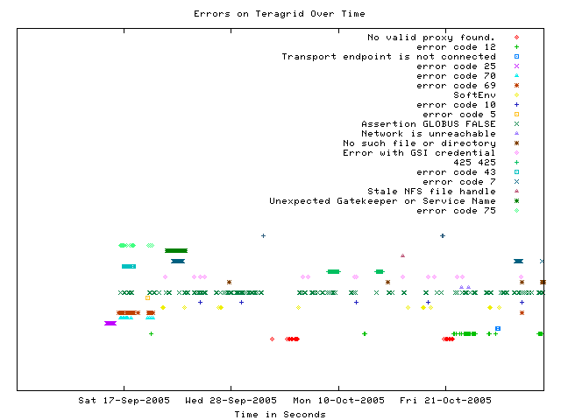
3) Inca in use: Error tracking over time
Notes:
This graph shows when a certain type of error occurs over time
Most errors only occur for a few days before being fixed - for example, the dark green * “Unexpected Gatekeeper of service name” is a configuration error
Dark green xxx’s represent the Globus 2.0 bug over time - a transient error occurs continuously

Slide 25
Outline
Inca in use
Architecture overview
Project plans

Slide 26
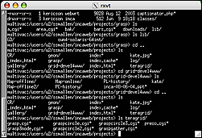
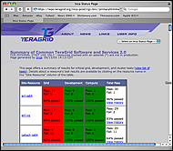
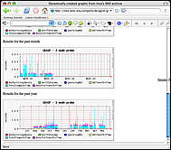
Architecture overview
5. GUIs can display collected data by querying Depot
Reporter
Repository
Admin
Tool
Create a “suite”
Suite
R
Reporter
Agent
Submit suite to Reporter Agent
Depot
Depot
3. Reporter Agent invokes Reporter Managers and distributes suite and reporters
S
S
S
R
R
R
4. Reporter Managers send data to Depot
Reporter
Manager
Reporter
Manager
Reporter
Manager
…
Resource N
Resource 1
Resource 2
Notes:
The Admin Tool is a user interface (java GUI) used by the Inca admin to administer all parts of an Inca deployment; it connects to the Reporter Agent
The Reporter Agent is a server which is the access point to an Inca deployment and is responsible for managing the control flow of an Inca installation
The Reporter Repository is responsible for storing Reporters (scripts that gather data from resources); reporters are packaged as RPMs; can be shared among multiple Inca deployments
The Reporter Manager is responsible for managing the schedule and execution of Reporters on a single resource; receives instructions from one and only one reporter agent.
The Depot is a server that is responsible for storing the data produced by reporters.
The Suite describes where to run the reporters, frequency of execution, and optionally expected values (I.e., instructions for how to collect data)

Slide 27
Architecture overview:
Scalable design
VO B
Admin
Tool
Reporter
Repository
VO A
Admin
Tool
Reporter
Repository
Forward suite
Reporter
Agent
Reporter
Agent
Depot
Depot
Forward results
Reporter
Manager
Reporter
Manager
Reporter
Manager
Reporter
Manager
Reporter
Manager
Resource 4
Resource 5
Resource 1
Resource 2
Resource 3
Notes:
Inca designed to be scalable in wrt to data collection and storage (e.g., depots can be arranged hierarchically)
For example, suppose VO B has access to resources on VOA. Rather than VO B running duplicate reporters on VO A resources, VO B can request data from VO A (securely) and then VO A will send the results to VO B.

Slide 28
Outline
Inca in use
Architecture overview
Project plans

Slide 29
Inca 2.0
Initial version of Inca focused on basic functionality
New features:
  Improved archiving capabilities
  Scalability - control and data storage
  Usability - improved installation and configuration control
  Monitor system impact (self-monitoring)
  Security - SSL, proxy delegation
  Condor integration
Release early 2006
Notes:
In early 2006 (January), we will release our first version Inca 2.0 which will have substantial improvements wrt Inca 1 which focused on basic functionality
In the talk, we mentioned features that were coming out in v2. As a summary, some of the new features
Improved archiving capabilities; version 1 was only able to archive numerical data; in version 2 we can archive textual information as well to support full archiving of reports
The control and data storage aspects of Inca are designed to be scalable
The installation and configuration control aspects will be greatly improved through the use of the Inca admin tool, reporter repository, and reporter agent/managers.
Mentioned earlier that there was such a thing as testing too much. So, we profile the execution of the reporter (CPU, memory) so that when Inca is consuming too much resources, we can figure out what reporters are taking the most resources and scale them back accordingly
The Inca components will communicate using SSL authentication, proxy delegation will be automated using MyProxy
Talking with the Condor team about how Inca reporters can be executed within the Condor Hawkeye mechanisms and as jobs, report information as ClassAds.

Slide 30
Improvements for TeraGrid
Email notifications of failures (if requested)
Improved GUIs
  User can select only information interested in
Historical Non-numerical data
  Error messages
  Resource usage (CPU/memory used by reporters)
Additional reporters - file transfer, batch queue and scheduler, compilers, HPSS, …

Slide 31
Summary
Periodic, user-level functionality testing needed to monitor Grid reliability
Inca provides a unique, automated framework for functionality testing and performance measurement
Inca is successfully deployed on several Grids today

Slide 32
Future work
Integration with knowledge base
Standardized suites
Automatic tuning of reporter execution frequencies to ensure low impact on resources
Notes:
Some ideas we’d eventually like to address:
Integration reporters with a type of knowledge base. For example, how you can use WebMD to diagnose medical problems, you could provide a similar interface for users to diagnose a problem they’re having on the Grid. Once a problem area had been identified, reporters could be used to verify the exact problem a user is having.
"certify" that your Grid passes a standard suite (e.g. gt4 or data transfer suite)
tie suite to a common application (e.g. Gamess certify your Grid).
a standard suite would come with a gui side for viewing
Mentioned earlier about profiling the reporter execution so that we can identify what reporters are consuming the most resources and scale them back. The idea here would be to automate this. Set some threshold for Inca on a resource and let Inca scale reporter frequencies accordingly if desired.
Smart failure notification - analyzing the data
Resource for CS research
Provide Python or C APIs for reporters

Slide 33



More information
Inca 2.0 to be released January 2006
Inca workshop tentatively scheduled for February 2006
Email:
inca@sdsc.edu
Website:
http://inca.sdsc.edu
Supported by:

Slide 34
How Inca compares to other tools
Nagios (http://www.nagios.org)
  Nagios is a host and service monitor designed to inform you of network problems before your clients, end-users or managers do. It has been designed to run under the Linux operating system, but works fine under most *NIX variants as well. The monitoring daemon runs intermittent checks on hosts and services you specify using external "plugins" which return status information to Nagios. When problems are encountered, the daemon can send notifications out to administrative contacts in a variety of different ways (email, instant message, SMS, etc.). Current status information, historical logs, and reports can all be accessed via a web browser.
  Similarities:
    Plugins are like Reporters
    Has clients and server similar to Reporter Managers and Reporter Agents/Depot
    Notifications
  Differences:
    History is stored using log files... so ours is a bit more space efficient andﾊqueries "should" be faster.
    Output from our reporters is a bit more flexible - can express more.
    At this point we have only email notifications -- they have more

Slide 35
How Inca compares to other tools
Big Brother (http://www.quest.com/bigbrother/)
  Big Brother simplifies the management of networks of computers. It features tests to notify administrators when defined events occur. This facilitates proactive problem resolution and prevents critical outages. With Big Brother, system administrators can visually assess the health of a network through a color-coded web interface. Designed around simplicity, anyone looking at the interface can understand the red, yellow, and green display. Big Brother is able to monitor and alert on almost anything in your network. The product supports common operating systems including the major flavors of Windows, Unix and Linux. In addition, the huge user community has greatly contributed to the extensibility of the product. An enormous repository of user-contributed scripts makes Big Brother highly customizable to your environment.
  Similarities:
    Uses a database to store data (Sybase)
    server/client very similar
    extensible
  Differences:
    Inca is not tied to a specific database
    Centered around pass/fail -- don't know that it could handle the measurements that we do?
    Owned by Quest, there is a free and a for purchase version

Slide 36
How Inca compares to other tools
GridICE (http://infnforge.cnaf.infn.it/gridice/)
  “GridICE is a distributed monitoring tool designed for Grid systems. Its design is based on requirements given by different type of users, each of them dealing with a different abstraction level of a Grid: the Virtual Organization level, the Grid Operation Center level, the Site Adminstration level and the End-User level. This work was started in 2003 during the European DataTAG project and is being evolved in the framework of the EGEE project.”
  The implementation is more like an aggregator like Monalisa though
    cluster monitoring system (they use Lemon but ganglia could also be used) -> MDS2/GLUE Schema -> Nagios -> Postgres -> email notifications/PHP viz
Similarities:
    Goal:
      detect and notify fault situations, contract violations, user-defined events
      Usage, behavior, and performance
    Scalable (in theory MDS is scalable)
    Extensible - push new data through MDS
  Differences:
    Able to handle dynamic grids where resources can join/unjoin
    Wants to collect fine-grained data (not just coarse-grained data)
    Uses Postgres, Inca is not tied to a specific database -- don’t know they’re schema
    Not as configurable -- With MDS, you have to declare your schema ahead of time - not easy to change data & frequency
    It looks like the only data they are collecting currently is GLUE data which is more about jobs and their status than tests although the paper claims that’s they’re goal

Slide 37
How Inca compares to other tools
MDS4 (http://www.globus.org/toolkit/mds/)
  “The Globus Toolkitﾕs Monitoring and Discovery System (MDS) implements a standard Web Services interface to a variety of local monitoring tools and other information sources. MDS4 can be understood as a “protocol hourglass” defining standard protocols for information access and delivery and standard schemas for information representation. Below the neck of the hourglass, MDS4 interfaces to different local information sources, translating their diverse schemas into appropriate XML schema (based on standards such as the GLUE schema whenever possible). Above the neck of the hourglass, various tools and applications can be constructed that take advantage of the uniform Web Services query, subscription, and notification interfaces to those information source that MDS4 implements.”
  Information providers push information or can be pulled to put data into MDS4.
  MDS4 provides an Index service and a trigger service (email notifications)
Similarities:
    Caches data like the depot and is scalable
Differences:
    Can be compared to the Depot but doesn’t do archiving.
    Does provide trigger services that we don’t have yet

Slide 38
How Inca compares to other tools
MonALISA (http://monalisa.caltech.edu/)
  The MonALISA framework is based on Dynamic Distributed Service Architecture and is able to provide complete monitoring, control and global optimization services for complex systems.The MonALISA system is designed as an ensemble of autonomous multi-threaded, self-describing agent-based subsystems which are registered as dynamic services, and are able to collaborate and cooperate in performing a wide range of information gathering and processing tasks. These agents can analyze and process the information, in a distributed way, to provide optimization decisions in large scale distributed applications. An agent-based architecture provides the ability to invest the system with increasing degrees of intelligence, to reduce complexity and make global systems manageable in real time. The scalability of the system derives from the use of multithreaded execution engine to host a variety of loosely coupled self-describing dynamic services or agents and the ability of each service to register itself and then to be discovered and used by any other services, or clients that require such information. The system is designed to easily integrate existing monitoring tools and procedures and to provide this information in a dynamic, customized, self describing way to any other services or clients.
  Similarities:
    monitoring modules like reporters, distributed agents, web service, security
    uses database to store data (ML supports MySQL, PostgreSQL, Microsoft SQL Server and the embedded Mckoi database system)
  Differences:
    ApMon can be used by any application to push monitoring information to MonALISA services (inca can also?)
    MonALISA seems to collect more network/hardware/job information than user V&V info

Slide 39
How Inca compares to other tools
Product: Clumon
URL: http://clumon.ncsa.uiuc.edu
Overview: The Clumon performance monitoring system was created to give another view of what the current state of the cluster was at a glance. This requires information from both the scheduler and the hosts themselves. The system was also needed to provide for a common structure and single point of access so that the many users and administrators would not overload the cluster itself with redundant requests for the same information. The primary requirements for the system were: scalability, low bandwidth, use freely-available components, versatility, controllability. Scalability was first and foremost. The system had to be able to potentially thousands of hosts and, at the same time, not create too large a load on the hosts from which data was being collected or the network layer. This also led to the requirement of controllability. Since there are many, many different potential configurations for clusters, the system needed to be flexible enough to be tuned to work on abroad range of clusters. Monitoring performance data is a trade off between detail, scale & frequency versus load & bandwidth. Therefore, the performance monitor's administrator should be able to adjust the frequency and amount of data collected since the scale and bandwidth of a cluster is commonly a fixed value. This should allow an administrator to balance the amount of resources used for performance monitoring versus those required for computation.Versatility is a requirement in any system such as this one, because it is to be used by different categories of users, including the users that are doing computation on the cluster, the system administrators keeping an eye on things,and developers and engineers doing testing and debugging.
Similarities:
  Archival (MySQL) of data
Differences:
  Cluster view of resources, rather than VO
  Extraction of data only in raw DB form
  Not (yet) extensible?
  Limited (MySQL) authentication
  Tight coupling to SGI PCP, Linux
  Periodicity fixed?

Slide 40
How Inca compares to other tools
Product: Hawkeye
URL: http://www.cs.wisc.edu/condor/hawkeye
Overview: Hawkeye utilizes the technologies already present in Condor and ClassAds to provide rich mechanisms for collecting, storing, and using information about computers. A Hawkeye system can be used to monitor various attributes of a collection of systems. The monitoring mechanism may also be used then to further the management of systems. Hawkeye works by configuring Condor such that it periodically executes specified program(s). These programs are typically scripts. A program produces output in the form of ClassAd attribute/value pairs. These pairs are then added (using defined naming conventions) to the machine ClassAd. The machine ClassAd then contains attributes which may be used in expressions (such as START and SUSPEND, as well as the submit description file REQUIREMENTS expression). A ClassAd may be displayed using condor_status.
Similarities:
  Similar server/client (Reporter Manager/Depot => Hawkeye/Collector)
  Tests extensible
  Certificate-based authentication
  Dynamic configuration
Differences:
  Tight coupling to Condor
  Monolithic update of system information (no separate series)
  No archiving
  Machine is the only resource

Slide 41
How Inca compares to other tools
Product: Ganglia
URL: http://ganglia.sourceforge.net
Overview: Ganglia is a scalable distributed monitoring system for high-performance computing systems such as clusters and Grids. It is based on a hierarchical design targeted at federations of clusters. It leverages widely used technologies such as XML for data representation, XDR for compact,portable data transport, and RRDtool for data storage and visualization. It uses carefully engineered data structures and algorithms to achieve very low per-node overheads and high concurrency. The implementation is robust, has been ported to an extensive set of operating systems and processor architectures,and is currently in use on over 500 clusters around the world. It has been used to link clusters across university campuses and around the world and can scale to handle clusters with 2000 nodes.
Similarities:
  Similar server/client (Reporter Manager/Depot => gmetad/gmond)
  Easy extraction of data in XML format
Differences:
  Archival of numeric series only
  Extension only by injecting data
  Limited (IP) authentication
  Machine is the only resource
  Periodicity fixed
  Configuration only on start-up

Slide 42
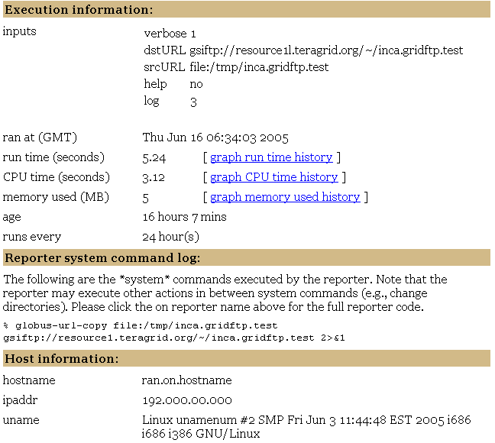
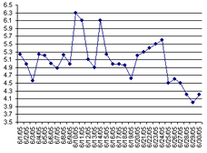
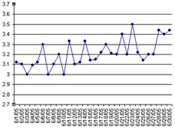
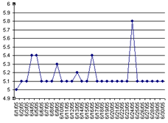
Self Monitoring

Slide 43
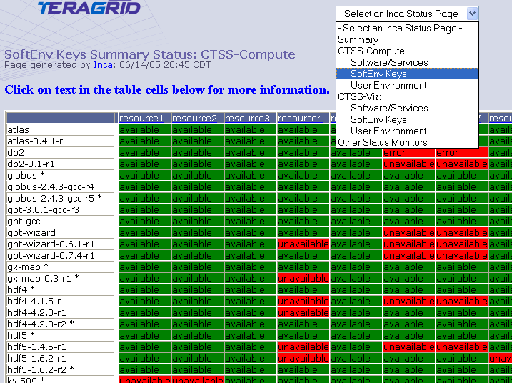
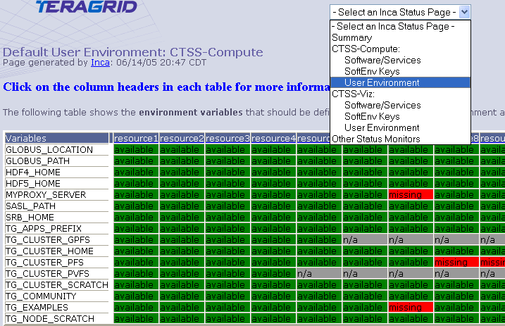
Inca in use: Status pages
Resources
SW
packages

