Slide 1
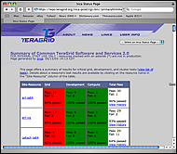
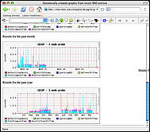
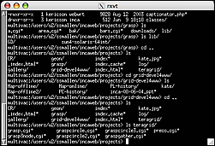
INCA
Inca is a flexible framework for the automated testing, benchmarking and monitoring of Grid systems.
Inca
Server
Inca
Client
Inca
Client
Inca
Client
Deployment of Inca on TeraGrid (November 2005)
…
Resource 1 … Resource n
Contacts: Kate Ericson, kericson@sdsc.edu
Shava Smallen, ssmallen@sdsc.edu
San Diego Supercomputer Center (SDSC)

Slide 2
Technology Area Title
A few words about image one. Short and to the point is probably better.
Image or Photo
Image or Photo
A few words about image two. Short and to the point is probably better.
Point of Contact: Name, Contact info
Point of Contact: Name, Contact info

Slide 3
Resource Provider Title
A few words about image one. Short and to the point is probably better.
Image or Photo
Image or Photo
A few words about image two. Short and to the point is probably better.
PI: Name of PI, Institution name
PI: Name of PI, Institution name

