Slide 1
Using the Inca APIs
Jim Hayes
jhayes@sdsc.edu
Inca Workshop
September 4-5, 2008

Slide 2
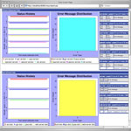
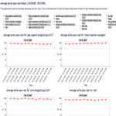
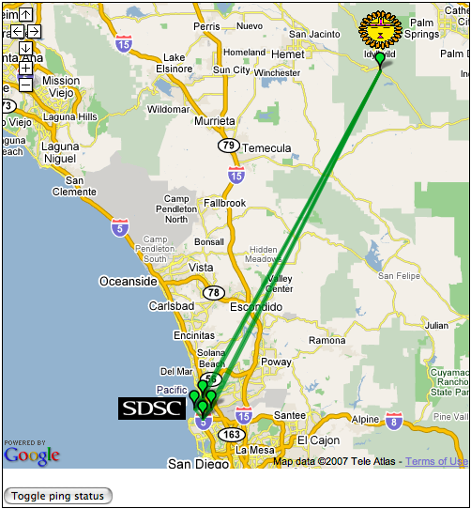
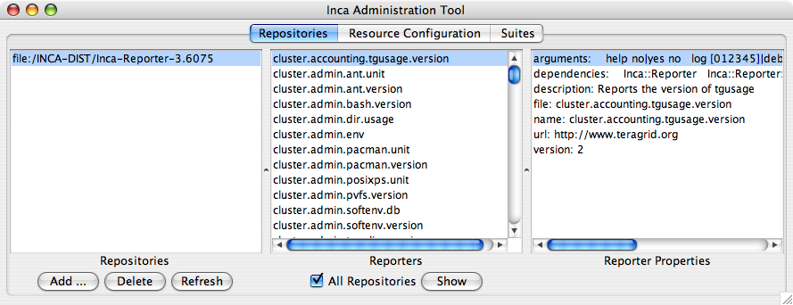
Depot
Reporter
Repository
Data Consumers
R
Incat
C
Agent
Depot
S
Inca Report storage providing:
Flexible data content
Efficient storage/retrieval
Flexible access to data
Data security
S
r
S
R
r
R
Reporter
Manager
Reporter
Manager
…
Grid Resource
Grid Resource
Notes:
Focus on storage--leaves decision-making to Agent, data interpretation to consumers

Slide 3
Agenda -- Day 2
9:00 - 9:30 | Inside the Inca Depot
9:30 - 10:00 | Inca APIs
10:00 - 11:00 | Data display (data consumers)
11:15 - 12:00 | Hands-on: Data display (data consumers)
1:00 - 3:00 | Hands-on: Inca deployment (part 2)
3:15 - 4:00 | Wrap up

