Slide 1
Writing Web Page Clients:
Hands-on
Kate Ericson, kericson@sdsc.edu
Inca 2.0 Workshop
February 24, 2006

Slide 2
Customize Display
Change:
HTML table layout (swStack.xml)
Style (swStack.xsl and inca.css)
Jetty port

Slide 3
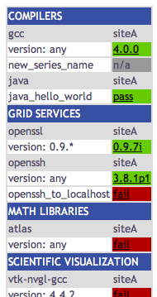
Customize Display: HTML table
1. Edit $INCA_INSTALL/etc/common/swStack.xml
to change HTML table:
<package>
<id>gcc</id>
<category>Compilers</category>
<version>any</version>
<versionRE>(^.*)</versionRE>
<tests>
<version>gcc_version</version>
<unitalias>new_series_name</unitalias>
</tests>
</package>
-> refresh http://localhost:8080/xslt.jsp?xsl=http://localhost:8080/swStack.xsl&resourceID=defaultvo&suiteName=TestSuiteLocal
<tests>: add same as your series
names in incat and refresh jsp page
Notes:
Later we’ll have swStack.xml name be an input

Slide 4
Customize Display: HTML table
xslt.jsp looks for $INCA_INSTALL/etc/common/swStack.xml
by default, but any xml file in $INCA_INSTALL/etc/common can
be used with the “xmlFile” parameter.
Copy $INCA_INSTALL/etc/common/swStack.xml to $INCA_INSTALL/etc/common/new.xml, edit some of the packages in test.xml and:
-> view http://localhost:8080/xslt.jsp?xsl=http://localhost:8080/swStack.xsl&resourceID=defaultvo&suiteName=TestSuiteLocal&xmlFile=new.xml
Notes:
Later we’ll have swStack.xml name be an input

Slide 5
Customize Display: Style
Customize style by editing the xsl and css and rebuilding the Jetty war file:
% cd $INCA_INSTALL
% mkdir war; cd war
% jar xvf ../etc/inca-consumers.war
% cp inca.css inca.css.orig; cp swStack.xsl swStack.xsl.orig
% vi inca.css
-> change line 101 to “background-color:#D07651;”
% vi swStack.xsl
-> insert the following after line 113 (after </tr>):
<tr>
<td><xsl:text>cron</xsl:text></td>
<td>
<xsl:for-each select="//cron/*[not(self::suspended)]">
<xsl:value-of select="."/><xsl:text> </xsl:text>
</xsl:for-each>
</td>
</tr>

Slide 6
Customize Display: Style
% rm ../etc/inca-consumers.war ; jar cf ../etc/inca-consumers.war *
% cd ..; ./bin/inca stop consumer
% ls /tmp | grep Jetty
-> make sure there isn’t a dir like Jetty__8080__
% ./bin/inca start consumer
-> refresh http://localhost:8080/xslt.jsp?xsl=http://localhost:8080/swStack.xsl&resourceID=defaultvo&suiteName=TestSuiteLocal
You should see the changes on the next slide…

Slide 7
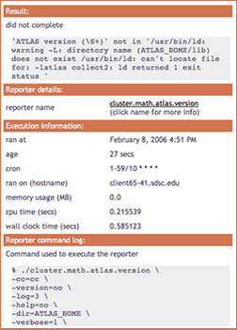
Customize Display: Style
Edit XSL: $INCA_INSTALL/etc/swStack.xsl
XML formatting (e.g. add row to display cron):
swStack.xsl has two main templates,
“test” to display series results and
“suite” to display suite results
Edit CSS: $INCA_INSTALL/etc/inca.css
colors (e.g. change .header background-color
from #3850A3 to #D07651)
fonts

Slide 8
Customize Display: Jetty
3. Jetty starts on port 8080 by default, but can be configured to start on another port:
% cd $INCA_INSTALL; vi etc/common/inca.properties
-> change line 69 to “inca.consumer.port=8082”
% ./bin/inca stop consumer
% ./bin/inca start consumer
Jetty should now be started on 8082. Load the new webpage:
http://localhost:8082/xslt.jsp?xsl=http://localhost:8082/swStack.xsl&resourceID=defaultvo&suiteName=TestSuiteLocal

