Slide 1
Inside the Inca Depot
Jim Hayes
jhayes@sdsc.edu
Inca Workshop
September 4-5, 2008

Slide 2
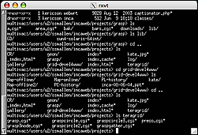
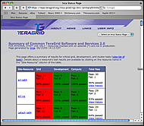
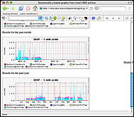
Architecture overview
Reporter
Repository
Admin
Tool
Data Consumers
Suite
R
Reporter
Agent
Depot
Depot
S
S
S
R
R
R
Reporter
Manager
Reporter
Manager
Reporter
Manager
…
Resource N
Resource 1
Resource 2

Slide 3
The Inca Depot
Data repository for Reporter output and Inca deployment configuration
Generally interacts only with other Inca components

Slide 4
Outline
Depot goals and design
What’s in the Depot?
Depot consumer services

Slide 5
Depot Goals
Flexible data content
Efficient storage and retrieval of data
Flexible access to data
Data security
Scalability

Slide 6
Depot Design Choices
Flexible data content
  No required schema for report body
Efficient storage and retrieval of data
  Storage in a selection of databases via Hibernate
  Schema designed to reduce redundant data
Flexible access to data
  Access to all data via SQL queries
  Depot protocol provides predefined queries; extensible
  Depot retains history of reporter output
  Queries via Inca protocol and (soon) web service interface
Data security
  Certificate-based authentication
Scalability
  Multiple depots organized into a hierarchy (planned)

Slide 7
Outline
Goals and design
What’s in the Depot?
Depot consumer services

Slide 8
What’s in the Depot?
Goal: Depot should provide centralized access to all Inca deployment information
Information available
  Inca deployment configuration
  Reporter output

Slide 9
Inca Deployment Configuration
Repository
Resource
Suite
Repository
Resource
Suite
Repository
Resource
Suite
Repository
Resource
Suite
Repository
Resource
Suite
Support incomplete; Consumer queries Reporter Agent
Repository/Reporter information not part of schema
Resources defined by schema; as yet unused
Suite info stored and returned as part of reports

Slide 10
Reporter Output
Instance
Instance
Report
Instance
Instance
Report
Series Config
Instance
Report
Instance
Instance
Instance
Instance
Report
Instance
Instance
Instance
Report
Instance
Instance
Instance
Instance
Report Config contains host and signature
Report contains body, stderr, exit status/message
Instance contains timestamp, resource usage info

Slide 11
Outline
Goals and design
What’s in the Depot?
Depot consumer services

Slide 12
Queries
Supported queries
  Single instance
  Latest instance for each series in a suite
  Report history for a series
Planned queries
  Graph image (e.g., series history)
  General SQL
  Inca Configuration
  Plug-in API?

Slide 13
Report Triggers
Register action when incoming report shows problem
Comparitors test reports for acceptable output
  Xml schema
  Regular expression
  Version
  Plug-in API (planned)
  Results stored in Depot
Actions
  Email
  Others?

