Slide 1
Defect detection Project Instructions
Written by: Kai Su
Checked by: Qiangfu Zhao
2019.1.17

Slide 2
Project Requirements
MATLAB (current one: R2018b)
Deep Learning Toolbox
Parallel Computing Toolbox
Deep Learning Toolbox Model for GoogLeNet Network
Can be downloaded with a MathWorks account
Deep Learning Toolbox Model for AlexNet Network
Can be downloaded with a MathWorks account
Microsoft Office
Required for ensemble-based detection

Slide 3
File structure
欠陥検出
AlexNet
GoogLeNet
正規化処理
GUI
モデル
投票結果
プログラム
画像データ
モデル
投票結果
プログラム
2種類の分類
3種類の分類
4種類の分類
2種類の分類
3種類の分類
4種類の分類
2種類の分類
3種類の分類
4種類の分類
その他
新しいデータ

Slide 4
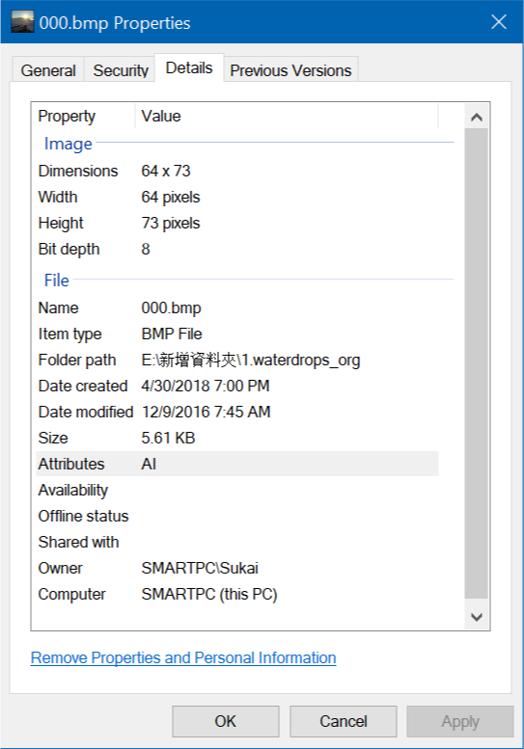
Image Pre-processing
AlexNet and GoogLeNet model require 24 bit depth image file. If the new image data is 8 bit depth, we need to resize data to 24 bit depth. If the image data is already 24 bit depth, we can skip the image process and save the data directly to the “画像データ” folder according to the data category.
We can check the image details information in the Windows system, in the right figure there is an example to see the bit depth information of image.
For this 8 bit depth image file, we need find the image process program to resize it in the “画像処理” folder.

Slide 5
ImageProcess
画像処理コード
入力データ
出力データ
Image Pre-processing
There are three files in the “ImageProcess” folder ( “ImageProcess.m”, “入力データ” and “出力データ”)
ImageProcess.m: MATLAB code file for resize image
入力データ: Put image file requiring an action that adjust to 24-bit depth in here.
出力データ: Output folder. We can copy the 24-bit depth image here into the "Image Data" folder according to the data category.

Slide 6
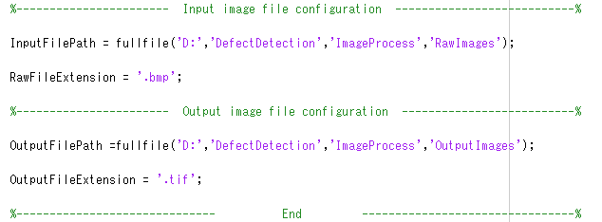
ImageProcess
画像処理コード
入力データ
出力データ
Flow of Image pre-processing
Step 1: Put the original image files in the ”入力データ” folder.
Step 2: Open MATLAB with “ImageProcess.m” file, correct the extension (“.bmp” or others ) if needed, and run this program.
Step 3: Check output image files in “出力データ” folder, then move the image files to a correct image folder.

Slide 7
Image data
Two categories
Three categories
Four categories
Training Data
Evaluation Data
Training Data
Evaluation Data
Training Data
Evaluation Data
Image Data
We already created three image folder for three different defect classification problems.
For any given defect classification problem, we have two image folders for training and evaluation.
1. Training Data are used for training a model.
2. Evaluation Data are used for evaluating the trained model.
Two categories
Training Data
Evaluation Data
unwater
water
unwater
water

Slide 8
Flow for import new Image Data
To add more data, you may follow the steps given below:
Step 1: Determine the categories of image data.
Step 2: Image pre-processing (see page 4-6)
Step 3: Create different folders according to the categories of the images in “TrainingData” and ”EvaluationData” (see example on the right).
Step 4: Place image data according to their types.
Three categories
Training Data
Evaluation Data
1.Knife
2.Scratch
1.Knife
3.Droplet
3.Droplet
2.Scratch
The file structure of the three categories task is as shown in the right figure.
Note: The subfolder “names” in both “TrainingData” and “EvaluationData” should be consistent.

Slide 9
AlexNet
Programs
NetworkModels
VotesResults
Two categories
Three categories
Four categories
Training.m
Evaluation.m
Training.m
Evaluation.m
Training.m
Evaluation.m
AlexNet
There have three folders in the AlexNet folder (Programs folder, NetworkModels folder and VotesResults folder)
Programs folder: Store MATLAB codes for training AlexNet model and evaluating AlexNet model.
NetworkModels folder: Files of trained AlexNet models, model files are named according to the date and time (e.g. 2019/01/13 16:09 will produce a model named ‘AModel_Jan_13_2019_16_09’ ).
VotesResults folder: Store votes information of the AlexNet ensemble system.

Slide 10
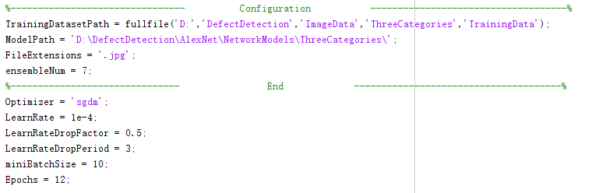
Three categories
Training.m
Evaluation.m
AlexNet
Here we take three categories classification task as an example.
Step 1: Open “Training.m” file in the “ThreeCategories” folder, modify training parameters if needed (see next page), then run the code.

Slide 11
AlexNet
Training parameters:
TrainingDatasetPath = fullfile('D:','DefectDetection','ImageData','ThreeCategories','TrainingData’);
# set training dataset path for three categories task
ModelPath = 'D:\DefectDetection\AlexNet\NetworkModels\ThreeCategories\’;
# set model file storage path for three categories task
FileExtensions = ‘.tif’;
# set training data extension
ensembleNum = 7;
# set network number in a ensemble system
Step 2: Wait for the program to finish running, check the generated model file in model path.
The size of an AlexNet ensemble model is about 1.38GB.

Slide 12
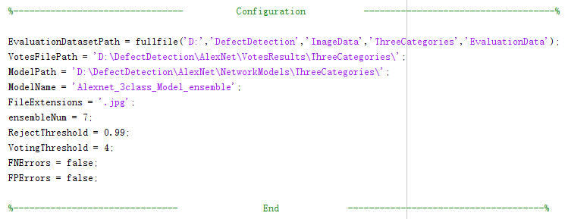
AlexNet
Step 3: Open “Evaluation.m” file in the “ThreeCategories” folder and modify the parameters if needed, then run the code.

Slide 13
AlexNet
Evaluation parameters (you may try different values for the red parts indicated below):
EvaluationDatasetPath = fullfile('D:','DefectDetection','ImageData','ThreeCategories','EvaluationData’);
# set evaluation dataset path for three categories task
VotesFilePath = ‘D:\DefectDetection\AlexNet\VotesResults\ThreeCategories\’;
# set votes file storage path for three categories task
ModelPath = 'D:\DefectDetection\AlexNet\NetworkModels\ThreeCategories\’;
# set model file storage path for three categories task
ModelName = 'Alexnet_3class_Model_ensemble’;
# set model evaluation model name
FileExtensions = ‘.tif’;
# set evaluation data extension
ensembleNum = 7;
# set network number in evaluation model
RejectThreshold = 0.99;
# set network reject threshold for three categories task on AlexNet
VotingThreshold = 4;
# set voting threshold in ensemble system
FNErrors = false;
# set this value to true if need display False negative image
FPErrors = false;
# set this value to true if need display False positive image

Slide 14
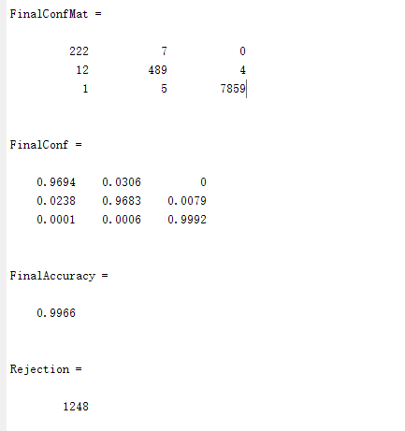
AlexNet
Step 4: waiting for the program to run, get the evaluation accuracy, confusion matrix and rejection number.
The matrix order will be consistent in the numerical order of the categories in the image folder
予測結果
 | 1.カス付き | 2.ニック跡 | 3.water
1.カス付き | 222 0.9694 | 7 0.0306 | 0 0.0000
2.ニック跡 | 12 0.0238 | 489 0.9683 | 4 0.0079
3.water | 1 0.0001 | 5 0.0006 | 7859 0.9992
正解

Slide 15
GoogLeNet
Programs
NetworkModels
VotesResults
Two categories
Three categories
Four categories
Training.m
Evaluation.m
Training.m
Evaluation.m
Training.m
Evaluation.m
GoogLeNet
There are also three folders in the GoogLeNet folder (Programs folder, NetworkModels folder and VotesResults folder)
Programs folder: Store MATLAB code for training GoogLeNet model and evaluate GoogLeNet model.
NetworkModels folder: Store GoogLeNet model file, model file will be saved in date and time format. (e.g. 2019/01/13 16:09 will change to ‘GModel_Jan_13_2019_16_09’ )
VotesResults folder: Store votes information of the GoogLeNet ensemble system

Slide 16
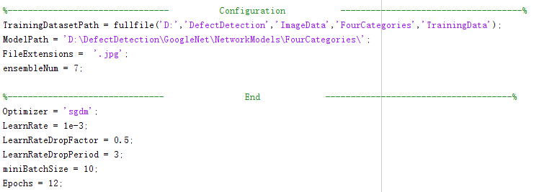
Four categories
Training.m
Evaluation.m
AlexNet
Here we take four categories classification task as an example
Step 1: Open “Training.m” file in the “ThreeCategories” folder and modify the parameters if needed, then run the code.

Slide 17
GoogLeNet
Training parameter:
TrainingDatasetPath = fullfile('D:','DefectDetection','ImageData', FourCategories','TrainingData’);
# set training dataset path for four categories task
ModelPath = 'D:\DefectDetection\GoogLeNet\NetworkModels\FourCategories\’;
# set model file storage path for four categories task
FileExtensions = '.jpg’;
# set training data extension
ensembleNum = 7;
# set network number in a ensemble system
Step 2: Wait for the program to finish running, check the generated model file in model path.
An GoogLeNet ensemble model is about 151MB.

Slide 18
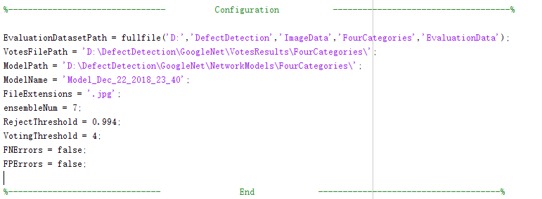
GoogLeNet
Step 3: Open “Evaluation.m” file in the “ThreeCategories” folder, modify the parameters if needed, and then run the code.

Slide 19
GoogLeNet
Evaluation parameter:
EvaluationDatasetPath = fullfile('D:','DefectDetection','ImageData', FourCategories','EvaluationData’);
# set evaluation dataset path for four categories task
VotesFilePath = ‘D:\DefectDetection\GoogLeNet\VotesResults\FourCategories\’;
# set votes file storage path for four categories task
ModelPath = 'D:\DefectDetection\GoogLeNet\NetworkModels\FourCategories\’;
# set model file storage path for four categories task
ModelName = Model_Dec_22_2018_23_40’;
# set model evaluation model name
FileExtensions = '.jpg’;
# set evaluation data extension
ensembleNum = 7;
# set network number in evaluation model
RejectThreshold = 0.994;
# set network reject threshold for four categories task on GoogLeNet
VotingThreshold = 4;
# set voting threshold in ensemble system
FNErrors = false;
# set this value to true if need display False negative image
FPErrors = false;
# set this value to true if need display False positive image

Slide 20
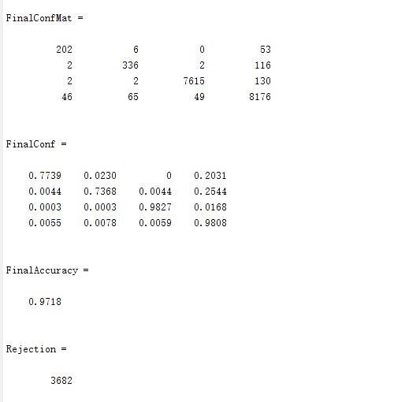
GoogLeNet
Step 4: waiting for the program to run, get the evaluation accuracy, confusion matrix and rejection number.
The matrix order will be consistent in the numerical order of the categories in the image folder
---for example
予測結果
 | 1.Knife | 2.Scratches | 3.water | 4.other
1.Knife | 202 0.7739 | 6 0.0230 | 0 0.0000 | 53 0.2031
2.Scratches | 2 0.0044 | 336 0.7368 | 2 0.0044 | 116 0.2544
3.water | 2 0.0003 | 2 0.0003 | 7615 0.9827 | 130 0.0168
4.other | 46 0.0055 | 65 0.0078 | 49 0.0059 | 8176 0.9808
正解

Slide 21
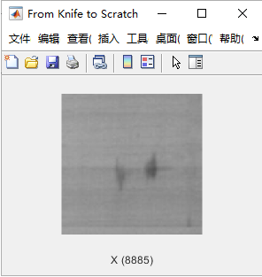
Error images
May find labelling errors
To display the FN Errors or FP Errors image, you can set “FNErrors” or ”FPErrors” value to “true” in the “Evaluation.m” file.
After the program finish running, the error images will be displayed automatically.
We can get following information from example error image.
Image name: X(8885)
Image label: Knife
Classification label: Scratch
Image information
An Error example

Slide 22
Classification of new data using “Prediction.m”
Input:
A folder containing all new data (e.g. data obtained in one day)
Output:
Labels of all data (predicted by the trained models)
Day_1
Training data
Evaluation data
New data
Day_2

Slide 23
Classification of new data using “Prediction.m”
Step 1: create a RawData folder under the corresponding task image folder and place new data into this folder.
Step 2: Find "Prediction.m" program in the corresponding programs folder and double click to run this prediction file by MATLAB
Step 3: Run Prediction.m file and select the appropriate image folder and model file.
Step 4: Check classification results in the corresponding image folder.
Step 5: Check summary file in the NewData folder
Note: Avoid opening the same Excel files during the classification process.

Slide 24
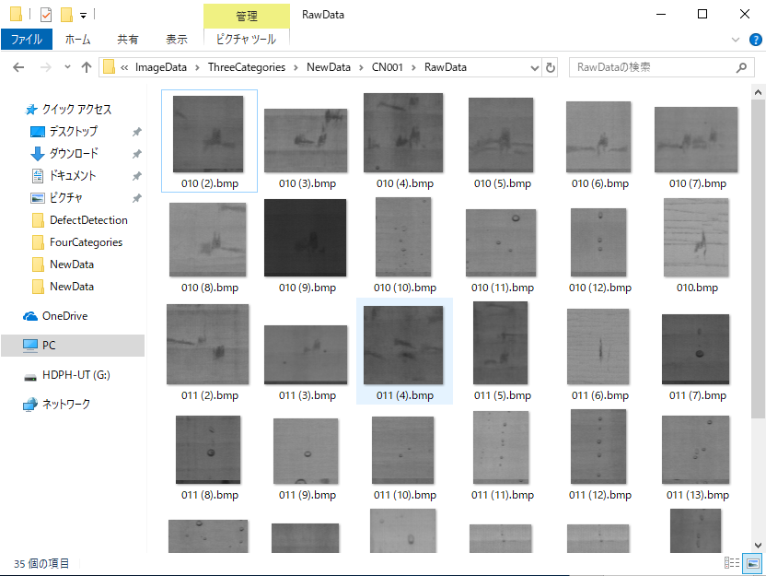
An example of three-categories task prediction using "Prediction.m"
Step 1:
Place new images in the corresponding task image folder.
Assume that the task ID is CN001 in this example.

Slide 25
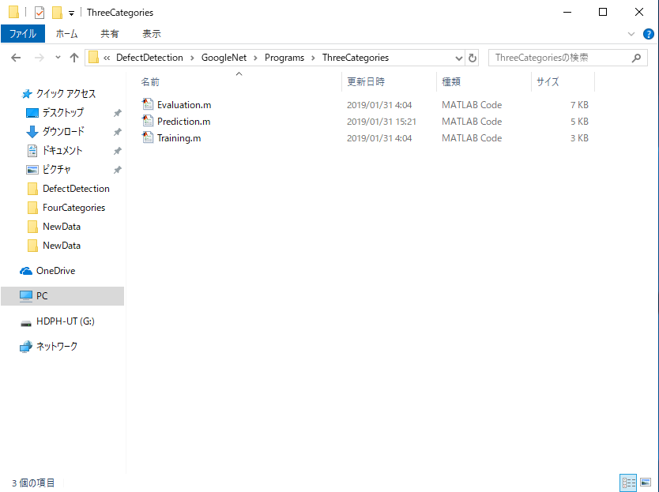
An example of three-categories task prediction using "Prediction.m"
Step 2:
Find "Prediction.m" program in the corresponding programs folder and double click to run this prediction file by MATLAB
Assume that we use GoogLeNet as prediction network in this example.

Slide 26
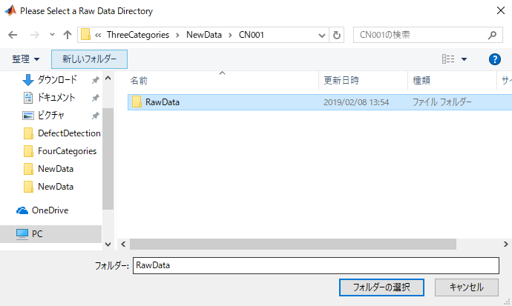
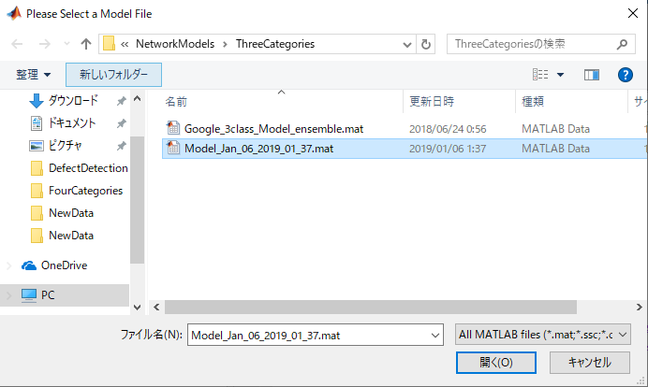
An example of three-categories task prediction using "Prediction.m"
Step 3:
Select the RawData folder and network model file according to the information in the prompt box.

Slide 27
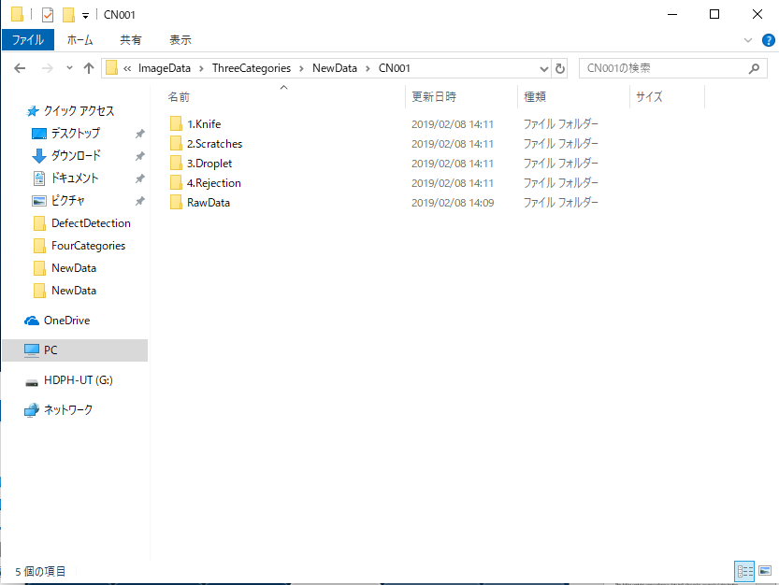
An example of three-categories task prediction using "Prediction.m"
Step 4:
Wait for the program to finish running, then check the classification results in corresponding image folder.

Slide 28
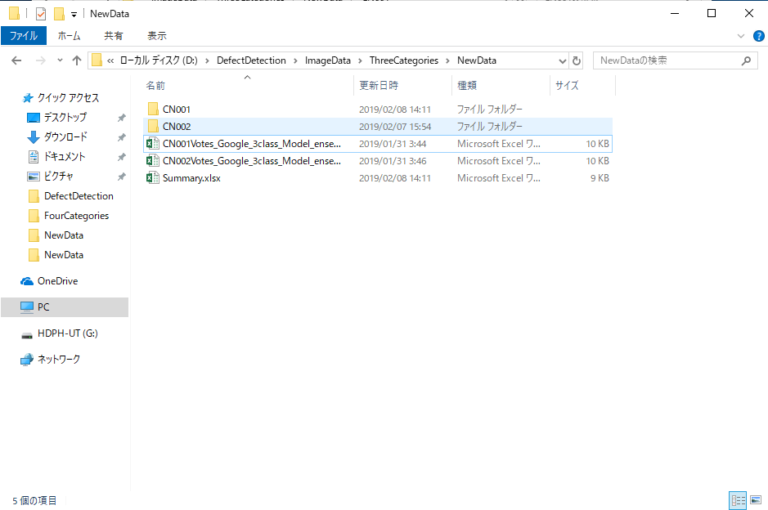
An example of three-categories task prediction using "Prediction.m"
Step 5:
Check the classification voting details and summary file in NewData folder.

Slide 29
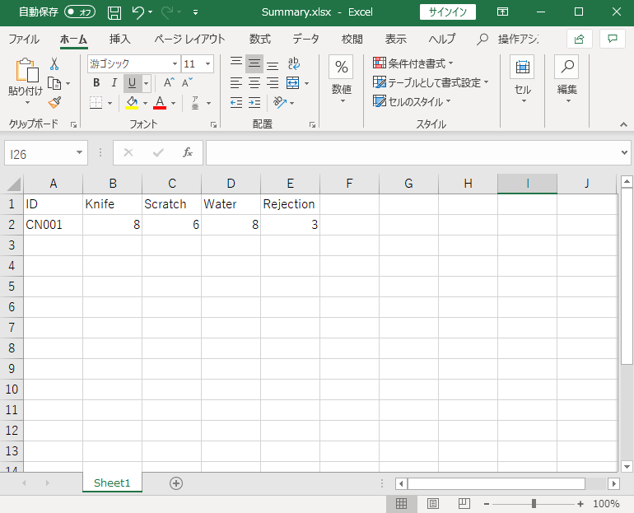
Summary file
Step 6:
We can find the excel file to check the whole classification information.

Slide 30
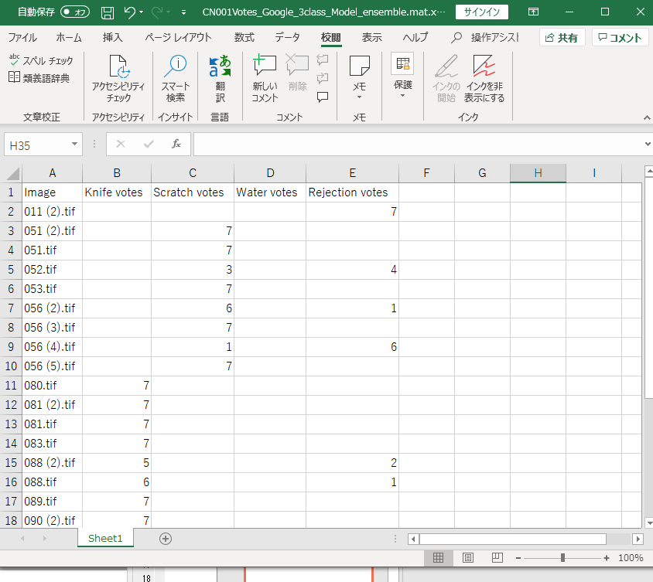
Voting information
Step 7:
We can find the excel file to check the voting details of each image data in the new image directory

Slide 31
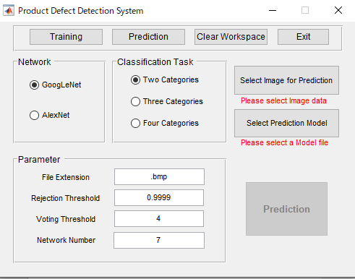
Classification of new data using GUI prediction program
Input: Select network and classification task information in the graphical user interface.
All parameters are default parameters
Note: Avoid opening the same Excel files during the classification process.

Slide 32
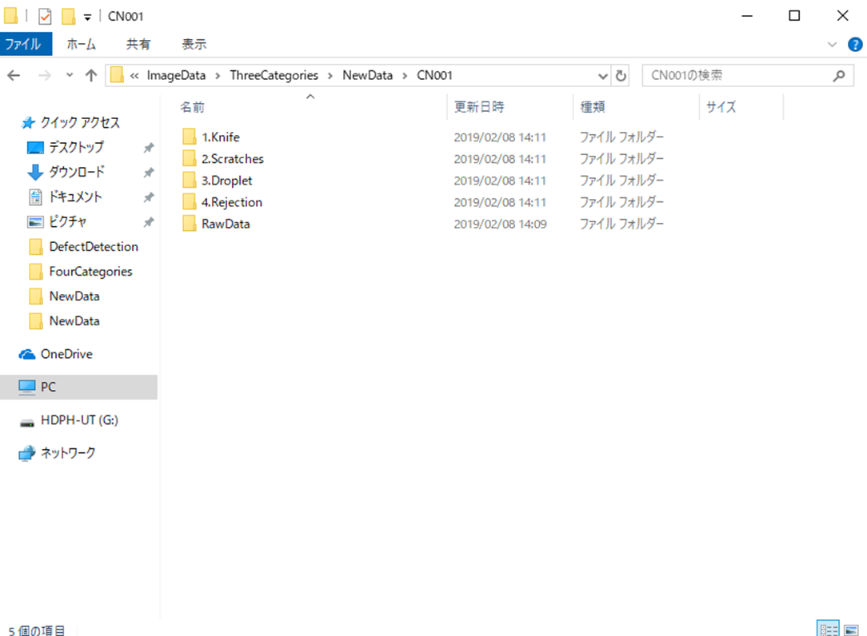
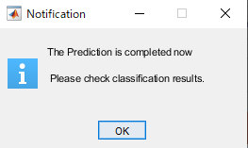
Classification of new data using GUI prediction program
Then we can check the classification results in corresponding image folder.
Output:
When the dialog below is displayed, the classification is complete.

Slide 33
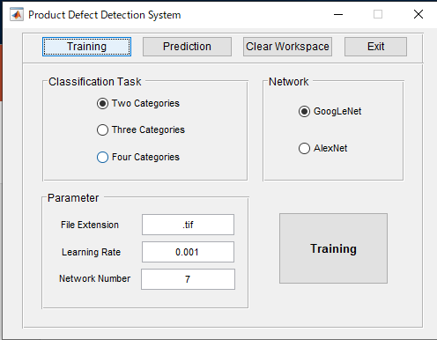
Training Model using GUI program
Input: Select network and classification task information in the graphical user interface.
All parameters are default parameters

Slide 34
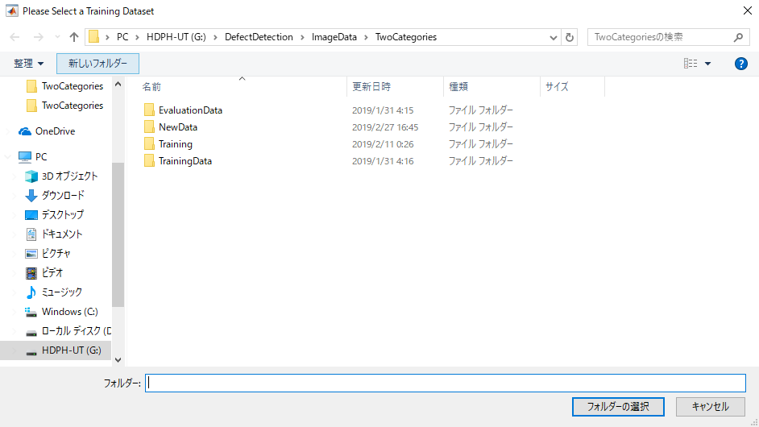
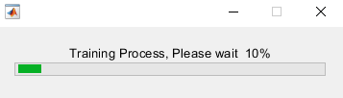
Training Model using GUI program
Select Raw data path and
Wait training process
After finish this process to check the model file

Slide 35
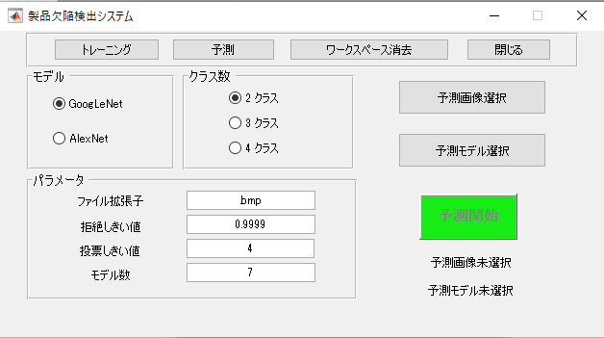
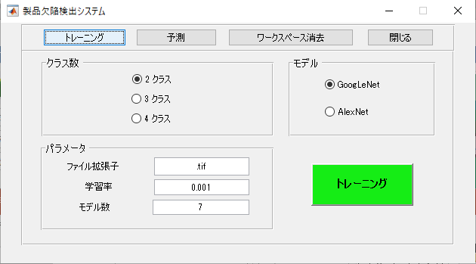
Japanese version
The basic operation process is the same as the English version.
Please refer to the previous instructions.

Slide 36
Other
This folder contains some reference data including codes we made during testing different methods, and some related papers.
This folder records some history of this project.

