Slide 1

Introduction to Full Stack Web Development
Full stack web development encompasses the entire process of building a web application, from the front-end user interface to the back-end server-side logic. This involves mastering a diverse set of technologies and skills to create dynamic, responsive, and scalable web experiences.

Slide 2
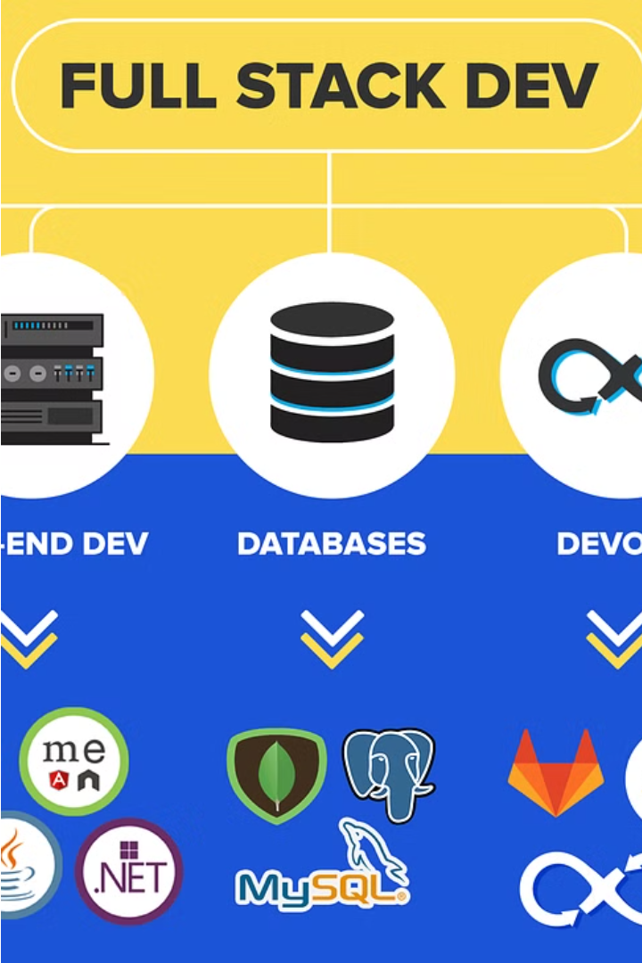

What is Full Stack Web Development?
Full stack web development refers to the practice of building both the front-end and back-end components of a website or web application. This includes developing the user interface, integrating with databases, and handling server-side logic.
A full stack developer is skilled in a variety of technologies, allowing them to take a project from conception to deployment, and maintain the entire application stack.

Slide 3




Key Components of Full Stack Web Development
Front-end
Back-end
Database
Workflow
The client-side interface that users interact with, built using HTML, CSS, and JavaScript.
The server-side logic that powers the application, often built with languages like Python, Ruby, or Java.
The data storage and management system, such as SQL or NoSQL databases, that holds the application's information.
The development tools, frameworks, and processes used to design, build, test, and deploy the full stack.

Slide 4
Front-end Technologies
HTML & CSS
JavaScript
Responsive Design
Front-end Frameworks
The foundational building blocks of web pages, HTML and CSS provide the structure and styling for the user interface.
A versatile programming language that enables dynamic and interactive web experiences, handling everything from animations to complex user interactions.
Techniques like media queries and flexible layouts ensure the website adapts seamlessly to different device sizes and screen resolutions.
Popular frameworks like React, Angular, and Vue.js streamline the development process and promote consistent, modular user interfaces.

Slide 5
Back-end Technologies
1
Programming Languages
2
Frameworks and Libraries
Common back-end programming languages include Python, Java, Ruby, PHP, and Node.js. These power the server-side logic and data processing.
Popular back-end frameworks and libraries such as Django, Spring, Ruby on Rails, and Express.js provide structure, tools, and functionality.
3
Databases
4
APIs and Web Services
Back-end developers work with databases like MySQL, PostgreSQL, MongoDB, and Redis to store and manage application data.
Building and integrating APIs and web services is a key back-end responsibility, allowing the front-end and back-end to communicate.

Slide 6
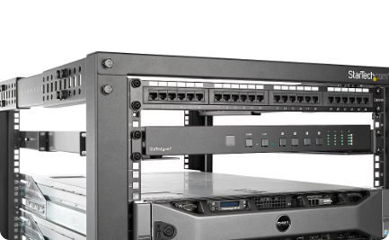
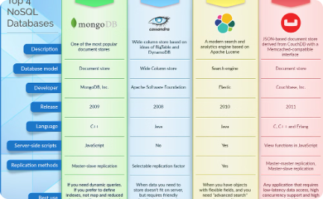

Database Technologies
Relational Databases
NoSQL Databases
Cloud Database Services
Relational databases like MySQL, PostgreSQL, and Oracle are the backbone of most web applications, providing structured storage and powerful querying capabilities.
NoSQL databases like MongoDB, Cassandra, and Couchbase offer flexible, schema-less storage for unstructured data, ideal for modern web applications with diverse data needs.
Managed cloud database services from providers like Amazon, Google, and Microsoft abstract away database administration, allowing developers to focus on building applications.

Slide 7
Web Server Technologies
Apache HTTP Server
Nginx
The most widely used open-source web server, known for its reliability, security, and flexibility.
A high-performance web server and reverse proxy, popular for its speed, scalability, and efficient resource utilization.
Microsoft IIS
Tomcat
The web server developed by Microsoft, tightly integrated with Windows operating systems and designed for enterprise-level applications.
An open-source Java Servlet and JavaServer Pages (JSP) container, widely used for running Java-based web applications.

Slide 8
Development Workflow
1
Plan
Define requirements, set goals, and create a roadmap.
2
Design
Wireframe user interfaces and architect the system.
3
Develop
Write clean, efficient code for the front-end and back-end.
Test
4
Thoroughly test the application to ensure quality and functionality.
Successful full stack web development follows a structured workflow. First, the project is carefully planned, with requirements defined and a clear roadmap established. The user experience is then designed, with wireframes and architectural diagrams created. Next, the front-end and back-end components are developed using best practices. Finally, the entire application is rigorously tested to identify and resolve any issues.

Slide 9




Technical Requirements for Full Stack Development
Hardware
Development Environment
Web Browsers
Database Tools
Powerful computer with ample RAM, storage, and processing power to handle development tasks and run local servers.
Multiple modern web browsers for testing and debugging web applications, including Chrome, Firefox, and Edge.
Database management tools like MySQL Workbench, pgAdmin, or MongoDB Compass to interact with and manage the application's database.
Integrated development environment (IDE) like Visual Studio Code, IntelliJ IDEA, or WebStorm to write, test, and debug code.

Slide 10
Challenges and Best Practices in Full Stack Development
1
Complexity Management
2
Communication and Collaboration
As a full stack developer, managing the complexity of both front-end and back-end technologies can be challenging. Staying up-to-date with the latest frameworks and best practices is crucial.
Effective communication with designers, project managers, and other developers is key. Collaborating seamlessly across the full stack requires strong interpersonal skills and a shared understanding of project goals.
3
Testing and Debugging
4
Continuous Integration and Deployment
Thoroughly testing the application across the entire stack, from the user interface to the database, is essential to ensure a high-quality, bug-free product. Developing robust debugging strategies is crucial.
Implementing a smooth CI/CD pipeline is critical for efficient and reliable software delivery. Automating build, test, and deployment processes can help reduce errors and streamline the development lifecycle.

