Slide 1
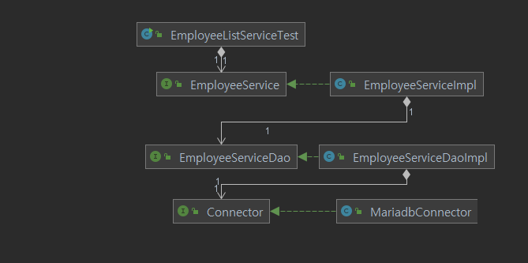
Business layer
Persistence layer
Database layer

