Slide 1
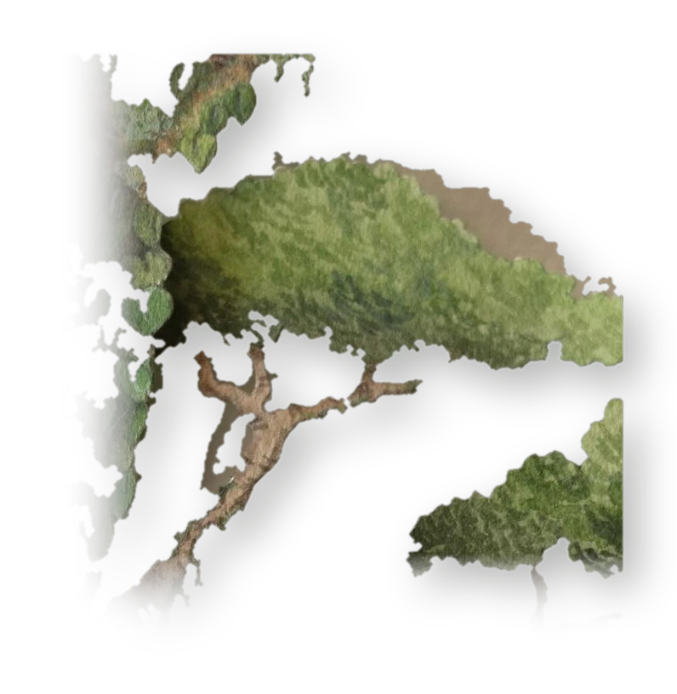
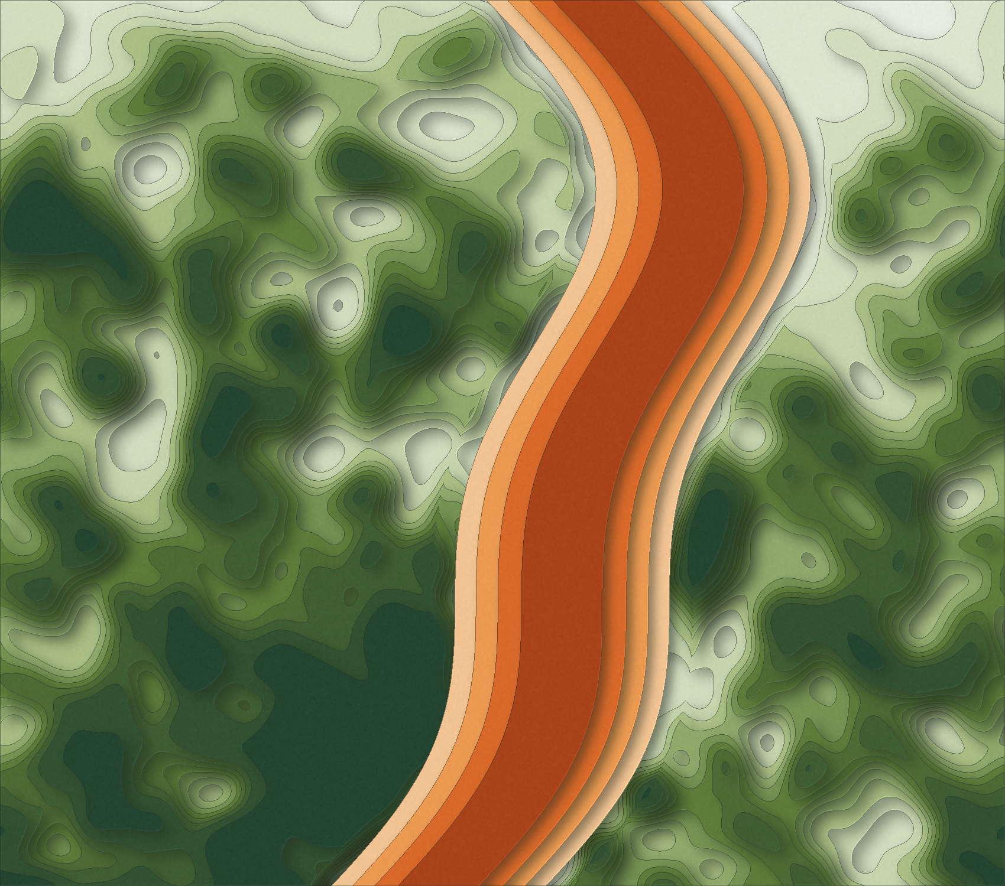
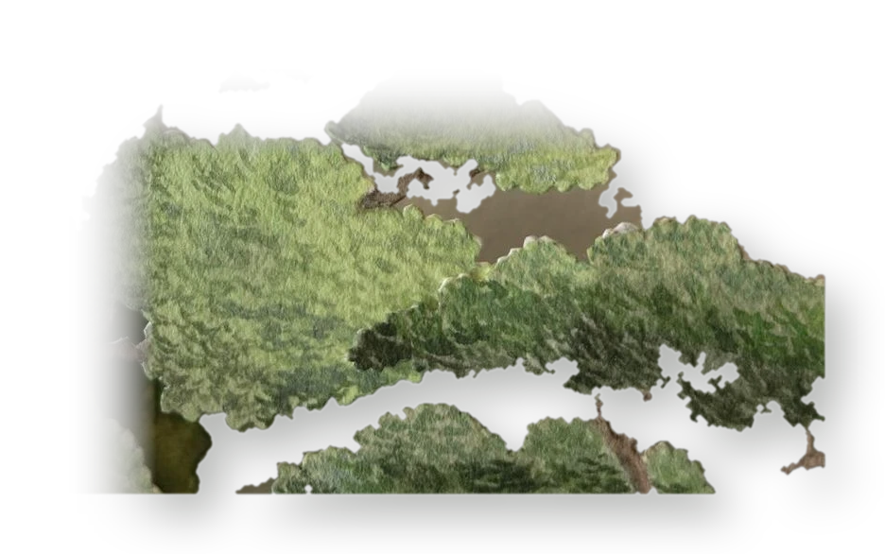
EVST · TOPIC 11 · MID-EVALUATION
Where the
roads end
Can AI identify biodiversity patterns missing from conventional sampling? A bias-aware test in the Western Ghats.
Ponnambalam V · Nandini C · Mohit Nallagatla · Manali Gupta
8 October 2026
Notes:
Opening (speaker 1). Biodiversity maps are built from records people chose to collect. We ask whether AI-predicted maps can show what those records miss, once we account for where people go. Four test beds, four experiments, one honest answer.

Slide 2
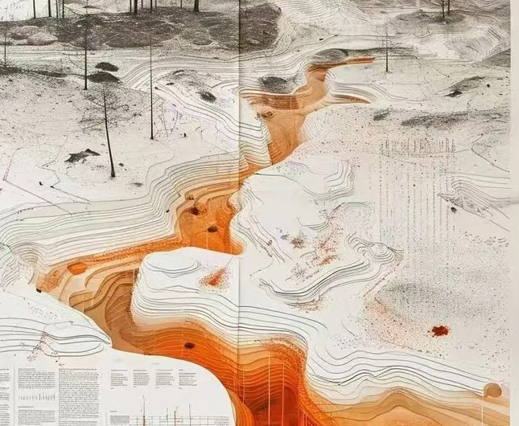
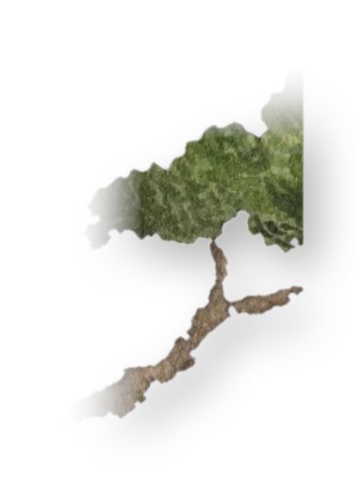
THE PROBLEM
A map of life is also a map of observers
Species records pile up where people can reach: roads, towns, reserves.
A model trained on those records can learn the observers instead of the species, and still score well.
Our question: once that bias is removed, do predicted patterns reveal real, unrecorded biodiversity?
H2 Flexible models absorb it
H4 Corrections can be ranked
Records follow the easy paths through a landscape.
H3 Standard checks miss it
H5 Corrected gaps are real
H1 Bias is measurable
Notes:
The chain we test: H1 records are biased and we can measure it; H2 flexible models absorb the bias; H3 standard validation misses it; H4 corrections can be ranked where truth is known; H5 corrected gaps are real. H1-H4 decide whether the method can be trusted; H5 answers the topic question.

Slide 3
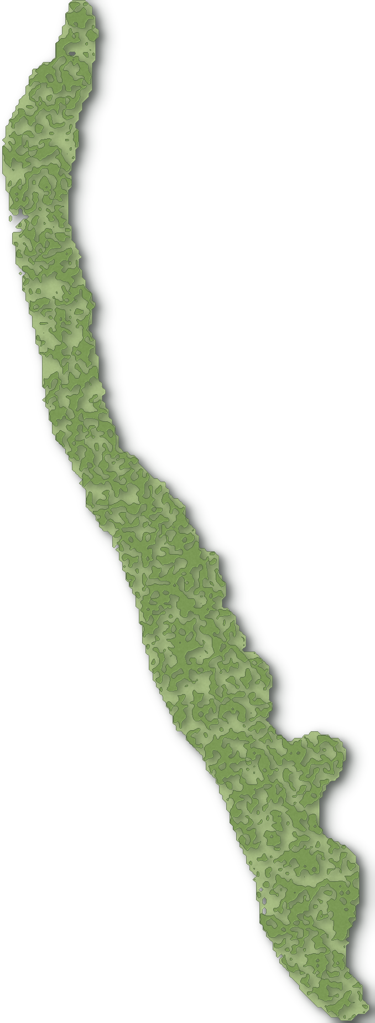
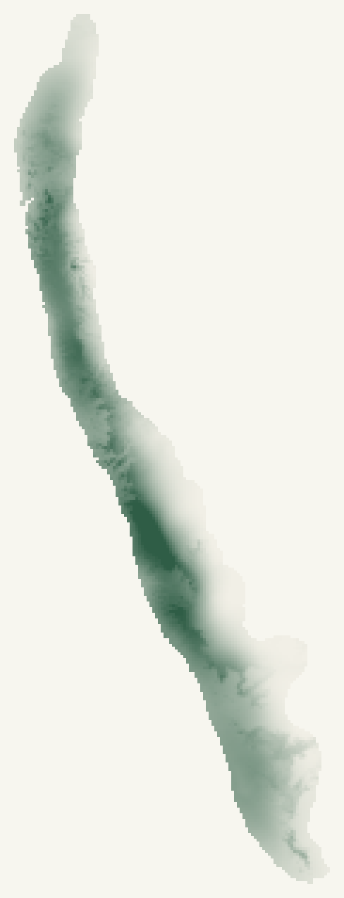
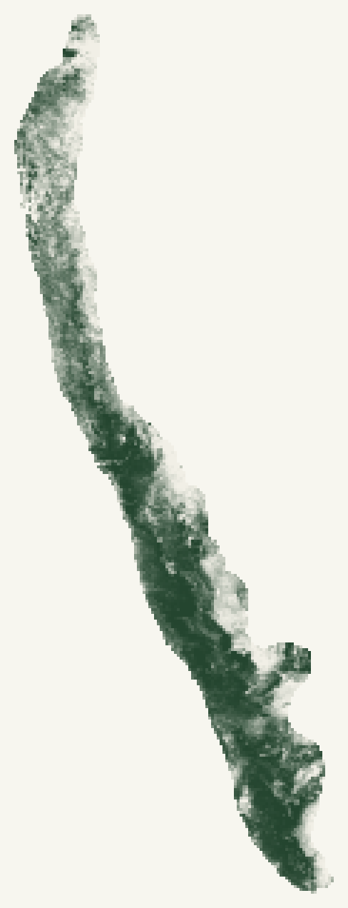
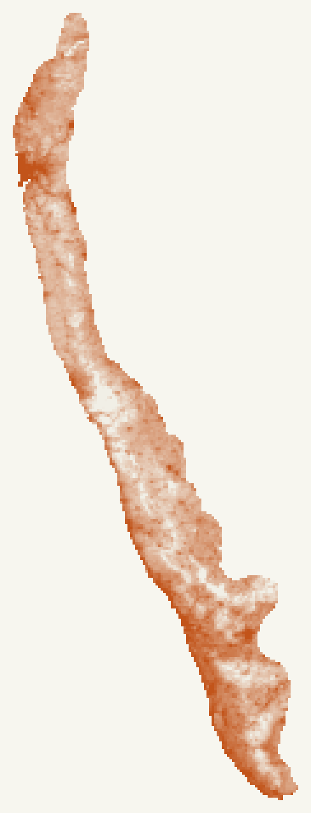
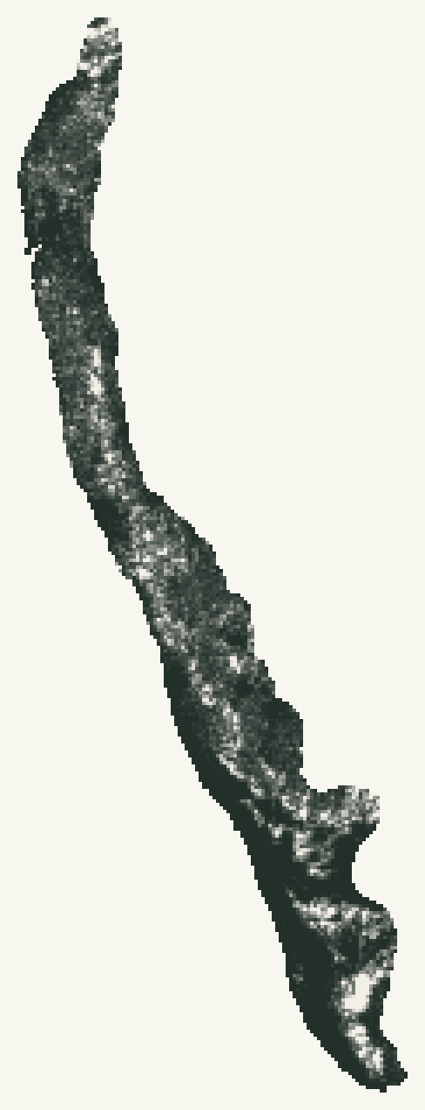
DATA
The Western Ghats, in 36 paper layers
181,347 km²
8°N – 22°N
1 km grid · 180,299 cells
FIELD NOTE · DATASETS
RECORDS iNaturalist open data · 493,227 research-grade records · 10,219 species
HABITAT 19 climate layers, elevation, 9 land-cover fractions
ACCESS population, distance to roads, towns, cities, rivers, reserves
TRUTH disdat (226 species, 53,044 survey sites) · GeoLifeCLEF 2024
RAINFALL
WorldClim 2.1
TREE COVER
ESA WorldCover
PEOPLE
WorldPop 2020
ROAD DISTANCE
OpenStreetMap
Notes:
Study area: the five RESOLVE ecoregions that make up the Western Ghats and Malabar coast, 181k km2 on a 1 km grid. Every cell carries 36 layers: what species respond to (climate, land cover) and what observers respond to (people, roads). The cards are the real layers.

Slide 4
METHOD
Four ways to find the truth
T1
VIRTUAL SPECIES
Invented on real Ghats layers, then observed through the real road bias
Truth: known exactly, by construction
T2
DISDAT / NCEAS
226 real species in 6 regions: the data behind Elith 2006 and Phillips 2009
Truth: 53,044 independent survey sites
FIELD NOTE · METHOD
MODELS GLM → MaxEnt → boosted trees → random forest → neural net → patch CNN
CORRECTIONS target-group background · geographic thinning · bias-covariate conditioning
CHECKS random CV · spatial-block CV · target-group CV · truth
MEASURES AUC · bias leakage = share of the map explained by access layers
T3
GEOLIFECLEF 2024
5.08 M European plant records with 88,987 survey plots
Truth: survey plots (phase B)
T4
WESTERN GHATS
493,227 iNaturalist records, 2008 – 2026
Truth: records that arrive after 2018
Notes:
Each test bed answers 'how do you know?' differently. Virtual species: we built them. disdat: independent absence surveys at 53,044 sites. GeoLifeCLEF: the real-data test of the CNN, next phase. Western Ghats: later records act as the test. The field note lists the model ladder, the three corrections and the four checks.

Slide 5
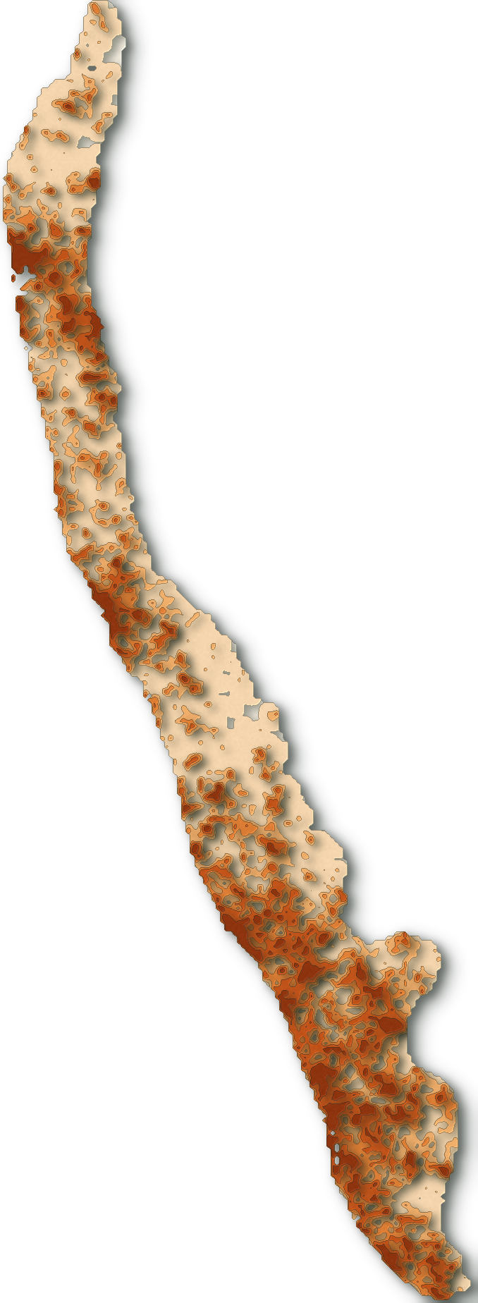
H1 · THE BIAS IS REAL
Records cling to the roads
34×
65%
of records sit on the 19% of land within 100 m of a road
66.7%
of 5 km cells hold any record
14.4%
of 1 km cells
1.4%
of 1 km cells for amphibians
more records per km² beside a road (0–100 m) than 2–5 km away
FIELD NOTE
DATA iNaturalist records · OSM roads at 100 m
METHOD share of records ÷ share of land, by distance band
Records per 5 km cell
Notes:
H1 (speaker 2). Land within 100 m of a road is 19% of the region but holds 65% of the records. Per square km, roadside land is recorded 34 times more than land 2-5 km away. A third of 5 km cells have no record at all, and amphibians, the flagship endemics, reach 1.4% of 1 km cells. Note: 95% of land is within 2.5 km of a road here, so the usual 'within 2.5 km' statistic from Hughes et al. is uninformative; the intensity ratio is the honest version.

Slide 6
H1 · MORE DATA, LESS NEWS
Sixty-one times the records, half the discovery
×61
records per year, 2008 → 2025 (1,442 → 88,636)
−56%
new species-in-place found per 1,000 records (689 → 306)
FIELD NOTE
METHOD Oliver et al. 2021 effectiveness indicator, 10 km cells
CAVEAT partly mechanical as cells fill up
Notes:
Recording has exploded: 61 times more records per year than in 2008. But each record adds less new knowledge: new species-in-a-new-10km-cell per 1,000 records fell 56%. This reproduces Oliver et al. 2021 locally. Caveat: part of the decline is mechanical, as cells fill up.

Slide 7
H3 · THE HEADLINE
The standard check rewards the wrong model
62%
of 896 species × model pairs: correcting the bias helps against independent surveys
4.5%
of those pairs: how often random cross-validation agrees
−0.17 rank correlation between its verdict and the truth
Every internal check prefers the uncorrected model; the surveys prefer the corrected one.
FIELD NOTE
DATA disdat: 226 species, 6 regions
Notes:
H3 (speaker 3). 226 real species with independent presence/absence surveys. Correcting with a target-group background helps against the surveys in 62% of species x model pairs (mean +0.023 AUC, p = 3e-16). Random cross-validation, the check most papers report, agrees only 4.5% of the time, and its verdict is anti-correlated with the truth. It also inflates skill by +0.10 to +0.33 AUC in 5 of 6 regions.

Slide 8
H3 · ROBUSTNESS
Blocking shrinks the optimism, not the mistake
Bigger blocks remove autocorrelation optimism, as Ploton et al. found. They cannot remove observer bias: the held-out records carry it too.
FIELD NOTE
METHOD blockCV ranges × 0.5 / 1 / 2
Notes:
Is this just a block-size choice? We re-ran spatial CV with the R blockCV package's own ranges at half, one and two times. Larger blocks shrink the optimism from +0.076 to +0.018 AUC, but spatial CV still says the correction helps only 12-18% of the time while the truth says 62%. The target-group check stays near the truth.

Slide 9
H2 · KNOWN TRUTH
As bias grows, models look better and get worse
Every flexible model leaks more than GLM (p ≤ 0.003). Boosted trees leak most, not the CNN.
FIELD NOTE
DATA 30 virtual species × 3 bias levels
Notes:
H2 (speaker 3). With virtual species we know the truth. As sampling bias grows from none to exaggerated, true accuracy falls from 0.79 to 0.71 while random-CV accuracy rises from 0.74 to 0.92. Bias leakage (excess over unbiased): GLM 0.11, CNN 0.15, MLP 0.15, RF 0.19, boosted trees 0.24. So 'AI absorbs bias' holds for flexible models generally; deep learning is not uniquely bad. The CNN had no spatial signal to exploit here, a design limitation; GeoLifeCLEF tests it properly next.

Slide 10
H4 · WHAT WORKS
Target-group background is what works
77–90%
of species: target-group background is the truly best correction
83–97%
of species: random CV instead picks bias-covariate conditioning
It rewards the method that models the bias best, not the one that removes it. Thinning barely helps.
FIELD NOTE
ALSO disdat: +0.023 AUC, p = 3×10⁻¹⁶
Notes:
H4. Under strong bias, target-group background lifts true AUC to 0.757 against 0.714 with no correction, and is the truly best correction for 77-90% of species. Geographic thinning barely helps, matching Inman et al. 2021. The twist: random CV picks bias-covariate conditioning for 83-97% of species, because that model uses accessibility explicitly and the biased held-out records reward it.

Slide 11
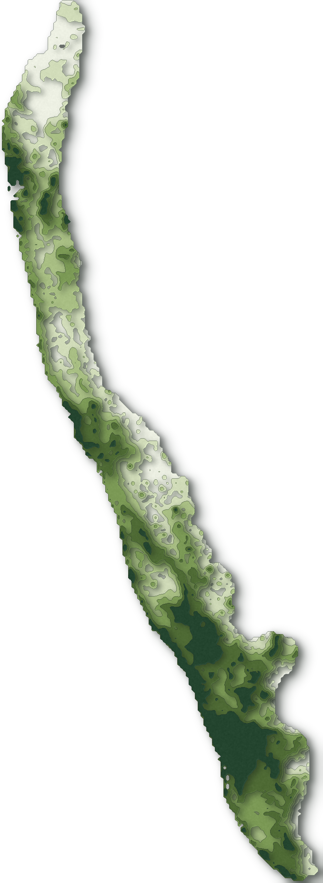
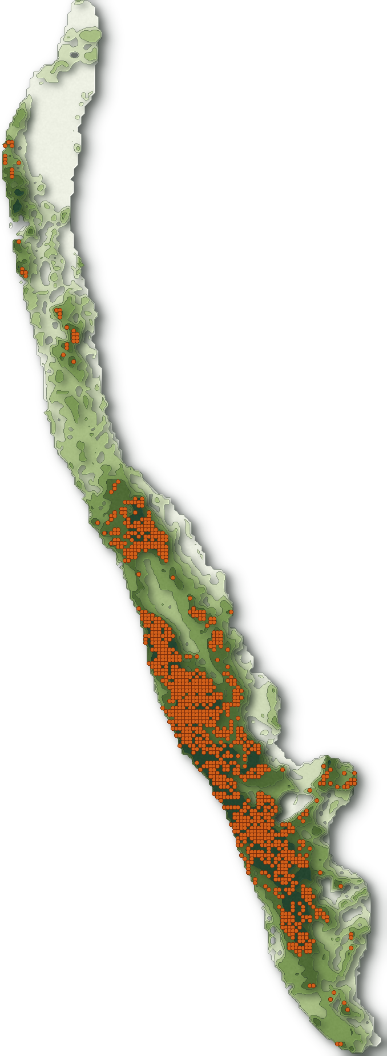
H5 · THE TOPIC QUESTION
Do corrected gaps hold undiscovered life? Not yet
RECORDS ≤ 2018
PREDICTED · UNCORRECTED
CORRECTED · GAPS ORANGE
92% vs 78%
tree cover of predicted hotspots, corrected vs uncorrected (GLM)
127 vs 321
records per hotspot cell: the corrected map stops following observers
THE HONEST NULL
In 2019 – 2026 records, predicted richness adds nothing beyond where observers went next: β = +0.005 per SD (95% CI ± 0.03).
FIELD NOTE
DATA 435 species · train ≤ 2018
Notes:
H5 (speaker 4). Corrected predictions move hotspots out of built-up, heavily recorded cells (321 records per cell, 7% built) into dense forest (92% tree cover, 127 records per cell). But did new records later turn up in the predicted gaps? A raw comparison looked good (1.6x more discoveries) but was a saturation artefact. Adjusting for how much each cell was visited later, predicted richness has zero effect. An honest null, for common species. Next we test rare endemics and off-road cells, which is where missed biodiversity would be.

Slide 12
WHERE WE STAND
Five links in the chain: four hold, one is open
 | Hypothesis | Verdict | Evidence
● | H1 Records are measurably biased | Supported | 34× roadside intensity · sampbias matches the R package
◐ | H2 Flexible models absorb the bias | Partly | all flexible models > GLM · trees worst, not the CNN
● | H3 Standard checks miss the damage | Strongly supported | random CV agrees with truth 38% · blocking doesn't fix it
● | H4 Corrections can be ranked | Supported | target-group background best, real and simulated data
○ | H5 Corrected gaps are real | Not yet | zero effect beyond effort (common species)
Notes:
Scorecard. H1, H3 and H4 are well supported, H2 partly (flexible models absorb more bias, but trees not deep nets are worst), and H5 is open. The method story is solid; the discovery story is what phase B tests.

Slide 13
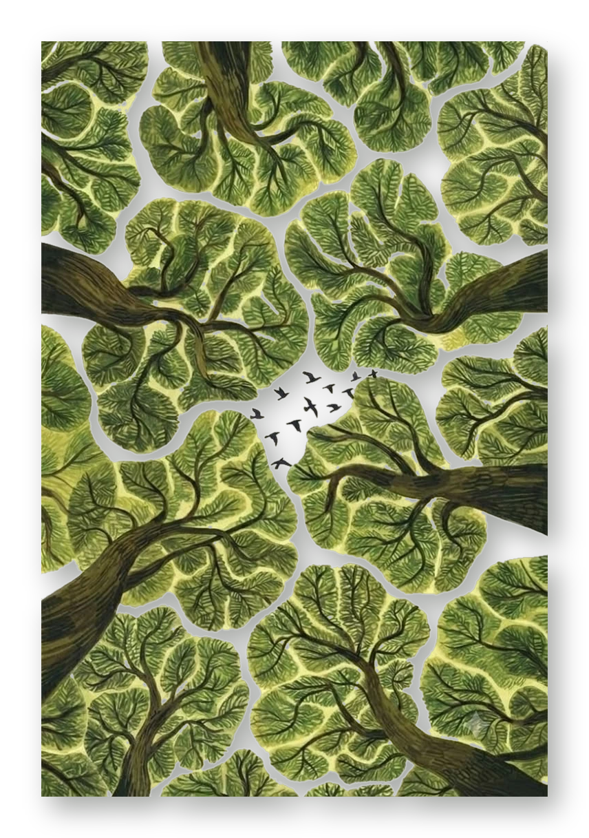
PHASE B
What we test next
Rare endemics, off-road cells
the forward test where missed biodiversity would actually be
eBird and museum records
through a citable GBIF download
GeoLifeCLEF 2024
the CNN on real European survey plots
Home-advantage control
for the target-group check
OSM vs GRIP4 roads
is incomplete mapping inflating the gaps?
Thank you · questions welcome
Notes:
Close (speaker 4). Phase B targets exactly where the null may flip: rare endemics and off-road cells, eBird and museum data via GBIF, the CNN on real survey plots, the control for the target-group check's home advantage, and OSM against GRIP4 roads.

Slide 14
BACKUP
What reading changed, and how we checked
CORRECTIONS TO OUR REVIEW
Deneu et al. 2021 handle observer bias implicitly (species given an observation) but test on a random split.
Elith et al. 2006 diagnosed bias in several regions; Phillips 2009 grew from it.
Fithian et al. 2015 used their own eucalypt surveys, not the disdat NSW data.
Hughes et al. 2021 'records within 2.5 km of a road' is uninformative where 95% of land qualifies.
VERIFICATION
sampbias: all 6 Python weights inside the R package's 95% intervals on the same grid; 4 agree within 1%.
blockCV: our variogram ranges did not match; conclusions hold at ×0.5, ×1, ×2 of blockCV's ranges.
disdat: target-group gains largest where bias is strongest (Ontario +0.11), as Phillips 2009 reported.
Caught artefact: '1.6× more discoveries in gaps' vanished after adjusting for later effort.
Notes:
Backup only. Use if asked how we know our code is right, or what changed in the literature review.

