Slide 1
Performance evaluation of WebRTC for Bilateral Teleoperation: A Comparative Analysis of SCTP Stream Configurations. Capstone Project Presentation
Rushi Keswar Reddy Payasam CS24MTECH11018
Notes:
ID=d924773e-9a16-4d6d-9803-8cb819e99682 Recipe=text_billboard Type=TextOnly Variant=0 FamilyID=AccentBoxWalbaum_Zero

Slide 2
Problem Statement & Motivation
Problem Statement:
High latency, jitter, and packet loss in long-distance networks disrupt the bilateral teleoperation control loop, causing severe robotic desynchronization or visual stuttering.
Motivation:
Standard symmetric protocols (pure TCP or pure UDP) force an unacceptable compromise between operational reliability and transmission speed. Solving this is critical for safe, real-time remote robotics over unpredictable real-world networks.
Key Objectives:
Implement WebRTC data channels to establish direct, low-latency Peer-to-Peer connections.
Evaluate the performance of SCTP stream multiplexing under emulated network stress conditions (e.g., 4G packet loss).
Determine the optimal hybrid protocol configuration (mixing reliable and unreliable behaviors) for distinct command and state telemetry flows.

Slide 3
Bilateral Teleoperation
The Teleoperation Challenge: A closed-loop system where an operator sends action commands (forward) and receives continuous sensor/haptic feedback (backward). Long-distance networks introduce jitter and packet loss, destabilizing these control loops.
WebRTC Infrastructure: Originally built for real-time video, it establishes secure, direct Peer-to-Peer (P2P) connections, bypassing middle-man servers entirely to drastically reduce latency.
Why WebRTC for Robotics?
Built-in Resilience: Automatically monitors bandwidth and handles congestion.
Secure by Default: Mandatory end-to-end encryption (DTLS/SRTP).

Slide 4
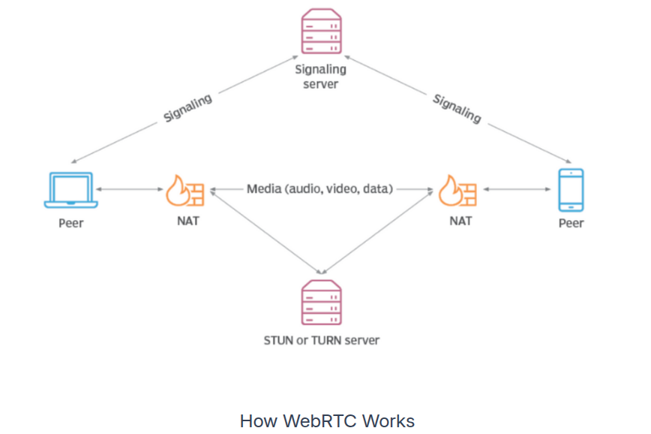
WebRTC Overview

Slide 5
The WebRTC Data Channel: SCTP & Multiplexing
The Underlying Protocol: WebRTC’s RTCDataChannel utilizes SCTP (Stream Control Transmission Protocol) encapsulated over secure UDP, offering per-channel configuration.
SCTP Multiplexing (The "Association"): Rather than opening multiple heavy network sockets, SCTP establishes a single secure connection and multiplexes independent logical "streams" within it.
Eliminating Head-of-Line (HoL) Blocking:
In standard TCP, one dropped packet halts the entire connection for retransmission.
In SCTP, if a packet drops on Stream 1, only Stream 1 pauses. Stream 2 continues instantly.
Application to Teleoperation: Allows simultaneous, non-interfering transmission of strict reliable data (e.g., discrete gripping commands mimicking TCP) and high-frequency loss-tolerant data (e.g., joint states mimicking UDP).

Slide 6

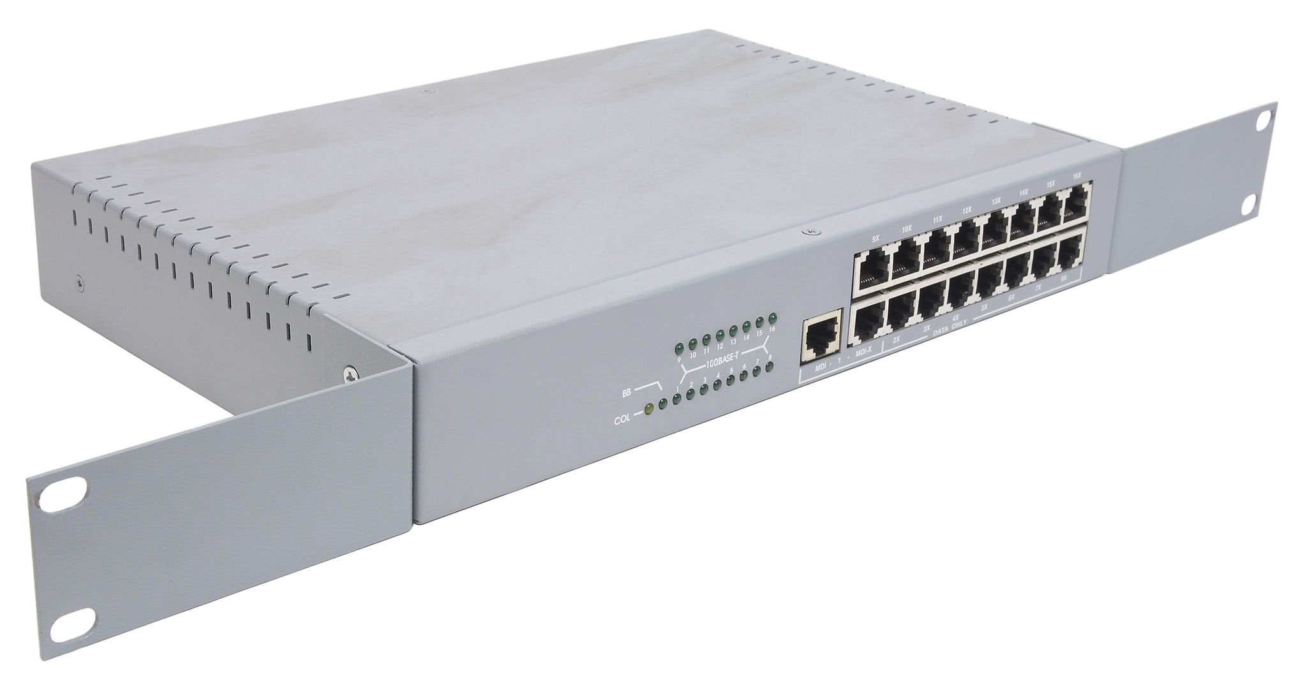
System Architecture
LAN as medium
LAN as medium
NVIDIA Isaac Sim (GPU)
Switch
NVIDIA Isaac Sim (GPU)
Server: Robot arm simulator
Client: DT version of Isaac Simulator

Slide 7
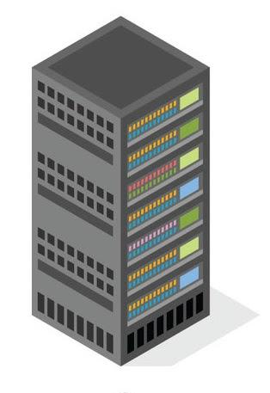
System Architecture
SDP offer
SDP offer
SDP Answer
SDP Answer
Signaling Server(GPU Machine)
4G Network Emulator
State Data Channel(SCTP)
Command Data Channel(SCTP)
4G Network Emulator
GPU Server: Robot arm simulator
P2P Connection(Single Socket)
Client: DT version of Isaac Simulator

Slide 8
Implementation Details
Hardware Setup:
Client: Local PC / XR interface for command generation.
Server: Host running NVIDIA Isaac Sim simulating the UR3 robot.
Software & Tools:
Unity (C# WebRTC libraries).
Python (aiortc, WebSockets).
Network Emulation (e.g., Linux tc / NetEm) to simulate 4G conditions.
Implementation:
Built: Custom WebRTC signaling server, WebRTC-based Unity Application
Notes:
This is the most important section. Show what you've done.

Slide 9
Experimental Setup
Setup: Evaluated the system using four symmetrical and asymmetrical matrices:
Command (UDP) / State (UDP)
Command (UDP) / State (TCP)
Command (TCP) / State (UDP)
Command (TCP) / State (TCP)
Configured using :
UDP behaviour(ordered=False & maxRetransmits=0) | TCP behaviour(ordered=True & maxRetransmits=Inf)
Scenarios Designed:
Baseline: Ideal local network.
Network Variant 1: Emulated 4G
Network Variant 2: 4G condition with a complete 10-second throughput blackout (0 kbps).

Slide 10
Experiment Configuration & Parameters
Update Rates:
Robot State Packets (Server to Client): ~50 ms (20 Hz)
Command Packets (Client to Server): ~40 ms (25 Hz)
Experiment Duration: 1 minute 30 seconds per trial.
Packet Sizes:
Mean State Packet Size: 214 Bytes
Mean Command Packet Size: 180 Bytes

Slide 11
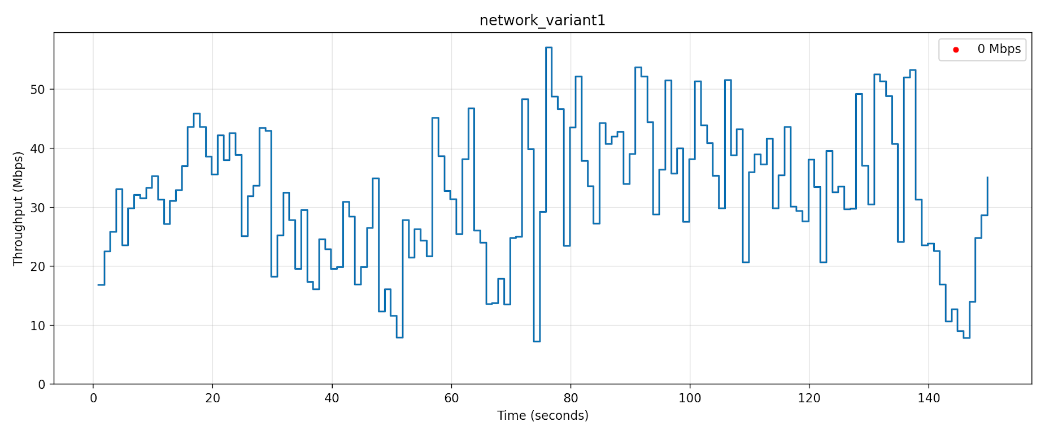
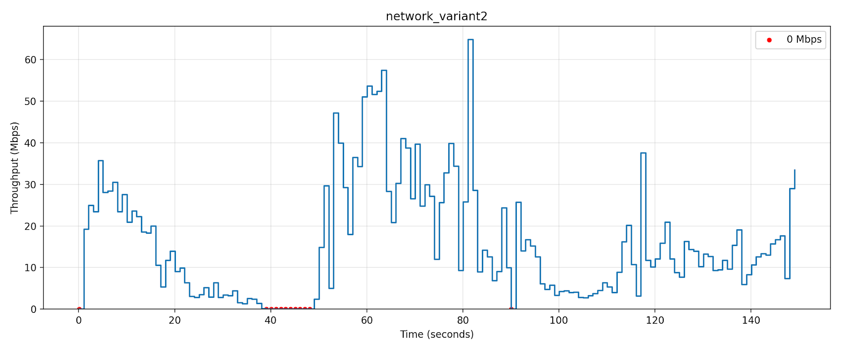
4G Dataset Emulation (Throughput)

Slide 12
Flow of Experimentation
Connection Phase:
Establish P2P DTLS Association via Signaling
Channel Initialization :
1) Configure Command Data Channel (UDP or TCP behaviour )
2) Configure State Data Channel (UDP or TCP behaviour )
Execution Phase:
1) Send Commands through the Command Data Channel from the Digital Twin
2) Issac Simulator sends State data through the State Data Channel

Slide 13
Metric
Metric | Formula | Description
Control Loop Latency (CLL) | (T6-T1) | Command to feedback latency
AppBuffer Delay | (TQ-T3) | Server application queue wait
Processing Delay | (T4-TQ) | Simulator robot processing (Server)
Network RTT | (CLL-(AppBuffer+dProcessing)) | 2 way propagation delay and TCP/IP network stack delay
Rendering Delay | (T7-T6) | Client rendering latency
Motion-to-Photon Delay (MTP) | (CLL + dRendering) | Total user-perceived latency

Slide 14
User QoE Metrics
State Jitter (Metric for Visual Continuity)
Definition: The variation in arrival time between consecutive state data packets across the network.
System Impact: High jitter means state updates arrive unpredictably. Visually, this manifests as "stutter"—the robot UI freezes while waiting for a delayed packet, then violently teleports to catch up.
Positional Drift (Metric for Operational Safety)
Definition: The accumulated physical error between the Master’s commanded target and the Slave robot's actual real-world position.
System Impact: Caused by permanently lost, unacknowledged command packets. Results in catastrophic desynchronization where the operator's digital twin no longer accurately reflects physical reality.
End-to-End Latency(MTP delay) (Metric for Control Responsiveness)
Definition: The total time required for a packet to travel from the sender (Unity Master), traverse the network, and be processed by the receiver (Isaac Sim Slave).
System Impact: High latency creates a noticeable delay between the operator's physical input and the robot's reaction. If this delay exceeds human perception thresholds, operators tend to overcorrect, leading to unstable control loops and dangerous robotic oscillations.

Slide 15
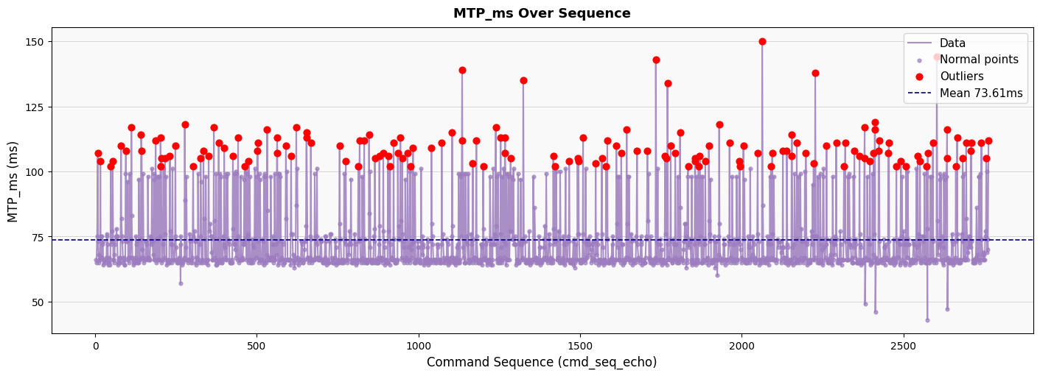
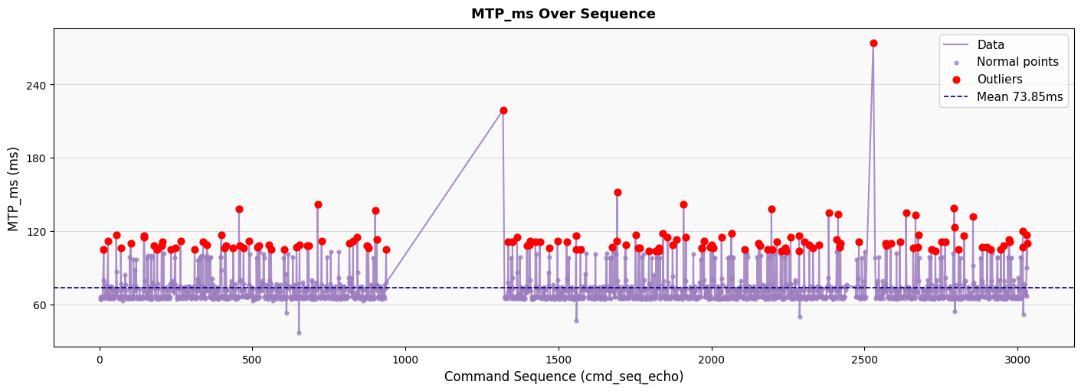
End to End Latency Analysis(UDP Behavior)
Baseline
Low throughput in cellular networks results in packet loss and significant increase in MotionToPhoton latency
Network Variant 2

Slide 16
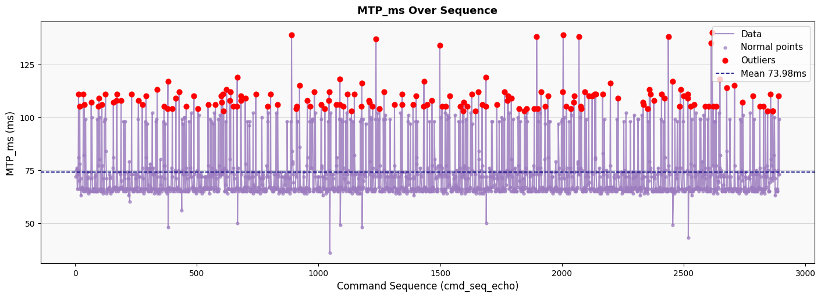
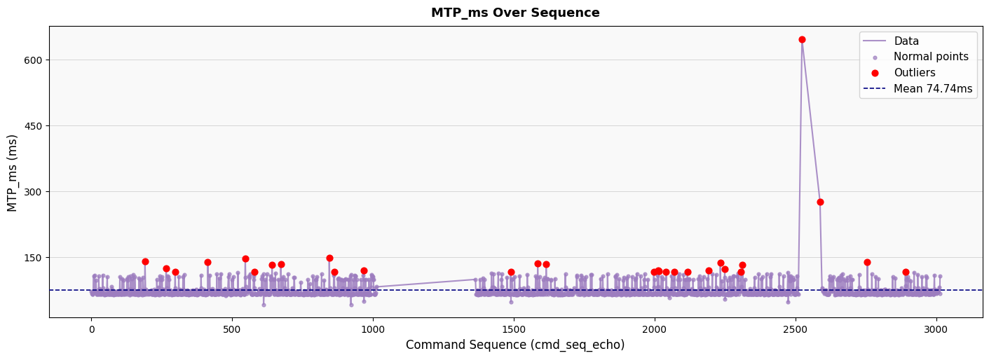
End to End Latency Analysis(TCP Behavior)
Baseline
Configuring to TCP Behavior results in significant increase in peak MTP value compared to UDP behavior.
Network Variant 2

Slide 17
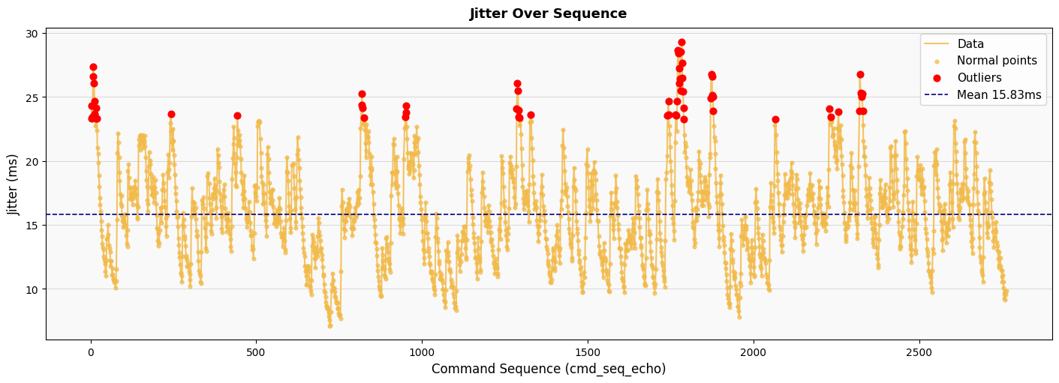
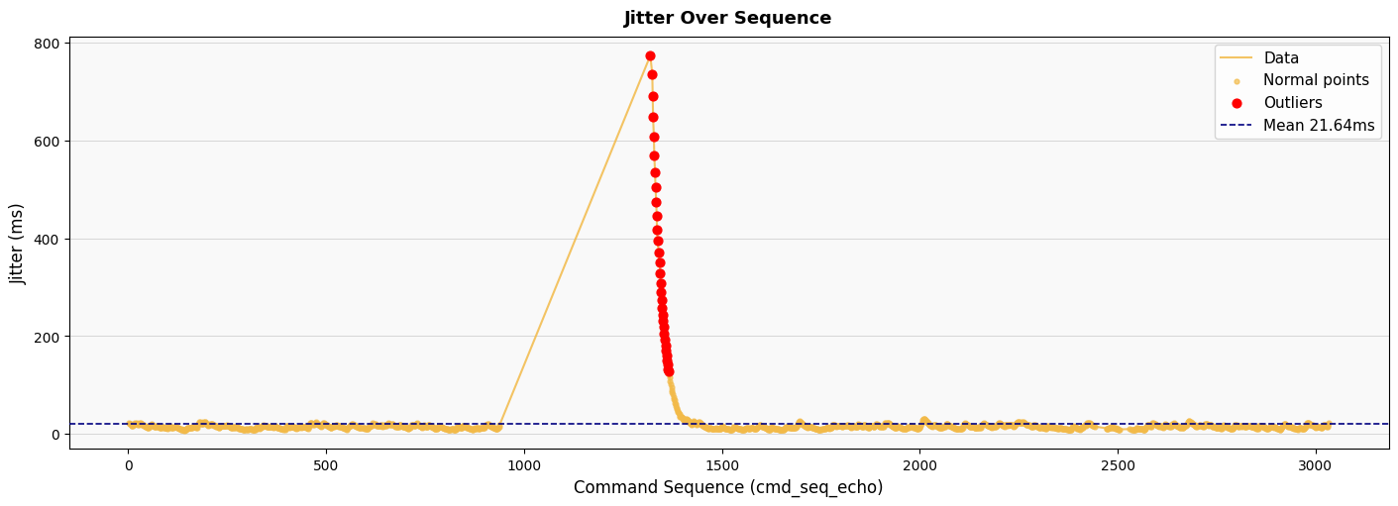
State Jitter Analysis (UDP Behavior)
Baseline
Mean jitter value increased significantly when there is 0 throughput network conditions results in affecting smoothness in visual continuity for user behaviour
Network Variant 2

Slide 18
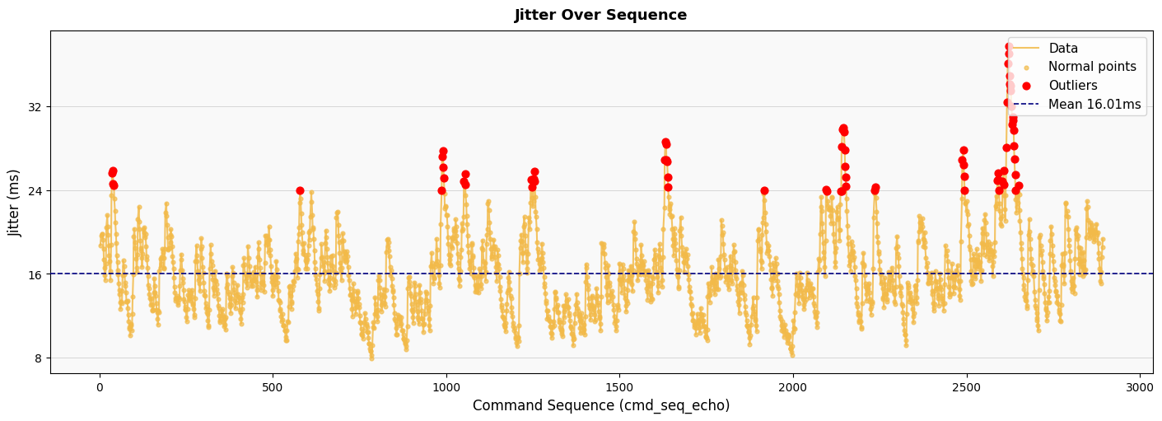
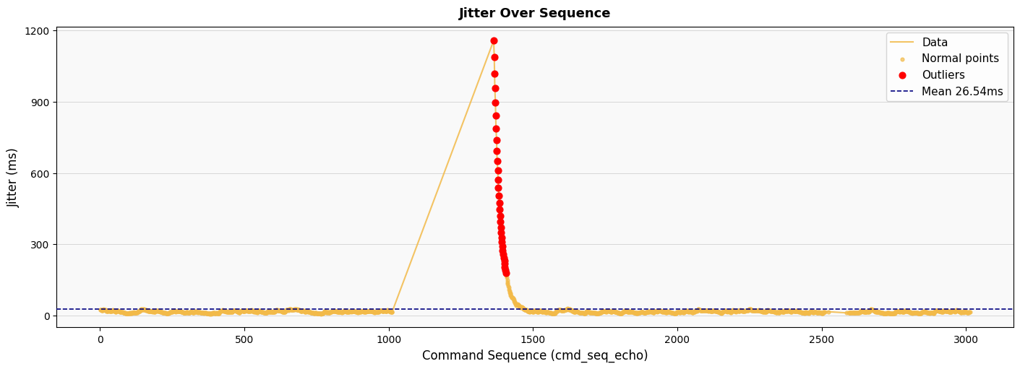
State Jitter Analysis(TCP Behavior)
Baseline
Compared to UDP behavior, configuring TCP behavior results in increased state jitter, affecting the user experience much more.
Network Variant 2

Slide 19
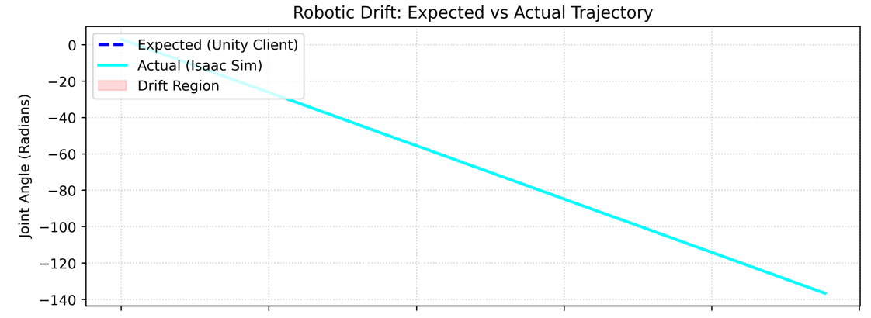
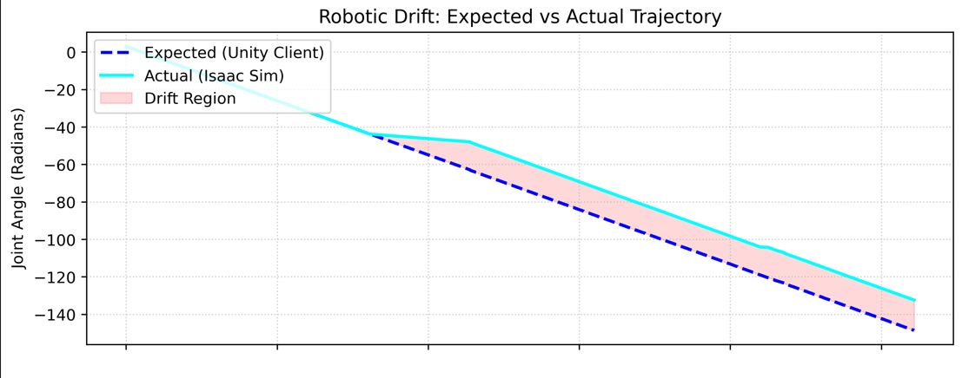
Positional Drift / Desynchronization
Baseline
Bad network conditions can drastically affects the positions of robot results in desynchronization from expected behavior.
Network Variant 2

Slide 20
Latency Analysis
 |  | UDP behaviour (ordered=false & maxRetransmits=0) |  |  | TCP behaviour(ordered=true & maxRetransmits=Inf)
 |  | BaseLine | Network variant 1 | Network variant 2 | BaseLine | Network variant 1 | Network variant 2
Latency (ms) | Control Loop Latency (CLL) | 39.85 | 40.1 | 44.4 | 40.13 | 44.05 | 56.73
 | AppBuffer Delay | 16.77 | 17.07 | 17.81 | 17.08 | 18.32 | 17.68
 | Rendering | 33.56 | 34.09 | 33.69 | 33.65 | 38.1 | 33.78
 | Processing Delay | 2.09 | 2.44 | 2.78 | 1.84 | 3.77 | 4.65
 | Network RTT | 20.99 | 20.59 | 23.81 | 21.21 | 21.96 | 34.4
 | MTP | 73.41 | 74.19 | 78.09 | 73.78 | 82.15 | 90.51
 | Jitter | 15.99 | 16.8 | 23.86 | 15.97 | 19.27 | 23.90

Slide 21
Conclusions
The TCP Bottleneck (High Latency & Jitter):
Strict reliability (TCP behavior) over congested networks triggers Head-of-Line (HoL) blocking.
Result: This mechanism is the primary cause of massive end-to-end latency and severe jitter spikes in the results.Retransmitting outdated telemetry stalls the entire pipeline, making it fundamentally incompatible with fluid visual/haptic feedback.
The UDP Advantage & Application-Level Cautions:
Unordered/Unreliable (UDP behavior) completely eliminates HoL blocking, keeping latency and jitter at baseline minimums.
The Catch: Simply using UDP is not enough. The system requires strict application-level logic to only consider the latest state.
Mitigating Positional Drift:
For relative control inputs(delta values), packet loss under UDP permanently deletes commands, resulting in physical Positional Drift.
Unless the application is heavily engineered to continuously override deltas with absolute global states, Command flows must utilize TCP behavior to ensure operational safety and zero drift.

Slide 22
References
Dataset: Utilized a validated 4G/LTE network dataset.
Source: J. van der Hooft et al., Ghent University (IEEE 2016)

