Slide 1

VitalLog
Revolutionizing post-transplant care

Slide 2
VitalLog
Kidneys are the most commonly transplanted organ, with wait times averaging 3-5 years
~17% of patients experience acute rejection episodes
~3K lose kidney function within a year of surgery, ~6K within three years
The main cause of rejection is non-adherence to medical instructions:
Prescription medications
Communication of symptoms
Revolutionizing post-transplant care

Slide 3
VitalLog
VitalLog facilitates post-op communication between patients and transplant teams…
Clinical Biomarkers
Time
monthly postop schedule for testing/checkups
Revolutionizing post-transplant care

Slide 4
VitalLog
… by filling in the feedback gap in between scheduled check-ups
Self-reported symptoms and prescription adherence
Clinical Biomarkers
Time
monthly postop schedule for testing/checkups
Revolutionizing post-transplant care

Slide 5
VitalLog
Patient View
Patients can log their daily symptoms
Provide comments about their overall well being
Self-report adherence to prescription schedule
System could flag symptoms common to rejection episodes
Revolutionizing post-transplant care

Slide 6
VitalLog
Patient View
Patients can keep track of changes in their condition with time
Provides a good, unbiased snapshot into their recovery process, or possible complications
Revolutionizing post-transplant care

Slide 7
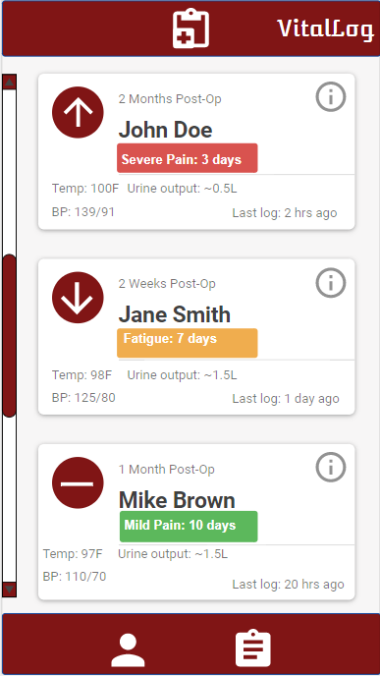
VitalLog
Healthcare Provider View
Healthcare providers can see a list of patients, time since the last log, and key clinical measurements
System will show color coded flags based on trends in the patient’s logs
Patients will be ranked based on changes in their average condition
Revolutionizing post-transplant care

Slide 8
VitalLog
Healthcare Provider View
Each patient will have a detail profile accessible from the main list
Full list of latest reported symptoms, and selected trends will be displayed
Providers will have the ability to quickly access a full medical chart, and contact the patient
Revolutionizing post-transplant care

Slide 9
VitalLog
Healthcare Provider View
Providers can also quickly access the full list of prescription medications for each patient
As well as an overall and individualized self-reported prescription adherence score
Revolutionizing post-transplant care

Slide 10
VitalLog
Questions?
Revolutionizing post-transplant care

