Slide 1
Blockchain hackathon
An Automobile Sale/Purchase Registration System using Blockchain

Slide 2
TEAM INDEFINITE INTEGRALS
Manish Devgan
Mrigank Singh
Abhay Sidhwani
We are a team of three Sophomores from NSIT, with a very beginner level experience in Blockchain Technology. In this Hackathon we aim to learn this world transforming technology and increase our horizon of knowledge with it.

Slide 3
The problem
The problem that our product aims to handle is the problem of Middlemen in the Automobile lending industry. There are not just petty “merchants” who act as a middleman in the DEAL between two individual but now there are large companies in it too.
How this works?
MIDDLEMAN
BUYER
SELLER

Slide 4
Problem?
You might seem to ask where is the problem in that case. It is a general trend that people follow while buying a second hand vehicle.
BUT, There is a problem. The Buyer binds a blind trust in a Middleman or an Organisation for all the documents related to the Vehicle that he is about to buy. And Trust can be a bit difficult sometimes.
The Records about the Vehicle’s past ownership can be lied about, can be tampered with or to be more specific can be completely erased from the ledger.
The Records of the CAR/BIKE being a legitimate thing to buy can be simply erased in seconds.

Slide 5
Without Blockchain
Unwanted Record Knocked OFF
Unwanted Record
Clean Record
Just Clean Records
Change/Alter

Slide 6
WITH BLOCKCHAIN
Unwanted Record
Clean Record
Change/Alter
No!

Slide 7
Our Solution - AUTONITY
AUTONITY is a Blockchain based application of the primitive Vehicle’s data storage.
It keeps track of all the Owners that a Vehicle has had in a sequences of Blocks which are further stored into a Blockchain to ensure authenticity and to modify the “trust”.
Each Vehicle bought is added as a block inside the Blockchain and is therefore made permanent. This storage allows the records to become “solid” and “stable”.
What comes with Autonity?
Autonity is powered by an Application which allows user to preform the Buying and/or Selling of Vehicles without involving any middleman or sequences of middlemen.
It also comes with an Open Portal that contains the information about all the blocks in the blockchain and the recent transactions related to Vehicles.
The Open Portal serves as an explorer for anyone to browse about the transactions, User’s information is not made public, but the vehicle involved in the transaction is.

Slide 8
How do we make it work?
It comprises of a REST API
A Web Based Platform
An iOS Application
The communication is done via REST API to establish the connections between the stored database and WEB/iOS Application and the Blockchain ledger.

Slide 9
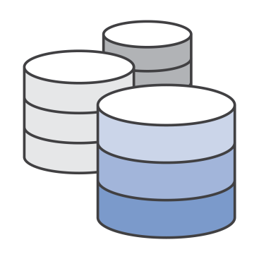
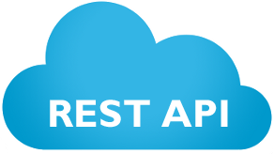

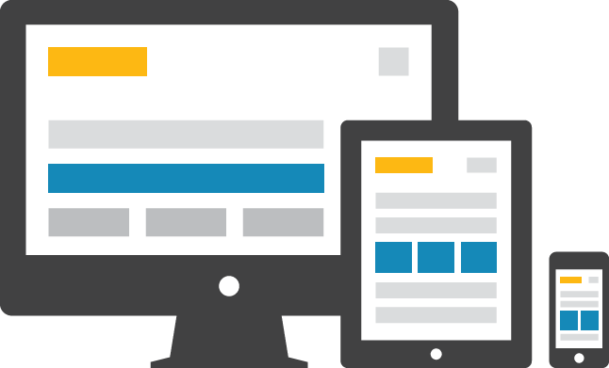
Interconnection of things

Slide 10
Thank You
Thank You for your time and this opportunity to let us explore beyond our regular areas

