Slide 1
Gesture Recognition Using RNNs and CNNs
Michael and Inder
CeADAR

Slide 2
The problem
Classify human gestures from real time video streaming.
Problem very difficult for deterministic algorithms
DNN provide a powerful method for classification
We will use CNNs as they have proved useful for image classification
RNNs will also be used as they are good at learning sequences of data and gestures are temporal sequences of images

Slide 3
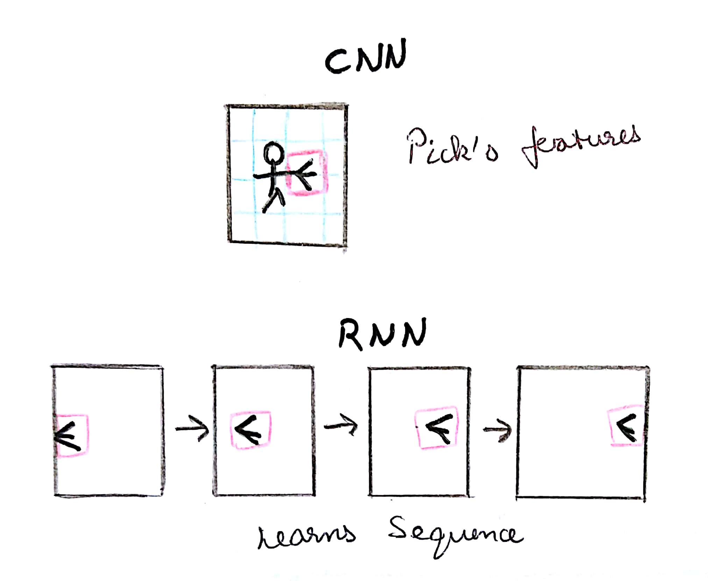
Roles played by CNN and RNN

Slide 4
Datasets available or making our own dataset
Jester is a labelled dataset containing over 148000 gesture videos
Includes 27 gestures including directional swipes, shaking fist, stop sign etc…..

Slide 5
Possible Applications
Emulate keypresses on our PC/Laptop
Playing games
Stepping stone to understanding more complex body language

